Slide 1
Finite Automata (DFA)
With Transition Diagram and Transition Table
Presented by: [Your Name]

Slide 2
Introduction to Finite Automata
Finite Automata are abstract machines used to recognize patterns within input.
They consist of states, transitions, input symbols, and accepting states.
Two types: DFA (Deterministic Finite Automata) and NFA (Non-deterministic Finite Automata).

Slide 3
Deterministic Finite Automaton (DFA)
A DFA is defined as a 5-tuple (Q, Σ, δ, q0, F) where:
- Q: Finite set of states
- Σ: Input alphabet
- δ: Transition function (Q × Σ → Q)
- q0: Start state
- F: Set of accepting states

Slide 4
Example DFA
DFA to accept strings over {0,1} that end with '01'.
States: Q = {q0, q1, q2}
Alphabet: Σ = {0,1}
Start State: q0
Accepting State: q2
Transitions:
δ(q0, 0) = q1, δ(q0, 1) = q0
δ(q1, 0) = q1, δ(q1, 1) = q2
δ(q2, 0) = q1, δ(q2, 1) = q0

Slide 5
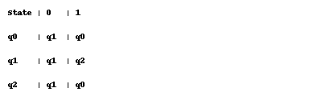
DFA Transition Table
Transition table for DFA accepting strings ending in '01'.

Slide 6
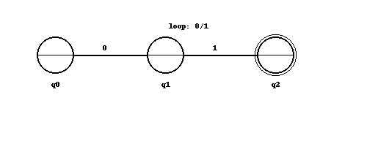
DFA Transition Diagram
Visual representation of DFA for strings ending with '01'.

