Slide 1
CONNECTIONS OF VLAN’S AND ROUTING
REPORT BASED ON NETWORKING USING CISCO PACKET TRACER.
By shalini sharma .
2018BITE006
NIT SRINAGAR
INFORMATION TECHNOLOGY

Slide 2
What is vlan?
Vlan stands for virtual local area network.
Any broadcast domain that is partitioned and isolated in acomputer network at the data link layer is vlan.
Virtual in vlan refers to a physical object recreated and altered by additional logic

Slide 3
What is routing?
Routing is a process of selecting a path for traffic in a network or between or across multiple networks.
Packet forwarding is the transit of network packets from one network interface to another.
Intermediate nodes are typically network hardware devices such as routers ,gateways, firewalls, or switches.

Slide 4
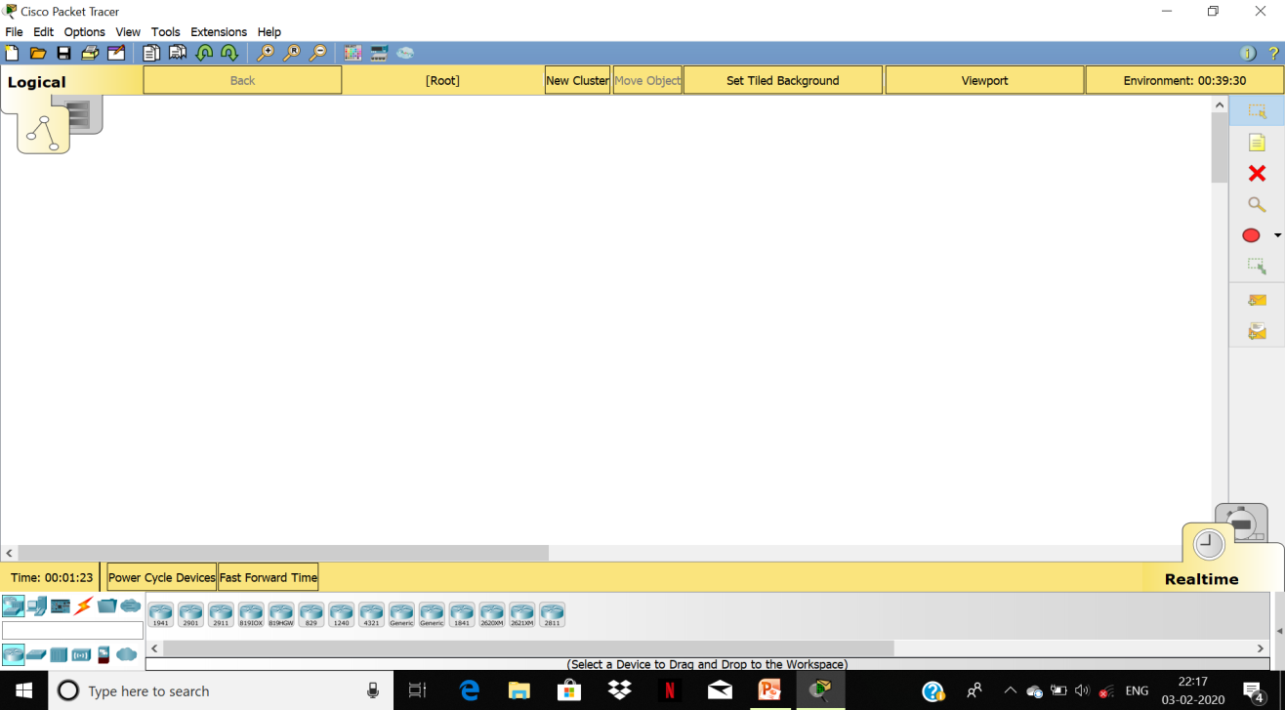
Cisco packet tracer
it is a cross-platform visual simulation tool designed by cisco systems that allow s users to create networl toplologies and imitate modern computer networks.The software allow users to simulate the configuration of cisco routers and switches using a simulated command line interface.

Slide 5
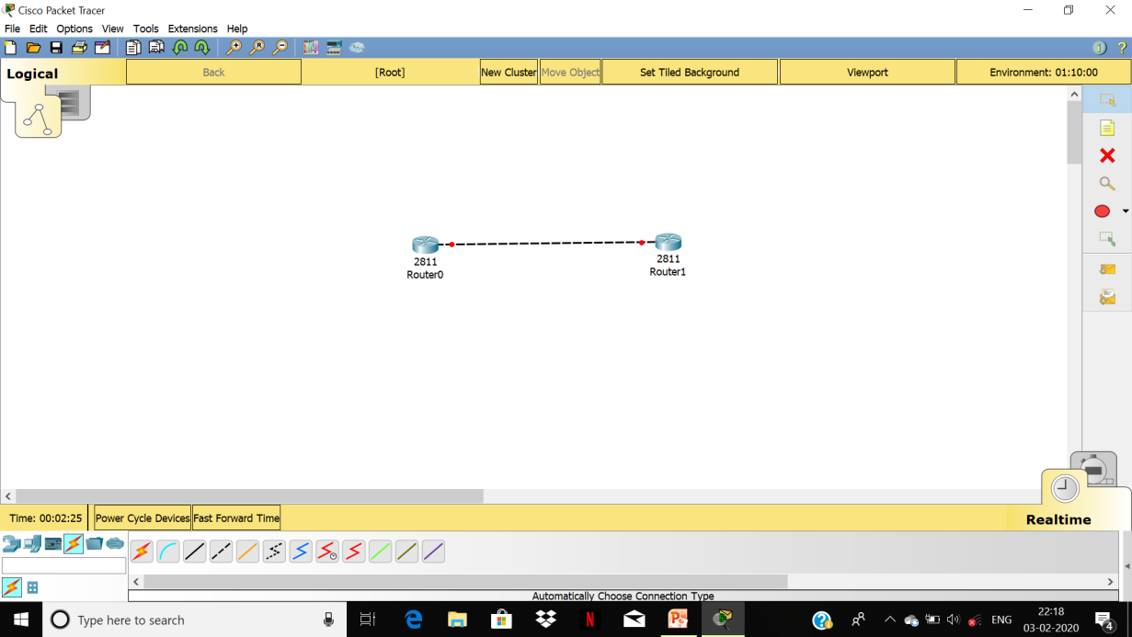
Steps for connecting different vlans
Firstly we took two 2811 routers and connect them.

Slide 6
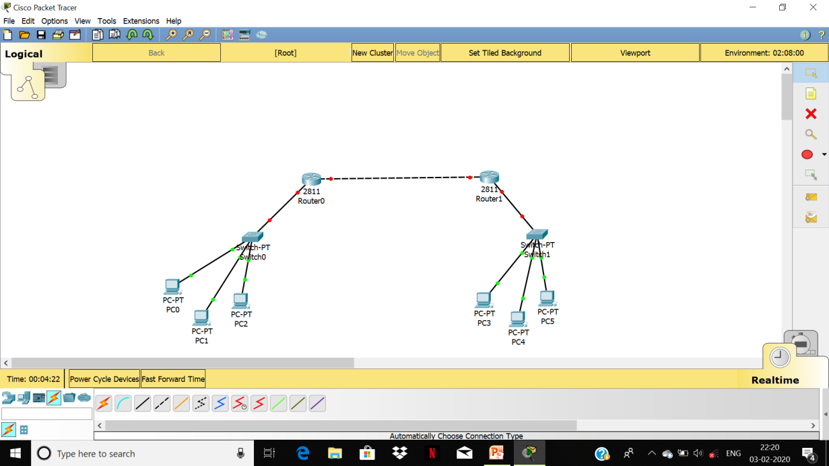
Steps for connecting two vlans
Then we take two general switches and connect it to each router.
Now each switch is connected with three different computers of different vlan.

Slide 7
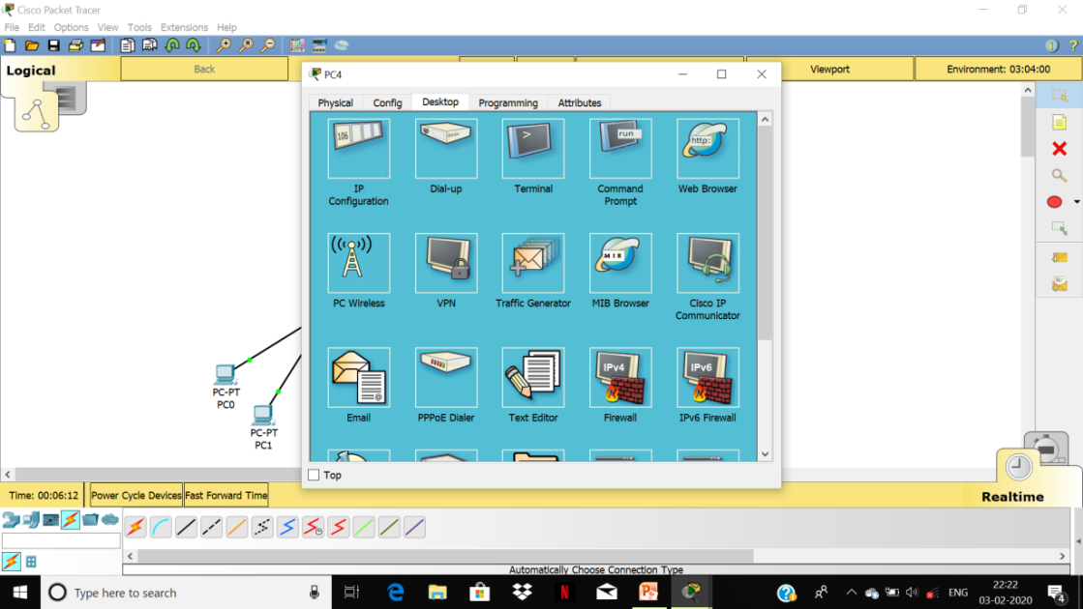
Steps for connecting two vlans
Now we click on each pc and assigning them ip address ,subnet mask and default gateway to manually in such a way that each pc belongs to different vlan.

Slide 8
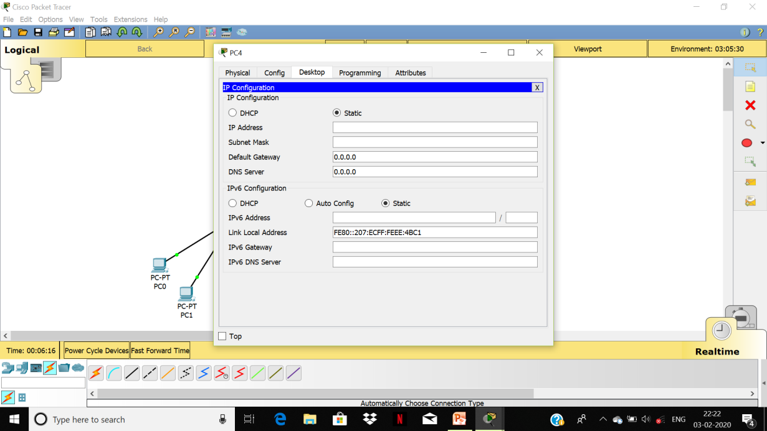
Steps for connecting different vlans
Assign ip address ,subnet mask and default gateway properly and then configure switches.

Slide 9
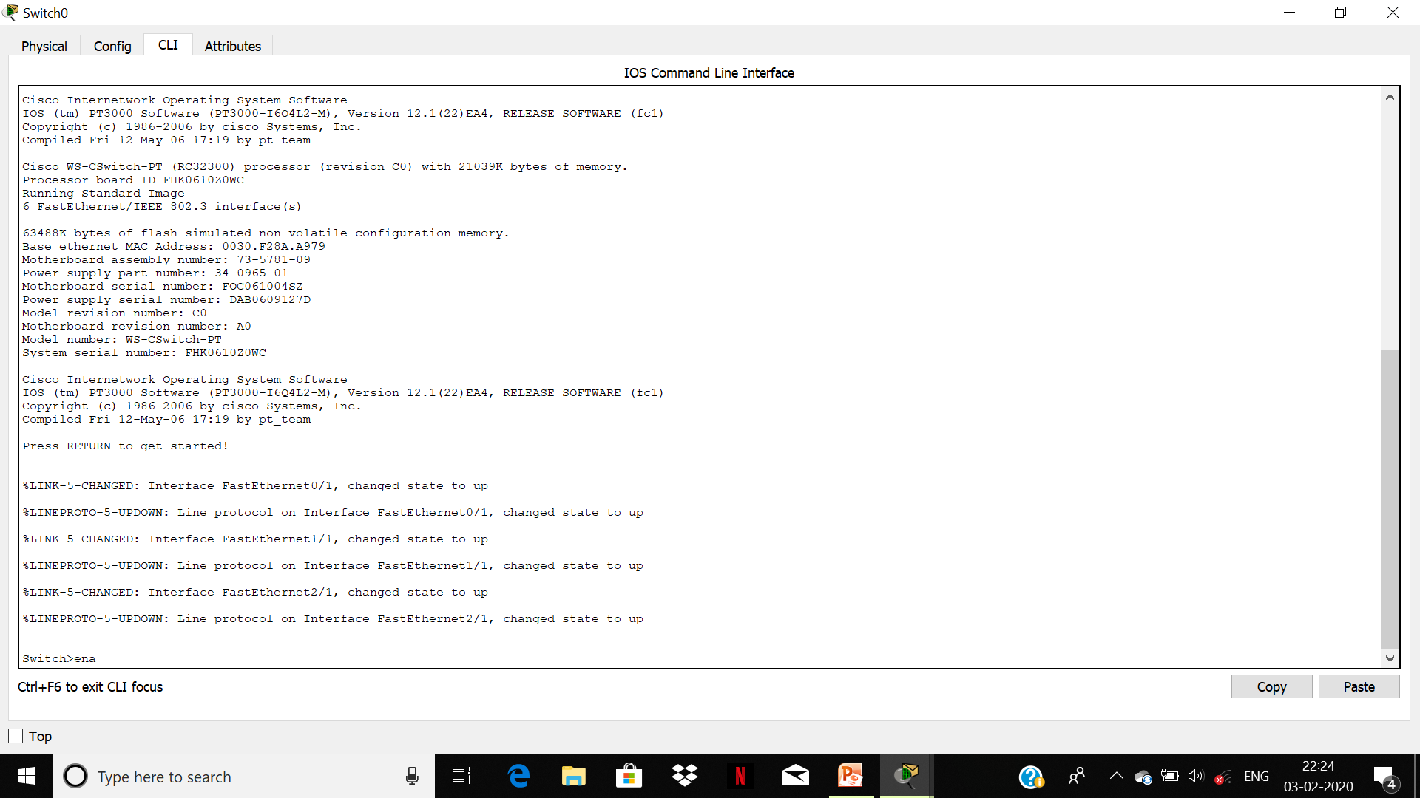
Steps for connecting different vlans
Configure switches .assign ports their mode whether access or trunk, speed and duplex.

Slide 10
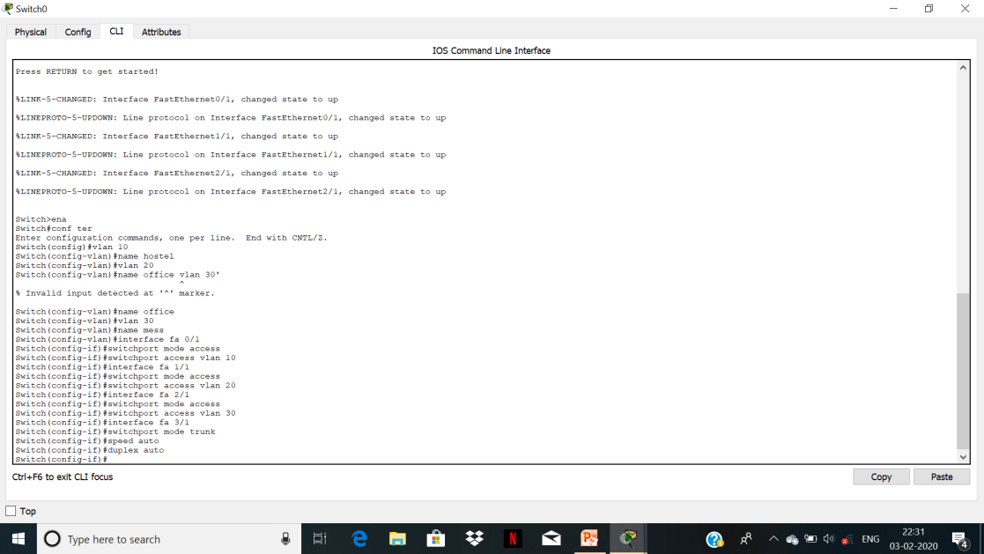
Steps for connecting different vlans
Commands are-
Enable
Configure terminal
Vlan 10
Name office
Vlan 20
Name mess
Vlan 30
Name hostel
Interface fastethernet 0/1
Switchport mode access
Switchport access vlan 10
Interface fastethernet 1/1
Swicthport mode access
Swicthport access vlan 20
Inteface fastethernet 2/1
Swicthport mode access
Swicthport access vlan 30
Inteface fastethernet 3/1
Swicthport mode trunk
Speed auto
Duplex auto

Slide 11
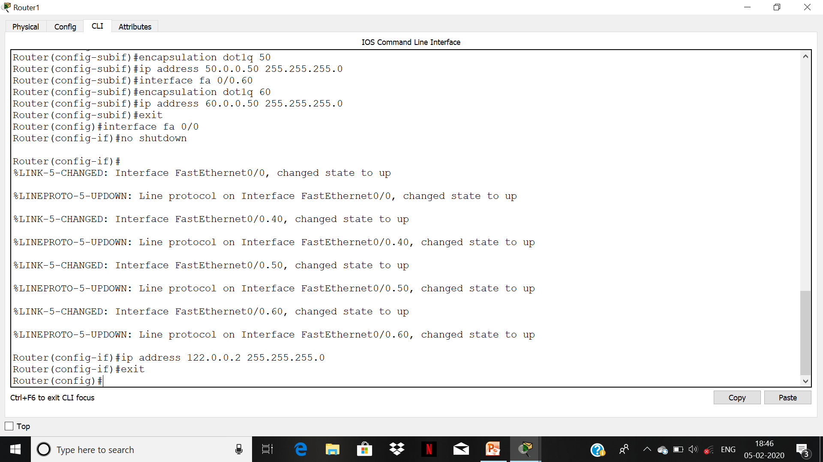
Steps for connecting different vlan.
Now configure routers and commands are-
Enable
Configure terminal
Interface fastethernet fa 0/1
No shutdown
Interface fastethernet 0/0.10
Encapsulation dot1q 10
Ip address 10.0.0.50 255.255.255.0
Interface fastethernet 0/0.20
Encapsulation dot1q 20
Ip address 20.0.0.50 255.255.255.0
Interface fastethernet 0/0.30
Encapsulation dot1q 30
Ip address 30.0.0.50 255.255.255.0
Exit
Interface fastethernet 0/0
No shutdown
Ip address 122.0.0.1 255.255.255.0
End

Slide 12
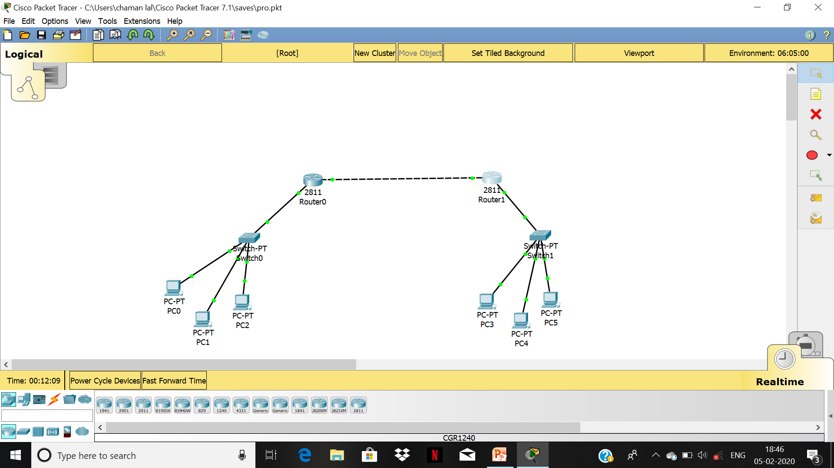
After configuring switches and routers and assigning ip address to pc’s we will have some network as shown below.

Slide 13
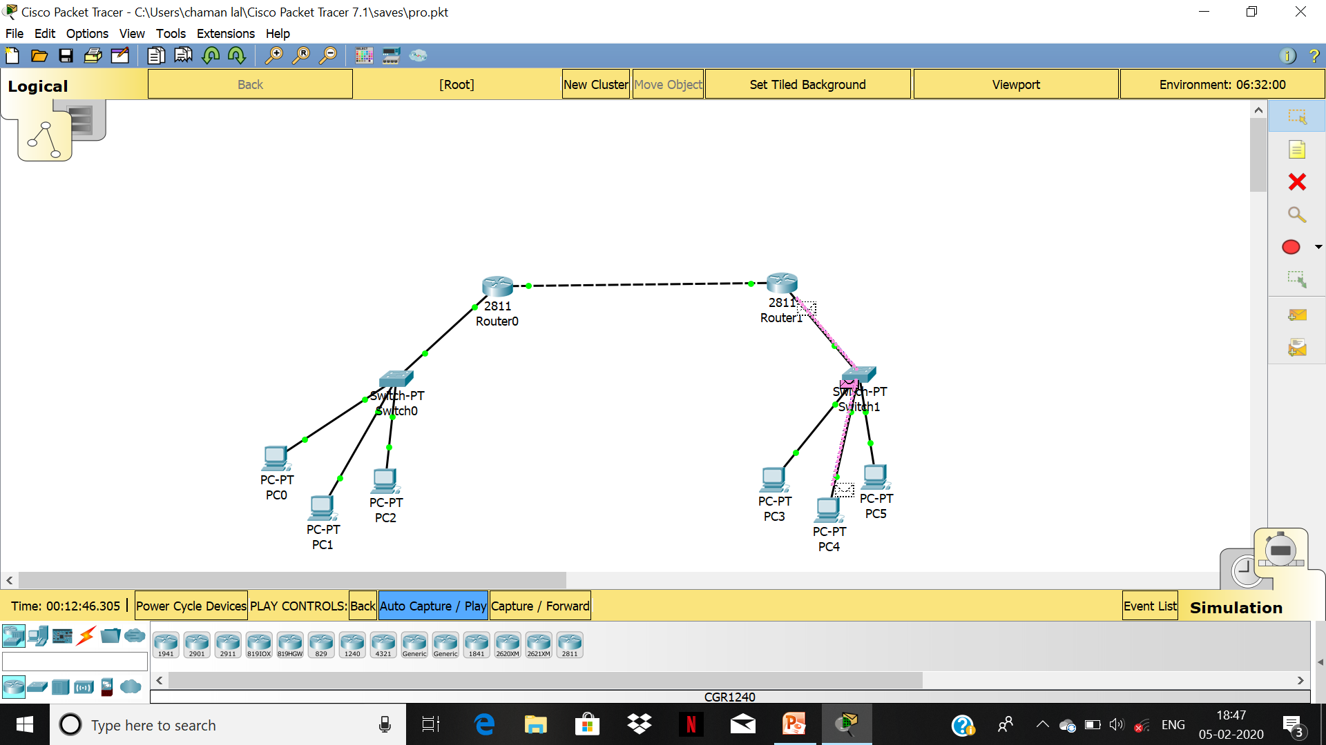
Now we can ping any computer from any other computer falling in this network and send/receive messages from each other to each other.

Slide 14
thank you for watching this report.

