Slide 1
COVID-19 Clinical Trials: Data Insights
Done by: B.Shalini
shalinimargrate2809@gmail.com

Slide 2

Introduction
Objective: Explore trends in COVID-19 clinical trials to understand global research efforts.
Dataset: Sourced from ClinicalTrials.gov
Key Focus: Trial status, interventions, and geographic distribution.

Slide 3
Dataset Overview
Description: Dataset with 27 columns, including:
Status: Recruiting, Active, Not yet recruiting
Interventions: Diagnostic tests, drugs
Locations: Global trial sites
Preview: Condensed table of first 5 rows (NCT Number, Title, Status, Locations).
NCT Number
Title
Status
Locations
NCT0456789
Study of Drug X for COVID-19
Recruiting
USA, UK
NCT0456790
Diagnostic Test Y Efficacy
Active
Germany, France
NCT0456791
Vaccine Z Phase 3 Trial
Not yet recruiting
Brazil, India
NCT0456792
Therapy A for Severe COVID
Recruiting
Canada, Australia
NCT0456793
Long COVID Symptom Study
Active
Japan, South Korea

Slide 4




Methodology
Install libraries
Load dataset
pandas, matplotlib, seaborn, plotly
using pandas read_csv
Preview data
Perform EDA
with df.head()
(status, interventions, locations)
Tools: Python, Jupyter Notebook

Slide 5
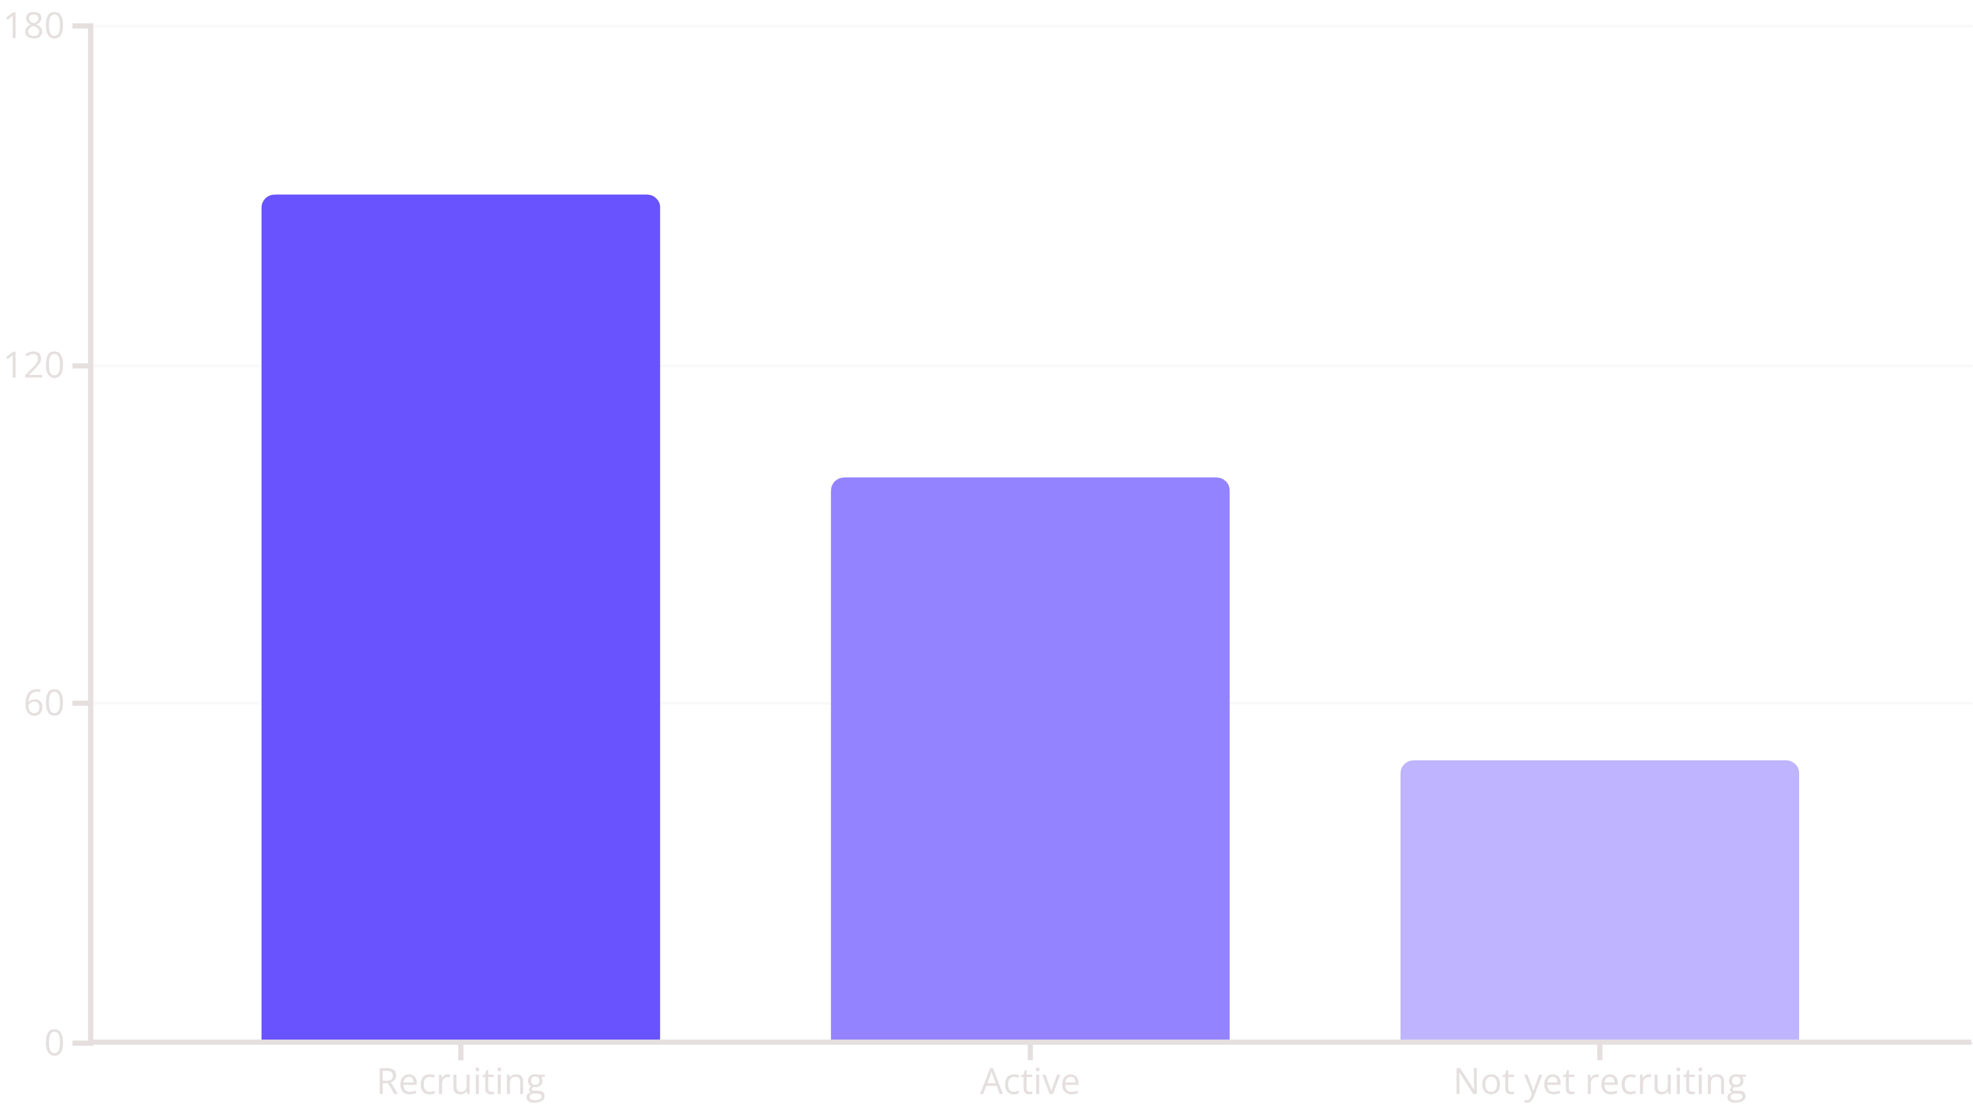
Key Insights
Most trials are Recruiting or Active.
Diagnostic tests dominate interventions.
Trials concentrated in Europe/North America.

Slide 6

Conclusion & Contact
Summary:
Active global research with focus on diagnostics.
Future Work:
Analyze trial outcomes and efficacy.
Contact:
Done by: B.Shalini
Email: shalinimargrate2809@gmail.com
ClinicalTrials.gov

