Slide 1

Next Generation Test Automation Platform using Visual AI
Via AI-ML Algorithms
1

Slide 2

Agenda
Overview
Problem Statement & Ideation
Architecture Used
Design Workflow & Implementation
Demo and Q&A

Slide 3

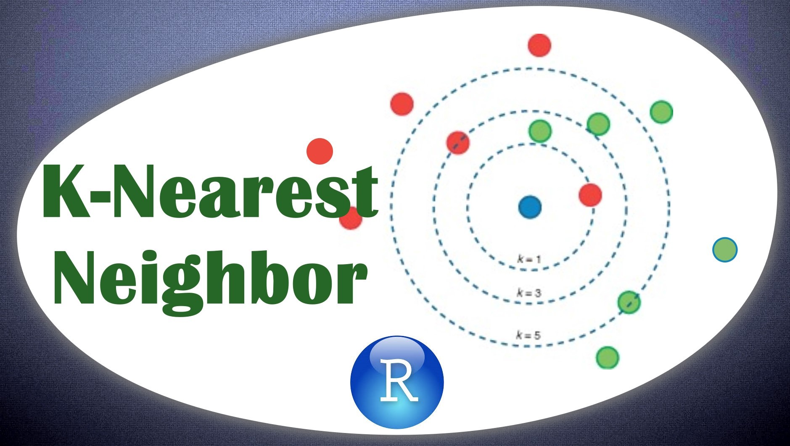
Overview
“The future of search will be about pictures rather than keywords.”
Visual AI - Capture the screen images, break it into visual elements using AI, compare the visual elements with an older screen image broken into visual elements using AI and identify visible differences.
Visual AI Tool- testing revolves around the graphical user interface (GUI) testing the screenshot of both web application and desktop application. By specifically using Visual AI , it refers to testing GUI elements like fonts, layouts, buttons, checkboxes, images, colors, etc.
Image processing is a method of converting an image into digital form and performing certain operations on it to obtain an improved image or extract useful information from it.
A user simply snaps an item they like, uploads the picture, and the technology does the rest.
This tools can save the output as annotations in (png, jpeg and webp image format)

Slide 4

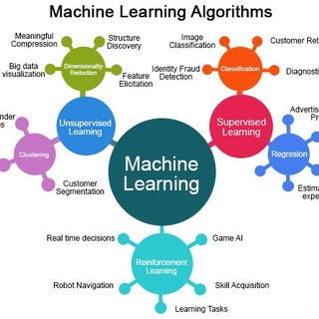




Ideation
Problem Statement
An application :
Access by authenticated user.
My page updated often – I want to identify the difference
Need to compare two screen image & pixel level changes
Need to check the changes in the web application
Sometimes human eyes is missing the identify the small difference
Solution
Visual testing evaluates the visible output of an application and compares that output against the results expected by design. In other words, it helps catch “visual bugs” in the appearance of a page or screen, which are distinct from strictly functional bugs.
Benefits
Open-Source Tool
100% Time Reduction
Zero test cases
Results are accurate
Finding errors
Increased efficiency
Prefer to choose codeless automation testing tools
Tech-Stack

Slide 5



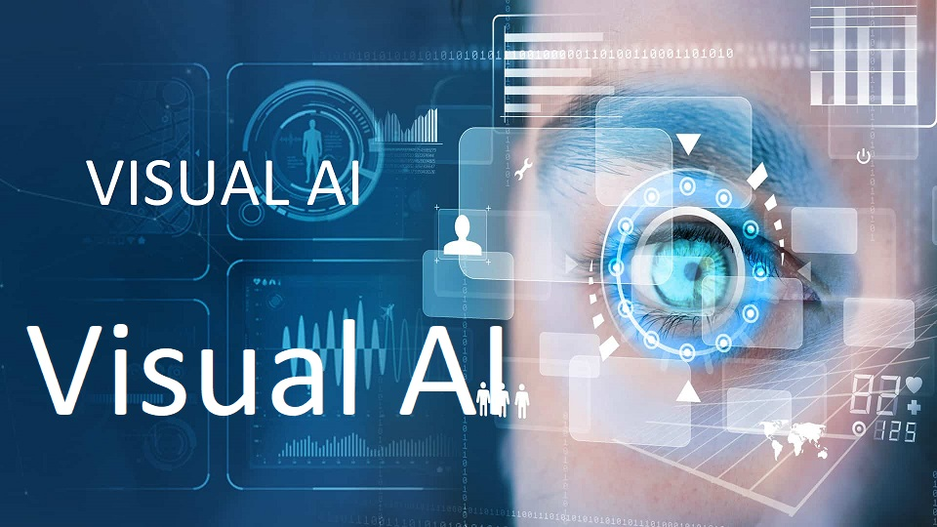
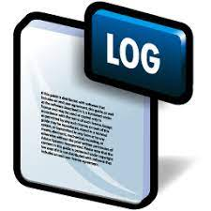


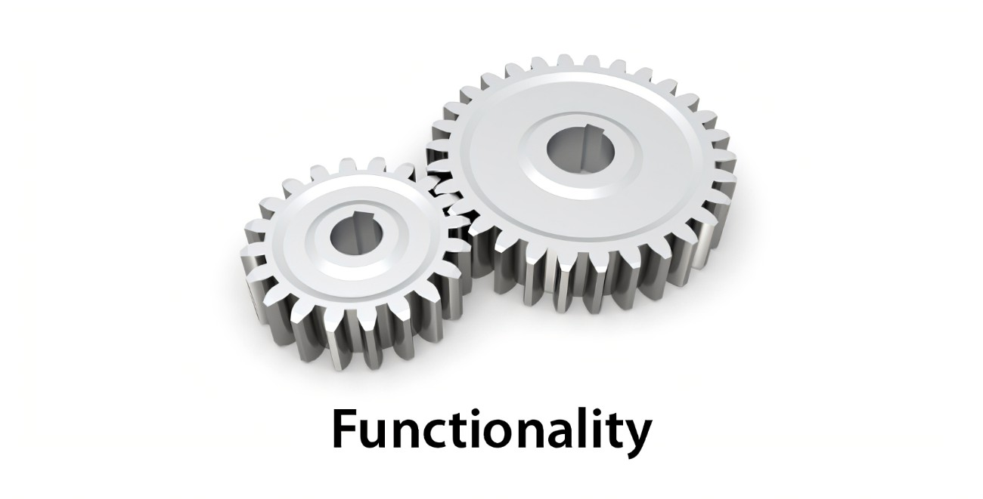
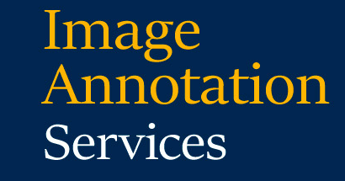
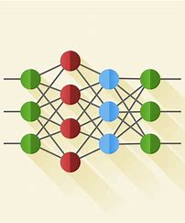



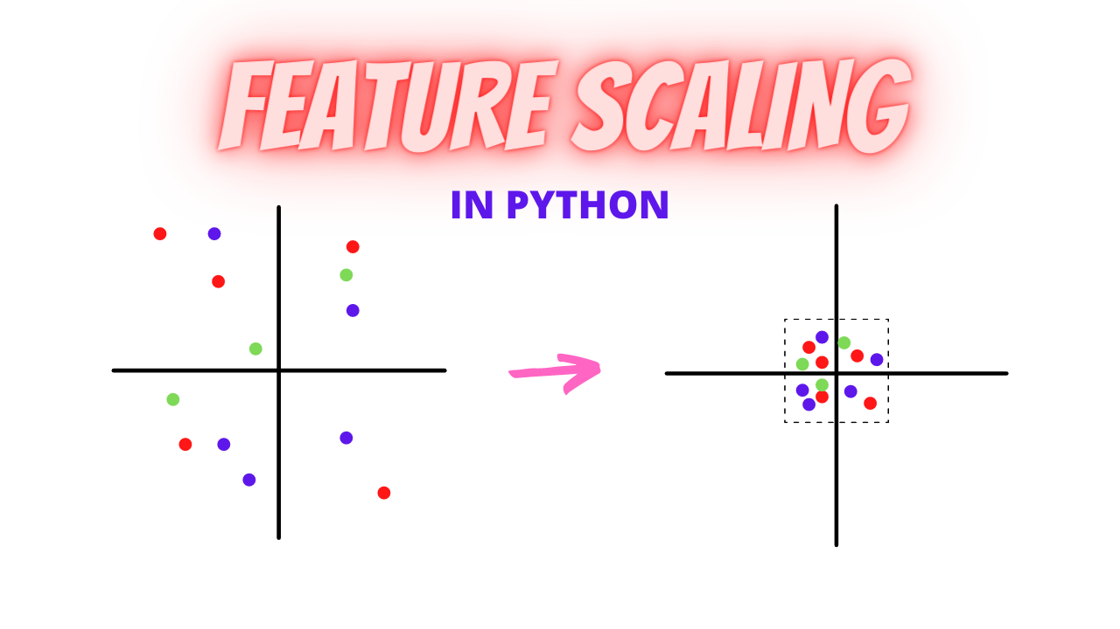
Architecture
Actual Image
Similar
Expected Image
Not Similar

Slide 6
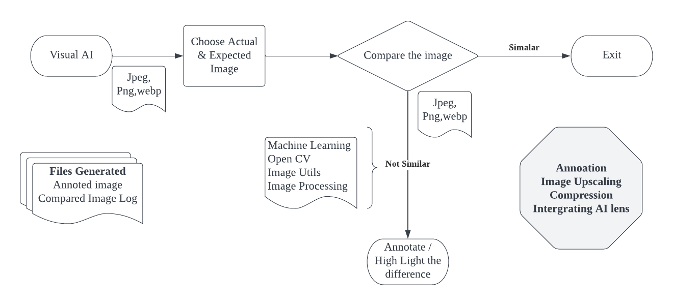
Design Workflow & Implementation

Slide 7
Demo and Q&A’s
7
© 2022 Cognizant

Slide 8
Thank You !!
Trading Hacker’s
Shalini,Pawan & Arpitha

