Slide 1
Lending Club Case Study Submission
Study Group:
Shalini S
Ankit Gupta

Slide 2
Problem Statement
Lending Club is the largest online loan marketplace, facilitating personal loans, business loans, and financing of medical procedures.
Like most other lending companies, lending loans to ‘risky’ applicants is the largest source of financial loss
If one is able to identify these risky loan applicants, then such loans can be reduced thereby cutting down the amount of credit loss. Identification of such applicants using EDA is the aim of this case study.
The company wants to understand the driving factors (or driver variables) behind loan default, i.e. the variables which are strong indicators of default. The company can utilise this knowledge for its portfolio and risk assessment.
For the above stated purpose, dataset has been provided starting from the year 2007 to 2011

Slide 3
Problem Solving Methodology
The first step performed was to remove columns that had greater than 90% null values thereby reducing the size of the dataset
Next step was to clean the values of certain columns such as ‘%’ symbol removal from int_rate, converting emp_length column to integer after removing ‘<‘ and ‘+’ symbols, removing ‘months’ literal from ‘Term’ column and so on.
Removing records with loan status as ‘Current’ as they are not relevant for this case study
Splitting the dataset into two dataframes, one each for ‘Fully Paid’ and ‘Charged Off’ loans
Performing univariate and bivariate analysis on various columns
Deriving results after the analysis and preparing recommendations

Slide 4
Loan Data Analysis – Flow Chart
Term
Loan Status
Funded Amount
Loan Amount
Funded AmountInv
Interest rate
Home ownership
Purpose
More defaulters in loan term 60 months
Home ownership as rent & mortgage are likely to default
Interest rate Grade D and above cause 1 out of 5 people to default
Purpose of the loan being debt consolidation , more tenure, more interest rate together cause more chances defaulters
Load loan data
Data cleansing
If isNull > 90%
Data Analysis
Yes
Remove the column
Uni-variate
Analysis
Recommendation
Int_rate – remove % symbol
Emp_length – remove special char
Term – remove the string ‘Months’
All date fields as ‘Date data type’
Bi-variate
Analysis
Loan Status – Interest
Year – Loan Request/Provided
Loan status – term
Loan status – home ownership
Loan status – purpose
Loan status – grade

Slide 5
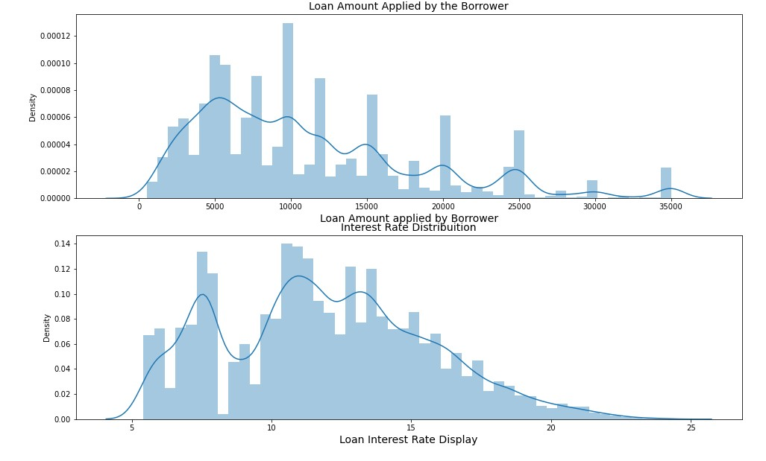
Univariate Analysis on Loan Amount Applied and Loan Interest Rate
In this step, we wanted to see the distribution of the amounts for which the loan was applied and the interest rates distribution for the various loans
As we can see, most of the loans applied were in the range of 5000 – 15000 and interest rates which were most frequent were between 8 – 15 percent

Slide 6
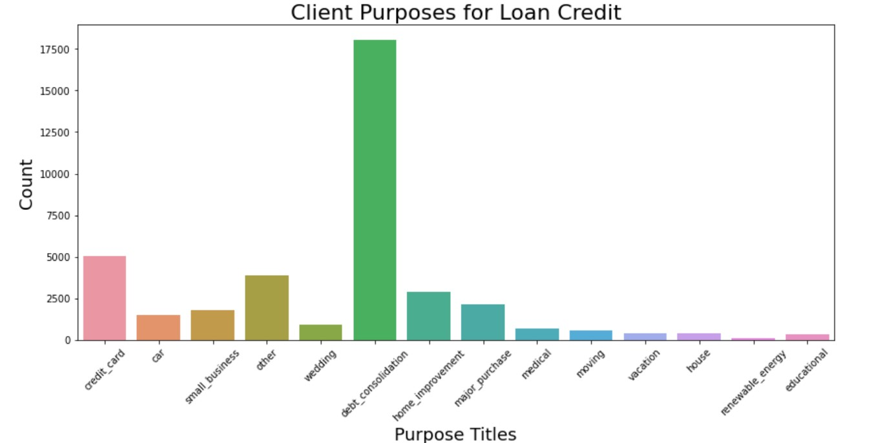
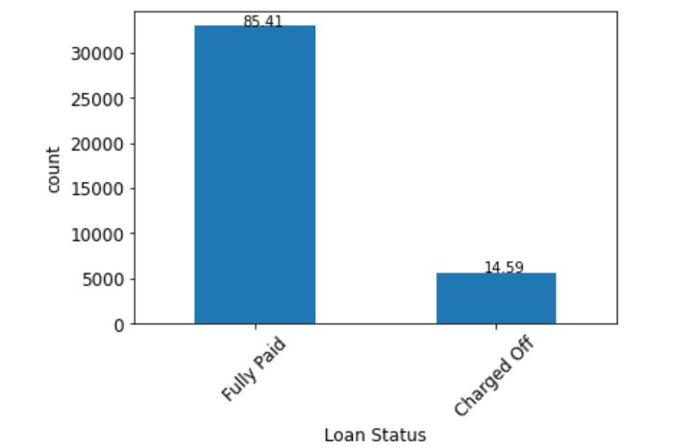
Univariate Analysis on Loan Purpose and Loan Status
We performed univariate analysis on loan purpose to find out the maximum loans were taken for the purpose of debt consolidation
Also after analysis the number of loans from 2007 to 2011, we can see the more than 80% of the loans have been successfully paid off leading to profitability for the investors

Slide 7
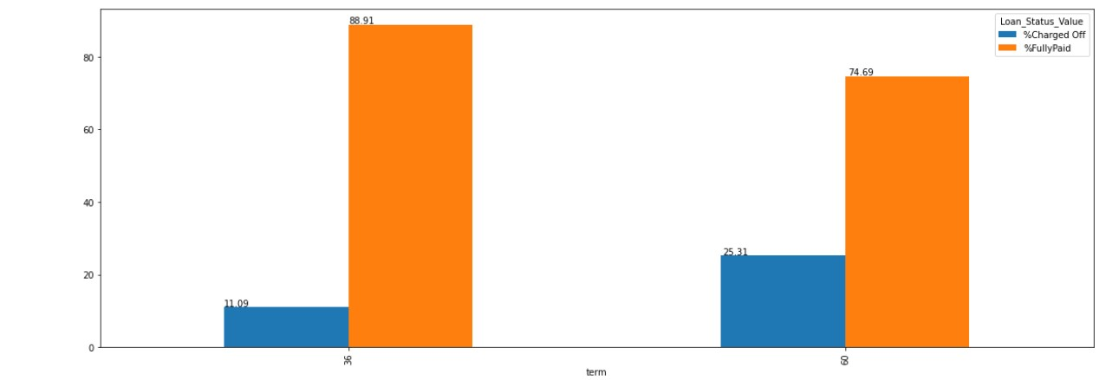
Bivariate Analysis on Loan Status and Term
In this step, we performed bivariate analysis on loan status and term
First, we calculated the total number of fully paid and charged off loans in each category i.e. 36 and 60 months
Next we calculated the percentage of each loan type in the months category
The above data was then plotted using a bar chart, to reveal that as the term of the loan increases, the rate of default also increases. In this case the jump is from 11 to 25 percent

Slide 8
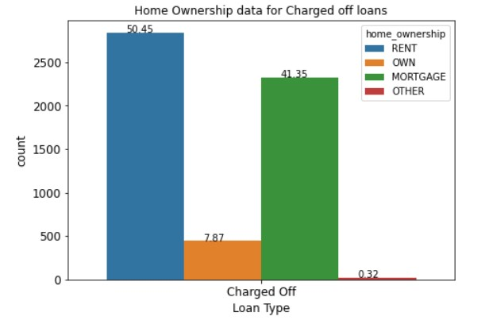
Bivariate Analysis on Charged off Loans and Home Ownership type
Next, for charged off loans we calculated the number of occurrences according to the home ownership type
This analysis revealed, that people who were defaulting on their loans, majority of them were either living on rent or had mortgaged their homes

Slide 9
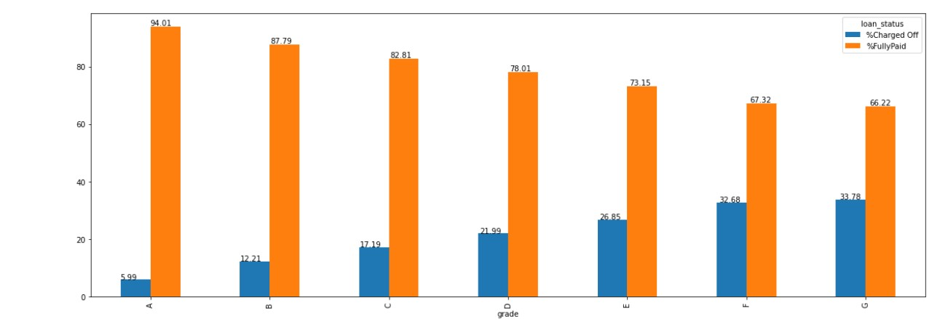
Bivariate analysis on loan status and interest rate(grade)
In the next step, for each grade type, where grade represents the interest rate, A being the lowest and F being the highest, we calculated the percentage of fully paid and charged off loans
As we can see, stating with grade C, the charged off loans start increasing quite steadily as a percentage of total number of loans given in that grade
Thus, it can be clearly determined, that higher interest rates lead to higher rates of default

Slide 10
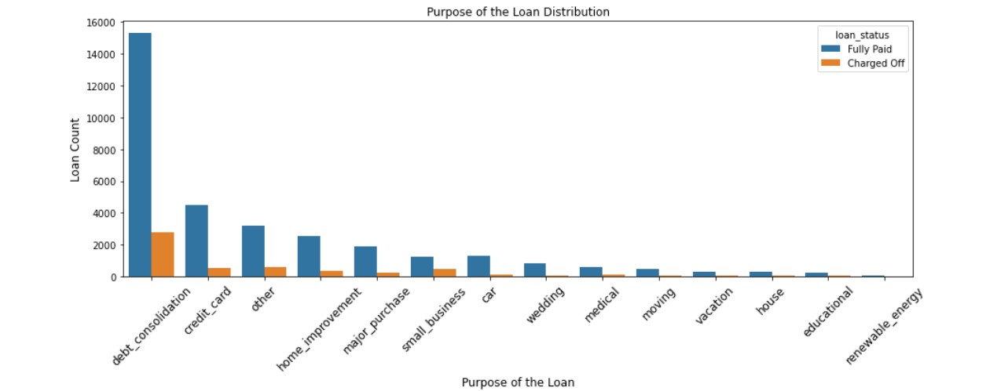
Bivariate analysis on loan status and purpose of loan
After performing bivariate analysis on loan status and purpose of loan, we can clearly see that in the debt consolidation category, the percentage of people who have defaulted on their loans is clearly the largest.
This makes debt consolidation the riskiest category

Slide 11
Recommendations
After analysing the data, we would like to recommend the following indicators for loan default:
Loan tenure – As we can see from the data, as the tenure increases the rate of defaulters also increases
When the applicant of the loan is either living on rent or has mortgaged their property, the rate of default is likely to increase
Increased rate of interest especially starting from grade D, poses a high risk of the borrower defaulting on their rate to the extent of every 1 in 5.
If the purpose of loan is debt consolidation, then the rate of default is also like to increase. But this indicator is best used when combined with the other three indicators. Reason for this is that majority of the loans are in debt consolidation, so tenure and interest rate will also play a crucial part.

