Slide 1
COVER LETTER
MADAKA TEJA
tejaswinim126@gmail.com
7997655393
09/07/2024 SkillsBuild management
Dear Mam/Sir, I'm applying for a junior management position at your company. Based on the posted description, I'm
confident that I am fully qualified for the position and will be a strong addition to your team. I would
appreciate a job interview at your earliest convenience. Please find my resume attached. I can be
reached at the contact above or at my email address. contact: 7997655393, 8367491124 Email :
tejaswinim126@gmail.com
.
Sincerely,
Madaka Teja

Slide 2
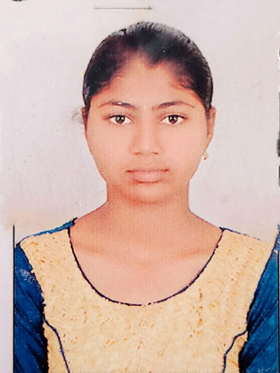





Objective
To obtain a challenging position in a high quality business environment where my resourceful academic skills and knowledge will add value to organizational operations.
Academic Details
Chaitanya Bharathi Institute of Technology. Master of Business Administration (MBA), 8.69
Pursuing
Sree vVedavyasa degree college ,Proddatur.
B. Com ( Computer Applications ), 8.25, 2023
Bhavana junior college, Proddatur.
Bi.p.c, 7.21, 2020
ZP High School, Proddatur.
SSC, 8.8, 2018
Madaka Teja
tejaswinim126@gmail.com 7997655393, 8367401124
Kadapa district, Andhra Pradesh.
Linkdin :
https://www.linkedin.com/in/teja-
madaka-2b3a70300?
utm_source=share&utm_campaign
=share_via&utm_content=profile&u
tm_medium=android_app
Work Experience
RK Services ( Amazon ) - Internship( 4 months ) Code Scanner, Jan 2023 - Apr 2023
Canara Bank - Internship ( 2 months )
Accounts holder, Oct 2022 - Dec 2022
Skills
Communication skills . Decision making and project
management .
Typing ( Lower Speed )
MS. Office - MS. Word, MS.
EXCEL, MS. PowerPoint.
Programming languages - C, C++,
HTML/CSS
Field of Interest
Project Details
Computer Courses The web pages which consists of a brief
information about trending Computer Courses for
the freshers/Students.
Period : 1 month
Financial Funds
The information collected and create a complete report on Chit funds. Which are one of the best
way to collect the funds for the sick companies.
Team Size:
Financial Management. Human Resource Management Programming Languages
Period : 1 month
Role : Leader
Team Size: 8
Industrial Exposure
Industrial Visit at: Canara Bank, Proddatur.
Kapileswar Chit funds, Proddatur.

Slide 3





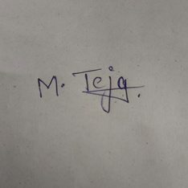
Achievements
Certification Courses - Google data analytics professional
Data Analysis with Excel
Curricular Activities
Co-Curricular Business Quiz - in CBIT itself.
Project Presentations.
Data visualization and buildings with Excel.
Strength
Environment Adaptability.
Self motivation. Quick
Learner.
Hobbies
Reading Books , Playing games , drawing,and Listening to music.
Declaration
I hereby declare that all the details furnished above
are true to the best of my knowledge and belief.
( Madaka Teja )

