Slide 1
Digital Portfolio
STUDENT NAME: V.SHALINI
REGISTER NO AND NMID: 24133091802522042/autanm309anm30924ucsc042
DEPARTMENT:COMPUTER SCIENCE
COLLEGE: COLLEGE/ UNIVERSITY:JAWAHARLAL NEHRU COLLEGE FOR WOMEN/ANNAMALAI UNIVERSITY

Slide 2
PROJECT TITLE
A student portfolio is a collection of a student's work, showcasing their progress, achievements, and experiences over time. It can include:
Assignments and projects
Essays and writings
Artwork and creative projects
Test scores and evaluations
Reflections and self-assessments
Portfolios help students:
Track their growth and development
Identify strengths and areas for improvement
Set goals and work towards them
Develop self-reflection and self-assessment skills
They can be physical or digital. What specific aspect of student portfolios would you like to know more about?

Slide 3


AGENDA
Problem Statement
Project Overview
End Users
Tools and Technologies
Portfolio design and Layout
Features and Functionality
Results and Screenshots
Conclusion
Github Link
3/21/2024 Annual Review

Slide 4

PROBLEM STATEMENT
Project Statement Examples
"This portfolio showcases my academic journey, highlighting my growth, achievements, and learning experiences throughout [X] years."
"Through this portfolio, I aim to demonstrate my skills, creativity, and dedication to my studies, showcasing my best work and progress over time."
"My portfolio represents my passion for learning, innovation, and self-improvement, featuring projects and assignments that demonstrate my capabilities and potential."
Key Elements
When crafting your project statement, consider including:
A brief introduction to yourself and your academic goals
An overview of the portfolio's contents and themes
Your aspirations and what you hope to achieve through the portfolio
What specific theme or focus would you like your project statement to convey?

Slide 5

PROJECT OVERVIEW
Project Overview Essentials
Project Title: A brief and descriptive title for the project.
Objective: A clear statement of what the project aimed to achieve.
Description: A concise summary of the project, including the problem or question addressed.
Methodology: A brief overview of the approach and methods used to complete the project.
Outcomes: A summary of the project's findings, results, or outcomes.
Skills Demonstrated: A list of the skills and knowledge demonstrated through the project.
Example
Here's an example of a project overview:
Project Title: Investigating the Impact of Climate Change on Local Ecosystems
Objective: To research and analyze the effects of climate change on local ecosystems and propose potential solutions.

Slide 6

WHO ARE THE END USERS?
Potential End-Users
Teachers/Educators: To assess student learning, progress, and achievement.
Parents/Guardians: To track student progress, identify areas for improvement, and stay informed about their child's education.
Employers: To assess a student's skills, experience, and potential as a job candidate.
College/University Admissions: To evaluate a student's qualifications, achievements, and potential for admission.
The Student Themselves: To reflect on their own learning, set goals, and track their progress over time.
Key Considerations
When creating a student portfolio, consider the needs and expectations of the intended end-users. What specific end-user group are you creating the portfolio for?

Slide 7

TOOLS AND TECHNIQUES
Digital Tools
Google Sites: A free website builder for creating digital portfolios.
Seesaw: A student-driven digital portfolio platform.
Google Drive: Cloud storage for storing and sharing files.
Microsoft OneDrive: Cloud storage for storing and sharing files.
Portfolio platforms: Such as Portfolium, FolioSpaces, or Digication.
Techniques
Reflection and self-assessment: Regularly reflecting on progress and goals.
Organization and categorization: Organizing work into clear categories and sections.
Storytelling: Using narratives to showcase experiences and achievements.
Multimedia inclusion: Incorporating images, videos, and audio files to enhance the portfolio.
Regular updates: Regularly updating the portfolio with new work and reflections.

Slide 8
POTFOLIO DESIGN AND LAYOUT
Design Principles
Consistency: Use a consistent layout, font, and color scheme throughout the portfolio.
Clarity: Make sure the portfolio is easy to navigate and understand.
Visual Hierarchy: Use headings, subheadings, and bullet points to create a clear hierarchy of information.
White Space: Use white space effectively to make the portfolio easy to read and visually appealing.
Layout Considerations
Homepage: Use the homepage to introduce yourself and showcase your best work.
Project Showcase: Use a clear and concise format to showcase each project, including images, descriptions, and outcomes.
About Page: Use the about page to tell your story, share your interests, and provide contact information.
Navigation: Make sure the navigation is easy to use and consistent throughout the portfolio.
8

Slide 9
FEATURES AND FUNCTIONALITY
Features
Project showcase: A platform to showcase projects, assignments, and achievements.
Multimedia support: Ability to include images, videos, audio files, and other multimedia elements.
Organization: Easy organization and categorization of work.
Search functionality: Ability to search and filter content.
Customization: Ability to customize the design and layout.
Functions
Upload and manage files: Ability to upload, edit, and manage files.
Create and edit content: Ability to create and edit text, images, and other content.
Share and collaborate: Ability to share the portfolio with others and collaborate on projects.
Track progress: Ability to track progress and reflect on learning.
Feedback and comments: Ability to receive feedback and comments from others.

Slide 10

RESULTS AND SCREENSHOTS
To better assist you, could you please clarify what kind of results and screenshots you're looking for? Are you:
Seeking examples of successful student portfolios?
Looking for screenshots of specific portfolio platforms or tools?
Wanting to showcase your own portfolio results and get feedback?
Please provide more context, and I'll do my best to help!
3/21/2024 Annual Review
10

Slide 11
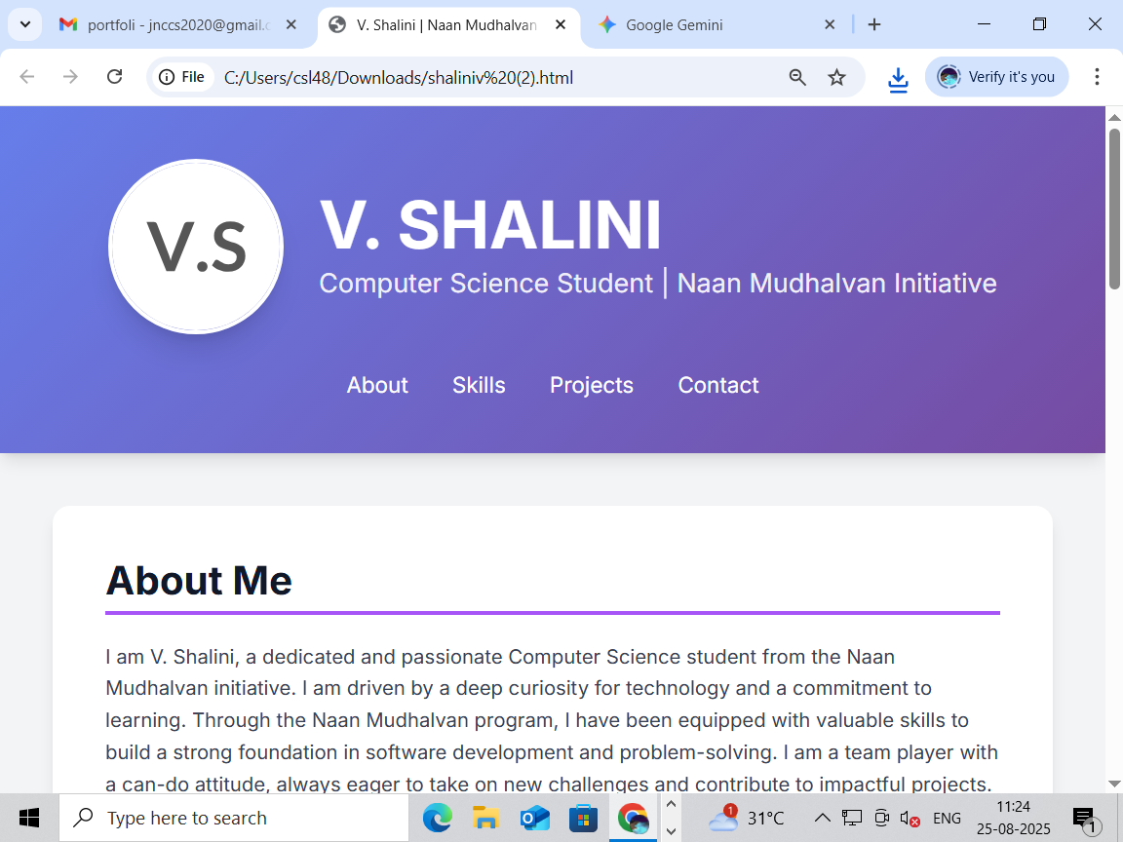
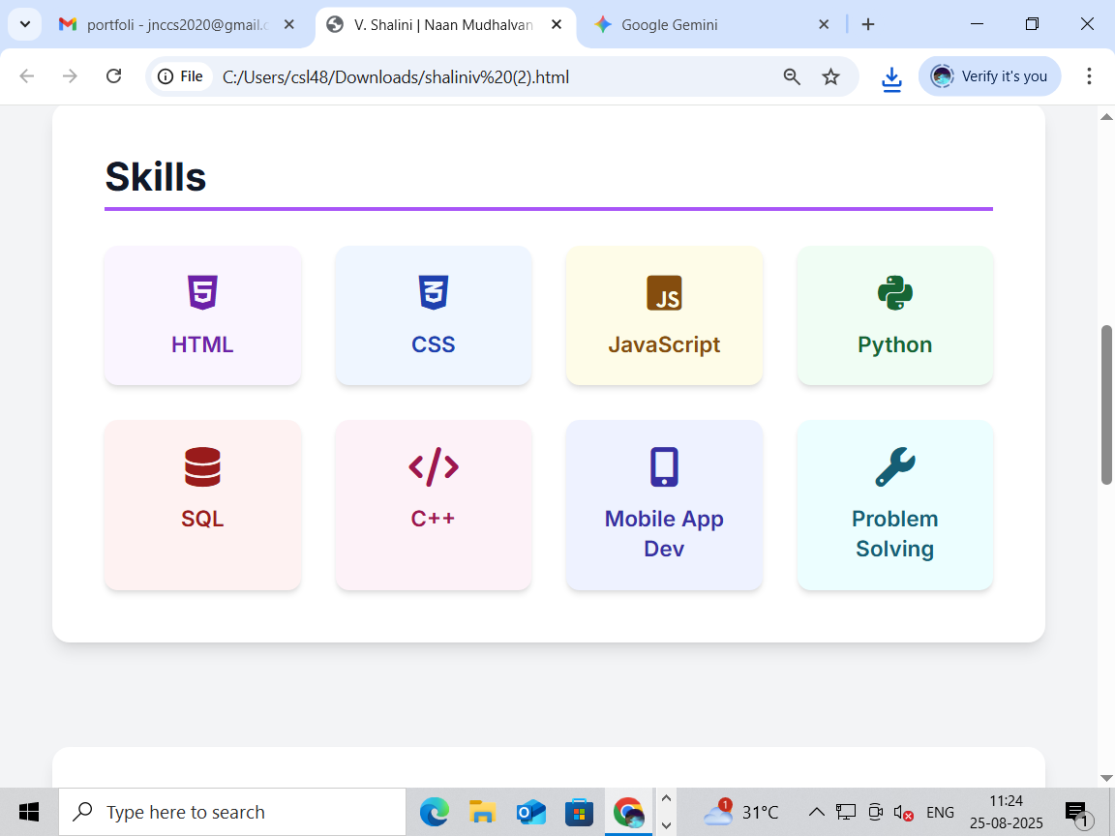

Slide 12
CONCLUSION
Conclusion Examples
"Through this portfolio, I have showcased my academic journey, highlighting my growth, achievements, and experiences. I am proud of my accomplishments and look forward to continued learning and growth."
"This portfolio represents my dedication to my studies and my passion for [field/subject]. I hope it demonstrates my potential and commitment to future academic and professional pursuits."
"In conclusion, this portfolio showcases my skills, knowledge, and experiences gained throughout my academic journey. I am excited to build upon these foundations and continue growing as a learner and individual."
Key Elements
When writing a conclusion for your student portfolio, consider:
Summarizing your achievements: Highlight your key accomplishments and experiences.
12

