Slide 1
TWO LEVEL AUTHENTICATION USING BRAIN WAVES
Shalini Kothuru
160116733013

Slide 2

INTRODUCTION
Authentication is process of verifying identity of a person
Biometrics uses physical or behavioural characteristics of a person to confirm identity
Authentication is essential everywhere

Slide 3

Authentication is generally provided through systems like passwords, PIN codes, card readers. At some places biometrics like fingerprint and retina scans are used.
Shoulder surfing problem
Vulnerable to various attacks such as dictionary attacks,false enrollment, denial of service attacks.

Slide 4
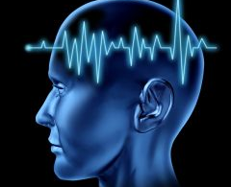
Authentication using brain waves or neural oscillations has more benefits compared to other authentication techniques.
No problem of shoulder surfing when authenticating using brain waves.
Differently abled persons

Slide 5
It is possible to understand if a human characteristic can be used for biometrics in terms of the following parameters
Universality
Uniqueness
Permanence
Collectability
Performance
Acceptability
Circumvention

Slide 6
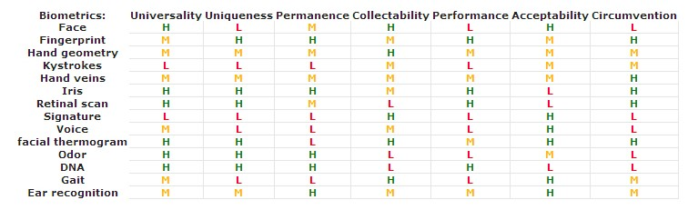
The following table shows a comparison of existing biometric systems in terms of those parameters:

Slide 7
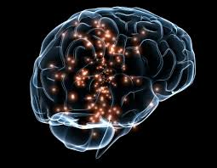
EEG as biometric
An adult brain contains about 100 billion interconnected neurons. Each of them generates and leads electrical charges while brain works.
The sum of all these very small electrical charges contributes to the generation of an electric field with fluctuating electrical potentials around our scalp.

Slide 8
The potentials are measured between two or more points called electrodes or sensors, which is placed on the scalp at different locations according to some standard configurations. This measurements are called as Electroencephalography (EEG). That is why the term brain waves can also be used when referring EEG signals.
The pattern of interconnections between billions of neurons is represented as thoughts and emotions.
Change in emotions and thoughts or actions will change the interconnections of neurons which will in term change the electric field. So, changes in thoughts can be interpreted by sensing brain signals.

Slide 9
Our brain consists of 5 different types of brain waves; Delta, Theta, Alpha, Beta and Gamma brain waves. The table below gives a brief overview of the primary function of these brain waves.
Frequency Range | Name | Usually associated with:
> 40 Hz | Gamma waves | Higher mental activity, including perception, problem solving, and consciousness.
13–39 Hz | Beta waves | Active, busy thinking, active processing , active concentration, arousal, and cognition
7–13 Hz | Alpha waves | Calm relaxed yet alert state
4–7 Hz | Theta waves | Deep meditation /relaxation, REM sleep
< 4 Hz | Delta waves | Deep dreamless sleep, loss of body awareness

Slide 10
Scheme of Implementation
The system is divided in three main blocks
Brain computer interface (BCI)
Level differentiator unit (LDU)
Checker module.
wireless
communication
serial
communication
BCI
LDU
Checker
module
Simplified block diagram of system

Slide 11
Brain Computer Interface
This block has the responsibility to connect human brain to the computer system.
Brain computer interface system uses brain wave sensors.
Brain wave sensor consists of dry electrodes and a reference electrode.
The captured raw data is then converted in the form of packets. These data packets are then transmitted to level differentiator unit using wireless Bluetooth transmission.

Slide 12
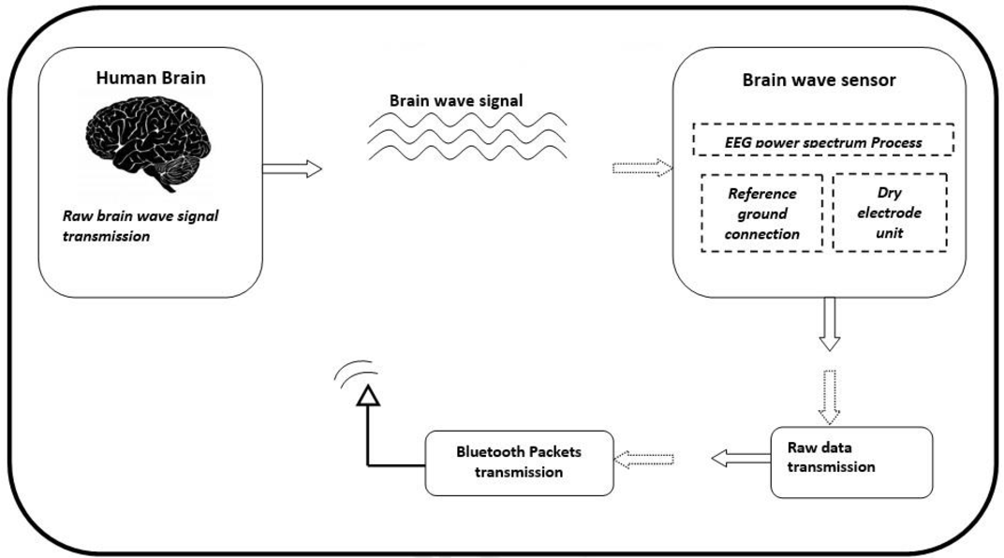
Brain Computer Interface

Slide 13
Level Differentiator unit (LDU)
This block receives wireless data and performs data extraction from raw data that is captured. This block uses Matlab platform for data extraction and interpretation from brain waves that are received.
A specific pattern of brain waves is pre-defined in level differentiator unit as an unlock pattern of brain waves for authentication. User needs to generate the authentic pattern to get the access.
Level differentiator unit receives the brain waves in real-time and checks whether the pattern generated now matches with the predefined pattern. It then sends ASCII keys to the checker module accordingly. Level differentiator unit uses serial communication for connection to checker module.

Slide 14
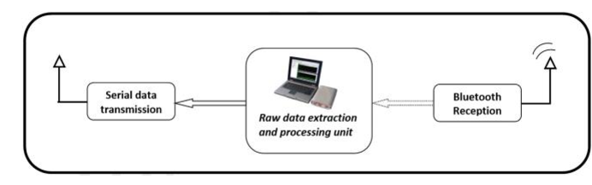
Level differentiator unit

Slide 15
Checker Module
This block is used to provide two-level authentication.
It receives ASCII key from level differentiator unit if authorized pattern of brain waves is generated. After satisfying brain wave condition checker module asks for a pass-key which is second level of authentication.
Checker module consists of an ARM processor interfaced with a touch panel and a LCD.

Slide 16

Checker Module

Slide 17
Why EEG over other biometrics
EEG is much more confidential due to the fact that it corresponds to a secret mental task created from a stimulus, which in no way is observable
EEG are very difficult to mimic.
Requires a living individual.

Slide 18
Disadvantages of EEG
It has poor spatial resolution.
EEG is particularly ineffective when it comes to differentiating regions or circuits specifically within the brain, in hindsight, this means that EEG is unable to produce a good image of the processed neurons at work within the brain.
The different possible types of mental tasks also plays a role in their usability within the system.Doesn’t work when drunk .

Slide 19
Results
It is a two-level authentication system, in which brain wave condition needs to be cracked first before traditional pass key system.
Once brain sensor passes the brain signals to the LDU through Bluetooth, the LDU matches it with predefined pattern defined in Matlab program.
Then user has to enter password if predefined pattern matches

Slide 20
Conclusion
In conclusion, this study has gone through the importance of authentication today, where multi-user systems are at large.
Due to that we looked at an authentication method which was different compared to traditional methods, with the use of biometrics.
Hence, the usage of EEG-based biometrics solves certain problems that other biometrics like fingerprint,retina,password face.
After that, a general methodology on the usage of EEG was briefly discussed.

Slide 21
References
[1] Authentication with brainwaves: a review on the application of EEG as an authentication method
https://ieeexplore.ieee.org/document/8776850
[2] Survey of EEG-based biometric authentication
https://ieeexplore.ieee.org/document/8256471
[3] Types of brain waves
https://itsusync.com/different-types-of-brain-waves-delta-theta-alpha-beta-gamma
[4] Performance of different biometrics
https://www.virtualcasemanagement.com/bio.aspx

Slide 22
Thank you

