Slide 1
Music Models classification: Contigo & BetterBots
Ambatipudi Abhiram (11840170) Asad Abidi (11840220)
Ayush Gupta (11840290) Shalini Kumari (11841030)

Slide 2
Introduction
Our goal is to train a model to find out whether the music sound taken as input by our model is created by any of the known and popular machine learning models out there in the market.
We are making a detector system to classify among different music generating machine learning models.
The aforementioned is a state-of-the-art problem and there hasn’t been much research done in this area.

Slide 3
Objective
Our goal is to develop a system that, upon taking input as a music file, predicts from which machine learning model this music has been generated.
Currently, our system is limited to three models only namely basic RNN, Loopback RNN, and attention RNN.

Slide 4
Datasets Used
Since there were no open-source datasets available for this project we had to create our own dataset.
We looked into the magenta library supported by TensorFlow and found various models for the music generation present there.
We chose the following models:
Attention RNN
Lookback RNN
Basic RNN.

Slide 5
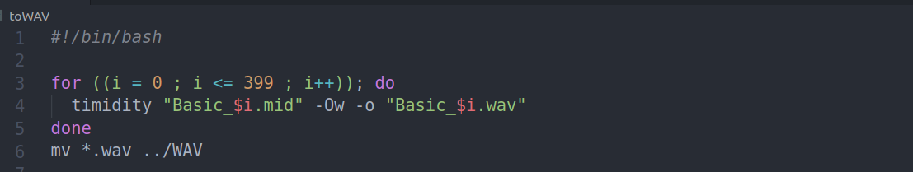
Datasets Used
We used a python library to create different primer sequences for our models.
By feeding these primer sequences into the model we created 600 music files from each model which were in MID format.
Since we needed the data in WAV format, we used a Linux file converter TiMidity to convert it into the WAV format which turned out to be around 4.5 GB.

Slide 6
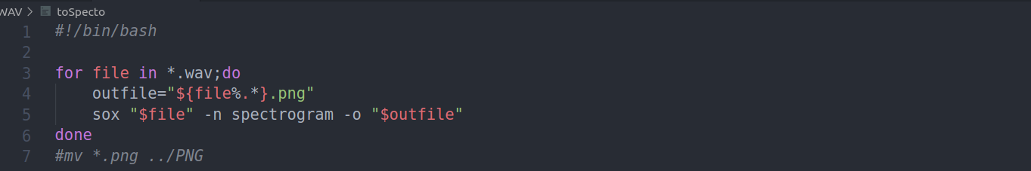
Datasets Used
Used another Linux command-line utility SoX, to convert the WAV files into corresponding spectrograms.

Slide 7
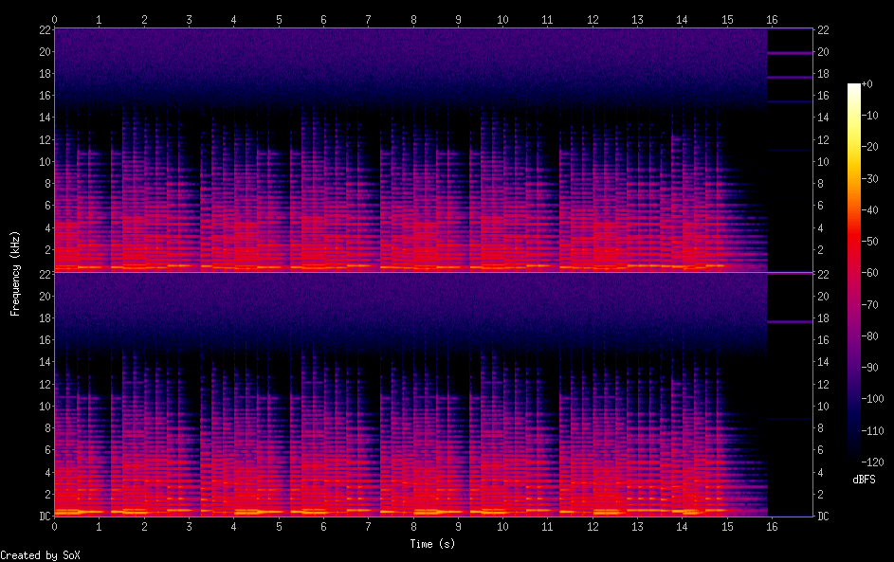
Preprocessing
Capturing high-level structure in audio waveforms is challenging because a single second of audio spans tens of thousands of timesteps. We choose two-dimensional mel-frequency representations of the audio file namely spectrograms.

Slide 8
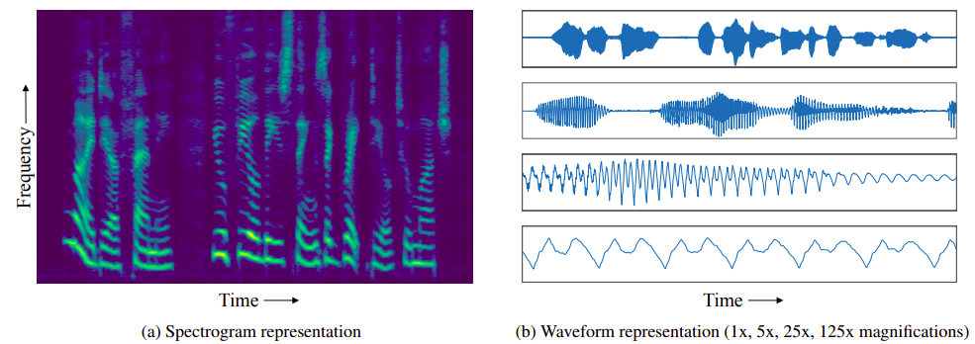
Spectrogram

Slide 9
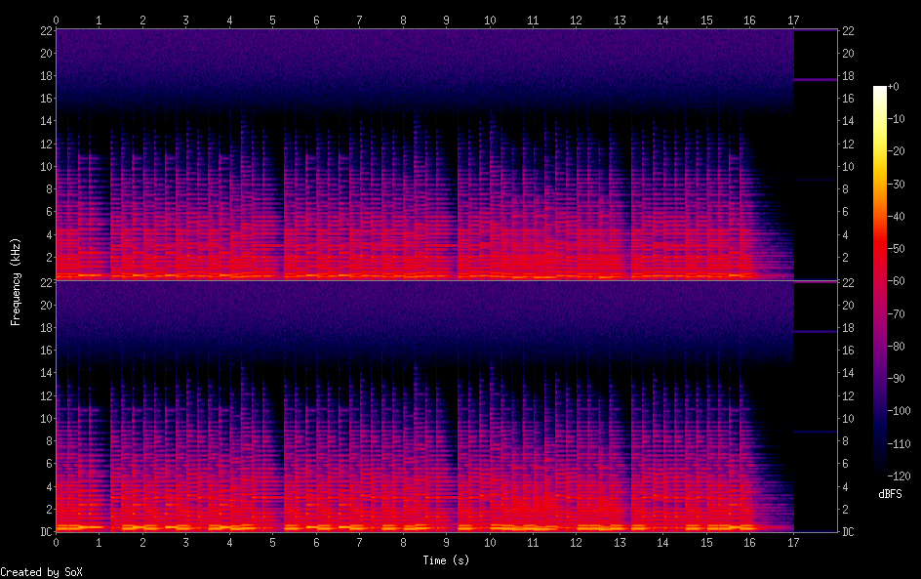
Attention RNN
Basic RNN

Slide 10
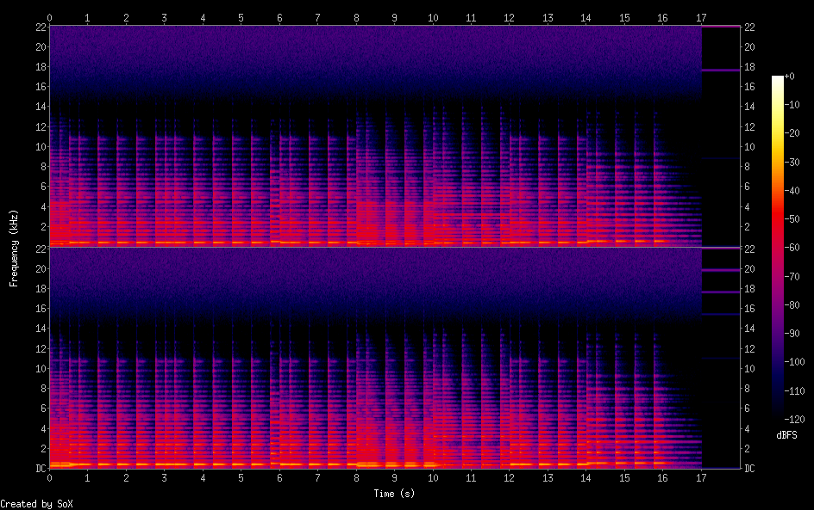
Lookback RNN

Slide 11
Methodology
After doing all preprocessing steps we reached a multi-class classification problem. So we analyzed different available models for the same. While there are different models that we might use, the ResNet50 model has fairly high accuracy, while not being too big in comparison to the computationally expensive VGG and other network architecture. So we opted for ResNet50.
We used Adam optimizer for optimization of our model and categorical cross-entropy loss as loss function. The brief info about both of them is given in the following section. Although we have tried RMSProp it didn’t work well with our problem.

Slide 12
Model
After doing all preprocessing with the dataset, the only part remaining was to use a suitable classification model according to our dataset. For that, we used two models. First was a simple model created using sequential model layers from Keras.

Slide 13
_________________________________________________________________
Layer (type) Output Shape Param #
=================================================================
conv2d (Conv2D) (None, 298, 298, 32) 896
_________________________________________________________________
batch_normalization (BatchNo (None, 298, 298, 32) 128
_________________________________________________________________
max_pooling2d (MaxPooling2D) (None, 149, 149, 32) 0
_________________________________________________________________
dropout (Dropout) (None, 149, 149, 32) 0
_________________________________________________________________
conv2d_1 (Conv2D) (None, 147, 147, 64) 18496
_________________________________________________________________
batch_normalization_1 (Batch (None, 147, 147, 64) 256
_________________________________________________________________
max_pooling2d_1 (MaxPooling2 (None, 73, 73, 64) 0
_________________________________________________________________
dropout_1 (Dropout) (None, 73, 73, 64) 0
_________________________________________________________________
conv2d_2 (Conv2D) (None, 71, 71, 128) 73856
_________________________________________________________________
batch_normalization_2 (Batch (None, 71, 71, 128) 512
_________________________________________________________________
max_pooling2d_2 (MaxPooling2 (None, 35, 35, 128) 0
_________________________________________________________________
dropout_2 (Dropout) (None, 35, 35, 128) 0
_________________________________________________________________
flatten (Flatten) (None, 156800) 0
_________________________________________________________________
dense (Dense) (None, 512) 80282112
_________________________________________________________________
batch_normalization_3 (Batch (None, 512) 2048
_________________________________________________________________
dropout_3 (Dropout) (None, 512) 0
_________________________________________________________________
dense_1 (Dense) (None, 3) 1539
=================================================================
Total params: 80,379,843
Trainable params: 80,378,371
Non-trainable params: 1,472

Slide 14
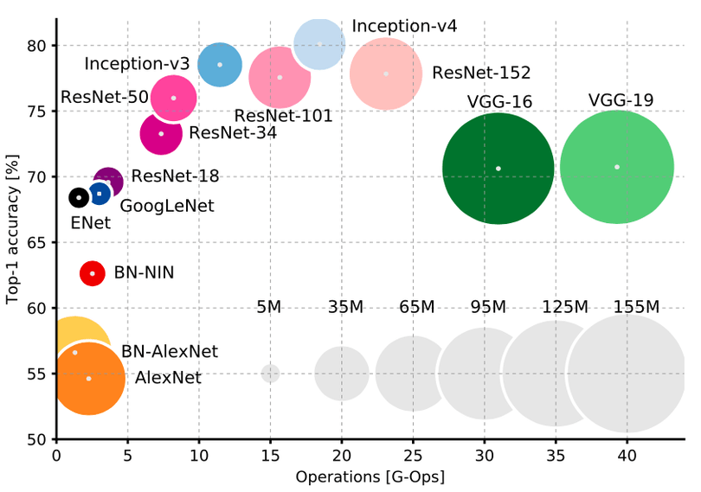

Slide 15
Another one was ResNet50 which we didn’t train from scratch but did transfer learning. ResNet50 is a convolutional neural network that is 50 layers deep. Which was first introduced by Microsoft for the Imagenet challenge for multi-class classification problems which includes 1000 categories of a wide range. There were other models available too but we chose ResNet50 as it solves the vanishing gradient problem which generally arises with very deep neural networks, with the help of skip connections. You can see the architecture of ResNet in the following figure

Slide 16
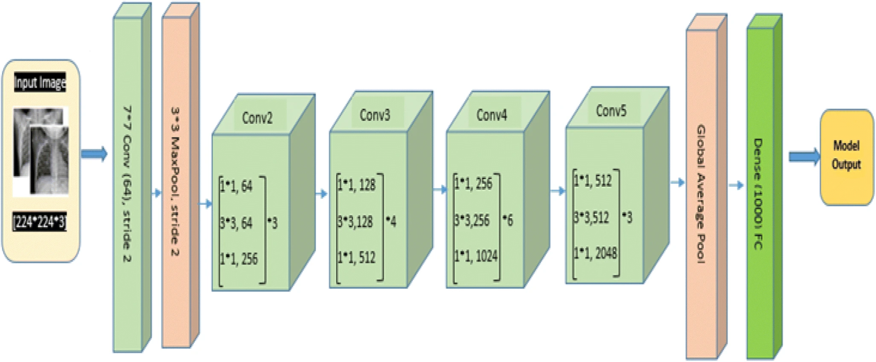

Slide 17
Results and Performance
With our naive model, we got,
the highest accuracy of 57% on training data and
39% on validation data, after running for 200 epochs.
On the other hand, after doing transfer learning with ReSNet50 our accuracy improved significantly,
with training accuracy of 66% and
validation accuracy of 52%.

Slide 18
Problems Faced
This problem was scantily explored before in research labs of Machine learning and artificial intelligence. And it was difficult to look into various aspects of audio models which spanned from basic RNN to attention RNN.
Also, this is not the kind of problem in which we can improve our accuracy with human introspection and data augmentation.
There can be no scope of so called human-level performance in this problem, as it would be difficult for a human to classify the audio files generated.

Slide 19
Conclusion
We have generated a classification model which can reasonably identify which
model was used while generating a particular music file in the given time
constraints.

Slide 20
References
https://arxiv.org/pdf/1906.01083.pdf
https://www.ijstr.org/final-print/oct2016/Detection-Of-Alterations-In-Audio-Files-Using-Spectrograph-Analysis.pdf
https://towardsdatascience.com/understanding-and-coding-a-resnet-in-keras-446d7ff84d33
https://medium.com/dessa-news/detecting-audio-deepfakes-f2edfd8e2b35

Slide 21
Thank you

