Slide 1
Digital portfolio
STUDENT NAME: Shalini P
REGISTER NO AND NMID: 32324U090/D45B51ADDD68820AD3B4D6CC61F3A134
DEPARTMENT: BCA
COLLEGE: Voorhees College ,Thiruvalluvar University

Slide 2
Student Portfolio Website

Slide 3
Agenda
Problem Statement
Project Overview
End Users
Tools and Technologies
Portfolio design and Layout
Features and Functionality
Results and Screenshots
Conclusion
GitHub

Slide 4
Problem Statement
In today’s competitive digital world, students and professionals need a unique way to highlight their skills, projects, and achievements. Traditional resumes often fail to showcase creativity and technical abilities effectively.

Slide 5
Project Overview
- Responsive personal portfolio website
- Sections: Home, About, Skills, Projects, Contact
- Technologies: HTML, CSS, JavaScript

Slide 6
End Users
• Students who want to showcase academic projects
• Job seekers
• Freelancers
• Developers

Slide 7
Tools & Technologies
• HTML5 – for structure
• CSS3 – for styling and layout
• JavaScript – for interactivity
• GitHub – for version control
• Responsive Design principles for multi-device support

Slide 8
Portfolio Layout & Design
The website consists of:
• Home – Engaging introduction with name and tagline
• About Me – Personal details and goals
• Skills – Highlighting core technical skills
• Projects – Showcasing practical work with descriptions
• Contact – Simple section with email and phone details

Slide 9
Features & Functionality
- Responsive navigation bar
- Interactive cards with hover effects
- Smooth scrolling
- Clean UI with modern color scheme

Slide 10
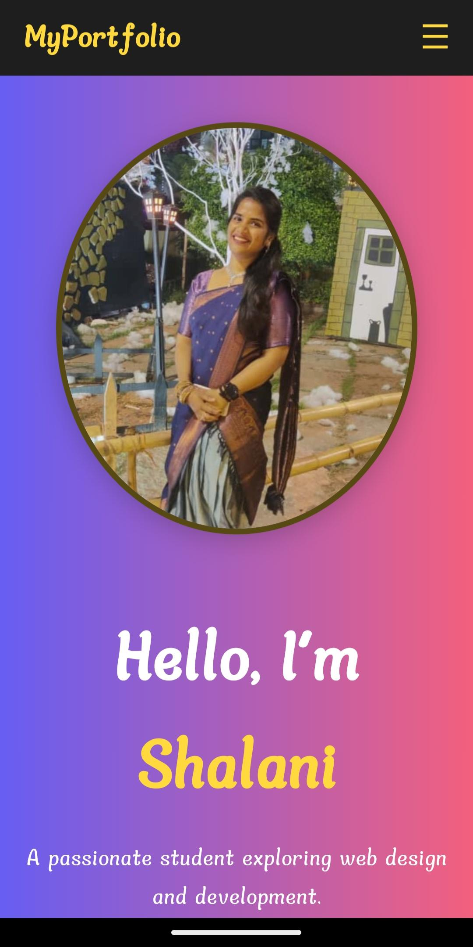
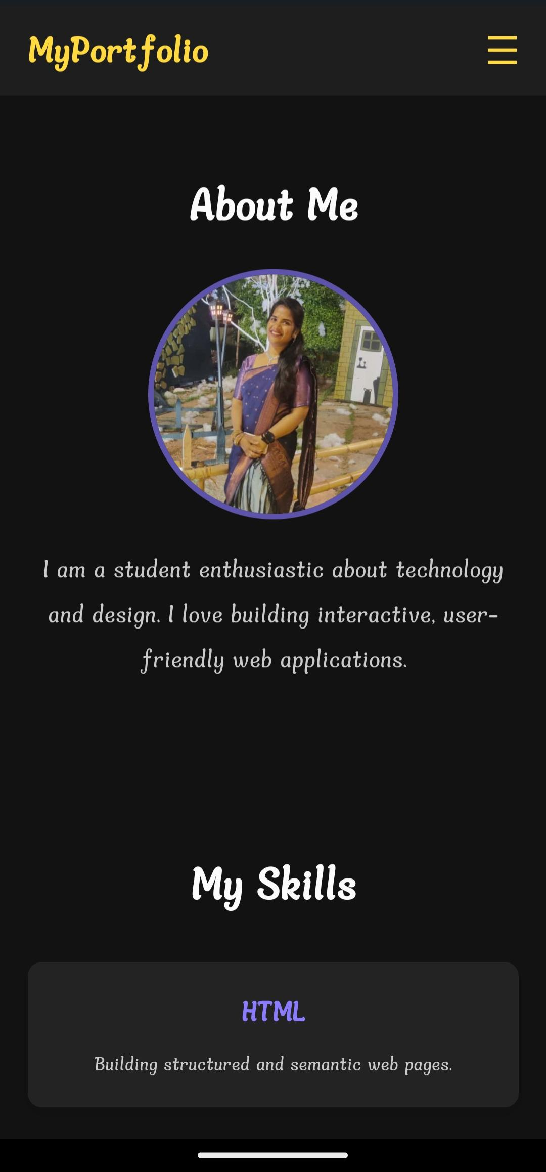
Result & Screenshots
Created a fully functional personal portfolio website

Slide 11
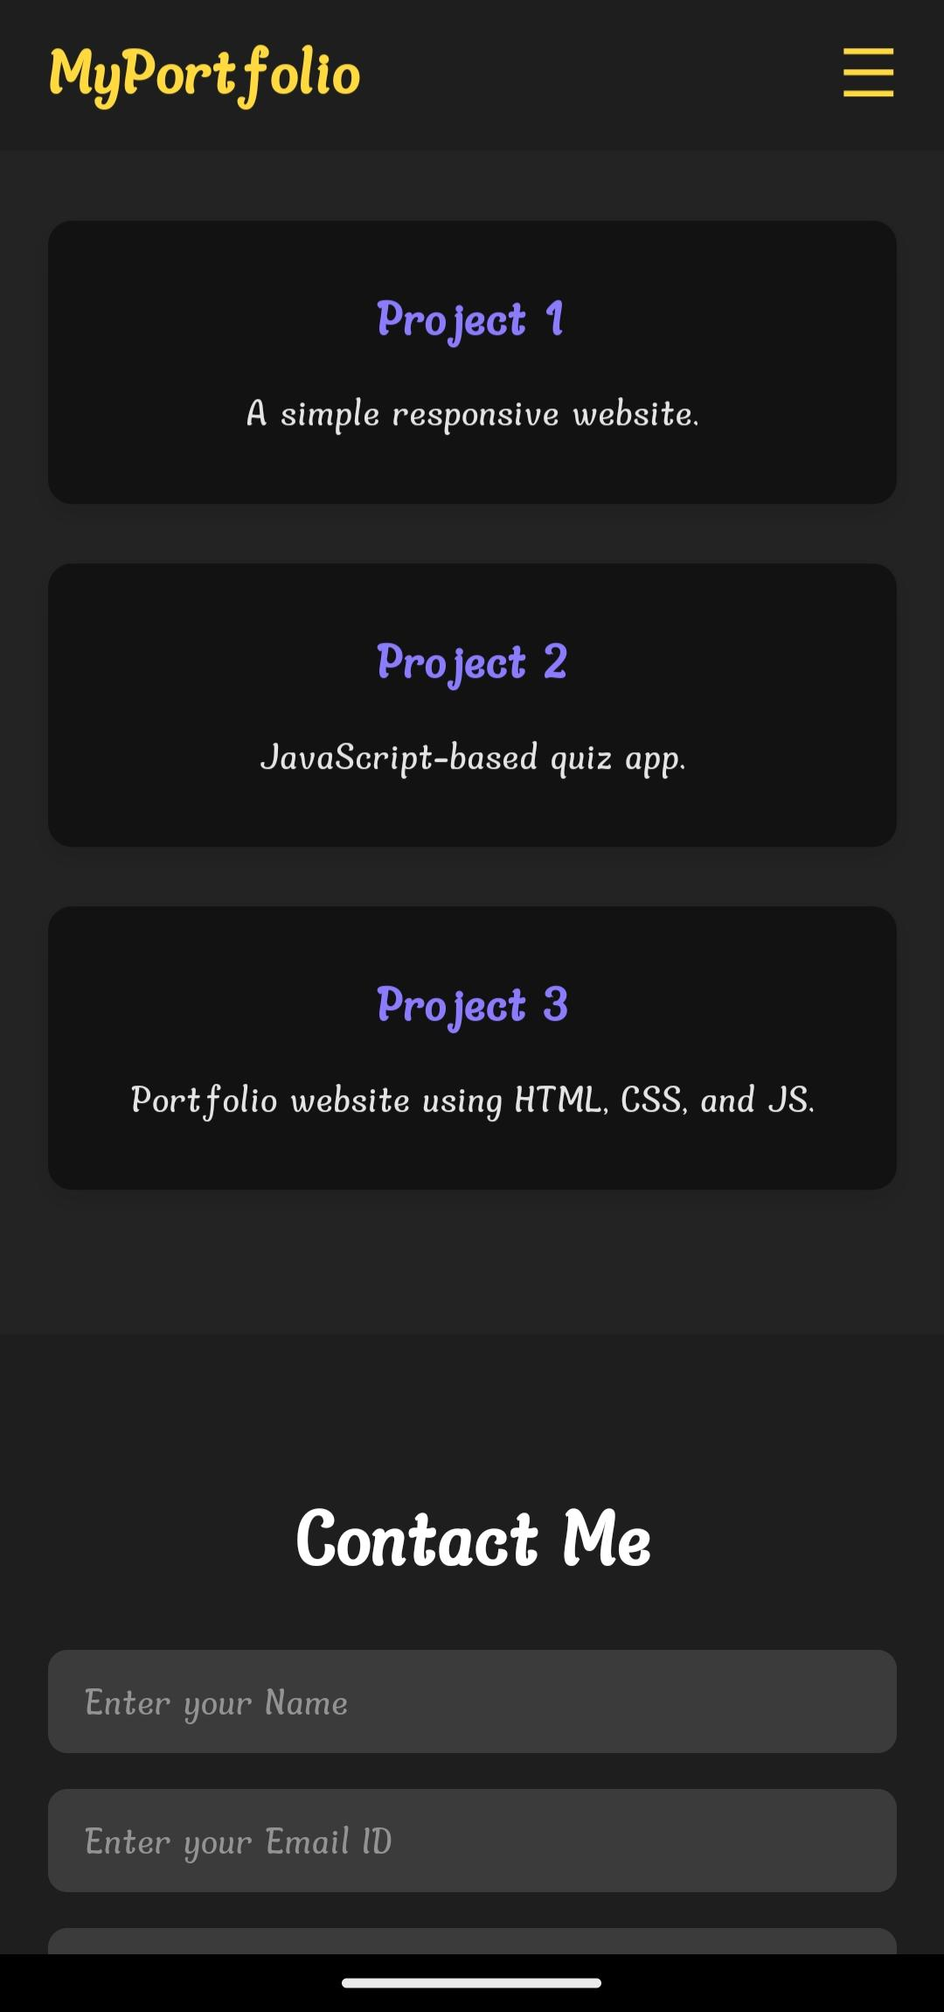
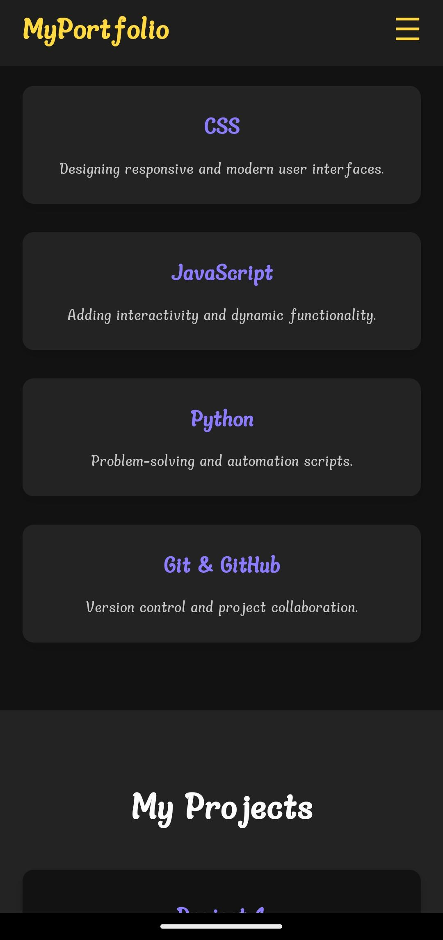
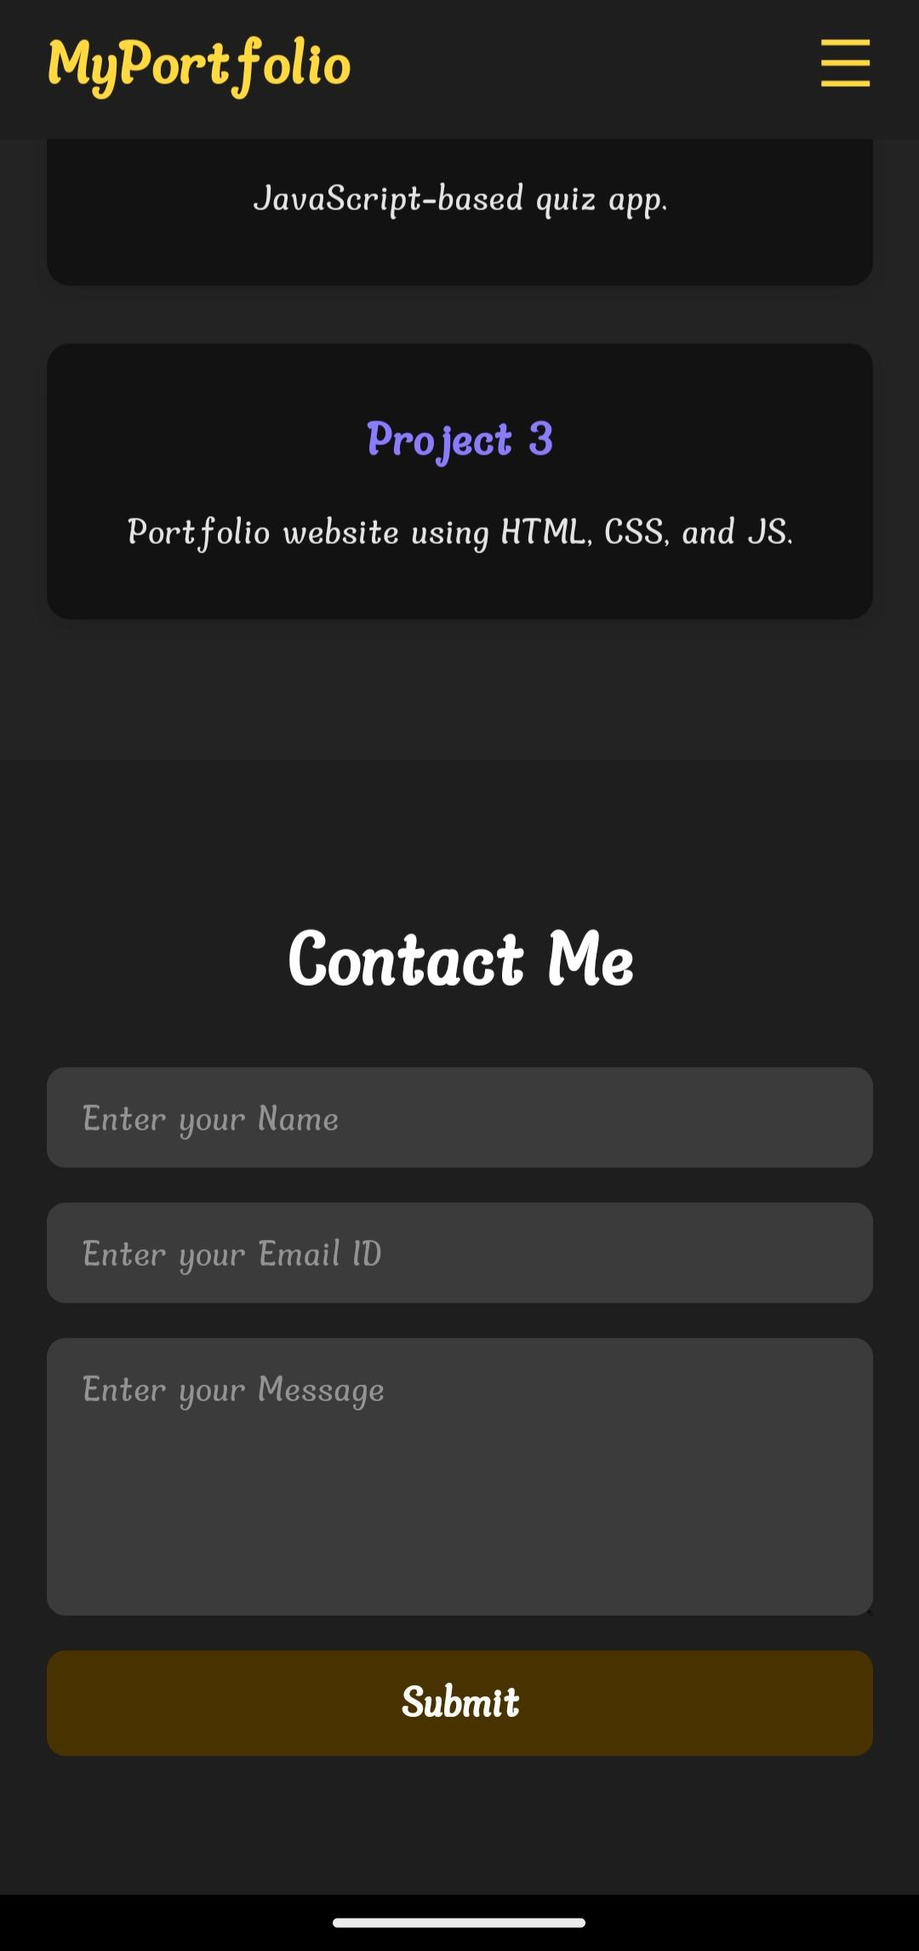

Slide 13
Conclusion
The portfolio website serves as a digital resume, enabling individuals to highlight their creativity and skills effectively. It combines technology, design, and functionality to create a strong personal brand in the digital world.

