Slide 1


Dept. of CS&E ( DATA SCIENCE)
Adichunchanagiri Institute of Technology Chikkamagaluru - 577102
Mini Project – Proposal Seminar
On
“BiblioTrack -An AI-Powered Bookstore ”
Group Number - 01
Presented By,
Harshitha S (4AI23CD019)
Prajna K S (4AI23CD038)
Ramya Manjunath Gouda (4AI23CD041)
Shalini M B (4AI23CD048)
Under the Guidance Of,
Prof.Gagana Deepa J
Asst. Professor
Dept of Data Science
AIT, Chikkamagaluru

Slide 2
AGENDA
About the Project
Motivation
Existing System
Proposed System
Problem Statement
Tools and Technology
Expected Outcomes

Slide 3
ABOUT THE PROJECT
An AI-powered bookstore for book discovery.
Personalized recommendations to every reader.
Smart visual search to find books instantly.
AI chatbot assistant for quick help and support.
Admin panel with real-time analytics and inventory tracking.

Slide 4
MOTIVATION
Managing large libraries or bookstores manually is slow and inefficient.
Readers find it hard to discover books that suit their interests or recognize them visually.
Existing online bookstore systems offer limited personalization and lack AI-driven recommendations or visual search.
BiblioTrack provides solution that enhances book discovery, streamlines management, and connects readers with sellers through intelligent insights.

Slide 5
EXISTING SYSTEM
EXISTING SYSTEM | PROPOSED SYSTEM
Relies mainly on keyword-based search. | Includes AI-powered visual search.
Basic recommendation engines often rule-based or static. | AI-driven personalized recommendations using user interests and preferences.
Focused primarily on browsing and purchasing. | Offers a intelligent discovery based on user interest and history.
Usually limited to reviews or ratings. | Introduces book clubs for interactive communication.

Slide 6
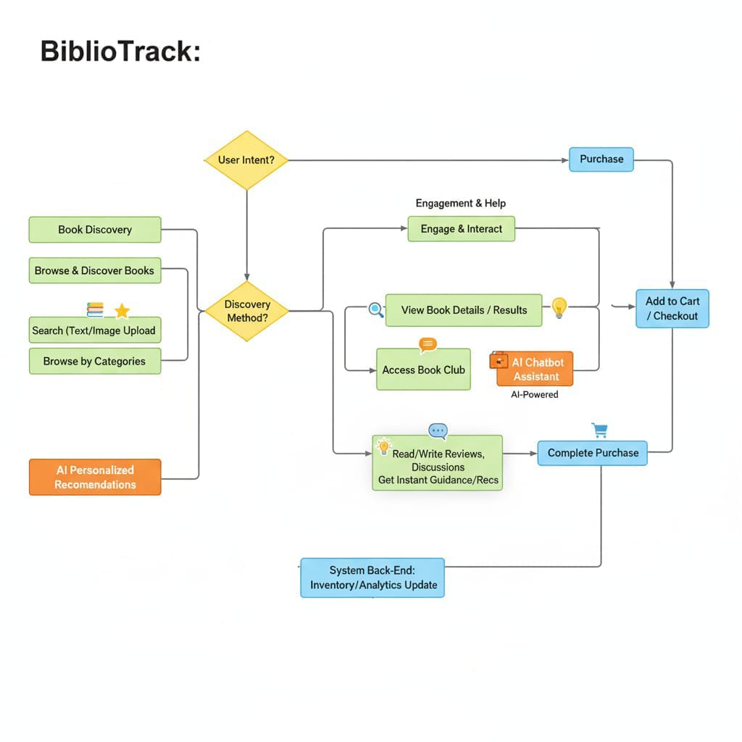
PROPOSED SYSTEM
User interface
End

Slide 7
PROBLEM STATEMENT
To design an AI-powered online bookstore that goes beyond simple search and purchase by offering smart recommendations, interactive features, and personalized book discovery for better user engagement.

Slide 8
TOOLS AND TECHNOLOGY
Frontend : HTML, CSS, JavaScript
Backend : Django Framework
Database : SQLite
AI&ML : TensorFlow.js

Slide 9
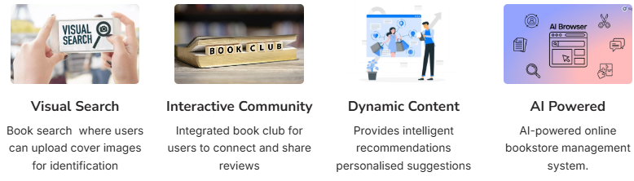
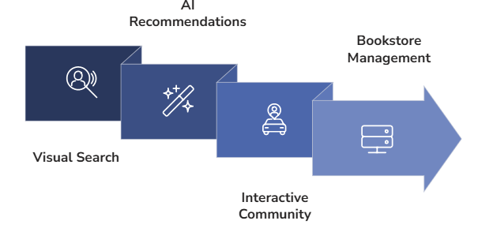
EXPECTED OUTCOMES

Slide 10
ThankYou!!!

