Slide 1

DEPARTMENT OF COMPUTER SCIENCE AND ENGINEERING
Project name : ENVIRONMENT MONITORING
Team name :Proj_224786_Team_2
Team members :
SANNAREDDY.ANUPAMA(113321104084)
SHAIK RESHMA(113321104089)
SHALINI.M(113321104090)
SHANTHI.G(113321104092)

Slide 2
Problem Statement:
In today’s rapidly changing world,there is a growing concern about the state of environment.Climate change,pollution and natural disasters are posing significant threats to our planet and the well-being of it’s inhabitants.To adress these challenges,there is a processing need for an advanced Environment Monitoring System(EMS)that can provide real-time data on key environmental parameters.This system should be capable of monitoring and reporting on factors such as air quality,temperature,humidity,water quality and more in various location and ecosystems.

Slide 3
Objectives:
Assessment Of Environmental Quality:
To evaluate the overall health and quality of natural ecosystems including air,water,soil and biodiversity.
Detection Of Pollution:
To identify and quantify the presence of pollutants,contaminants and hazardous subsatnces in the environment.
Early Warning Of Environmental Risks:
To provide timely warnings of potential environmental disasters,such as floods,wildfires,or chemical spills.
Compliance Monitoring:
To ensure that industrial and human activities are in compilance with environmental laws and regulations.

Slide 4
Protection Of Biodiversity:
To monitor and conserve biodiversity by assessing the health and populations of various species and ecosystems.
Resource Management:
To support sustainable management of natural resources such as fisheries,forests and water sources througgh data-driven decision-making.
Public Health Protection:
To safeguard public health by monitoring air and water quality to detect potential health hazards.

Slide 5
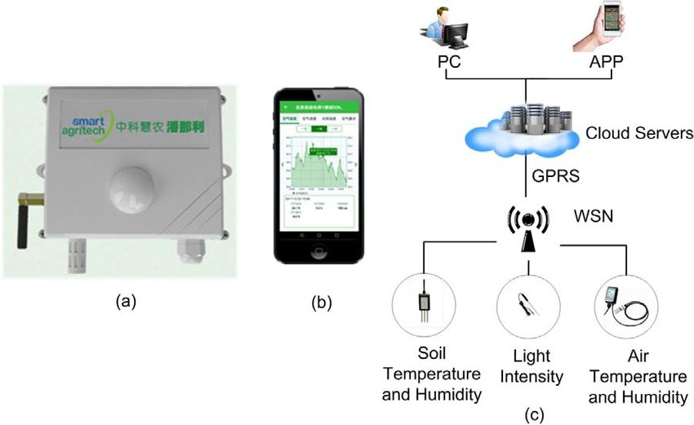
IOT SENSOR DESIGN:

Slide 6
IOT Sensors Design:
There are several IOT sensors and components that are used in Environment Monitoring.some of them are as follows:
Temperature Sensor
Humidity Sensor
Air Quality Sensor
Gas Sensor
Sound Sensor
Soil Moisture Sensor
Light Sensor
Water Level Sensor
Pressure Sensor

Slide 7
Real-Time Transit Information Platform:
Creating a real time transit information platform as part of an environmental monitoring project can be valuable for various applications,especially in urban environments.Here’s how it can be implemeted:
Data Source
Data Processing
User Interface
Environmental Insights
Communication
Integration
Accessibility
Data Security and Privacy
Continuous Improvement

Slide 8
INTEGRATION APPROACH:
List all the components, systems, or elements that need to be integrated. This can include hardware, software, processes, data sources, and external systems.
Assess Compatibility
Select Integration Technologies
Design Integration Architecture
Data Mapping and Transformation
Develop Integration Code or Configurations
Testing and Validation
Security and Logging
User Training and Documentation
Change Management
Communication and Reporting

Slide 9
THANK YOU

