Slide 1

RESTAURANT DISH DEMAND FORECASTING
Demand Forecasting for 7 days – Dish wise
Himanshu Bharati , Jaival Patel, Shalini S
PGP AI-DS Co ‘26

Slide 2
PROBLEM STATEMENT
Predict Daily Dish Demand to Optimize Inventory & Cut Waste Restaurants face frequent demand fluctuations, leading to overstocking or understocking. Our model forecasts daily dish-wise sales to help plan procurement and preparation efficiently, reducing food spoilage and improving cost control.
Enhance Predictions Using Holidays and Weather Data Demand patterns vary during holidays and with weather changes. By integrating calendar data from Calendarific using api and weather data from Open-Meteo, the model captures external influences to deliver more accurate 7-day demand forecasts.

Slide 3
PROPOSAL
Dish Forecasting System
Brief Pitch: JA-PED is a command-line interface (CLI) application powered by machine learning that classifies email content as either PHISHING or LEGITIMATE. Designed for speed, transparency, and adaptability, JA-PED is your lightweight guardian against email fraud.
Why JA-PED? In a world flooded with anti-phishing tools, JA-PED embraces simplicity and clarity, while still packing a punch with accurate predictions and real-time explanations—right from your terminal.
Special Features The application has three flexible modes that provide an explanation for the classification, tighten the detection criteria and a save mode that enables users to log results to a file for future refer

Slide 4
TECH STACK
Dish Forecasting System
Python: Core scripting and data processing
Pandas / NumPy: Data cleaning, transformation, and manipulation
Matplotlib / Seaborn: Data visualization
Scikit-learn: Machine learning model evaluation and preprocessing
XGBoost: Advanced regression model for demand forecasting
Open-Meteo API: Historical weather data for demand influence
Calendarific API: Public holiday data for seasonal trend tracking
Streamlit: Lightweight interactive web app for dashboard and user interface
Excel / CSV: Data import/export and manual inputs
Pickle / Joblib: Model serialization
Local File Storage: JSON/CSV for weather and holiday cache

Slide 5
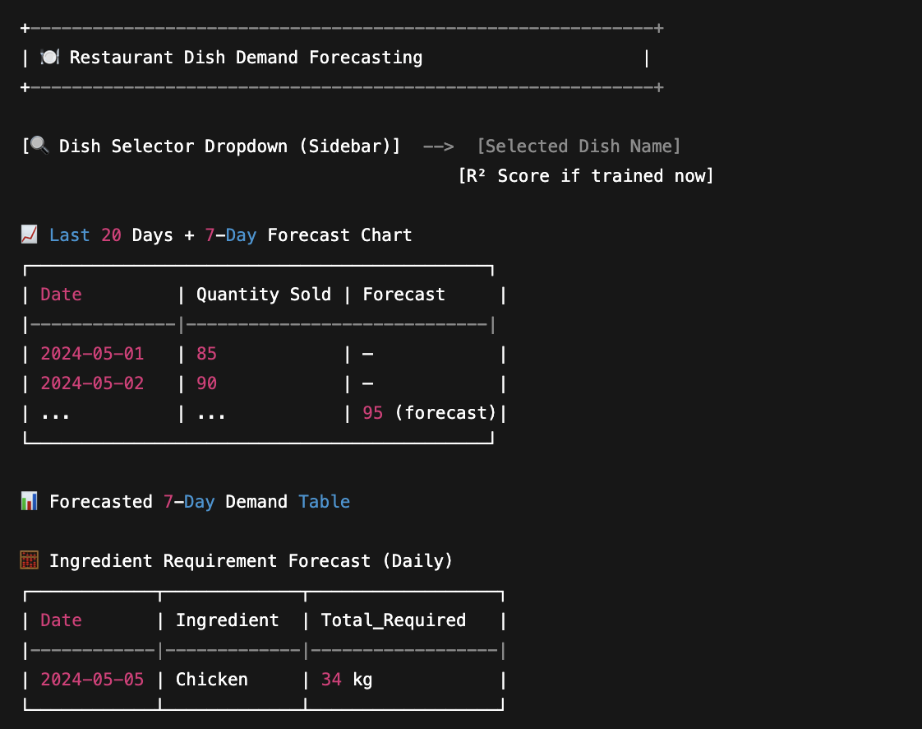
PRE-ALPHA SKETCH
Dish Forecasting System
Below is an expected flow and visualization of the application output.

Slide 6
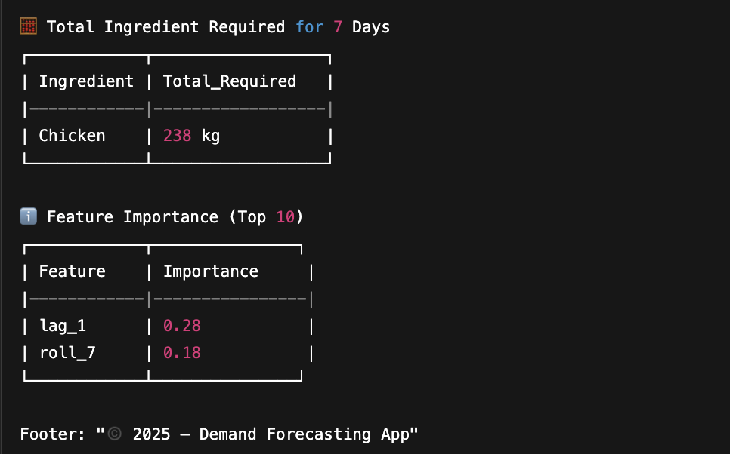
PRE-ALPHA SKETCH
Dish Forecasting System
Below is an expected flow and visualization of the application output.

Slide 7
PROJECT PHASES
Dish Forecasting System
Phase 1: Data Collection & Integration Data was sourced from multiple Excel files covering sales, production, and recipes. These were cleaned and merged into a unified SQLite database, allowing smooth querying and efficient data access across all modules.
Phase 2: Feature Engineering We derived key features such as day of the week, month, weekend flag, and sales lags. Rolling averages and sales differences were added to capture trends, while weather and holiday data enriched the dataset for external influence.
Phase 3: Model Development A Random Forest model was trained on the engineered dataset using an 80-20 split. Hyperparameters were optimized with RandomizedSearchCV, and performance was evaluated using MAE and R² metrics, ensuring accurate predictions.

Slide 8
PROJECT PHASES
Dish Forecasting System
Phase 4: Forecasting & Ingredient Mapping The model generates 7-day forecasts using a recursive strategy. Forecasted sales are mapped to ingredient quantities using recipe data, enabling precise inventory planning for the upcoming week.
Phase 5: Streamlit Application An interactive Streamlit app was built for real-time insights. Users can select dishes, view forecasts, and check ingredient requirements in a clean, visual format. The app loads saved models or retrains on demand.

Slide 9
APPLICATION
Dish Forecasting System

Slide 10
FUTURE SCOPE
Dish Forecasting System
Lightweight GUI Development Build a simple, optional graphical interface so non-technical users can easily interact with JA-PED without using the command line.
Multilingual Phishing Detection Expand the model to handle phishing emails written in major languages like Hindi, Spanish, or French, making JA-PED accessible to a wider audience.
Real-Time Email Client Integration Enable JA-PED to plug into email platforms (like Outlook or Gmail via API) for instant phishing detection as emails arrive.

Slide 11
THANK YOU

