Slide 1
Multibeam Time domain technique for RFI mitigation.
Shalini Sengupta
Advisor: David Champion.
FPRA group meeting talk : 23.03.2021

Slide 2
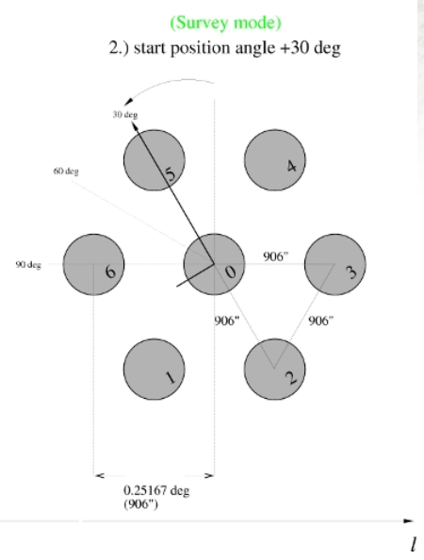
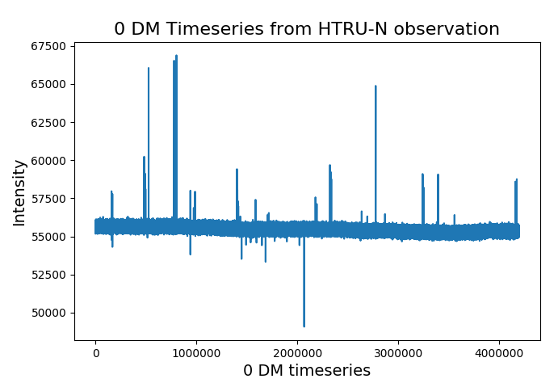
Key Ideas:
Credit: R.P. Eatough
Time in sec
RFI appears in multiple beams.
Assuming same time of incidence of RFI entering the multibeam receivers, a spatial filtering system is applied.
Sample by sample comparison is done for 0 DM timeseries of each of the 7 beams to flag samples affected by RFI in >= 4 beams.
7 beam map of 21 cm receiver at Effelsberg.

Slide 3
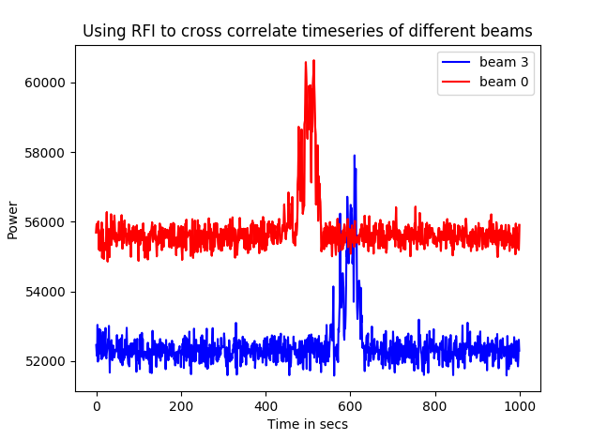
Challenges:
The 7 beam servers at Effelsberg do not start at the same time.
Simultaneous occurrence of RFI in multiple beams.
↓
Strong cross correlation between the 0 DM timeseries of different beams.
↓
Based on lead/lag values from cross correlation, absolute reference for comparing time samples between beams for RFI mitigation is decided.
⁷C₂ combinations of correlations performed to get mutual delays.

Slide 4
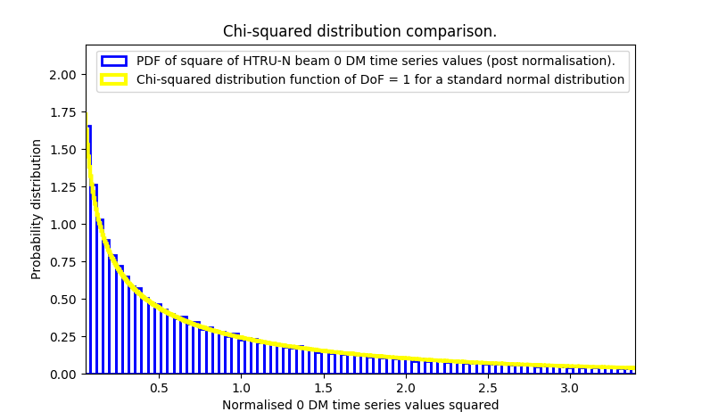
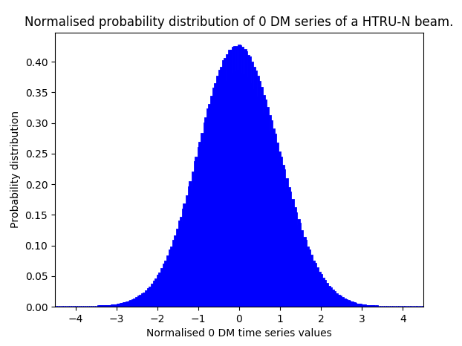
Probability distribution to decide thresholds

Slide 5

Thresholding and Implementation
Assuming Gaussian distribution for each beam, the cumulative probability distribution is :
Using 1 - error function, the probability that a particular bin exceeds the threshold in n beams simultaneously is 1, threshold for flagging is decided (false alarm).
The no. of simultaneous beams, n takes values 4, 5, 6, 7. Lowest threshold is for 7 beams.
With mutual delays calculated respective to a reference beam, time bins exceeding respective thresholds in 4 or 5 or 6 or 7 beams simultaneously are flagged.

Slide 6
A beam specific list of time bins having outliers is prepared.
For each outlying time bin, the values of the 512 frequency channels are replaced with median distribution of noise from neighbouring ‘good’ bins in the original filterbank file.
On average 0.05 - 0.09 % of time bins (having in total 2**25 time bins) are flagged this way.
To account for the non-transitive property of correlation, the reference beam is rotated form the 0th to 6th beam taking care of the dynamic RFI environment between the beams.

Slide 7
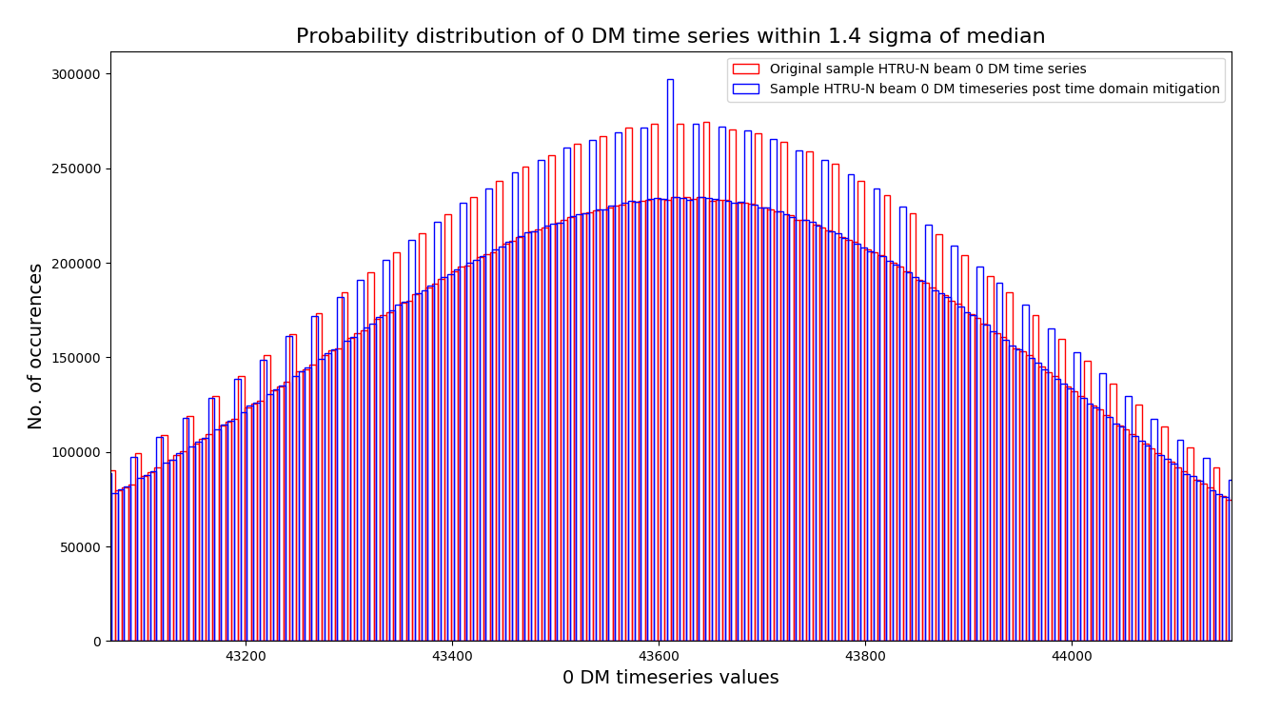
Results and Discussions:

Slide 8
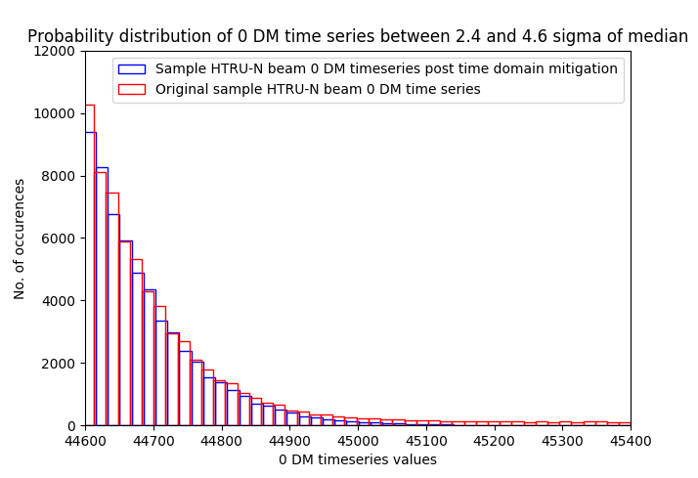

Slide 9
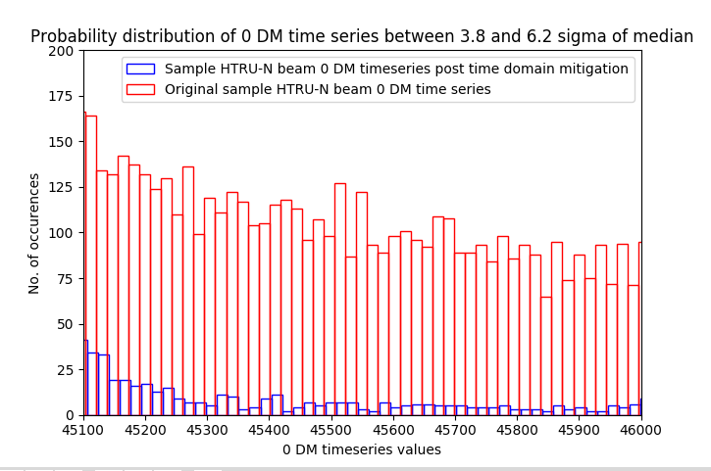

Slide 10
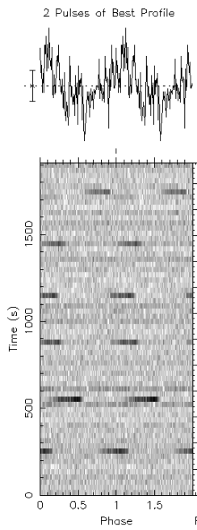
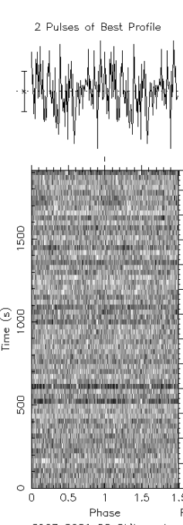
Sample time-phase plot pre and post zap. .
Notes:
Time phase plot of a rfi candidate plot found in the search that was folded. Right said is the same filterbank fodled at the rpevious avbleus post time domain cleaning

Slide 11
Improvements in Search pipeline:
The no. of fourier bins zapped from multibeam fourier domain RFI mitigation goes down by 50-75% on average.
Improved spectral significance resulting in going up the candidate list in the search for DMs near the known pulsar candidate. More DM detections.
Improved sifting of candidates (more folds of desired candidate).
Leading to detection of test pulsars in the segmented filterbank’s sifted candidate list which were not appearing before!

Slide 12
CONCLUSION:
Among observing frequency domain mitigation, fourier domain mitigation, and time domain mitigation, latter has given the most improvement to the search pipeline.
Currently being used for HTRU-N. Will soon be implementing this for the L-band survey for MeerKAT.
THANK YOU.

