Slide 1
Customer Purchase
&
Revenue Analysis

Slide 2
Customer Purchase & Revenue Analysis
Customer Data Analysis Project (2021–2023)
Internship Project

Slide 3
Project Objective
• Analyze customer purchasing behavior
• Identify revenue-generating segments
• Understand payment preferences
• Provide business insights

Slide 4
Dataset Overview
• 10 shopping malls in Istanbul
• Period: 2021–2023
• Attributes: Gender, Age, Category, Revenue, Payment Method

Slide 5
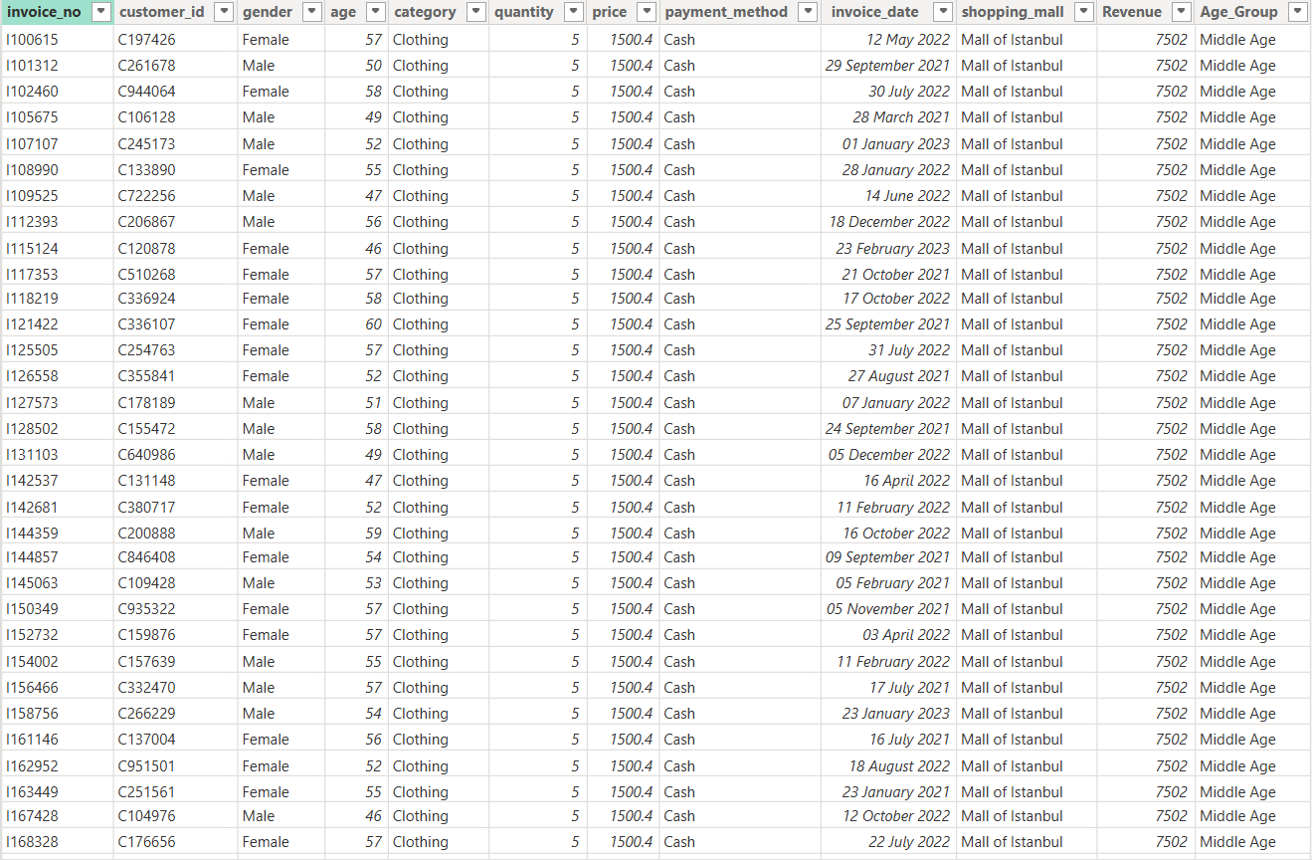

Slide 6
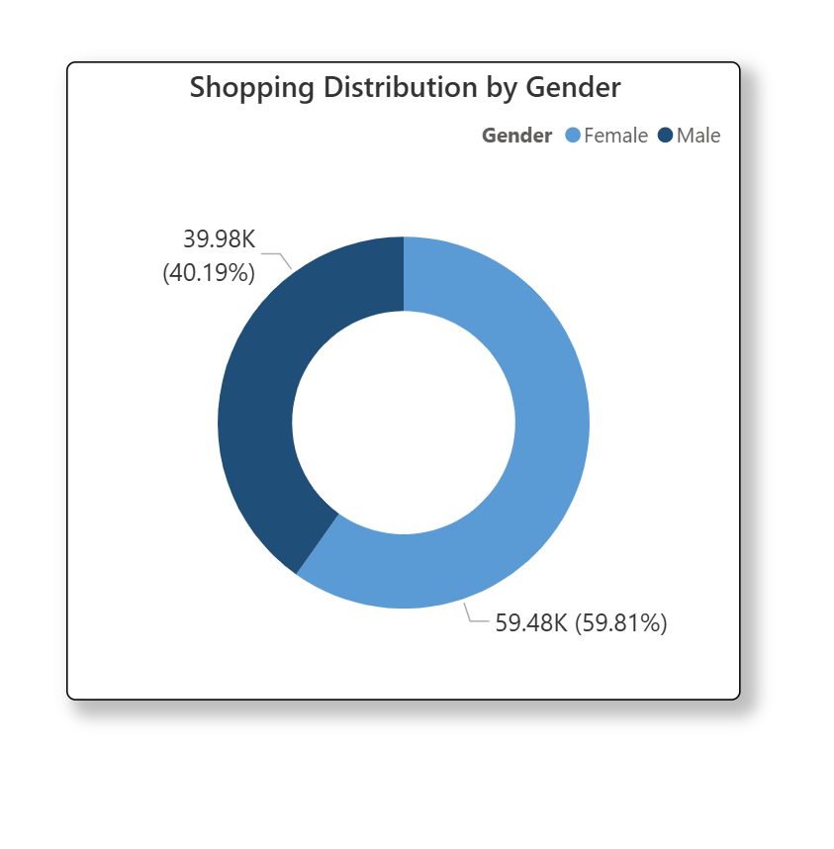
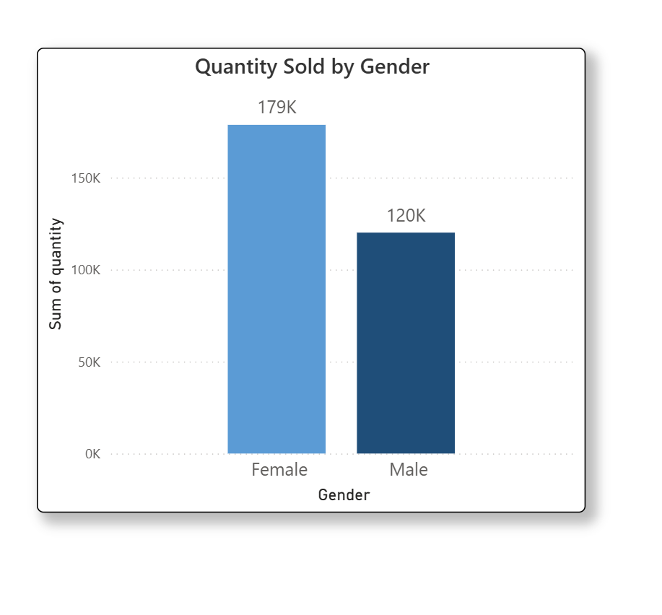
Gender-Based Analysis
• Female customers generate higher revenue
• Higher purchase quantity by females

Slide 7
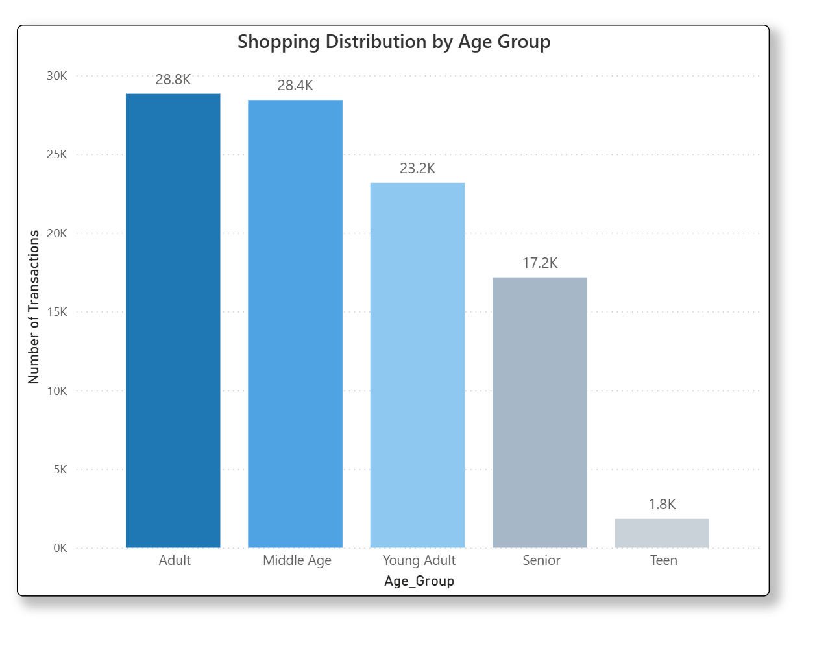
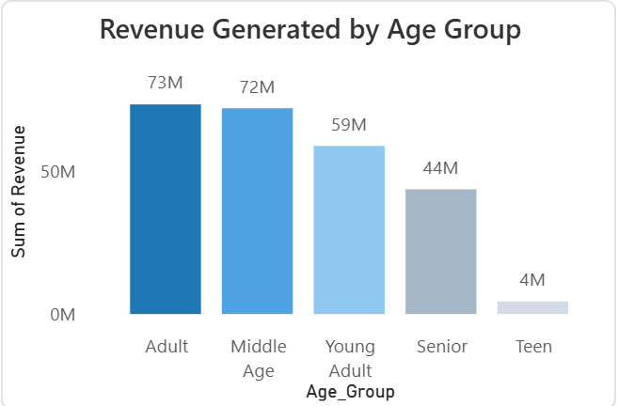
Age Group Analysis
• Adult & Middle-Age are core customers
• Teen segment contributes minimally

Slide 8
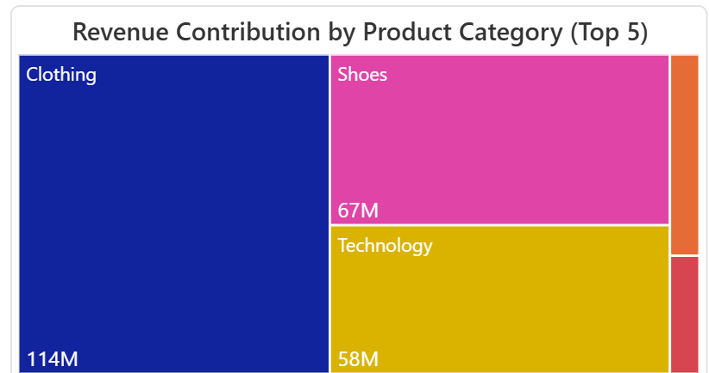
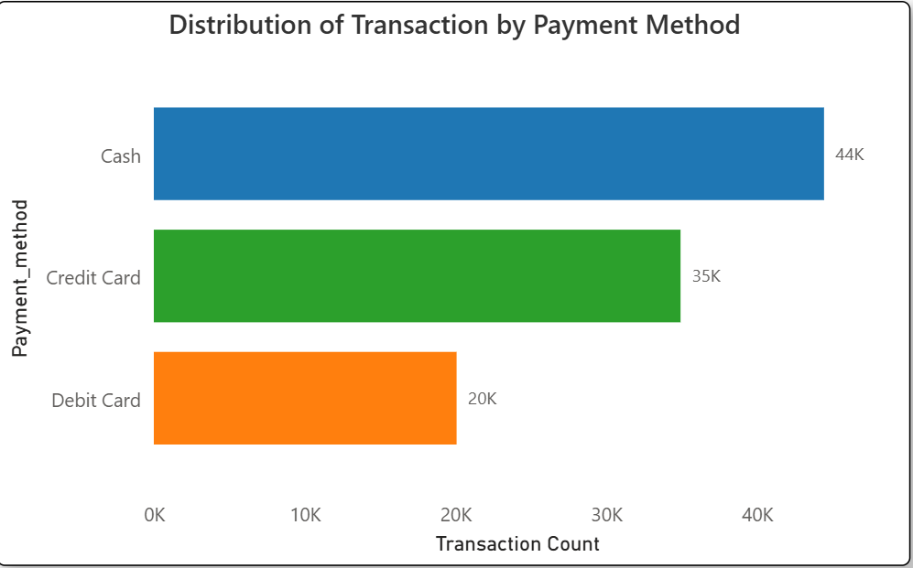
Category & Payment Analysis
• Clothing is top revenue category
• Cash is most preferred payment method

Slide 9
Final Insights & Suggestions
• Focus marketing on Adult & Middle-Age groups
• Expand clothing promotions
• Encourage digital payments

Slide 10


