Slide 1
Purchase Pattern Analysis
Market Basket Analysis Report

Slide 2
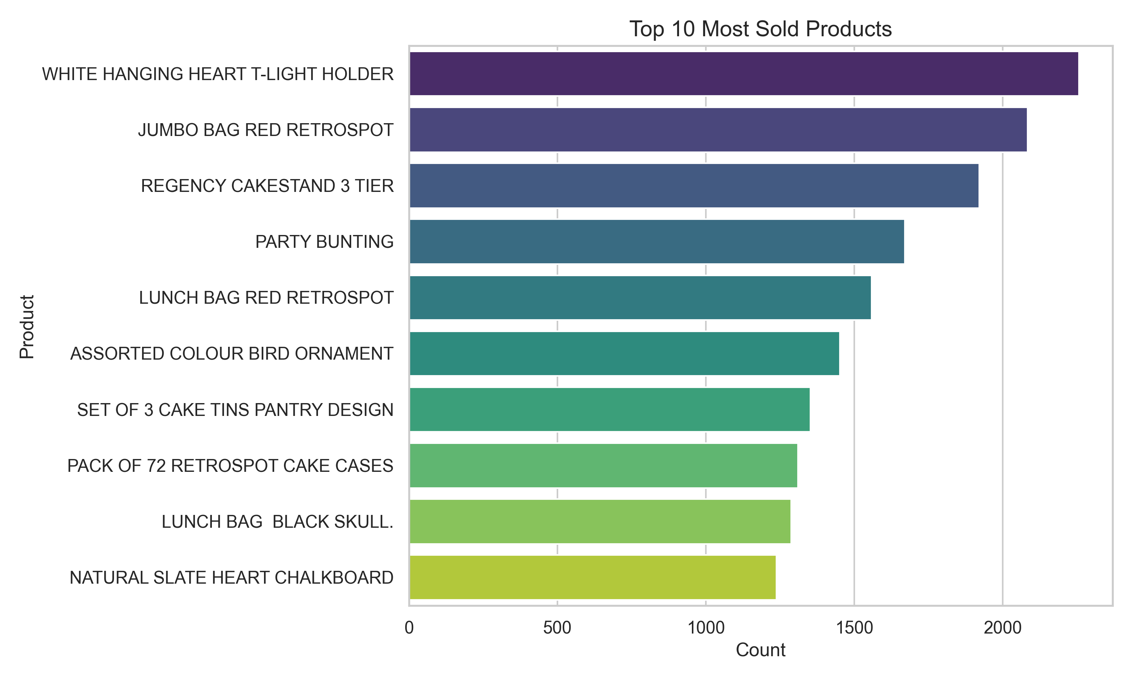
Top Selling Products

Slide 3
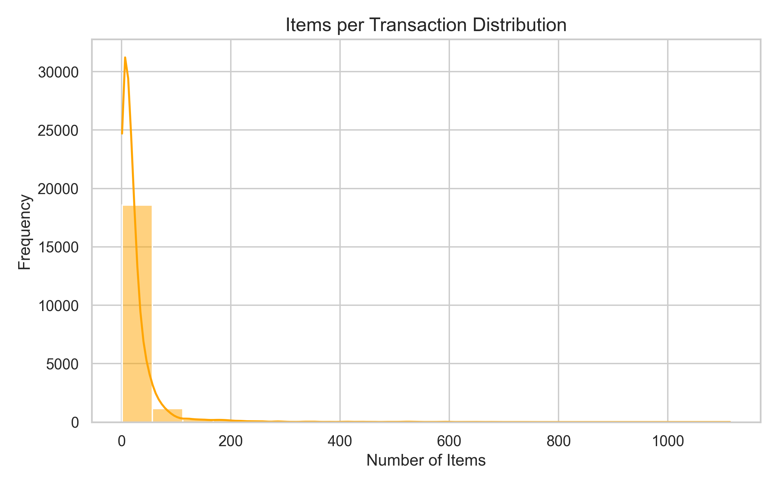
Items per Transaction Distribution

Slide 4
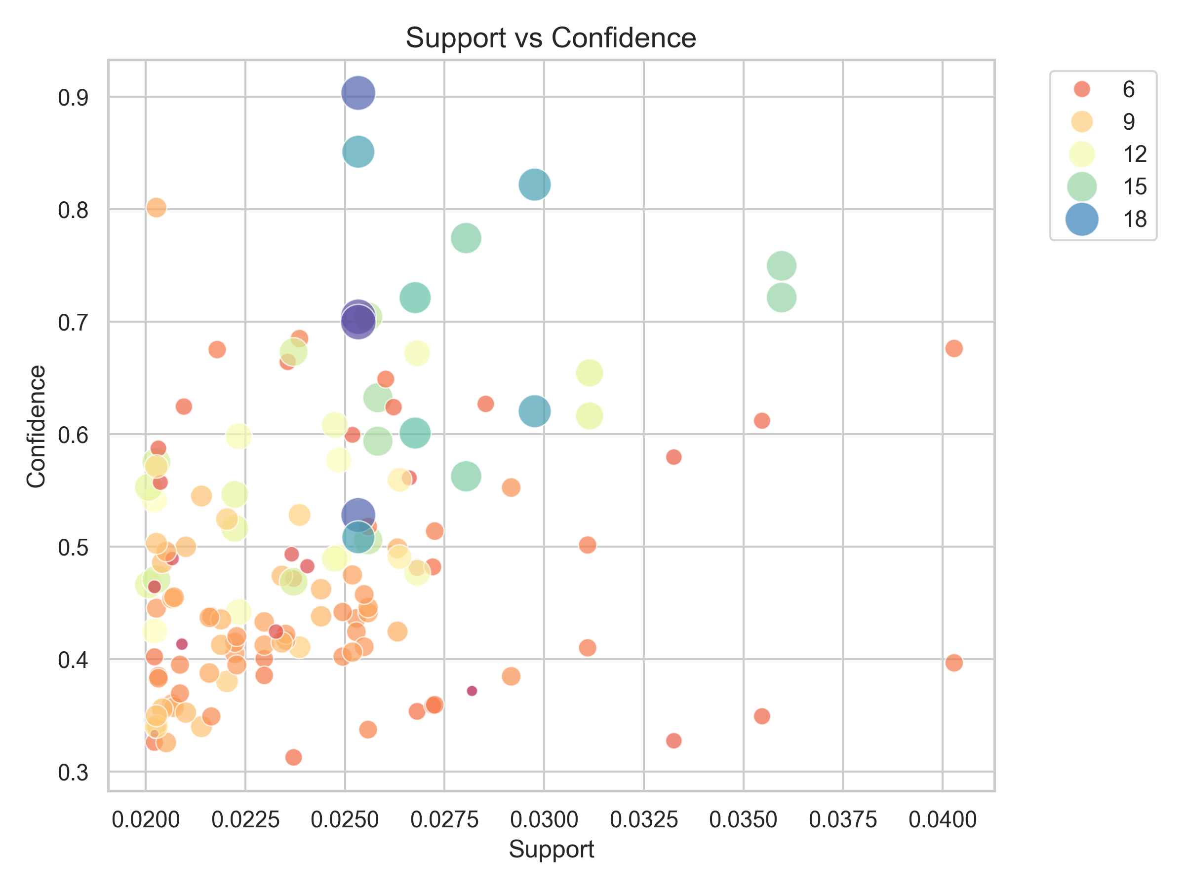
Support vs Confidence Analysis

Slide 5
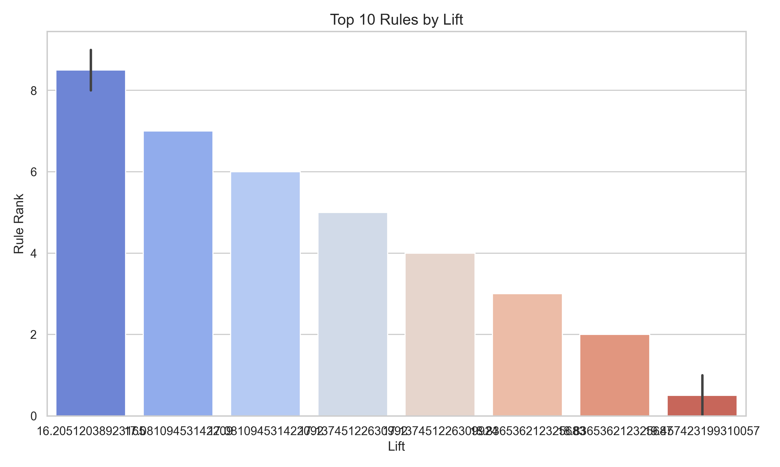
Top 10 Rules by Lift

Slide 6
Key Business Insights
• Most transactions contain small number of items
• Strong association rules identified with lift > 5
• High confidence rules (>80%) indicate bundling opportunities
• Cross-selling strategy recommended for high-lift product pairs

