Slide 1
UBER ASSIGNMENT SUBMISSION
Presented by Shalini

Slide 2
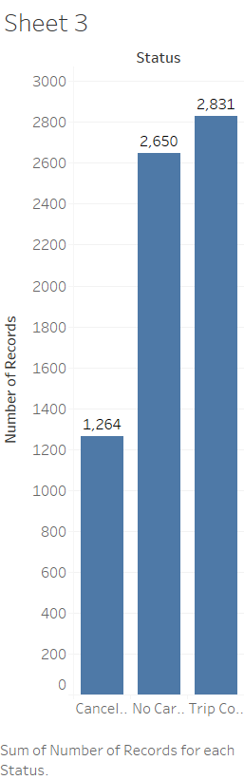
Total Status of Taxi Trips
The combination of No cars available(2650) and cancelled(1264) is 3914 which is more than trip completed(2831), This shows a high unmet demand for uber because of no availability of cars and cancellations

Slide 3
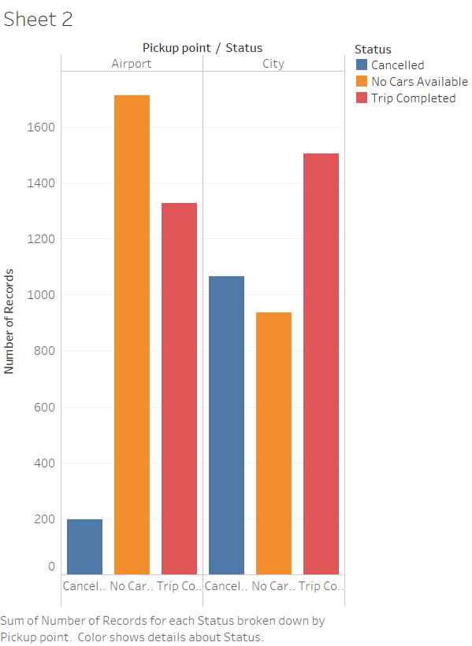
Trips From and To Airport
This shows there is more non availability of cars in Airport compared to trip completed and cancelled
There are more cancellations from City to Airport than Airport to City which means drivers are not interested to go Airport as they may not get any in return trip.

Slide 4
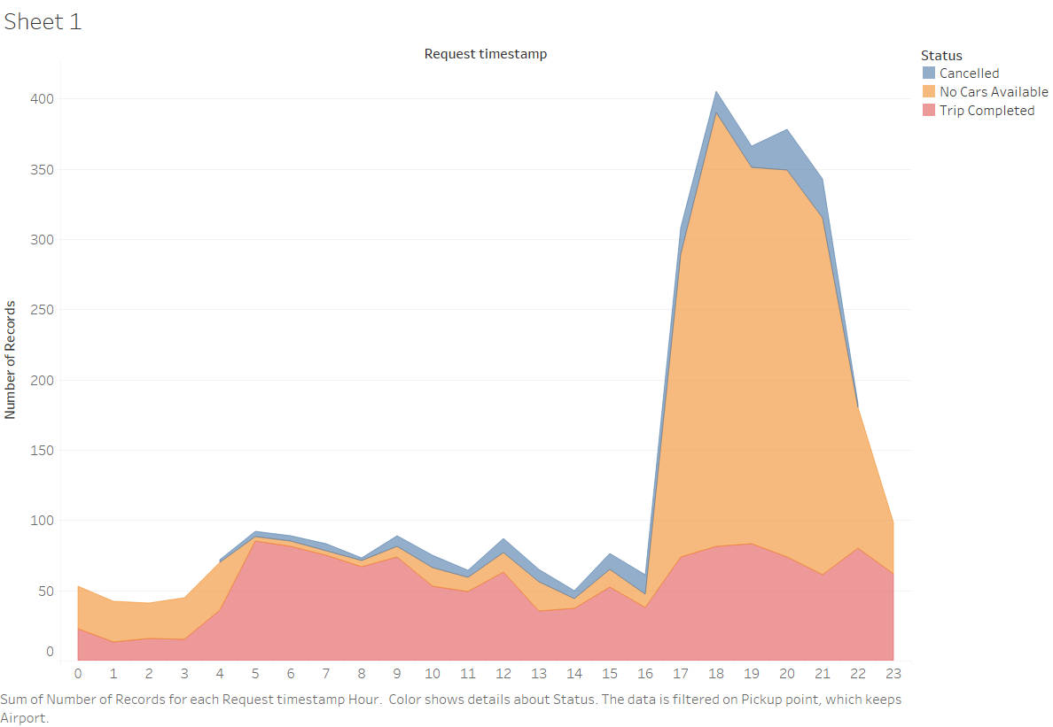
Trip distribution Hour-by-Hour from Airport to City
There are more non availability of Taxis in Airport in Evenings(4pm-11pm)
Trips completed and cancelled are same at all times, it clearly shows a high demand in evenings in Airport
The supply is almost same in all time slots

Slide 5
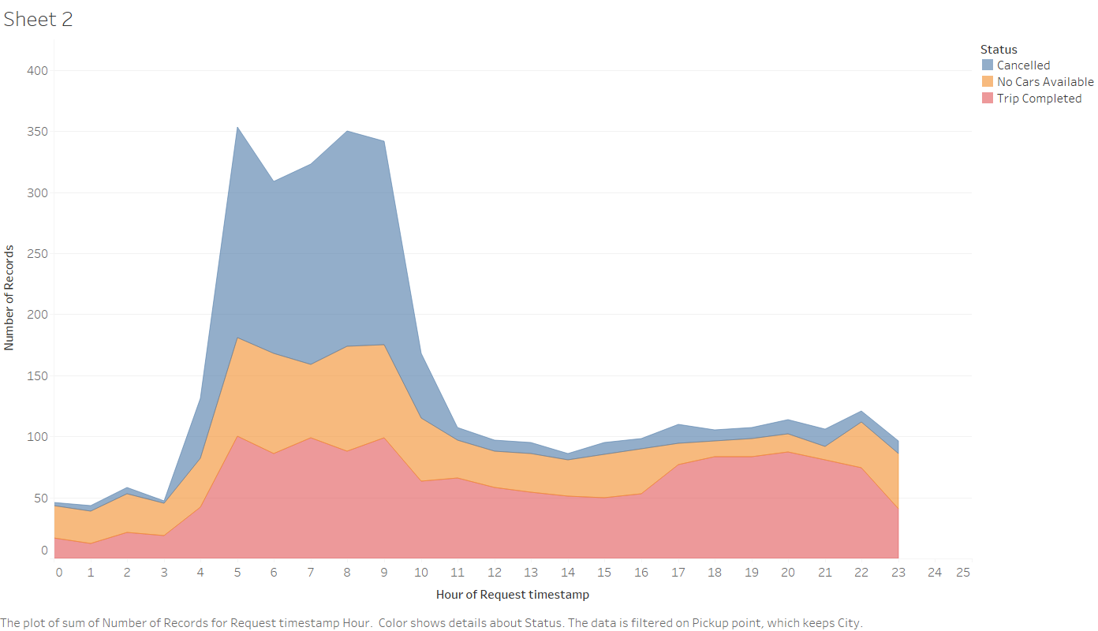
Trips distribution hour by hour from City to Airport
There are more cancellations and non availability of cars in mornings from 4am – 10am From City to Airport, it means more demand in the mornings to go to Airport.
This can be addressed by uber by providing Special Airport Taxis from city to Airport in this time slot.

Slide 6
Recommendations
From Airport
There are more non availability of Taxis in Airport in Evenings(4pm-11pm) which means a huge unmet demand of Taxis in Airport in Evenings(4pm-11pm)
It may be because of more Arrival flights in this time and it can be addressed by Uber by providing More Number of taxis in Airport in the evenings in between 4pm – 11pm
To Airport
There are more cancellations and non availability of cars in mornings from 4am – 10am From City to Airport, it means more demand in the mornings to go to Airport.
The more cancellations from city in morning hours also shows means drivers are not interested to go Airports in this slot as they might afraid of not getting return trip from airport
It may be because of more departures in this time. This can be addressed by uber by providing Special Airport Taxis from city to Airport in mornings between 4am – 10am .

