Slide 1
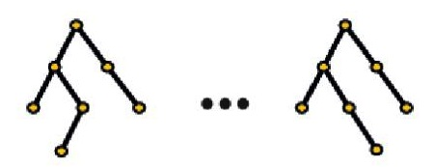
Response
Global Proteomics
Model protein as function of other proteins
Model protein as function of other proteins
For each edge (j,k), take average to find final score G_{j,k}, i.e.,
(A_{j,k} + B_{j,k})/2
k
k
Final Weights
Global
Proteomics
j
A_{j,k}
j
B_{j,k}
Protein J-th
Model phospho site 1 as function of other tumor protein phospho sites
Model phospho site 2 as function of other tumor protein phospho sites
Phospho Sites
Tumor Phospho
Proteomics
k
k
For each edge (j,k), take average to find final score H_{j,k}, i.e.,
(C_{j,k} + D_{j,k})/2
and I_{j,k}, i.e.,
(E_{j,k} + F_{j,k})/2
Site 1
j
C_{j,k}
j
D_{j,k}
Site 2
Model phospho site 1 as function of other notmal protein phospho sites
Model phospho site 2 as function of other normal protein phospho sites
Normal Phospho
Proteomics
k
k
Site 1
j
E_{j,k}
j
F_{j,k}
Site 2
The three tree ensembles use the same protein for the splitting rules
Randomly sample M proteins
For each
k
in
S
Split node based on protein K=K* which minimizes
U₁(K) + U₂(K) + U₃(k)
S
- For the Global proteomic tree, find the best splitting rule (minimize node impurity) based on protein k. Impurity = U₁(k)
- For Phospho trees, find the best splitting rule based on the phosphosites of protein k. Choose the phosphosites with the best splitting rule. Impurity = U₂(k) and Impurity = U₃(k)
?
?
?
?
?
?
Global Proteomics
Tumor Phospho
Proteomics
Normal Phospho
Proteomics

