Slide 1
Sleep signature project
Goals:
I) Demonstrate sleep state is encoded in gene expression matrix
II) Find subset of genes encoding this state (~feature selection)

Slide 2
1) Decode state from gene expression
Data generation:
Monitor animals with ethoscope platform > sample @ diff ZT and cond > SCS > analysis with Kris Davie’s scanpy pipeline (documented on his notebook) > .h5ad import
Proposal:
Train MLP with different architectures on the same datasets:
6 different clusters: y, ab, abp, AST, EG, SG
Consider:
* 1 timepoint (ZT20) → remove circadian effects
* 2 conditions (sleep vs sleep deprivation) → simplicity
* 2 DGRP lines (303 and 88) → minimise DGRP effec
https://github.com/shaliulab/SleepClassifier/blob/master/notebooks/01-20210715_skMLP.py.ipynb

Slide 3
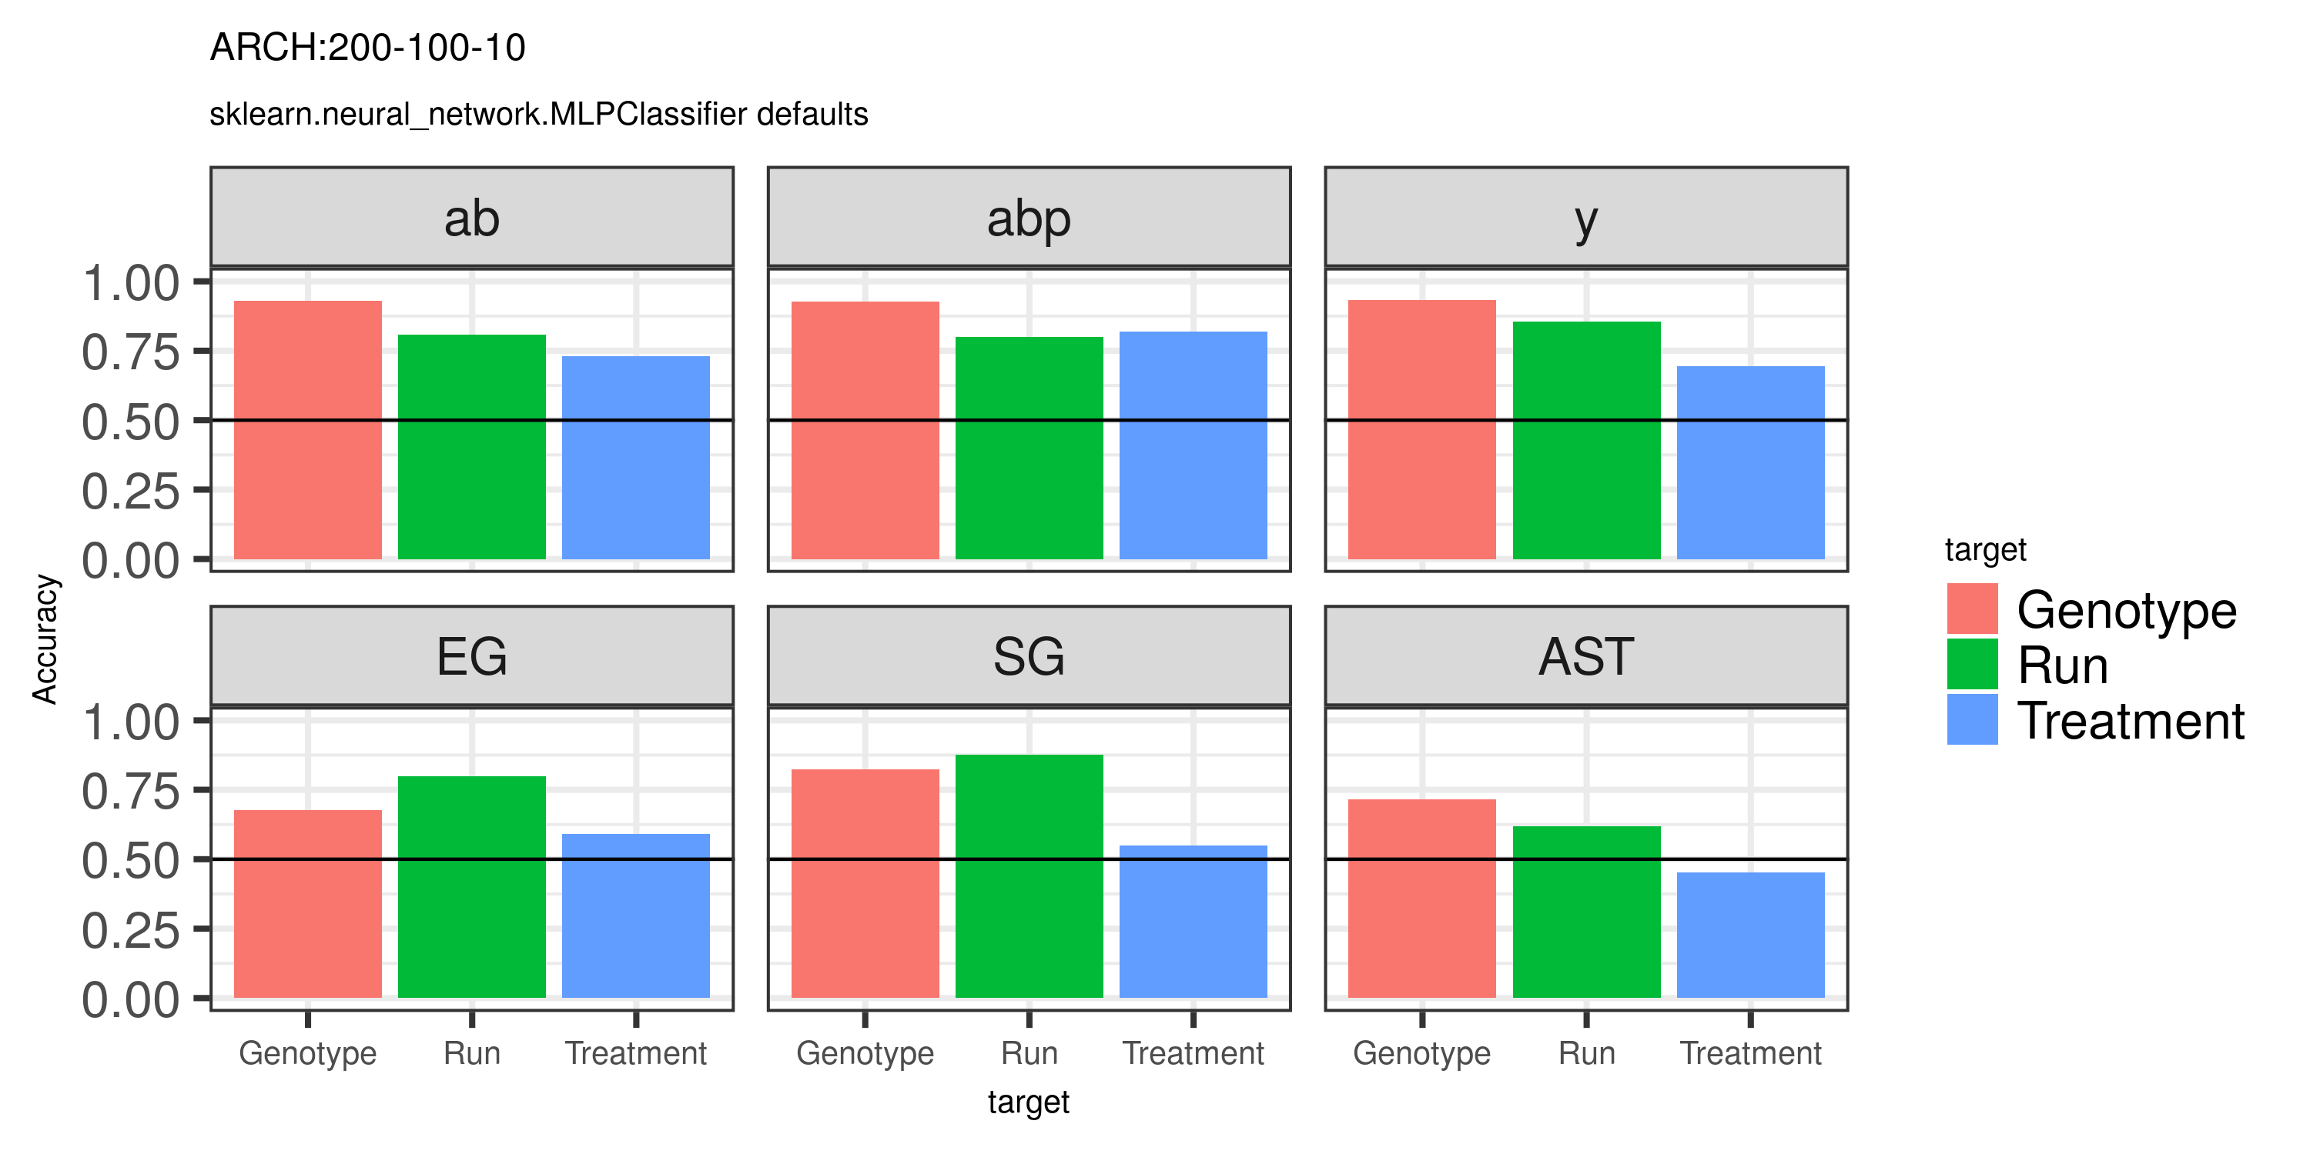
1) Decode state from gene expression

Slide 4
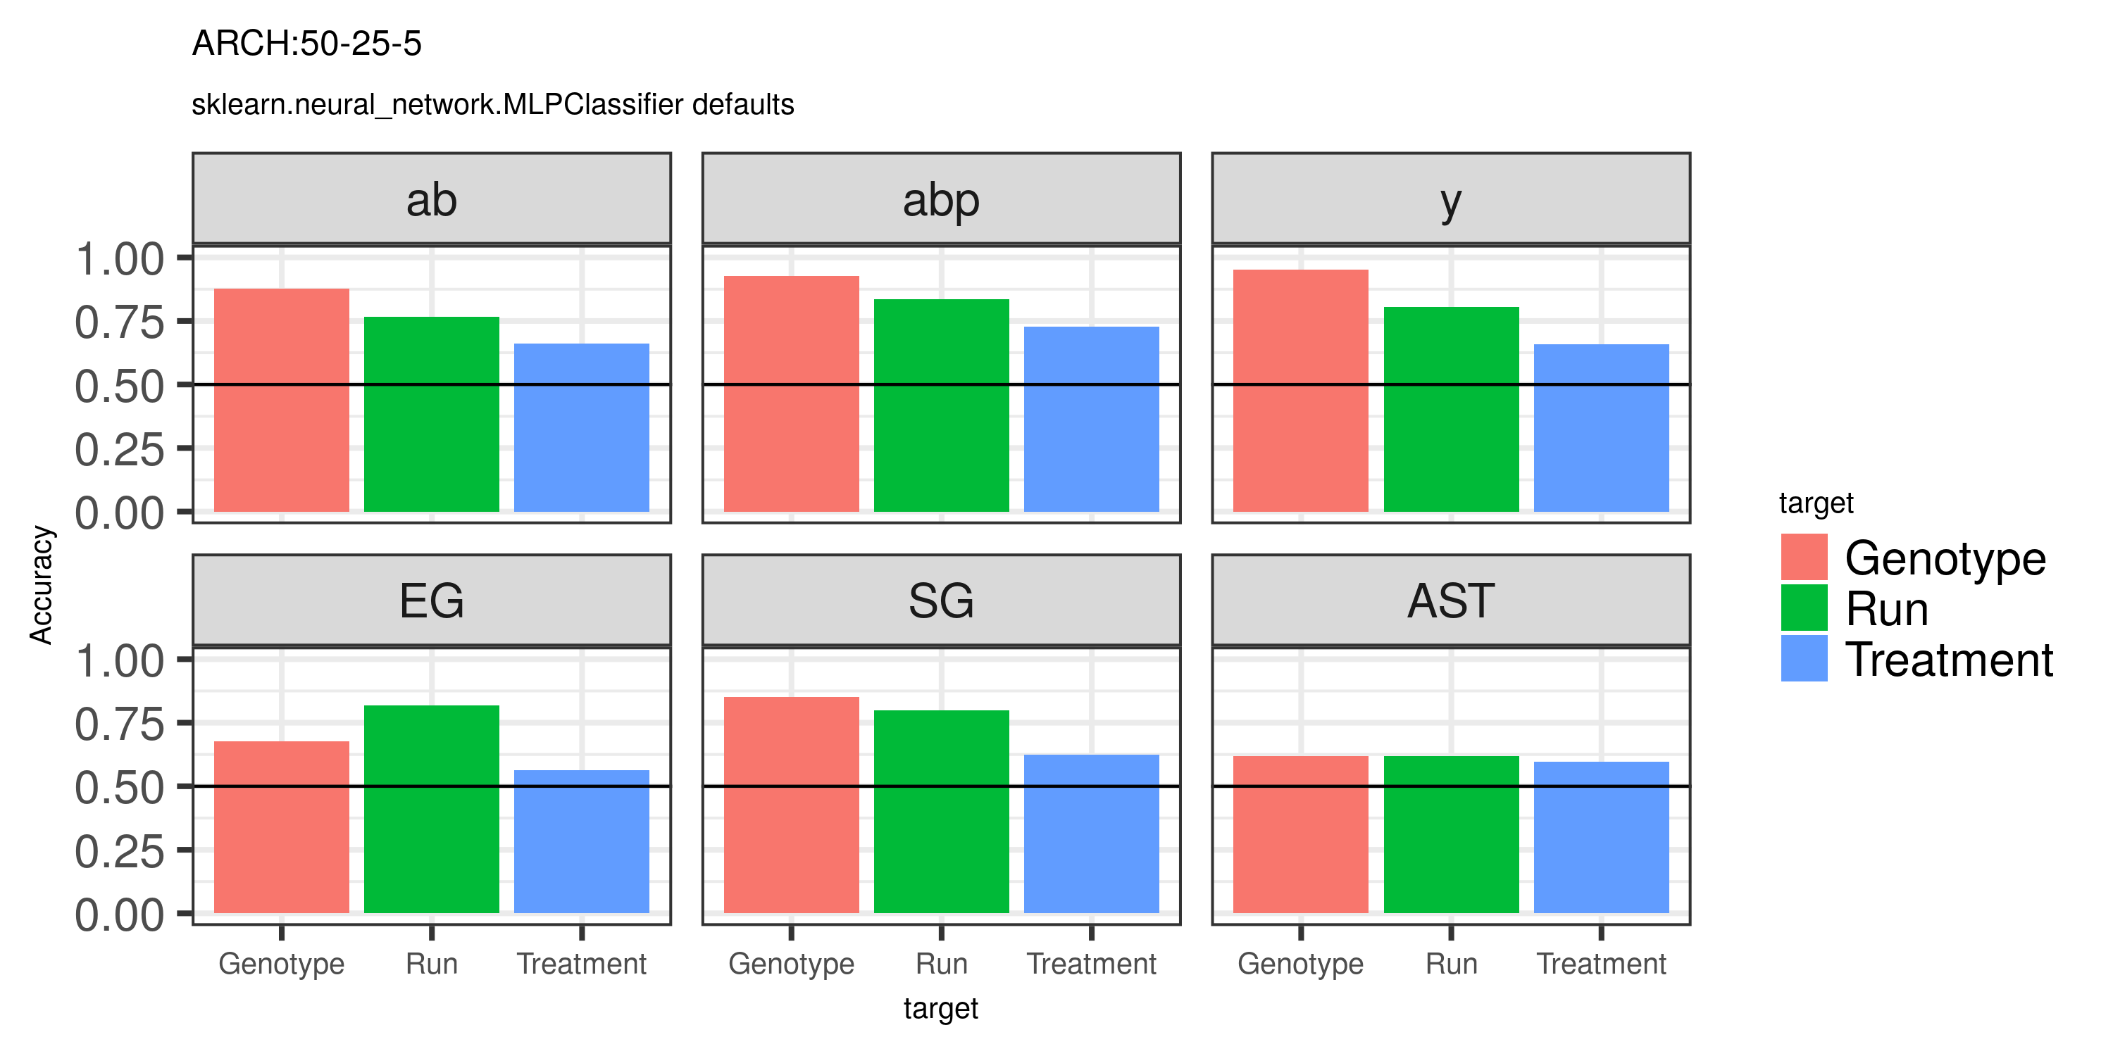
1) Decode state from gene expression

Slide 5
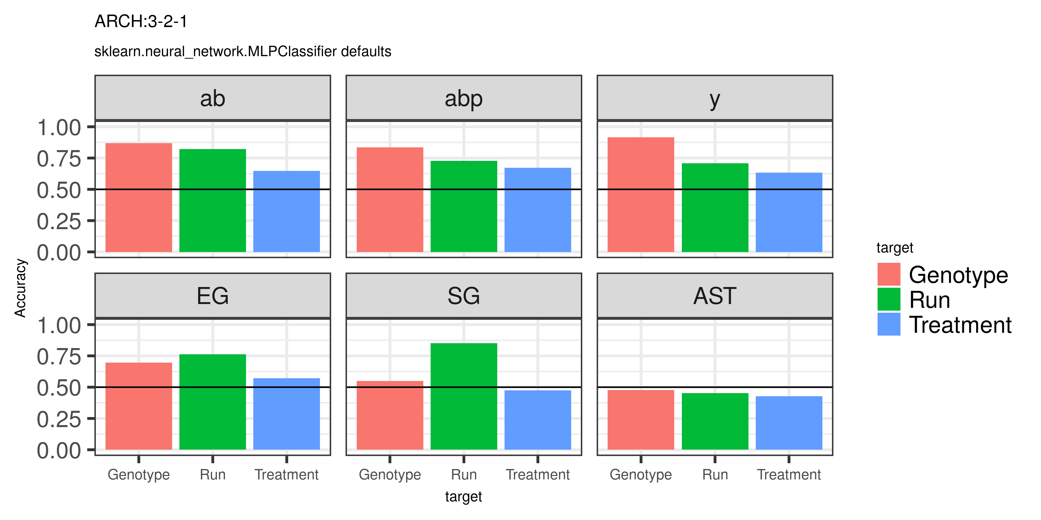
1) Decode state from gene expression

Slide 6
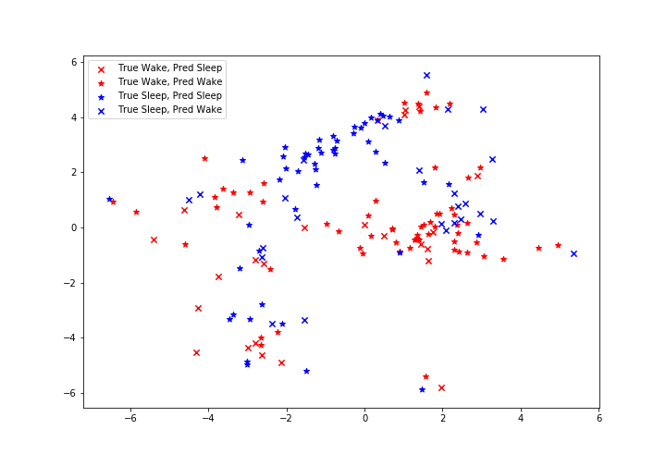
1) Decode state from gene expression
1320 genes, y KCs, 69.5 % accuracy

Slide 7
Conclusions
* State partially predictable
*Predictable on some clusters, not others (!)
* Technical effect very predictable with simple model

Slide 8
Conclusions
* Remove technical components?
→ SVD, …?
* Is state still predictable after that? → Evidence of state encoding
* Better models? Autoencoder, etc

Slide 9
2) Find subset of genes
* DEA: Wilcoxon rank test
→ (already done by Joana)
* Feature selection of genes? Which genes support state prediction?
→ in silico gene knockdown

