Slide 1
F.I.S.H
Filming Industry Systematic Heuristic
Classification on Netflix Movie Genre
Zengxiaoran (Shawn) Kang
Yifei Liang
Ashley Li
Joycelin Gu

Slide 2
Introduction
Motivation
Netflix is the dominant company in entertainment industry
Original shows, movies, and network TV
Project aims to uncover the popular trend of current entertainment streaming device and construct model for multi label classification.
Target Audience
Netflix users
Recommend users with movies they will most likely enjoy based on dataset features

Slide 3
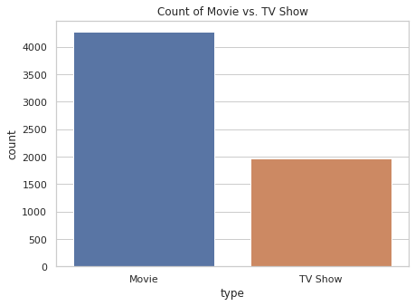
Dataset
6234 objects
12 attributes
Show_id
Type (movie or tv show)
Title
Director
Cast
Country
Date_added
Release_year
Rating
Duration
Listed_in (International movies, Comedies, ...)
Description

Slide 4
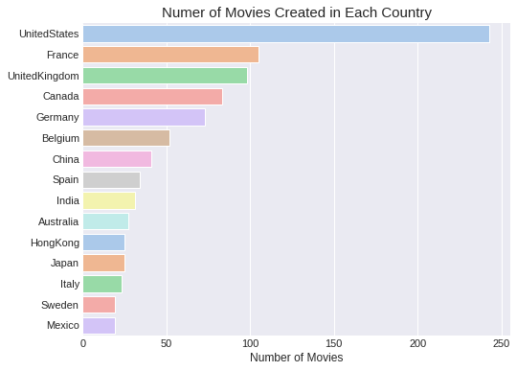
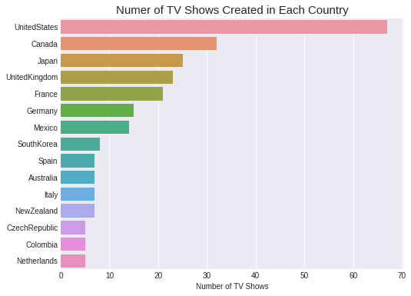
EDA: Most & Least Content Creating Countries

Slide 5
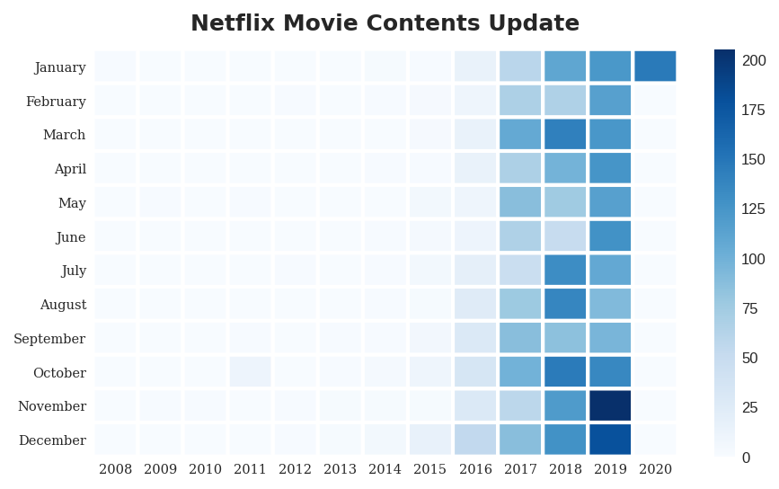
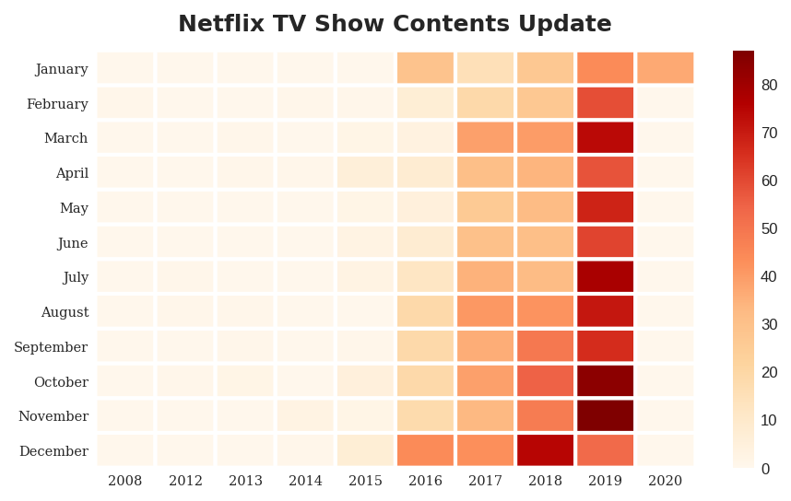
EDA: Number of Releases in Each Year

Slide 6
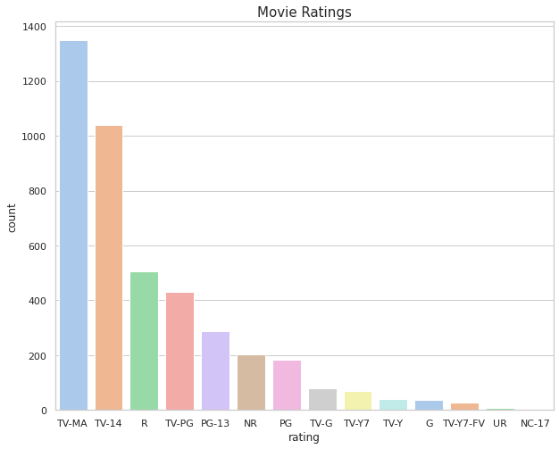
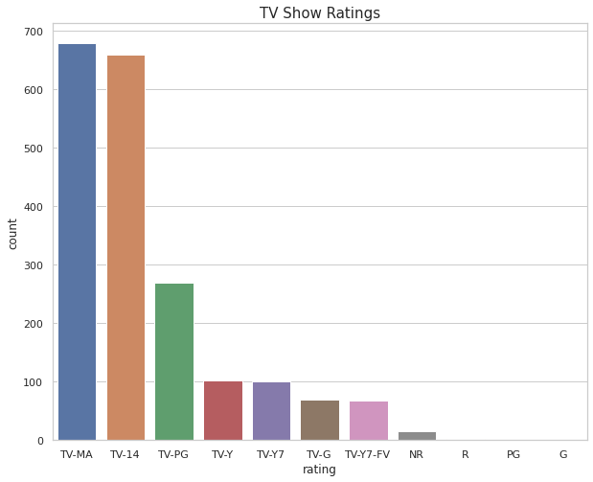
EDA: Rating Analysis
TV-MA: This program is intended to be viewed by mature, adult audiences and may be unsuitable for children under 17.
TV-14: This program contains some material that many parents would find unsuitable for children under 14 years of age.

Slide 7
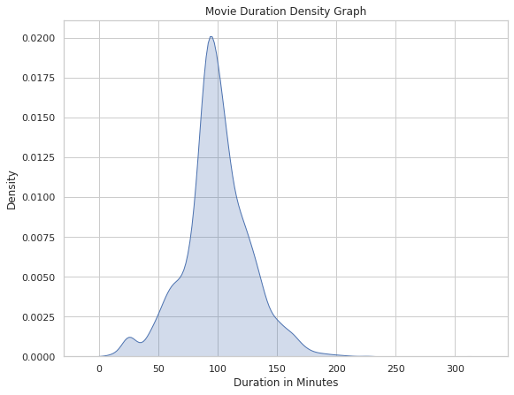
EDA: Movie Duration Analysis

Slide 8
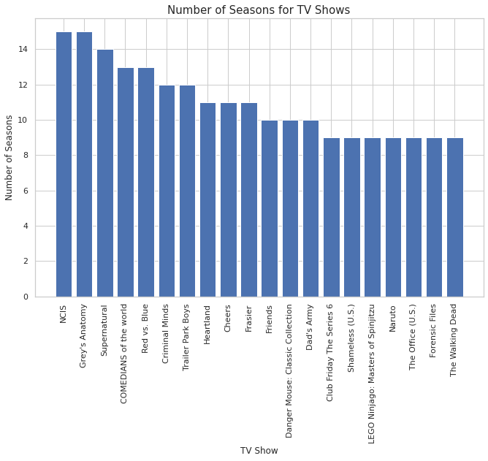
EDA: TV Show Season Analysis

Slide 9
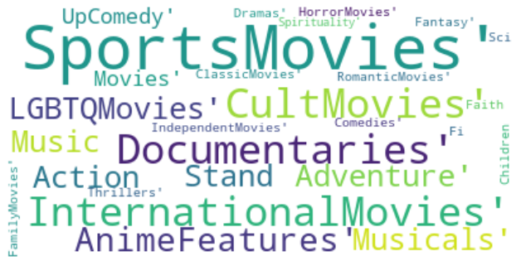
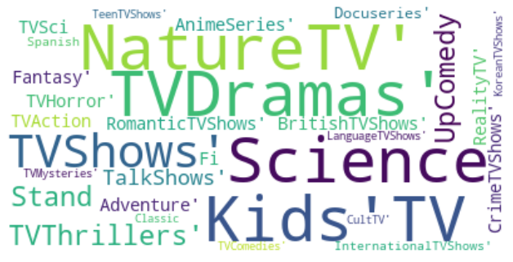
EDA: Word Cloud
Movie
TV show

Slide 10
Data Processing
Drop all the rows where “listed_in” and “description” contains null values
Convert the “listed_in”(multi label) into multiple binary columns
Drop TV data
Splitted the data into train and testing set
Set “description” to be the feature and “listed_in” to be the label
Vectorized the text data from the “description”

Slide 11
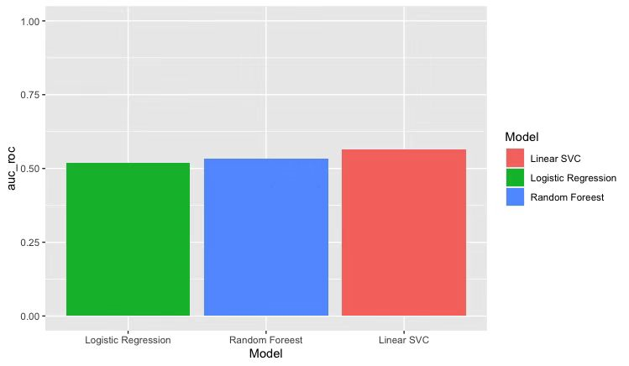
Model:
Logistics Regression
ROC-AUC: 0.5179
Random Forest
ROC-AUC: 0.53212
Linear Support Vector Classification
ROC-AUC: 0.56335

Slide 12
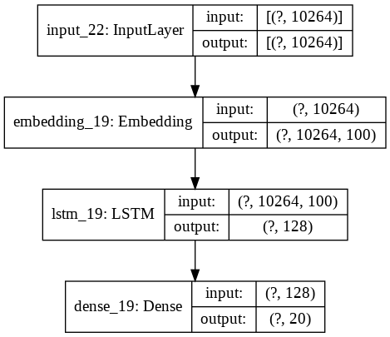
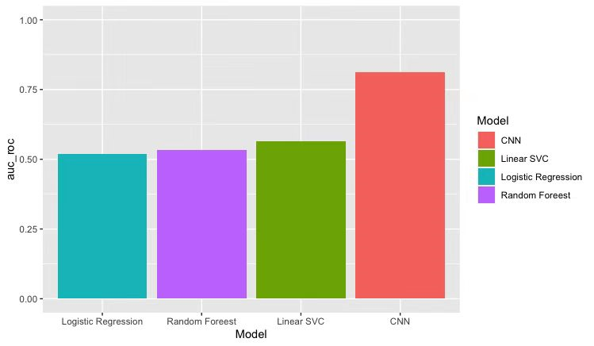
Neural Network
Overall Roc-auc: 0.8126
Model Design
Tokenizer
Pad - Sequence
Class Weights
GloVe
LSTM

Slide 13
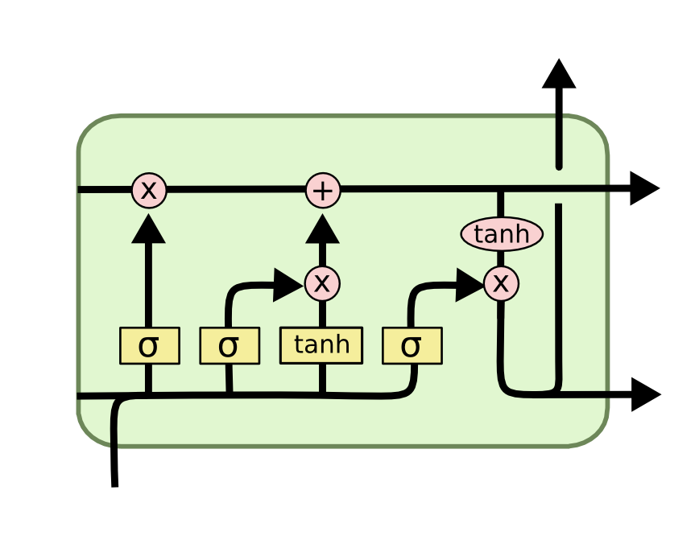
Neural Network- continue
GloVe
Global Vectors for Word Representation
Aggregated global word-word co-occurrence statistics from given corpus
LSTM

Slide 14
Empirical Analysis - Case 1
Predicted probability: [0.072052 0.28723747 0.5076671 0.05697086 0.15419677 0.01069635 0.06939691 0.4531484 0.09403536 0.14484262 0.00449982 0.10807553 0.020082 0.05135286 0.04094008 0.00807366 0.09111542 0.01101145 0.03737101 0.00980088]
True label: [0 0 0 0 0 0 0 0 1 0 0 0 0 0 0 0 0 0 0 0]
Corresponding categories: ['Children & Family Movies', 'Comedies', 'International Movies', 'Stand-Up Comedy', 'Action & Adventure', 'Cult Movies', 'Horror Movies', 'Dramas', Documentaries', 'Independent Movies', 'Movies', 'Thrillers', Classic Movies', 'Music & Musicals', 'Sci-Fi & Fantasy', 'Anime Features', 'Romantic Movies', 'LGBTQ Movies', 'Sports Movies',' Faith & Spirituality']
['Featuring archival footage and exclusive interviews, this documentary looks at the rise, fall and comeback of charismatic fashion designer Zac Posen.']

Slide 15
Empirical Analysis - Case 2
Predicted probability: [0.08683234 0.30879366 0.45069584 0.05945012 0.1640177 0.01369348 0.09472477 0.4406873 0.07671204 0.1860123 0.00515196 0.11521545 0.01767391 0.05644023 0.05278051 0.00802773 0.10038298 0.01157469 0.02974355 0.0085893 ]
True Label: [0 0 0 0 0 0 0 1 0 1 0 1 0 0 0 0 0 0 0 0]
Corresponding categories: ['Children & Family Movies', 'Comedies', 'International Movies', 'Stand-Up Comedy', 'Action & Adventure', 'Cult Movies', 'Horror Movies', 'Dramas', Documentaries', 'Independent Movies', 'Movies', 'Thrillers', Classic Movies', 'Music & Musicals', 'Sci-Fi & Fantasy', 'Anime Features', 'Romantic Movies', 'LGBTQ Movies', 'Sports Movies',' Faith & Spirituality']
['Conducting a study on the psychology of incarceration, a Stanford professor assigns guard and prisoner roles to 24 male test subjects in a mock jail.']

Slide 16
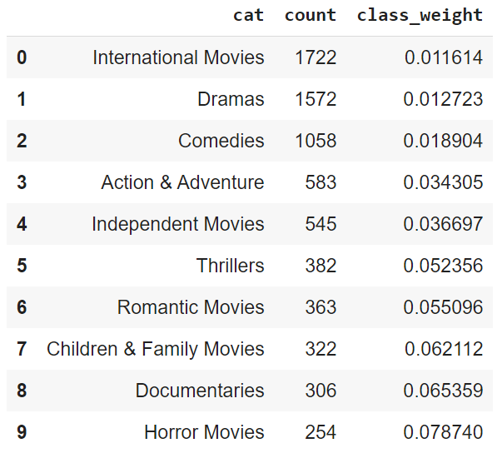
Class Weight Adjustment
class_weight="balanced"
Replicating the smaller class until you have as many samples as in the larger one in an implicit way.
Higher class-weight means you want to put more emphasis on a class
# of Genres / count of each genre = each genre’s class_weight

Slide 17
Conclusion
Traditional Machine Learning algorithm is not suitable for multi label Text classification
NN is much more powerful than traditional machine learning technique for multi label text classification
The number of movies and TV shows with a rating of TV-MA are the greatest.
November is the month with the most content release

Slide 18
Reference
LSTM - https://colah.github.io/posts/2015-08-Understanding-LSTMs/
GloVe - https://nlp.stanford.edu/projects/glove/

