Slide 1
SDT 202
Gradient Descent Algorithm
RetentionRadar — initial presentation
Team 4
Uliana Matviienko · Andrii Moroz
Group BSEAI 2025 · American University Kyiv
Instructor: Dr. Valeriy Kolesnikov
https://github.com/shalltearfrost/RetentionRadar · 1/13

Slide 2
Agenda
Initial presentation scope from the course brief
• Problem description
• Classical / general algorithm
• Pseudocode
• Real-world situation (RetentionRadar)
• Progress, repository, risks, next steps
SDT 202 · Team 4 · Initial presentation · https://github.com/shalltearfrost/RetentionRadar
2/13

Slide 3
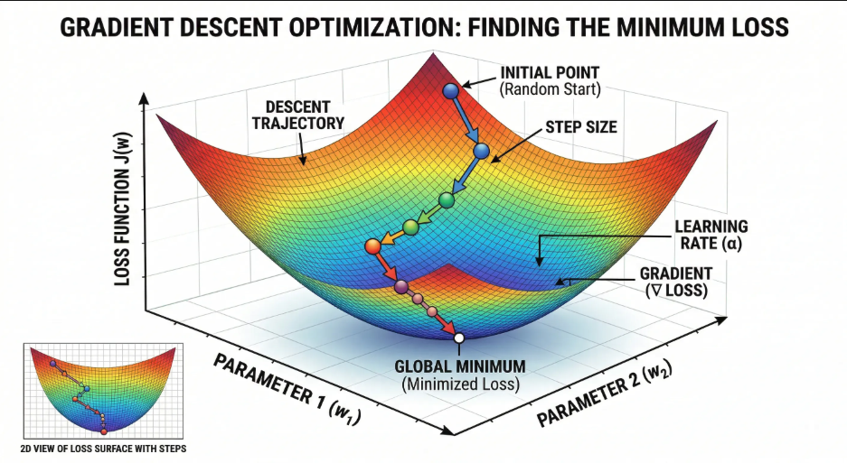
1. Problem
Unconstrained smooth minimization
• Given a differentiable objective f : ℝᵈ → ℝ, find x that minimizes f(x)
• Setting ∇f(x) = 0 often yields a nonlinear system with no closed form
• Need a numerical method that uses only first-order information
• Gradient descent: repeatedly step opposite the gradient
• Negative gradient = steepest local descent direction (Euclidean norm)
SDT 202 · Team 4 · Initial presentation · https://github.com/shalltearfrost/RetentionRadar
3/13

Slide 4
2. Classical algorithm
• Update rule:
• xₖ₊₁ = xₖ − α · ∇f(xₖ)
• α > 0 is a fixed step size (learning rate)
• “Batch” = each gradient uses the full objective / full dataset
• Stop when ‖∇f(x)‖ is small, or after a maximum number of updates
• If α is too large, iterates can diverge; if too small, progress is slow
Step size matters!
• If ∇f is L-Lipschitz (L-smooth) and f is convex with a minimizer x*
• Choose 0 < α ≤ 1/L
• Then: f(xₖ) − f(x*) ≤ ‖x₀ − x*‖² / (2 α k) → O(1/k)
• Our program stops on gradient norm (not the same as objective-gap ε)
• Complexity per iteration depends on the cost of ∇f (for logistic: Θ(m·d))
SDT 202 · Team 4 · Initial presentation · https://github.com/shalltearfrost/RetentionRadar
4/13

Slide 5
3. Pseudocode
Matches GradientDescent.minimize in our Java code
GRADIENT-DESCENT(f, x0, alpha, tolerance, maxUpdates)
x ← copy(x0)
updates ← 0
repeat
value ← f(x)
if nonfinite(x/value) or magnitude-guard fails
return DIVERGED
g ← ∇f(x)
if nonfinite(g) or nonfinite(‖g‖)
return DIVERGED
if ‖g‖ ≤ tolerance
return x, CONVERGED, updates
if updates = maxUpdates
return x, MAX_ITERATIONS, updates
x ← x − alpha · g
updates ← updates + 1
• Stopping test is before an update → optimal start needs 0 updates
• Also check the point produced by the final allowed update
• All coordinates share the same gradient vector g (true batch GD)
• Magnitude guard (practical): value > 10⁶ · (|f(x₀)| + 1) → DIVERGED
• Java API: minimize(ObjectiveFunction, double[] x0, OptimizerConfig)
• Driver RetentionRadarApp calls GradientDescent.minimize(...)
SDT 202 · Team 4 · Initial presentation · https://github.com/shalltearfrost/RetentionRadar
5/13

Slide 6
Worked example
f(x) = x², ∇f = 2x, L = 2, x₀ = 5
• α = 0.1 → 5, 4, 3.2, 2.56, … (contracts by 0.8 each step)
• α = 0.9 → oscillates while contracting
• α = 1.1 → magnitude grows (step too large vs 2/L)
SDT 202 · Team 4 · Initial presentation · https://github.com/shalltearfrost/RetentionRadar
6/13

Slide 7
4. Real-world situation
RetentionRadar — educational early-warning demo
• Problem: estimate risk of eventual Dropout vs Graduate
• Using information available by the end of semester one
• Fit logistic regression by minimizing regularized logistic loss with GD
• Practical value: rank held-out students so advisors know whom to review first
• Real data: UCI “Predict Students’ Dropout and Academic Success” (dataset #697, Realinho et al.; CC BY 4.0) [3][4]
• Our extract: 7 first-semester features; 4,424 rows; Enrolled dropped at load
• Also: seeded synthetic cohort for offline demos without the CSV
• Limits: educational prototype — not AUK operational data or causal proof
SDT 202 · Team 4 · Initial presentation · https://github.com/shalltearfrost/RetentionRadar
7/13

Slide 8
Data source (citation)
What UCI #697 is, in one slide
• Public dataset from the UCI Machine Learning Repository
• Full name: Predict Students’ Dropout and Academic Success
• Authors: Realinho, Vieira Martins, Machado, Baptista (and related Data 2022 paper)
• Labels: Dropout / Graduate / Enrolled (we keep Dropout vs Graduate only)
• Licence: Creative Commons Attribution 4.0 (CC BY 4.0) — attribute + note changes
• Project file: data/students-first-semester.csv (+ DATA-SOURCE.md attribution)
• URL: archive.ics.uci.edu/dataset/697/… (see References slide)
SDT 202 · Team 4 · Initial presentation · https://github.com/shalltearfrost/RetentionRadar
8/13

Slide 9
How the Java program uses the algorithm
Main program must call the algorithm function
• LogisticObjective implements ObjectiveFunction (value + gradient)
• RetentionRadarApp prepares data → calls GradientDescent.minimize
• Then scores held-out records, metrics, and optional ranking
• Packages: optimization / model / data / app / verify
• Stack: plain Java 17, IntelliJ, no external libraries
SDT 202 · Team 4 · Initial presentation · https://github.com/shalltearfrost/RetentionRadar
9/13

Slide 10
Progress for week 8 (initial)
• Done / in progress toward the initial deliverable:
◦ Classical GD implemented as a reusable Java function
◦ Real-world logistic application wired to call that function
◦ Public GitHub repository + IntelliJ project structure
◦ Report draft + these slides for Canvas (24h before talk)
• Still for later / final:
◦ Improved algorithm (Nesterov), full screenshots, comments polish
◦ GUI and algorithms visualisations
◦ Final report parts, abstract, effort analysis, live demo polish
SDT 202 · Team 4 · Initial presentation · https://github.com/shalltearfrost/RetentionRadar
10/13

Slide 11
Project risks
Called out for the initial presentation
• Step size too large → non-finite loss / divergence (mitigate with safe α = 1/B)
• Ill-conditioned features → many iterations (standardize using training only)
• Feature timing misunderstanding → invalid “early warning” claims
• Single split oversold as deployment performance
• Repo visibility / clickable link / contribution evidence before final
• Schedule pressure — start early; rehearse with both members speaking
SDT 202 · Team 4 · Initial presentation · https://github.com/shalltearfrost/RetentionRadar
11/13

Slide 12
References
Cited in this presentation
• [1] Tibshirani R. Gradient Descent (CMU convex opt. notes).
• [2] Su, Boyd, Candes. ODE analysis of Nesterov’s accelerated gradient.
• [3] Realinho V. et al. Predict Students’ Dropout and Academic Success. UCI ML Repository, dataset #697. https://archive.ics.uci.edu/dataset/697/predict+students+dropout+and+academic+success
• [4] Realinho et al. Predicting Student Dropout and Academic Success. Data 2022, 7(11), 146. https://www.mdpi.com/2306-5729/7/11/146
• [5] Shalizi C. Logistic Regression (CMU lecture notes).
• [6] Creative Commons Attribution 4.0 (CC BY 4.0).
SDT 202 · Team 4 · Initial presentation · https://github.com/shalltearfrost/RetentionRadar
12/13

Slide 13
Thank you
Questions?
Team 4 · Uliana Matviienko · Andrii Moroz · https://github.com/shalltearfrost/RetentionRadar

