Slide 1


Smart Helmet for Accident Detection and Safety
Group Members
Navaneeth Yadav 22BTDS119
S Shalini 22BTDS174
Thanushree N S 22BTDS155
Anushree V S 22BTDS145

Slide 2

Problem Statement
Two-wheeler riders are highly vulnerable to road accidents, and conventional helmets only provide basic physical protection. There is no integrated system that can prevent drunk driving, detect accidents in real-time, track the rider’s live location, and automatically send emergency alerts to family . This lack of smart safety features results in delayed medical assistance, increased injury severity, and a higher risk of fatalities. Therefore, there is a need for an IoT-based Smart Helmet that enhances rider safety through alcohol detection, accident sensing, GPS tracking, and automated emergency communication

Slide 3
Literature Survey
Many research works focus on accident detection using MPU6050 sensors, but most only send data to serial monitor or app.
some systems use GSM modules to send SMS after an accident,
but lack alcohol detection or ignition control.
GPS-based tracking systems exist, but they do not prevent
accidents or control the vehicle.
Few smart helmets include alcohol sensing but do not send live location or manage vehicle ignition.
Most available systems are expensive or provide only a single feature rather than a complete safety solution.

Slide 4
Literature Survey
Accident detection systems using only accelerometers or gyroscopes often
fail to differentiate between minor bumps and serious crashes.
This leads to false alerts or missed emergencies.
Many IoT-based alert systems depend on GSM or mobile networks,which can be
unreliable in remote areas.
Some do not provide real-time GPS tracking or automatic emergency messages.
Existing solutions rarely integrate all safety features—alcohol detection,
accident sensing, GPS tracking, and vehicle control—into one affordable device.
This limits practical implementation for everyday riders.

Slide 5
Methodology
System Overview:
The smart helmet integrates sensors, microcontroller, and communication systems to prevent accidents and alert emergencies.
Input Devices: MQ3 Alcohol Sensor, MPU6050 Accelerometer + Gyroscope, GPS Module, Push Button
Processing Unit: ESP32 Microcontroller processes sensor data and makes real-time decisions
Outputs: L298N Motor Driver (ignition control), Buzzer, LED, Telegram alerts
Flow of Operation:
Rider wears helmet and starts journey.
Alcohol sensor checks rider’s sobriety → ignition allowed if safe.
MPU6050 detects sudden shocks/fall → accident detection.
GPS tracks live location continuously.
ESP32 triggers buzzer/LED and sends Telegram alert if accident occurs.
Push button allows manual start/stop as override.

Slide 6
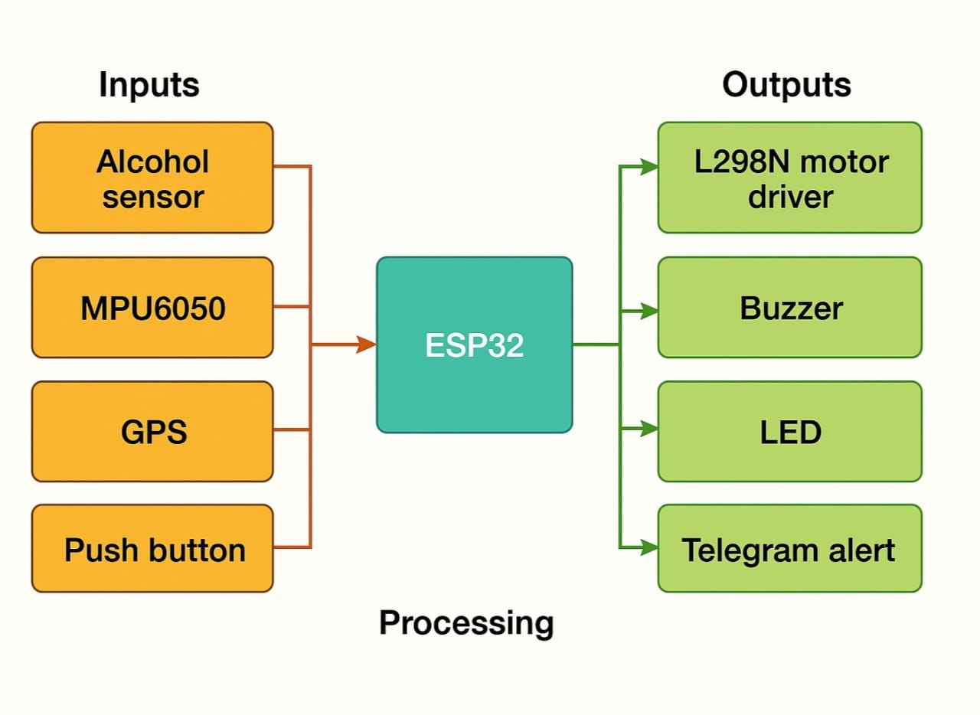
Block diagram Image

Slide 7
Results
Alcohol Detection Results
Alcohol Level (ppm) | Ignition Status | Observation
0–50 | ON | Safe to ride
51–100 | OFF | Ignition blocked
>100 | OFF + Alert | High alcohol, alert sent

Slide 8
Results
Accident Detection Results
Shock Level (g-force) | Accident Detected | Buzzer/Alert
<2 | No | None
2–4 | Possible | Buzzer ON
>4 | Yes | Buzzer + Telegram alert

Slide 9
Results
GPS & Emergency Alert Performance
Scenario | Location Accuracy | Alert Delay
Normal Ride | ±5 meters | None
Accident (Urban Area) | ±8 meters | 2–3 seconds
Accident (Remote Area) | ±10 meters | 3–5 seconds

Slide 10
Conclusion
The Smart Helmet system successfully integrates alcohol detection, accident sensing, GPS tracking, and automated emergency alerts into a single IoT-based safety device. By continuously monitoring rider conditions and vehicle status, the system ensures real-time response during critical situations. The ignition control mechanism effectively prevents drunk driving, while the accident detection and location-sharing features significantly reduce the delay in receiving help, thereby minimizing the risk of severe injuries and fatalities.

Slide 11
Project Plan
Work Done So Far:
Sensor integration (MQ3, MPU6050, GPS) with ESP32
Accident detection algorithm and ignition control implemented
Telegram-based real-time alert system tested
System tested for alcohol detection, shock response, and GPS tracking
Next Steps / Future Plan:
Miniaturization of electronics for helmet integration
Testing in real-world riding conditions
Adding extra features like speed monitoring and automatic braking
Deploying in fleets or public safety programs for wider use

Slide 12
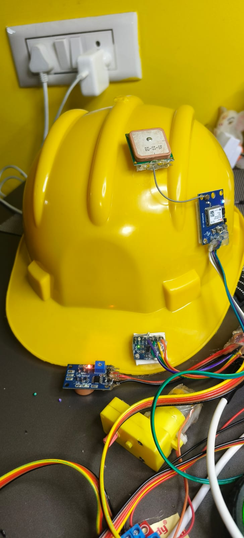
Conclusion and Project Plan
Work Done So Far(Image)

Slide 13
References
Development Tools:
Arduino IDE – https://www.arduino.cc/en/software
ESP32 Core for Arduino – https://docs.espressif.com/projects/arduino-esp32/en/latest/
Libraries Used:
Wire.h – I2C communication: https://www.arduino.cc/en/Reference/Wire
MPU6050 & I2Cdev – Sensor interfacing: https://github.com/jrowberg/i2cdevlib
TinyGPSPlus – GPS parsing: https://github.com/mikalhart/TinyGPSPlus
WiFi.h – ESP32 Wi-Fi: https://www.arduino.cc/reference/en/libraries/wifi/
UniversalTelegramBot – Telegram Bot API: https://github.com/witnessmenow/Universal-Arduino-Telegram-Bot
Additional References / Learning Material:
ESP32 Projects & IoT tutorials – https://randomnerdtutorials.com/
MPU6050 Sensor Documentation – https://www.invensense.com/products/motion-tracking/6-axis/mpu-6050/
NEO-6M GPS Module – https://www.u-blox.com/en/product/neo-6-series

