Slide 1


CODEKRAKEN

Slide 2
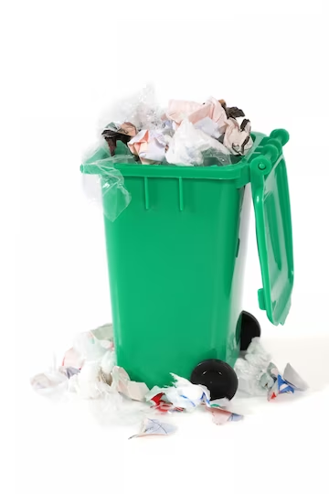
PROBLEM STATEMENT
The problem we aim to solve in this hackathon is to create a smart waste management system for urban areas. The current waste management systems are inefficient and often result in overflowing bins, littered streets, and environmental hazards. We need a solution that can optimize waste collection, reduce operational costs, and promote a cleaner and healthier environment.

Slide 3

SOLUTION
Our proposed solution is to develop a smart waste management system using IoT technology and data analytics. The system will consist of smart bins equipped with sensors, a central server for data processing, and a user-friendly mobile application for monitoring and management.
Goals and Benefits:
Revolutionize Waste Management
Efficiency Improvement
Cost-Effectiveness
Environmental Benefits

Slide 4
TECHSTACK
Programming Language: Python
IoT Devices: Raspberry Pi, Ultrasonic Sensors, GPS Module
Cloud Computing: AWS IoT Core, AWS Lambda, AWS DynamoDB
Data Analytics: Python Libraries (Pandas, NumPy, Scikit-learn)
Mobile Application: React Native

Slide 5


UNIQUENESS
Our idea for a smart waste management system is unique due to
Its real-time route optimization
Environmental focus
Data-driven insights
User-friendly mobile app
Scalability
Seamless integration potential.

Slide 6
ARCHITECTURE:
IoT Devices:
Raspberry Pi will be used as the edge device to connect the sensors and transmit data.
Ultrasonic sensors will measure the fill-level of the bins.
GPS module will track the location of the bins.
2. Data Collection and Transmission:
Raspberry Pi will collect data from the sensors.
AWS IoT Core will be used to securely transmit the data to the cloud.

Slide 7
3. Cloud Server:
AWS Lambda functions will receive the data from IoT Core and process it.
The processed data will be stored in AWS DynamoDB for further analysis.
4. Data Analytics:
Python libraries such as Pandas, NumPy, and Scikit-learn will be used for data analysis.
Machine learning algorithms will be applied to predict the fill-level of the bins and optimize waste collection routes.
5. Mobile Application:
A cross-platform mobile application will be developed using React Native.
The application will allow users to report overflowing bins, track waste collection schedules, and receive notifications.

Slide 8
UPDATED TO PRO
Team Lead:
Shalini Patel
Team Members:
Aastha Parey
Shreya Gupta
Vedant Garhwal

