Slide 1
Trustworthy Recommender System using Machine Learning Techniques
Sarbajit Nandy
Shalmoli Neogi
Supriya Kundu
Vishnu Pandey
Under the supervision of
Mrs. Sasmita Subhadarsinee Choudhury
Assistant Professor, Computer Science and Engineering

Slide 2
Acknowledgement
It is our proud privilege and duty to acknowledge the kind of help and guidance received from several people in preparation of this report. We express our gratitude and respect towards all those who guided us throughout the completion of this project and report.
First and foremost, we wish to record our sincere gratitude to our project guide Mrs. Sasmita Subhadarsinee Choudhury, Assistant Professor, CSE for his constant support and encouragement in preparation of this project and report. We would also like to thank all the people who have provided their valuable suggestions and feedbacks to make this project.
Our sincere thanks to Prof. (Dr.) S. S. Thakur, Associate Professor & Head of the Department, Department of Computer Science and Engineering, MCKVIE, for his valuable suggestions and encouragement.

Slide 3

What is recommender system?
A recommendation engine filters the data using different techniques and recommends the most relevant items to users.
It first captures the past behaviour of a customer and based on that, recommends products that the users might be likely to buy.

Slide 4
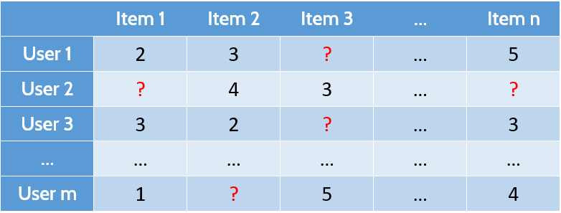
What recommender system does?
Predicting the rating for these

Slide 5
Dataset Description
Dataset Source:- Movielens (url:https://grouplens.org/datasets/movielens/).
Actual Dataset: There are 27,000,000 ratings for 58,000 movies and 2,80,000 users .
Project Dataset: We have used the small version of the dataset which contains 100,837 ratings for 9724 movies and 610 users.

Slide 6
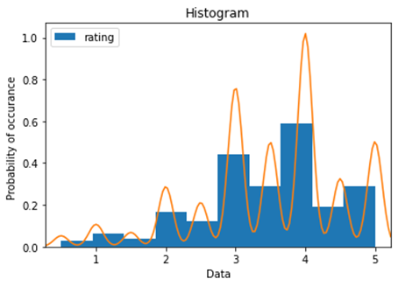
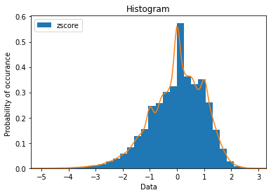
Dataset normalization
Normalization techniques: Z-score , min-max
Requirement of normalization:
Dataset before normalization
Dataset after normalization

Slide 7
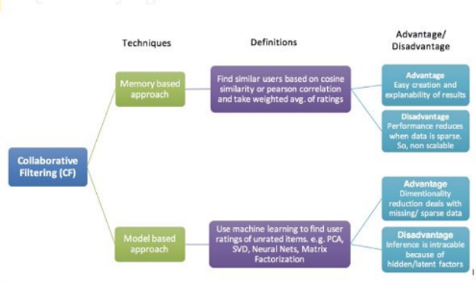
Model based v/s Memory based

Slide 8
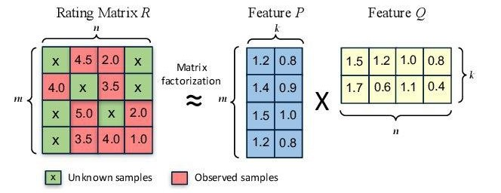
Matrix Factorization
It is a process of where the actual matrix is divided into two more matrices such a way that multiplication of the new two matrices will give the actual matrix.
Number of users: m
Number of items: n
Number of features: k
Requirement of Matrix Factorization:

Slide 9
We have used three techniques for Matrix Factorization:
Singular Value Decomposition (SVD) Model
Backpropagation Model
Deep Neural Network (DNN) Model

Slide 10
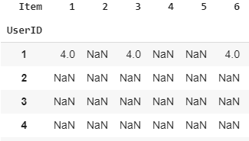
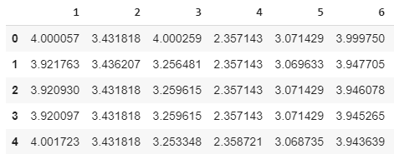
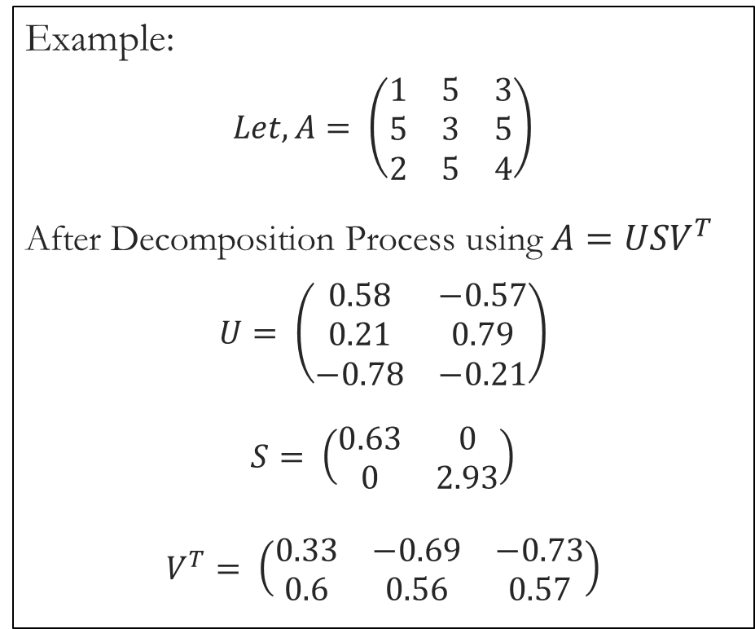
Singular Value Decomposition(SVD)
Actual Rating Matrix:
Predicted Rating Matrix:
Example:
$$Let, A= \left(\begin{matrix}1 & 5 & 3 \\ 5 & 3 & 5 \\ 2 & 5 & 4\end{matrix}\right)$$
After Decomposition Process using $A=USV^{T}$
$$U= \left(\begin{matrix}0.58 & −0.57 \\ 0.21 & 0.79 \\ −0.78 & −0.21\end{matrix}\right)$$
$$S= \left(\begin{matrix}0.63 & 0 \\ 0 & 2.93\end{matrix}\right)$$
$$V^{T}= \left(\begin{matrix}0.33 & −0.69 & −0.73 \\ 0.6 & 0.56 & 0.57\end{matrix}\right)$$

Slide 11
Problem with SVD
Sparse Rating Matrix
Sparsity removed
User | Item | Rating
1 | 4 | 2
2 | 2 | 5
2 | 6 | 3
3 | 4 | 5
3 | 6 | 2
4 | 1 | 3
4 | 3 | 4
4 | 5 | 5
5 | 2 | 2
5 | 3 | 3

Slide 12
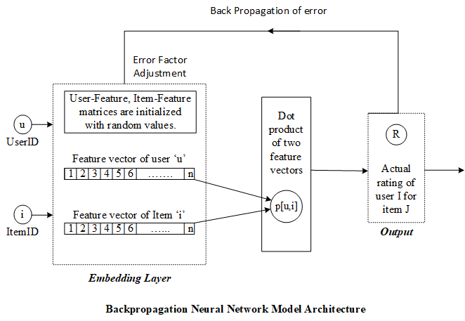
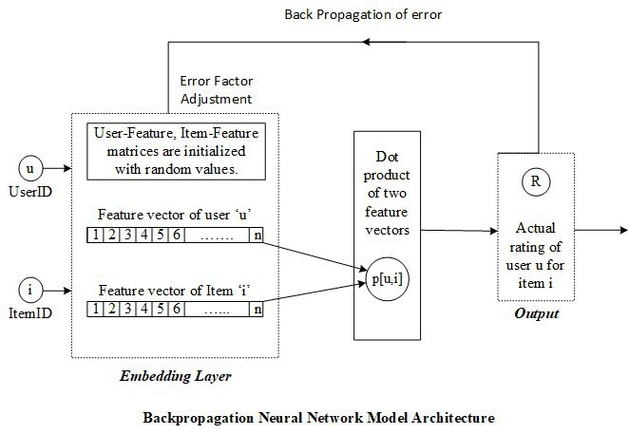
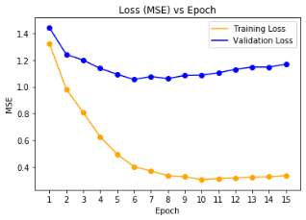
Backpropagation Model
Loss vs Epoch Graph
X-Axis : Epoch
Y-Axis : Loss (MSE)

Slide 13
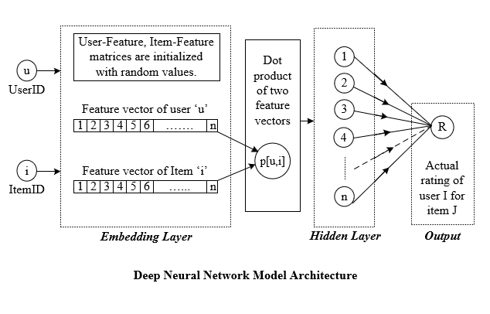
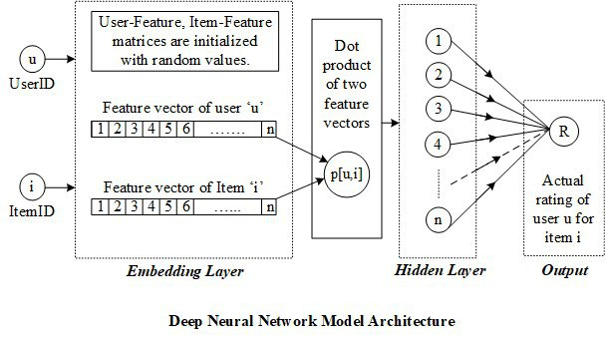
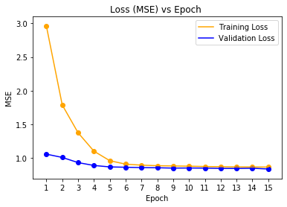
Deep Neural Network(DNN) Model
Loss vs Epoch Graph
X-Axis : Epoch
Y-Axis : Loss (MSE)

Slide 14
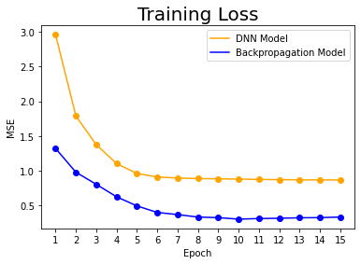
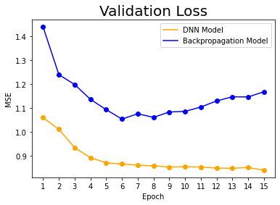
Loss Comparison
Backpropagation model training loss is less than DNN model.
DNN model validation loss is less than Backpropagation model.

Slide 15
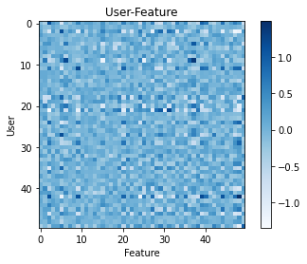
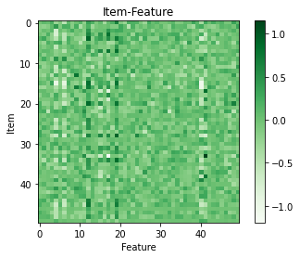
Feature Matrix Plot

Slide 16
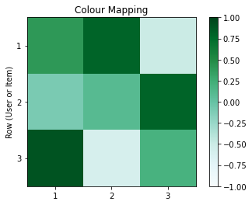
Feature Matrix Plot
Example:
Intensity of the colour is changing according to the feature value.
Range of feature value is ‘-1’ to ‘+1’

Slide 17
What we have :
UserID
Rating Predictor model
Rating
ItemID
Feature
Feature
……………………
……………………
Users
Item
.
.
.
.
.
.
User feature
610 x 50
Item feature
9724 x 50

Slide 18
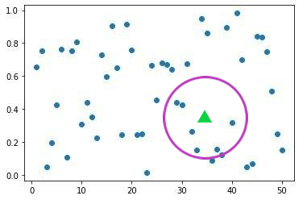
Use of Feature Maps:
We can use it for similarity calculation
Based on a target user, we can run K-nearest neighbour to find out k most similar user and use their top rated movies for the recommendation.
Here, Similarity value between two user is referred to Pearson’s correlation coefficient

Slide 19
Computational model of Trust
User Classification
Consumers
Producers
Trust Classification
Profile-level trust
Item-level trust

Slide 20
Computational model of Trust
Consumer rating Prediction
Here we have used Resnick’s standard prediction :
$$c\left(i\right)= \overline{c}+ \frac{\sum_{p ∈P(i)}{ \left(p\left(i\right) − \overline{p}\right) ∗ sim(c,p)}}{\sum_{p ∈ P(i)}{ \left|sim(c,p)\right|}}$$
c = consumer
$\overline{c}$ = mean rating of consumer
p = producer
P = set of producers
$\overline{p}$ = mean rating of producer
sim(c,p) = similarity metric between a pair of producer and consumer

Slide 21
Computational model of Trust
Profile level Trust Calculation
$$Correct\left(i,p,c\right) ⇔ \left|p\left(i\right) − c(i)\right| < ε$$
$$RecSet\left(p,c\right)= \left\{\left(c, i_{1}\right), ….., \left(c, i_{n}\right)\right\}$$
$$CorrectSet\left(p,c\right)= \left\{\left(c, i_{k} \right)∈ RecSet\left(p\right) ⋮ Correct\left(i_{k}, p,c\right)\right\}$$
$${Trust}^{p}( c,p)= \frac{\left|CorrectSet(p,c)\right|}{\left|RecSet(p,c)\right|}$$

Slide 22
Computational model of Trust
Trust Based Filtering : another layer of filtering
Appling Resnick’s prediction, which is now based only on the trusted producers.
$$c\left(i\right)= \overline{c}+ \frac{\sum_{p ∈P^{T}(i)}{ \left(p\left(i\right) − \overline{p}\right) ∗ sim(c,p)}}{\sum_{p ∈ P^{T}(i)}{ \left|sim(c,p)\right|}}$$
$$P^{T}(i)= \left\{ p ∈P (i) : {Trust}^{p} (p, i) > T \right\}$$

Slide 23
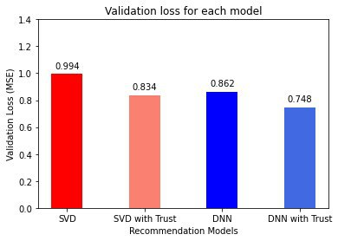
Computational model of Trust
Result After Trust Incorporation: ( in MSE )
Performance comparison:
RSDNN: 13% improvement
SVD : 16% improvement

Slide 24
Computational model of Trust
Result After Trust Incorporation: ( in MSE )
Performance comparison:
DNN: 13% improvement
SVD : 16% improvement

Slide 25
Popularity Based Recommendation

Slide 26
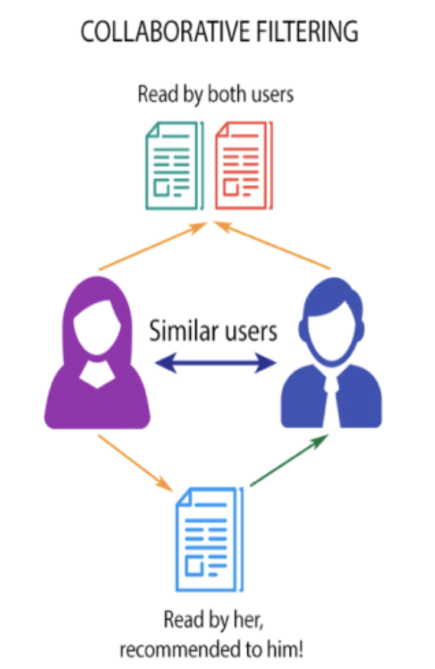

Problem of Collaborative Filtering
Cold User
A potential problem of Collaborative Filtering

Slide 27

Solution to Cold User Problem: Popularity based Recommendation
Popularity Based Recommendation means recommending trendy items, i.e. movies , books etc. to users
This does not depends on the similarity between users
Neither item similarity it cares
It only considers the preferences of the active user and recommends most popular things of his/her preference
Ask Preferences
Cold User
Preference List

Slide 28
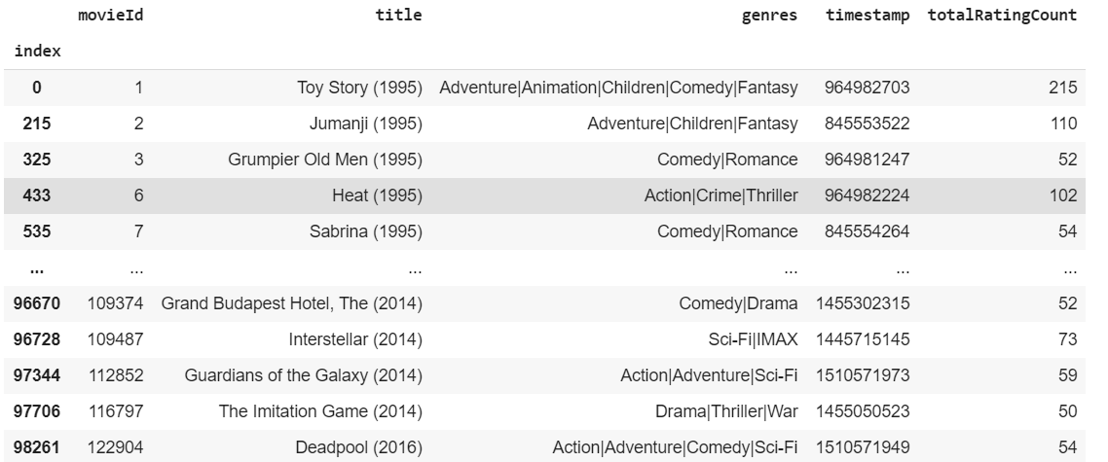
How the model is developed?
Movies below a particular popularity threshold is discarded

Slide 29
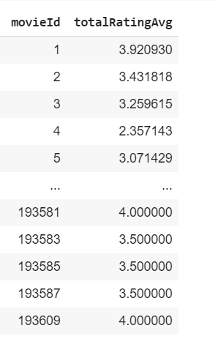
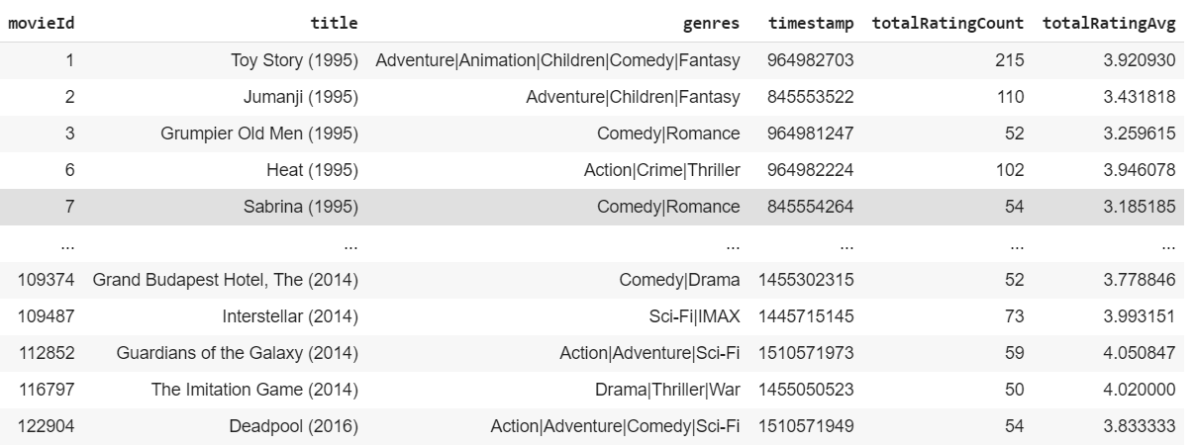
Average rating of each movie is calculated

Slide 30
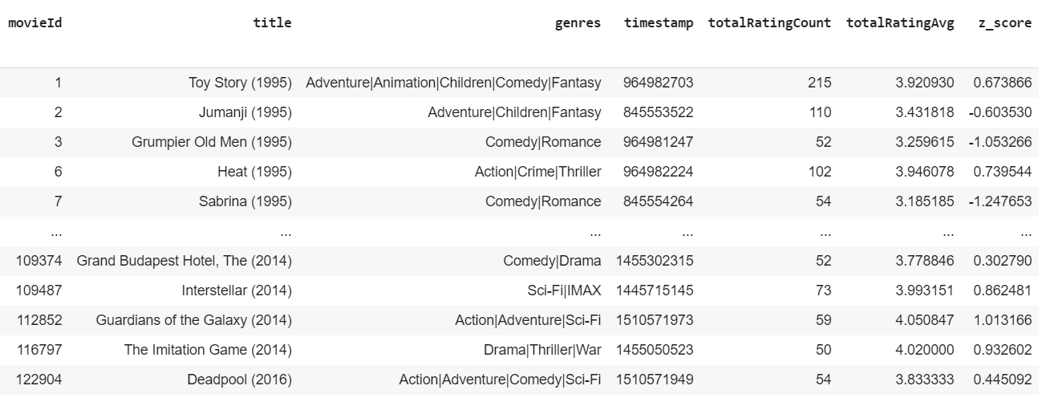
Z-score is applied on the rating average
$$\text{z}\text{_}\text{score}\text{ = (}\text{ratingAvg}\text{ – }\text{ratingAvg}\text{. }\text{mean}\text{()) / }\text{ratingAvg}\text{. }\text{std}\text{(}\text{ddof}\text{ = 0) }$$

Slide 31
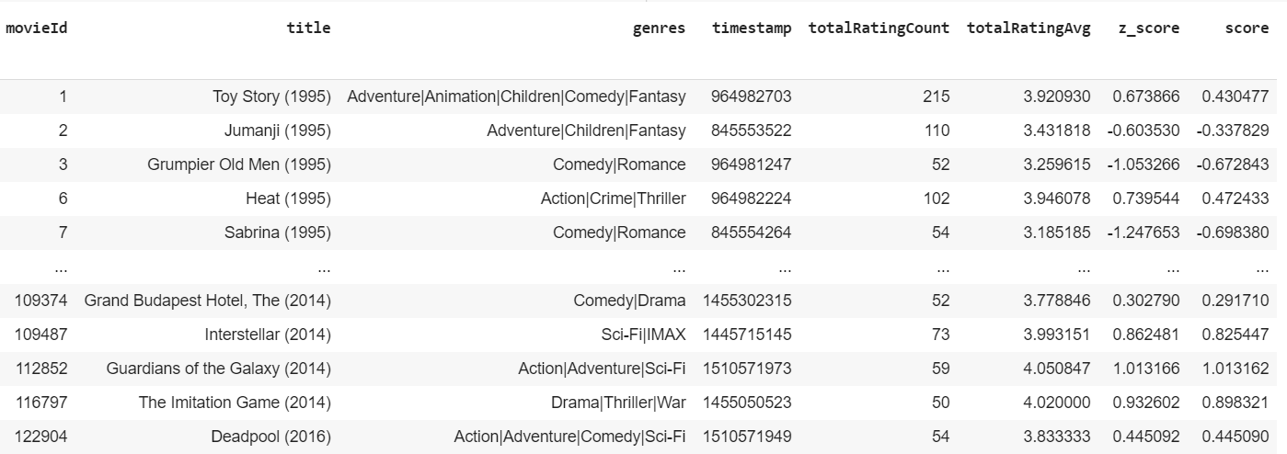
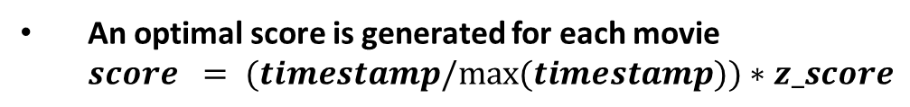
An optimal score is generated for each movie
$score = (timestamp/max⁡(timestamp))∗z_score$

Slide 32
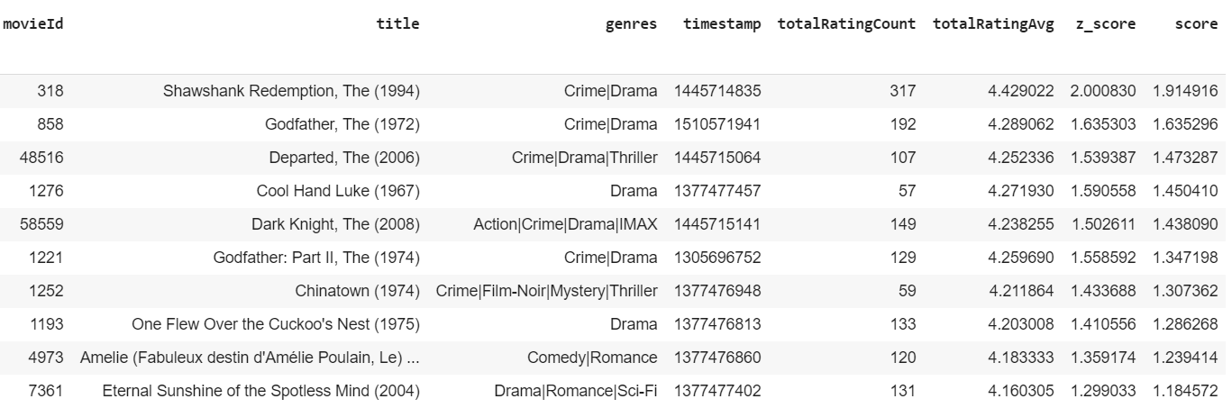
Movies are sorted in descending order depending upon the field ‘score’

Slide 33
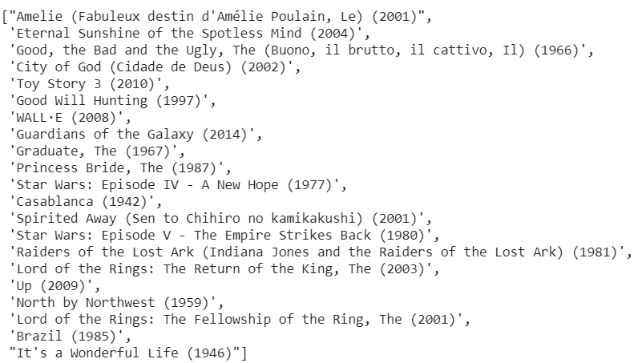
Now considering the preferences of the user most popular and recent movies are recommended to the user

Slide 34

Trust Profile Calculator
Trust Matrix
DNN
Train
Set
SVD
Trust based Filtering
Recommendation Generator
Recommended List of Movies
Cold user Checker
No
Input Dataset
BP
Yes
Test
Set
Accuracy Calculator
Dataset Sanitizer
Dataset Normalizer
Optimal Score Generator
Finding popular movies
User Preferences
Combining user preferences

Slide 35
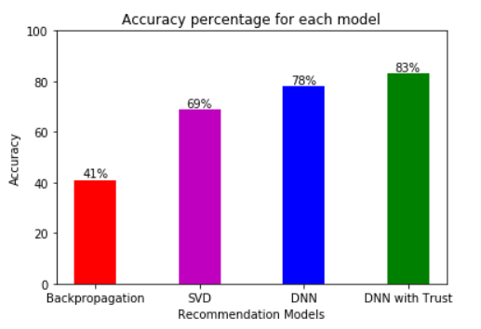
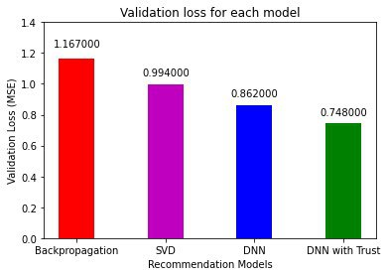
Conclusion:

Slide 36
Future Scope
Here only 3 machine learning models are used, i.e. Backpropagation model, SVD model, Deep Neural Network model. More models can be used like SVD++, Co-Clustering etc.
Optimization techniques can be applied on our recommendation models to get batter accuracy. There are different types of optimization techniques is available like PSO (Particle Swarm Optimization), Ant Colony optimization technique.
It’s a Hybrid Model built with both Collaborative Filtering and Popularity Based Filtering. Hybrid Nature of this can be extended by incorporating Content-based Filtering and Demographic Filtering.
This Hybrid model can serve as a recommender system in the background of any e-commerce website
We can calculate global trust for users, and can use this in popularity based model also

Slide 37
References
Ahirwadkar B, & Deshmukh S N. (2019). Deep Neural Networks for Recommender Systems. International Journal of Innovative Technology and Exploring (IJITEE), 8 (12), 2278-3075.
Bedi, P., &amp; Sharma, R. (2012). Trust based recommender system using ant colony for trust computation. Expert Systems with Applications, 39 (1), 1183- 1190.
Bell R, Koren Y, & Volinsky C. (2018). Matrix Factorization Techniques for Recommender Systems. IEEE Journals & Magazines Computer, 42 (8), 8 pages.
Donovan O J, & Smyth B. (2005). Trust in Recommender Systems. Proceedings of the 10th international conference on Intelligent user interfaces, 05, 167-174.
Gohari, F.S., Aliee, F. S., &amp; Haghighi, H. (2019). A dynamic local–global trust-aware recommendation approach. Electronic commerce research and applications, 34 (1), 100838.
Gupta S, & Nagpal S. (2015). Trust Aware Recommender Systems: A Survey on Implicit Trust Generation Techniques. International Journal of Computer Science and Information Technologies, 6 (4), 3594-3599.
Guo, G., Zhang, J., &amp; Smith, N.Y. (2016). A novel recommendation model regularized with user trust and item ratings. IEEE Trans. Knowl. Data Eng., 28 (7), 1607-1620.
He J, Huang G, Zhang Y, & Zhou X. (2015). SVD-based incremental approaches for recommender systems. Journal of Computer and System Sciences, 81 (4), 717-733.
Kumar V, Nagpal S, Sinha S, & Yadav S. (2018). Trust Aware recommender System using swarm intelligence. Journal of Computational Science, 28, 180-192.
Nasiri M, Rezghi M, & Sharifi Z. (2013). New algorithm for recommender systems based on singular value decomposition method. IEEE.
Sun A, Tay Y, Yao L, & Zhang S. (2019). Deep Learning based Recommender System: A Survey and New Perspectives. ACM Computing Surveys, Article 1, 35 pages.

Slide 38
Thank You

