Slide 1
PEOPLE ANALYTICS · JULY 2026
Employee Attrition: Cost, Drivers,
and a Retention Plan
Analysis of 1,470 employees across Engineering, Sales, and HR — descriptive analysis, predictive model, and costed interventions.
16.1%
ANNUAL ATTRITION — 237 OF 1,470 EMPLOYEES
$8.67M
ANNUAL REPLACEMENT COST — 7.6% OF PAYROLL
7.1 mo
OF SALARY LOST PER DEPARTURE (AVG $36.6K)

Slide 2
Attrition costs us ~$8.7M a year — and it's concentrated
16.1% annual attrition sits at the high end of the 13–17% typical range for mid-size tech/SaaS companies.
$36.6K per departure — recruiting, onboarding, vacancy, and ramp-up; ≈7.1 months of salary, conservative vs. SHRM (6–9 mo) and Gallup (0.5–2× salary) benchmarks.
Sales bleeds fastest at 20.6% attrition ($4.25M/yr); Engineering loses the most absolute dollars after Sales ($4.10M/yr at 13.8%).
Every dollar is traceable to an explicit assumption — soft costs (knowledge loss, morale, customer damage) are deliberately excluded, so the true number is higher.
Attrition rate by department: Sales 20.6% · HR 19.0% · Engineering 13.8% (company avg 16.1%)

Slide 3
It's not random: overtime and early tenure do the damage
52.6%
attrition among junior (L1) employees working overtime — a third of all departures from just 11% of headcount.
34.9% first-year employees (4.3× the 10-yr+ rate)
30.5% overtime workers overall (vs 10.4% without)
29.3% bottom income quartile (2.8× top quartile)
24.9% frequent business travelers (3.1× non-travelers)
66.7% sales representatives working overtime

Slide 4
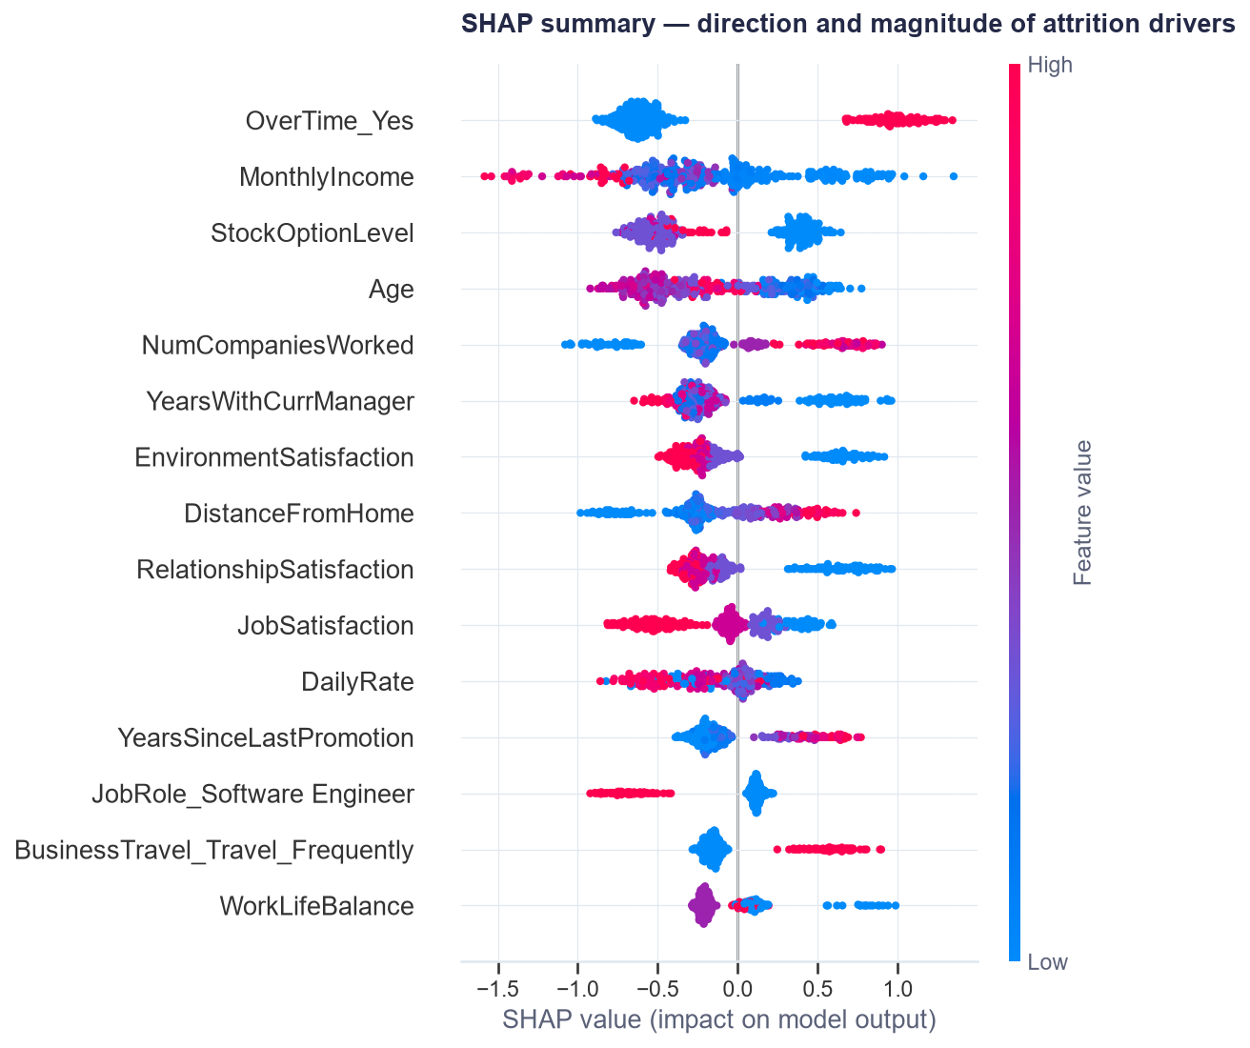
The model confirms the drivers — and adds a hidden one
1. Overtime — strongest predictor; ~2× the odds of leaving, all else equal.
2. Low pay / junior level / short tenure — a correlated cluster; top SHAP features after overtime (income, stock options, age).
3. Frequent business travel — odds ratio ≈1.7; underappreciated.
4. Promotion stagnation — years since last promotion raises risk (OR ≈1.6/SD) once tenure is controlled for. The naive segment cut hides this; the regression surfaces it.
5. Low satisfaction, long commute, single — secondary but consistent.
Model quality: ROC-AUC 0.81 (logistic; XGBoost 0.79). Catches 71% of true leavers while flagging 33% of employees — for prioritizing manager check-ins, not automated decisions.

Slide 5
Cost of inaction: ~$26M over the next three years
Population | Leavers / yr | Annual cost | Share of cost
Overtime employees (n=416) | 127 | $4.55M | 52.5%
First-year employees (n=215) | 75 | $1.68M | 19.4%
Junior + overtime core (n=156) | 82 | $1.42M | 16.3%
Everyone else | — | balance | —
$8.67M
per year at the current run-rate
$26M
over three years, before headcount growth
Populations overlap (a first-year junior on overtime appears in all three rows) — shares don't sum to 100%.
What's not in the number: lost domain knowledge, customer relationship damage in Sales, team morale drag, manager time. All push the true cost higher.

Slide 6
Three intervention options
A — Targeted overtime reduction
On-call restructuring, workload rebalancing, comp-time, and a ~4-hire backfill buffer, prioritizing the 156 junior+overtime core.
Effect (assumed): −25% relative attrition in the OT group → 32 fewer exits, $1.13M/yr saved
Cost: ~$300K/yr
Net ≈ +$830K/yr · ~3.8× gross ROI
Tradeoff: manager behavior change; some delivery-speed sacrifice.
B — Broad comp adjustment
Raise the 369 bottom-quartile earners by 10%.
Effect (assumed): −25% relative attrition → 27 fewer exits, but junior replacements are cheap: $0.40M/yr saved
Cost: ~$1.04M/yr, recurring
Net ≈ −$640K/yr · does not pay for itself
Tradeoff: strongest signal of investment; hardest to reverse. Reserve targeted corrections for proven market gaps (needs comp benchmark).
C — First-year experience + promotion velocity
Structured 90-day onboarding, mentor program, defined L1→L2 path with 12–18 month checkpoints.
Effect (assumed): −20% first-year attrition → 15 fewer exits, $0.34M/yr saved + promotion-velocity upside
Cost: ~$120K/yr
Net ≈ +$215K/yr · ~2.8× gross ROI
Tradeoff: cheapest, lowest-risk; addresses only ~20% of the cost pool.

Slide 7
Recommendation: do A + C together — piloted, model-assisted
+$0.8M/yr net
≈ $1.25M/yr saved (overlap-discounted) for ~$420K/yr program cost — roughly 3× ROI
Stated assumptions
Effect sizes (−25% / −20% relative) are industry-plausible but unproven here — the pilot exists to test them.
Replacement costs are conservative; soft costs excluded.
Salary figures are the dataset's — if real payroll is higher, savings scale linearly.
Savings discounted ~15% for population overlap between A and C.
~47 fewer departures a year — company attrition moves from 16.1% to ~13%, from worst quartile to mid-band for tech.
Model sequences the rollout — risk scores pick which teams get on-call restructuring and enhanced onboarding first. Support only, never punitive.
Pilot before scaling — one quarter in the 2 highest-attrition Sales pods + 1 Engineering group, with a control group to validate the assumed effect sizes.
Defer B — revisit targeted comp corrections once market benchmark data is in.

Slide 8
12-month roadmap
Qtr | Action | Owner | Success metric
Q1 | Overtime audit + pilot in 3 highest-risk teams; structured onboarding for all new hires | HRBP + Eng/Sales leads | Pilot vs. control attrition; onboarding NPS
Q2 | Read pilot; scale Option A if ≥15% relative reduction observed; define L1→L2 promotion rubric | CHRO | Effect size confirmed; rubric shipped
Q3 | Full rollout; model-scored quarterly retention check-ins for the top-risk decile | People Analytics | 71%+ of eventual leavers had a check-in
Q4 | Re-measure: target ≤14% trailing attrition; decide targeted comp corrections with market data | CHRO + Finance | Attrition rate; $ saved vs. model

Slide 9
Appendix: methodology & caveats
Data
IBM HR Analytics dataset (1,470 employees, 35 fields, no missing values; 3 constant columns dropped). 'R&D' relabelled 'Engineering' for narrative. Synthetic and cross-sectional — a single snapshot, no dates — so attrition is treated as an annualized rate and no time-based validation is possible.
Cost model (per departure)
Recruiting 20% of annual salary + onboarding 10% + vacancy (1.5–4 months × monthly salary, by level) + ramp-up (3–6 months at 50% productivity). Yields 55% of salary (junior) to 88% (exec); average $36.6K ≈ 7.1 months. Anchors: SHRM cost-per-hire and time-to-fill studies; SHRM 6–9-month rule of thumb; Gallup 0.5–2× salary.
Models
75/25 stratified split, 5-fold CV; class imbalance handled with class weights (accuracy deliberately not headlined). Logistic regression: test ROC-AUC 0.810, PR-AUC 0.562 (baseline 0.16), CV 0.842 ± 0.044. XGBoost: 0.785 / 0.522. The simpler model wins on this small dataset; both reported.
Caveats
– Correlation ≠ causation — every intervention effect size is an assumption to be piloted, not a model output.
– 237 positive cases → wide confidence intervals on per-role estimates.
– No voluntary/involuntary split — some 'attrition' may be terminations.
– No external comp benchmarks — can't distinguish 'paid low' from 'paid below market'.
– Ethics: risk scores prioritize support (check-ins, workload relief), never punitive action; not visible in performance contexts.
Open inputs needed from leadership
Real payroll scaling · market comp benchmarks · voluntary/involuntary attrition split · actual time-to-fill by role.

