Slide 1
CHURN ANALYSIS & RETENTION STRATEGY
Customer churn is a $4.5M problem.
Half of it sits where we can act.
Shalom Wu · July 2026
7,043
customers in the book
$456K
monthly recurring revenue
26.5%
of customers churned
Public Telco Customer Churn dataset (Kaggle/IBM), deliberately framed as a subscription/SaaS-style business — see data-sources.md

Slide 2
26.5% of customers churned — taking 31% of recurring revenue with them
The churned cohort skews premium. Churners average $74/month against $61 for those who stay — the loss is worth more than its headcount suggests.
The average hides the problem. Blended monthly churn is ~0.8% — healthy by subscription benchmarks. But the month-to-month segment runs at ~2.4%/month, and it holds 55% of customers.
The loss repeats. Every year of inaction replays this cohort's cost. The $4.5M figure is the present value of profits already committed to walking out the door, plus what it costs to replace them (~$400 per customer).
$139K
MRR lost with the churned cohort
$1.67M
annualized lost revenue if none of it is replaced
$4.5M
full economic cost: foregone lifetime value + replacement acquisition (range $3.3M–$6.3M)
Source: public Telco Customer Churn dataset (Kaggle/IBM), n=7,043 — reframed as a subscription/SaaS business. Reproducible: python -m src.run_pipeline

Slide 3
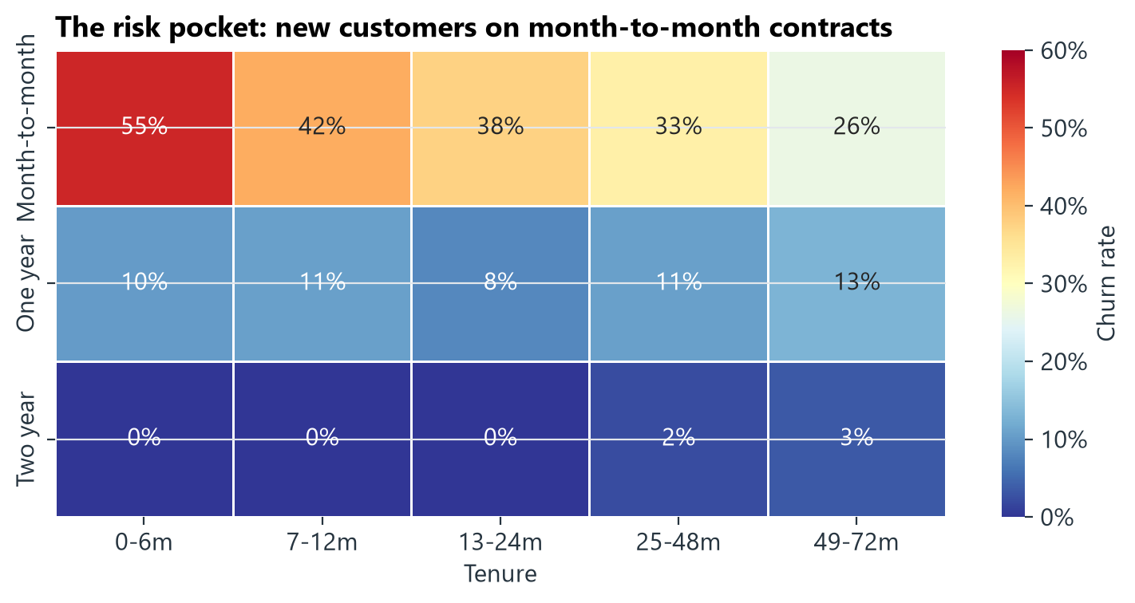
Five churn drivers, consistent across the data and both models
1
Contract type is the fault line
Month-to-month churns at 43% vs 11% (one-year) and 3% (two-year) — and it is 55% of the book.
2
Risk is front-loaded
53% of customers in their first 6 months churn; new month-to-month customers hit 55%.
3
The premium tier leaks most
Churn peaks at 38% in the $70–90 tier — mostly fiber. A price/value problem, and the $70+ tiers hold 71% of MRR.
4
Add-ons anchor customers
Churn falls monotonically from 52% (no add-ons) to 5% (all six); support-type add-ons matter most.
The models agree with the eyeball.
Logistic regression and XGBoost land on the same drivers (test ROC-AUC 0.84). Nothing exotic — every driver above is one the business can act on.
5
Electronic check is a red flag
45% churn vs 15–19% on automatic payment methods, even after controlling for contract.
Source: public Telco Customer Churn dataset (Kaggle/IBM), n=7,043 — reframed as a subscription/SaaS business. Reproducible: python -m src.run_pipeline

Slide 4
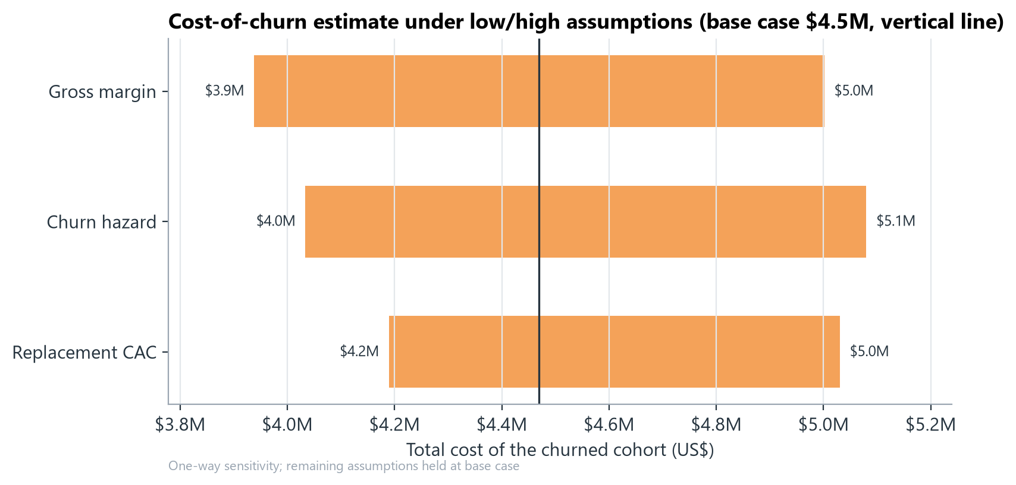
The cost of doing nothing is ~$4.5M per cohort — and it is concentrated
At-risk segment (overlapping) | Customers | Churn | MRR at stake
New month-to-month (≤ 12m tenure) | 1,994 | 51% | $116K
Month-to-month + electronic check | 1,850 | 54% | $139K
Fiber, no support/security add-ons | 1,765 | 55% | $152K
Premium ($90+), first year | 219 | 76% | $21K
Whole book (reference) | 7,043 | 26.5% | $456K
Segments overlap — they are three views of the same risk pocket: newer, month-to-month, premium-priced customers paying manually.
Cost per lost customer runs $2,061 (month-to-month) to $2,887 (one-year), including ~$400 to acquire a replacement.
No assumption makes this small.
Pushing every assumption to its most favorable end still leaves a $3.3M cohort cost; the least favorable end reaches $6.3M.
Source: public Telco Customer Churn dataset (Kaggle/IBM), n=7,043 — reframed as a subscription/SaaS business. Reproducible: python -m src.run_pipeline

Slide 5
Three self-funding interventions
A
Contract-shift incentive
B
Model-targeted saves
C
Premium onboarding bundle
“12 months for the price of 11” to move month-to-month customers onto annual contracts.
Annual-contract economics add ~$830 of present value per customer (LTV $1,661 → $2,487).
Score the book monthly; retention offers to the riskiest 20% by model score.
The model finds churners at 2.5x random — 67% precision at 20% campaign depth.
Bundle tech support + online security free for 6 months for new fiber customers.
Support add-ons show the steepest retention gradient in the data (52% → 5%).
~$134K
net PV, year 1
6x
ROI
~$231K
net PV, year 1
4.7x
ROI
~$37K
net PV, year 1
3.4x
ROI
Key risk: Discounts some customers who would have stayed anyway (half assumed).
Key risk: Offer fatigue; precision decays without quarterly retraining.
Key risk: Add-on effect may be self-selection — pilot as a 500-customer A/B test.
Net PV figures use deliberately conservative assumptions — stated on the next slide. All three are capped and self-limiting: offers only pay out on acceptance.

Slide 6
Recommendation: run A + B together, pilot C — ~$0.4M net PV in year 1
1
NOW
Launch the contract-shift offer (A) to all 3,875 month-to-month customers, prioritized by model score (B) so the riskiest hear first. One campaign, two levers.
Assumptions behind the ROI (deliberately conservative)
Assumption | Value | Basis
Contract-offer take-up | 10% | low end of upgrade-campaign rates
Deadweight haircut on A | 50% | half of converters would have stayed
Save rate, true churn risks | 15% | retention campaigns save 10–30%
Value per save | $2,061 | month-to-month cost per churn
Offer + ops cost, year 1 | ~$88K | free month + $150/save offer + ops
2
QUARTERLY
Rescore the book and rerun. Track take-up and save rate against the assumptions on the right; retire the campaign if realized ROI drops below 2x.
3
PILOT
Onboarding bundle (C) as a 500-customer A/B test on new fiber signups. Scale only on a causal read, not the correlational gradient.
Downside floor: every cost above is capped and only pays out on acceptance. The exposed spend if nothing works is the ops budget, not the offer pool.
If realized rates land mid-range instead of low-end, year-1 impact roughly doubles to ~$0.8M — against a $4.5M/year problem.
Source: public Telco Customer Churn dataset (Kaggle/IBM), n=7,043 — reframed as a subscription/SaaS business. Reproducible: python -m src.run_pipeline

Slide 7
Appendix — methodology & caveats
Method
Caveats, stated plainly
Exposure-based churn hazard (events ÷ customer-months), per contract segment
Expected lifetime = 1/hazard, capped at the 72-month observation window
LTV = discounted gross profit (70% margin, 10%/yr discount rate)
Cost of churn = foregone LTV + $400 replacement CAC, stress-tested (tornado)
Models: class-weighted logistic regression + shallow XGBoost, 80/20 stratified split
Drivers: SHAP values (XGBoost) cross-checked against standardized coefficients
Snapshot dataset — no event timestamps; production needs point-in-time features and out-of-time validation
Label window unspecified — 26.5% is a cohort share, not a monthly rate; cohort framings used throughout
Margin, CAC and discount rate are SaaS benchmarks, not company actuals — all live in src/config.py
Correlation ≠ causation — contract type is partly self-selection; ROI uses haircuts and pilots
Telecom data in SaaS framing — the method transfers, the coefficients don't
Model ceiling (~0.84 AUC) reflects missing behavioral features (usage, tickets), not modeling choices
Full detail: reports/model-report.md · notebooks 01–03 · every assumption in src/config.py

