Slide 1
APPANROM
A Tanglish Programming Language and
Android App Development Studio
TEAM MEMBERS
P. Santhosh
M. Shalom Arputha Singh
Anand Institute of Higher Technology
Notes:
Title slide. Team list to be confirmed.

Slide 2
The problem and our idea
Building a mobile app is hard to start for a beginner
The problem
Our idea
Native Android needs Kotlin or Java, Android Studio and Gradle knowledge
Programming languages are written in English, a barrier for many first-time learners
Designing screens and writing code are separate, disconnected steps
Getting from source code to an installable APK needs a heavy toolchain
A small language with Tanglish keywords: mari, enna_na, ovvoru, screen_uruvakku
A local-first web Studio: code editor, live preview and drag-and-drop designer
One shared runtime, so the preview behaves exactly like the real app
One click to generate an Android project and build an APK

Slide 3
What AppPanrom provides
Three parts that work together
1
2
3
Language
Studio
Android pipeline
Tanglish keywords, indentation-based syntax, helpful error messages with suggestions. Compiled to a validated intermediate representation.
Web IDE with CodeMirror editor, live phone preview, visual designer, diagnostics, console and a build tab. Data stays on your machine.
Generates a real Gradle project from the same output, runs the build, verifies the APK and reports honestly.
Principles: no eval or exec of user code, secrets never stored in the repository, preview and APK share one runtime.

Slide 4
System architecture
One compiler output feeds both the preview and the Android app
Studio UI
(React + CodeMirror)
Backend API
(FastAPI + SQLite)
Compiler
Lexer, Parser, Validator
IR (JSON)
components, styles, permissions
Preview path
Android path
Shared runtime (JS)
interpreter + renderer
Designer engine
(text edits)
Android project
generator + template
Gradle
Drag-and-drop edits the source text, so code and design stay in sync
Live phone preview
Verify (zip, signature)
APK

Slide 5
The AppPanrom language
Readable Tanglish keywords with a familiar structure
mari
declare a variable
app_uruvakku("Counter")
mari clicks = 0
function tap():
clicks = clicks + 1
enna_na clicks >= 10:
toast_kaattu("Ten taps!")
screen_uruvakku("home"):
column_uruvakku():
text_kaattu("Taps: " + str(clicks))
button("Tap", click_pannumbodhu=tap)
enna_na / illana_enna / illana
if / else if / else
ovvoru ... in
for-each loop
irukkura_varai
while loop
screen_uruvakku
define a screen
click_pannumbodhu
on-click handler
Hand-written indentation-aware lexer and parser. Errors come with line, column and a suggested fix. About 18 UI components and 50 built-in functions.

Slide 6
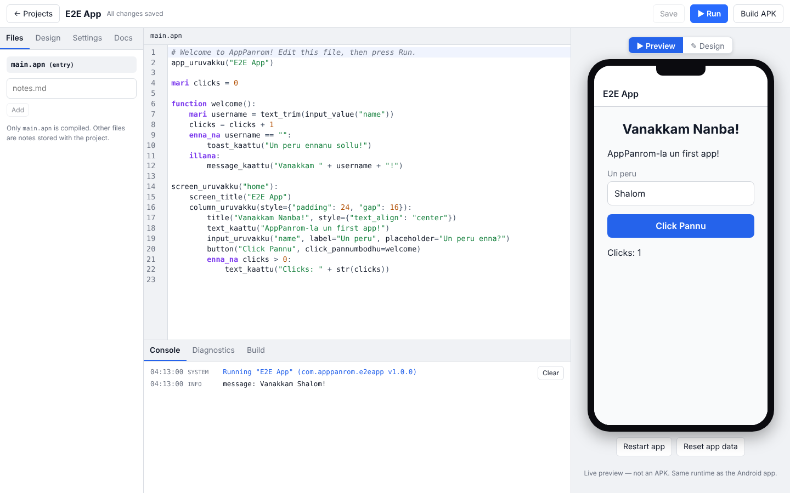
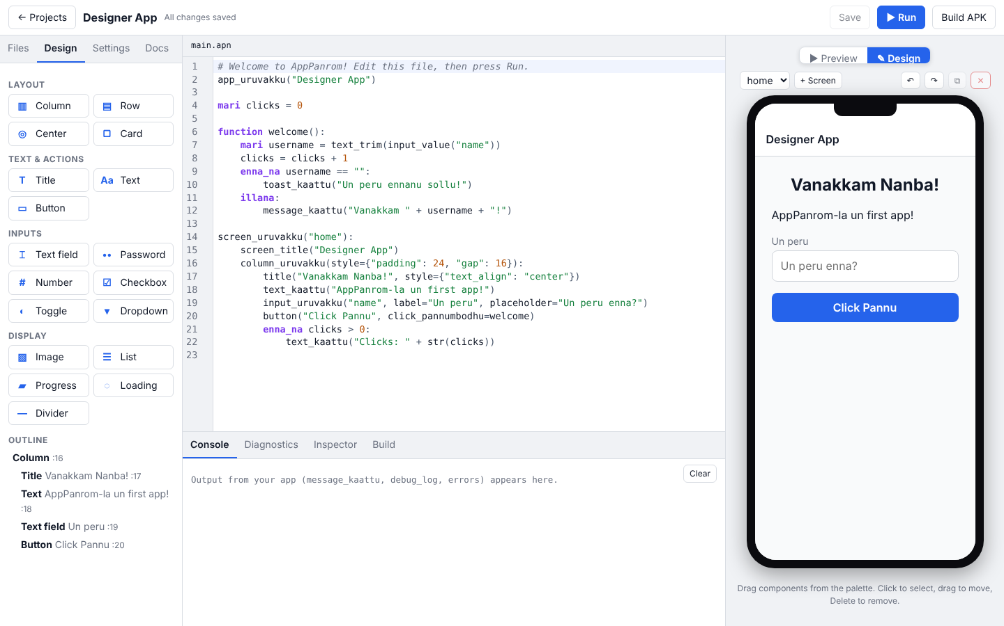
AppPanrom Studio
Write, preview and design in one window
Editor with live preview and console
Visual designer: palette, outline, drag and drop
Two-way sync: dragging a component rewrites the code, and typing code updates the canvas
Undo and redo, inspector for styles, projects saved locally in SQLite

Slide 7
From source code to an installable APK
Honest reporting: a build succeeds only when a verified APK exists
Source
.apn
Compile
+ validate
Generate
Android project
Gradle
assembleDebug
Verify
zip + signature
APK
Safe by design
Signing and permissions
Built in CI
Web content is served from local assets with a strict CSP. No JavaScript bridge. User code is interpreted, never evaluated.
Release signing keys are read from environment variables only. Permissions are derived from the components and functions an app uses.
GitHub Actions builds each example with the Android SDK and Gradle, verifies the APK and publishes it with a SHA-256 checksum.

Slide 8
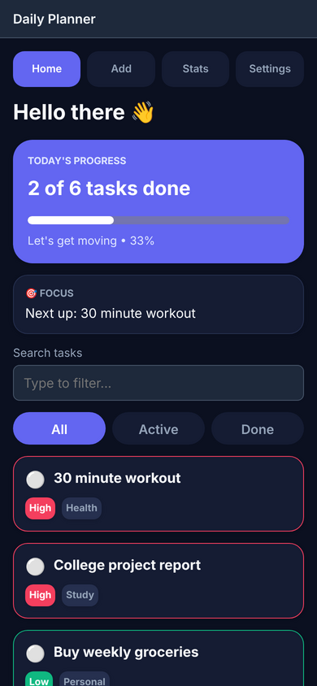
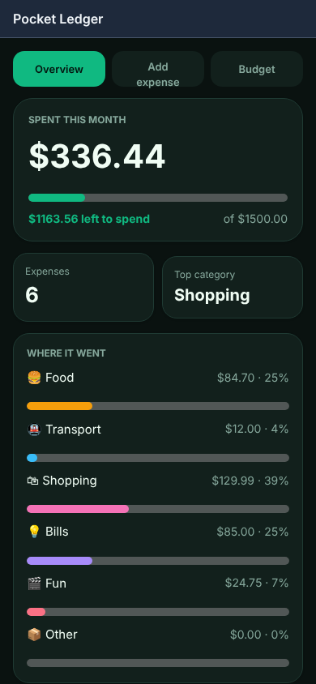
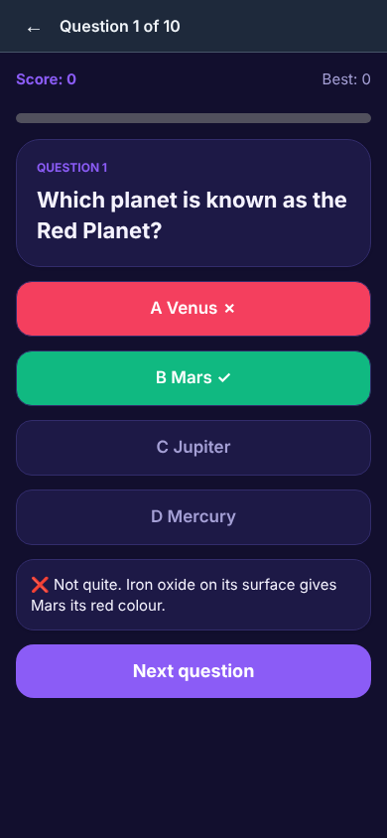
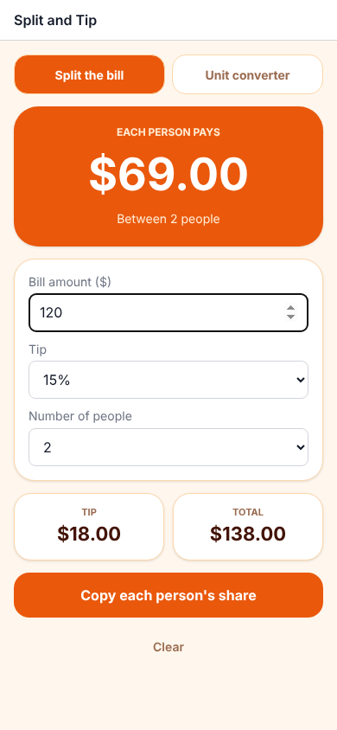
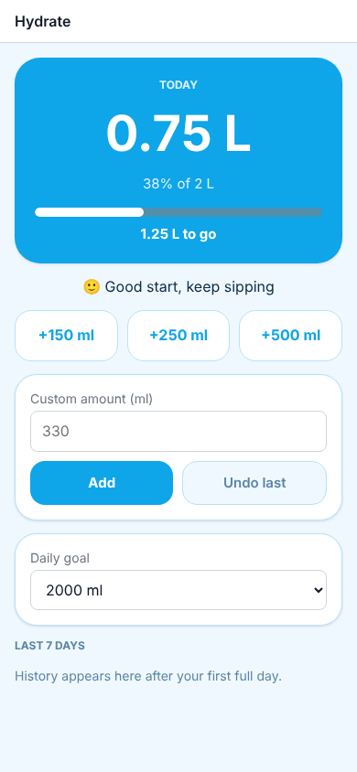
Apps built with AppPanrom
Seven example apps, all written in the language and built as real APKs
Daily Planner
Pocket Ledger
Brain Quiz
Split & Tip
Hydrate
Also included: Calculator and the Tanglish "Vanakkam" starter. Screens are real renders of the shared runtime.

Slide 9
Results and conclusion
156
7
0
1
automated tests
(120 backend, 36 runtime)
example apps built
as real APKs
eval or exec of
user code
shared runtime for
preview and APK
Conclusion
Next steps
AppPanrom turns a Tanglish program into a working Android app in one studio. The designer and code editor edit the same text, the preview and the APK run the same runtime, and every build is verified before it is reported as successful.
Test the APKs on a range of real devices
Release signing and Play Store bundle (AAB) flow
Network access, camera and location features

