Slide 1
AppPanrom
Build Android apps in Tanglish
TEAM
P. Santhosh
M. Shalom Arputha Singh
Anand Institute of Higher Technology

Slide 2
THE PROBLEM
Making your first app is harder than it should be.
Heavy tools
A language barrier
Disconnected steps
Android Studio, Gradle, Kotlin. Hours of setup before the first button appears.
Code is written in English keywords, a hurdle for many first-time learners.
Design, code and build live in different tools and never quite agree.

Slide 3
OUR SOLUTION
Write in Tanglish. Preview instantly. Ship an APK.
1
2
3
Write
Preview
Build
A small language with Tanglish keywords: mari, enna_na, ovvoru, screen_uruvakku.
A live phone preview and a drag-and-drop designer that rewrites your code as you drag.
One click generates an Android project, builds it and verifies the APK.

Slide 4
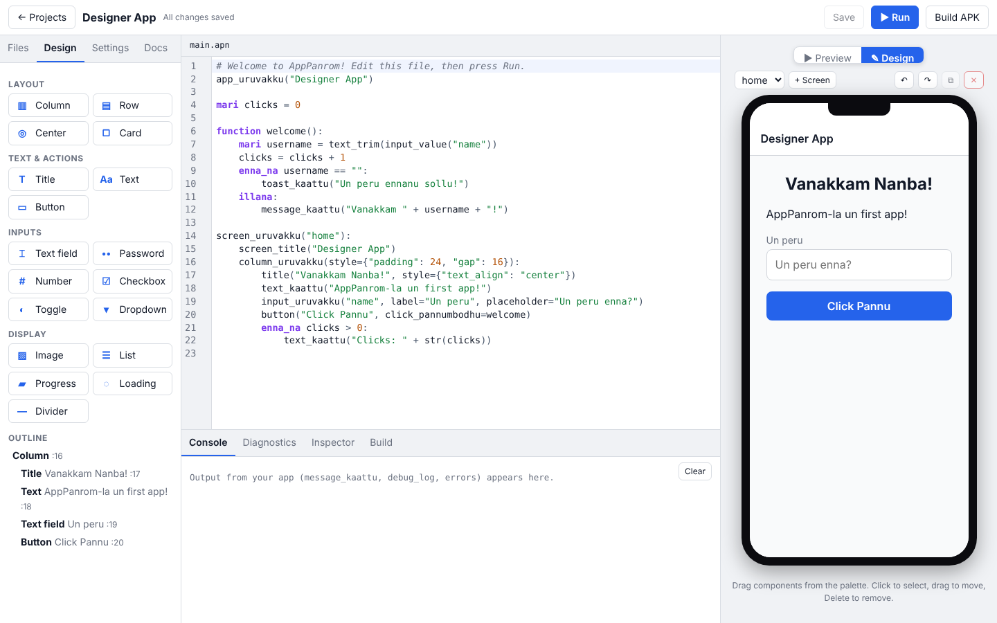
THE PRODUCT
One window for the whole journey
Code editor
Syntax highlighting and friendly errors with suggestions.
Visual designer
Drag components onto the phone. The code updates live.
Local first
Your projects stay on your machine.

Slide 5
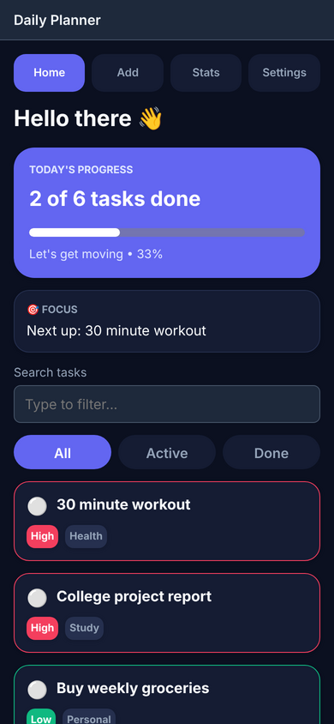
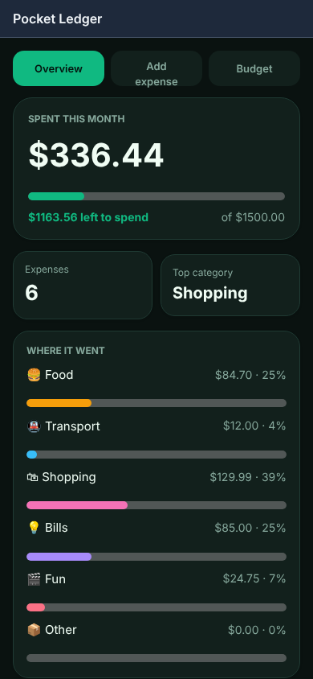
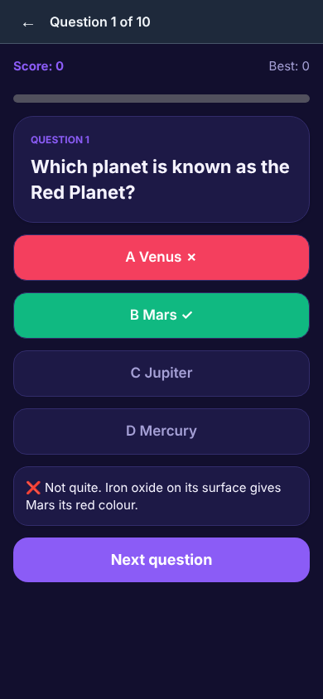
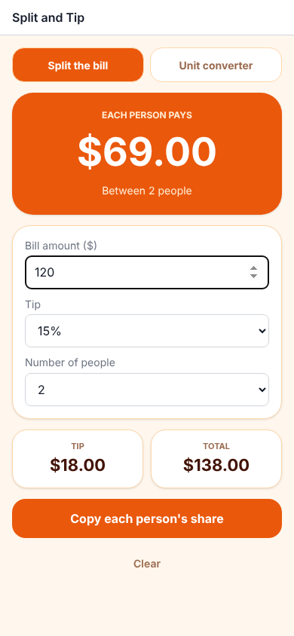
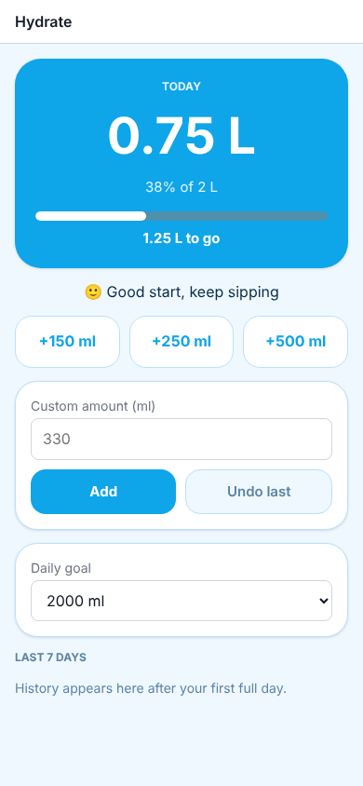
PROOF IT WORKS
Real apps, built as real APKs
Daily Planner
Pocket Ledger
Brain Quiz
Split & Tip
Hydrate
All written in AppPanrom. Seven apps built so far, including a calculator.

Slide 6
HOW IT WORKS
One compiler. One runtime. Two destinations.
Tanglish source
Compiler
lexer, parser, validator
Intermediate
representation (JSON)
Shared runtime
The preview and the APK run the same runtime, so what you see is what you ship.
Android project + Gradle
Live preview in Studio
Verified APK

Slide 7
WHY IT IS DIFFERENT
Built for learners, engineered like a real tool.
Tanglish-first
Design and code stay in sync
Keywords learners already speak, with errors that suggest the fix.
The designer edits the source text itself, so nothing drifts apart.
Safe by design
Honest builds
User code is interpreted, never evaluated. No JavaScript bridge in the app.
A build is reported successful only when a verified APK exists.

Slide 8
WHERE WE ARE TODAY
Working end to end, with tests behind it.
156
7
0
1
automated tests
apps built as APKs
eval or exec of user code
runtime for preview and app
APKs are built by GitHub Actions with the real Android SDK and Gradle. Next we test them on physical devices.

Slide 9
WHAT IS NEXT
Programming in your own language, on every phone.
Now
Next
Later
Language, Studio, designer and verified APK builds.
Device testing, release signing and Play Store bundles.
Network access, camera and location, more regional languages.
Thank you

