Slide 1
PdfParser
Hackathon

Slide 2
Scope of Work
Develop a PDF table parsing solution using the Camelot framework to extract structured information from PDF documents.
Integrate the parser with a TCP connection module to facilitate the transmission of structured data to target applications.
Capabilities:
Ability to extract text content from PDF documents considering variations in font size, style, and orientation.
Capable of recognizing and extracting structured data from tables, including handling merged and split cells, different row and column configurations, and variations in table layout.
Support for parsing multiple pages within a PDF document.
Ability to handle dynamic structures for data generation.
Recognition and extraction of different data types within cells, such as text, numeric values, and date formats.
Limitations:
Cannot guarantee seamless transmission of data via TCP in all network conditions, as external factors such as network congestion or connectivity issues may impact performance.
Cannot provide compatibility with all types of PDF documents and target applications without potential adjustments or customization (Cannot handle scanned pdfs).

Slide 3
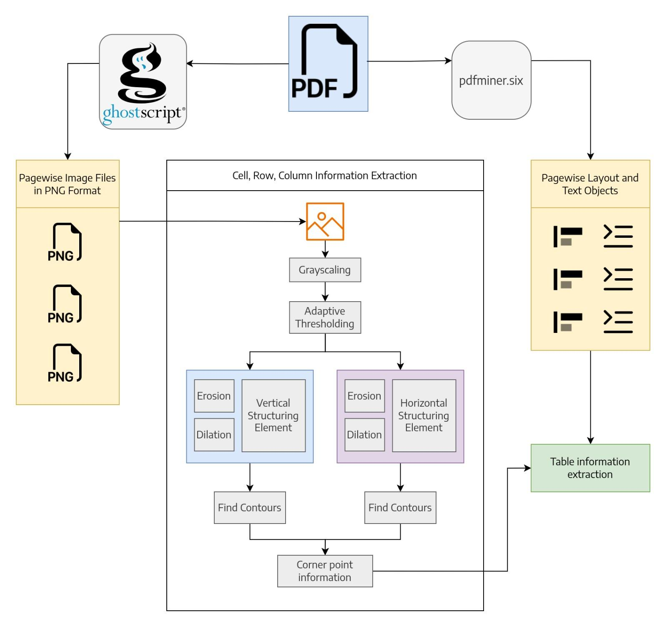
2.
Solution Method
Fig 2.1
Solution Architecture For Pdf Parser: We use ghostscript and pdf parser to extract the relevant cornerpoint and layout information of the tables

Slide 4
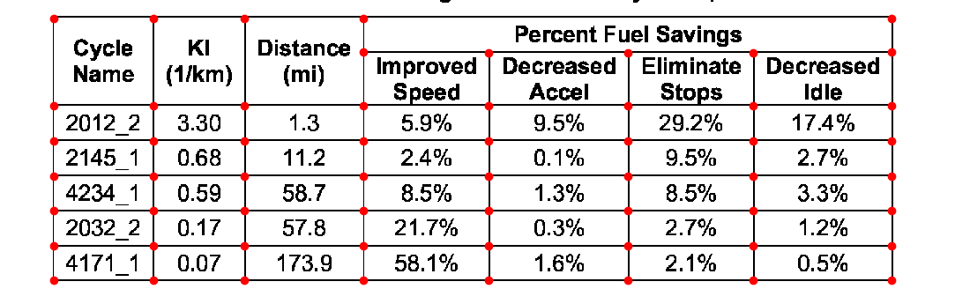
2. Solution Method (Continued)
Our solution to extract pdf table information uses Traditional Image Processing Techniques. It comprises of the following:
Extraction of Corner Points:
After applying adaptive thresholding, erosion and dilution, we find contours which will give the corner points of the tables
Fig 2.2 Corner point identification

Slide 5
2. Solution Method (Continued)
2. Layout and text of the PDF table
We use pdfminer.six library to get the layout and the text of the table so that we can use the coordinate information obtained at step 1 to get the pdf table information
3. TCP Connection Integration:
Integration of a TCP connection module to establish communication with target applications.

Slide 6
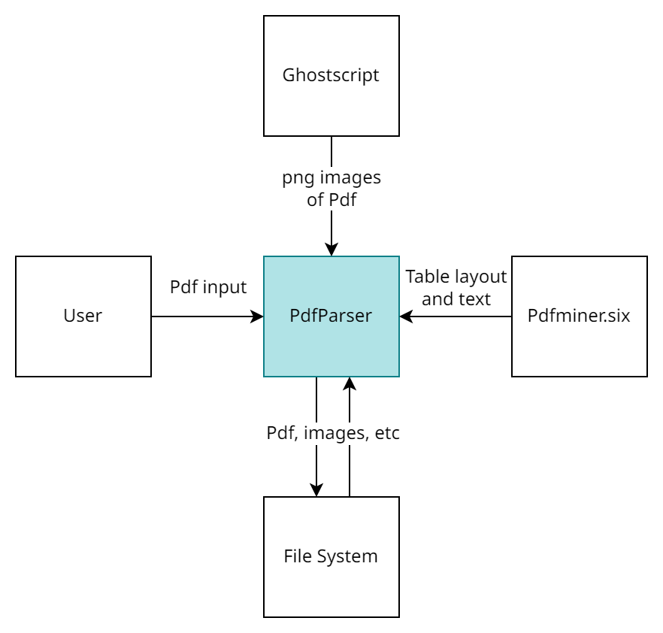
3. Solution Design Approach
Fig 3.1 Context Model of Pdf Parser

Slide 7
3. Solution Design Approach (Continued)
Problem Decomposition
Obtaining corner points from the image of the table
Ghostscript is used to convert the pdf pages to images
Vertical and horizontal structuring element is used in dilution and erosion
The resultant images are used to find corner points by contours
The coordinates of the corner points are thus obtained
Obtaining the layout and the corresponding text
Pdfminer.six is used to obtain the layout and the corresponding text
Obtaining table in pandas.dataframe format
Coordinate information from 1 and text and layout information from 2 is used to obtain the pdf table in pandas.dataframe format
Transmission of Data using TCP

Slide 8
3. Solution Design Approach (Continued)
Data Structures:
Pandas.dataframe
Used for tables
structured like a spreadsheet with rows and columns, making it simpler to work with data
Python String:
Used for TCP transmission
Algorithms:
Adaptive Thresholding
Contour retrieval & Contour approximation
Erosion and Dilation
Handling Assumption and Constraints:
We assume that the pdf is not a scanned pdf where the tables exist as images. Currently we produce an error message. But with more progress we can integrate OCR for text in images.

Slide 9
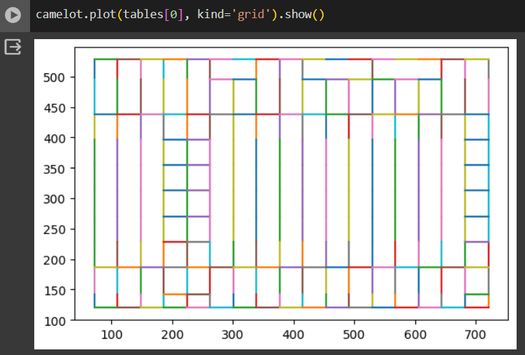
Solution Implementation Approach
The solution is implemented in python. The code should be attached with the ppt file. We have used the camelot library to make our implementation easier.

Slide 10
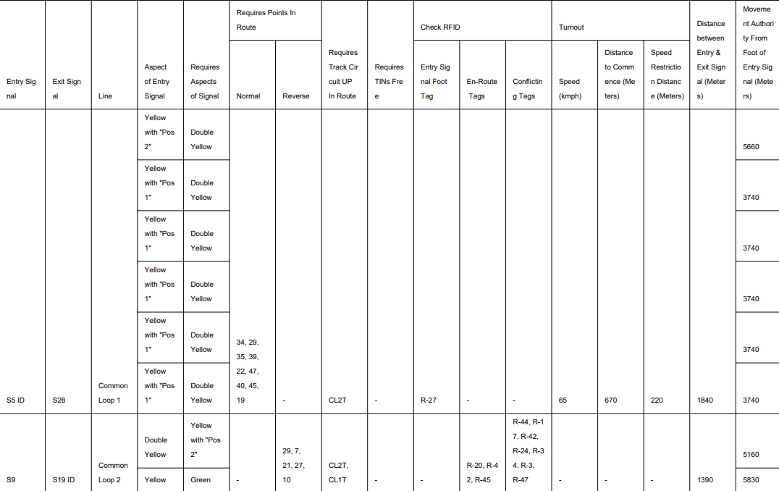
Test and Validation Approach
We use reportlab library to generate pdf. The pdf cells are filled with random values and the number of row is also selected to make the table span across multiple pages. A sample generated pdf is to the right.
During testing the pdf parser could correctly identify the lattice point 100% while using generated files

Slide 11
Knowledge/ Technology Enhancements
This uses traditional image processing and tools like ghostscript, pdfminer,camelot in order to extract information from the pdf.
Only requiring basic python libraries, it can easily be implemented in any of BEL’s project

Slide 12
Scope of Work: Enhancing Night Vision Capabilities Using Image Processing Techniques
1. Introduction:
The scope of this project is to develop and implement an image processing pipeline aimed at enhancing the night vision capabilities of images captured by an IR Cut Pi Camera under low-light conditions. The objective is to transform dark, low-visibility images into visually appealing RGB-color images suitable for various applications, including surveillance and object detection.
2. Objectives:
- Develop a modular image enhancement pipeline using a combination of image processing techniques.
- Improve image visibility and contrast without requiring hardware modifications to the IR Cut Pi Camera.
- Ensure adaptability to diverse low-light scenarios and compatibility with standard image processing tools.
- Optimize the pipeline for real-time performance to provide immediate visual feedback.
3. Scope of Deliverables:
The project will deliver the following:
- Python implementation of an image enhancement pipeline incorporating noise reduction, contrast enhancement, and other relevant techniques.
- Detailed documentation outlining the functionality of each module and the overall pipeline architecture.
- Installation instructions and requirements to ensure reproducibility and ease of use.
- Test scripts and procedures to validate the effectiveness and performance of the image enhancement pipeline.
4. Tasks and Timeline:
The project will be divided into the following tasks with associated timelines:
a) Research and Planning (1 week):
- Conduct research on image processing techniques suitable for night vision enhancement.
- Define the pipeline architecture and select appropriate algorithms for each stage.
b) Implementation (1 weeks):
- Develop Python modules for noise reduction, adaptive histogram equalization, gamma correction, and other enhancement techniques.
- Integrate the modules into a cohesive image enhancement pipeline.
c) Testing and Optimization (1 week):
- Test the pipeline using a variety of input images captured in low-light conditions.
- Optimize parameters and algorithms to achieve the desired level of image enhancement.
d) Documentation and Reporting (1 week):
- Document the implementation details, including code comments and usage instructions.
- Prepare a comprehensive report summarizing the project scope, methodology, results, and future recommendations.
5. Success Criteria:
The success of the project will be evaluated based on:
- Improvement in image quality and visibility demonstrated through comparative analysis.
- Real-time performance achieved during image enhancement processing.
- Adaptability and robustness of the pipeline across diverse low-light scenarios.
6. Resources and Constraints:
- The project will utilize OpenCV and other relevant Python libraries for image processing.
- Computational resources such as CPU/GPU capacity will be considered for optimizing performance.
- The implementation should be compatible with standard Python environments to ensure broad accessibility.
7. Stakeholders and Collaboration:
Collaboration with domain experts in image processing or computer vision may be sought to validate the effectiveness of the proposed techniques.
8. Risk Assessment:
Potential risks include algorithmic complexity affecting real-time performance, limitations of image enhancement techniques in extreme low-light conditions, and compatibility issues with specific hardware configurations.
9. Future Recommendations:
Future work may include exploring deep learning-based approaches for image enhancement, integrating additional sensor modalities for enhanced visibility, and scaling the pipeline for deployment in real-world applications.
10. Conclusion:
This scope of work aims to address the challenge of enhancing night vision capabilities using image processing techniques, with a focus on delivering an effective and adaptable solution suitable for a range of practical applications. The project outcome will contribute to advancements in image enhancement technology and its utility in low-light imaging scenarios.

Slide 13
Solution Method Approach
1. Expressiveness of the Solution Method:
The expressiveness of the solution method refers to its ability to effectively capture and enhance key features of the input images while maintaining visual fidelity and clarity. In the context of the proposed pipeline, the solution method demonstrates expressiveness through the following aspects:
- Modularity and Flexibility: The solution method employs a modular approach, allowing for the integration of various image processing techniques (e.g., noise reduction, adaptive histogram equalization, gamma correction) tailored to address specific challenges in enhancing night vision capabilities.
- Parameter Tuning and Adaptability: The method allows for parameter tuning (e.g., clip limit, grid size, gamma value) to adjust the enhancement process based on the characteristics of the input images and desired output quality.
- Visualization and Interpretability: The pipeline converts the processed grayscale images back to RGB format, enabling visualization and interpretation of the enhanced images suitable for downstream analysis and application.
2. Efficacy of the Solution Method:
The efficacy of the solution method refers to its effectiveness in achieving the desired enhancement goals, such as improving image visibility and contrast in low-light conditions. The efficacy of the proposed pipeline is demonstrated by:
- Enhancement Quality: The method aims to significantly improve image quality by reducing noise, enhancing contrast, and correcting gamma values to optimize brightness levels.
- Real-time Processing: The solution method is designed to optimize for real-time performance, ensuring timely feedback and responsiveness in applications requiring immediate visual analysis (e.g., surveillance systems, object detection).
- Comparative Analysis: The efficacy can be evaluated through comparative analysis between original and enhanced images, quantifying improvements in visibility metrics (e.g., contrast, sharpness) and subjective assessments of image quality.
3. Intellectual Stimulation of the Solution Method:
The intellectual stimulation of the solution method pertains to its capacity to engage and stimulate further exploration and innovation in image processing techniques. This is evidenced by:
- Algorithmic Exploration: The method incorporates a combination of established and potentially novel image processing algorithms (e.g., adaptive histogram equalization, gamma correction), encouraging exploration and experimentation with alternative techniques for night vision enhancement.
- Research and Development: The solution method fosters ongoing research and development in computer vision and image processing, motivating the exploration of advanced methods such as deep learning-based approaches for image enhancement in challenging low-light scenarios.
- Problem-Solving Approach: The method encourages a problem-solving mindset, promoting iterative refinement of algorithms and techniques to address specific challenges in enhancing night vision capabilities across diverse applications.
In summary, the solution method for enhancing night vision capabilities using image processing techniques demonstrates expressiveness through its modular design and adaptability, efficacy through its ability to significantly improve image quality in low-light conditions, and intellectual stimulation by fostering ongoing exploration and innovation in image processing algorithms and methodologies.

