Slide 1

GIT

Slide 2

Terminology
master - the repository’s main branch. Depending on the work flow it is the one people work on or the one where the integration happens
clone - copies an existing git repository, normally from some remote location to your local environment.
commit - submitting files to the repository (the local one); in other VCS it is often referred to as “checkin”
fetch or pull - is like “update” or “get latest” in other VCS. The difference between fetch and pull is that pull combines both, fetching the latest code from a remote repo as well as performs the merging.
push - is used to submit the code to a remote repository
remote - these are “remote” locations of your repository, normally on some central server.
SHA - every commit or node in the Git tree is identified by a unique SHA key. You can use them in various commands in order to manipulate a specific node.
head - is a reference to the node to which our working space of the repository currently points.
branch - is just like in other VCS with the difference that a branch in Git is actually nothing more special than a particular label on a given node. It is not a physical copy of the files as in other popular VCS.

Slide 3

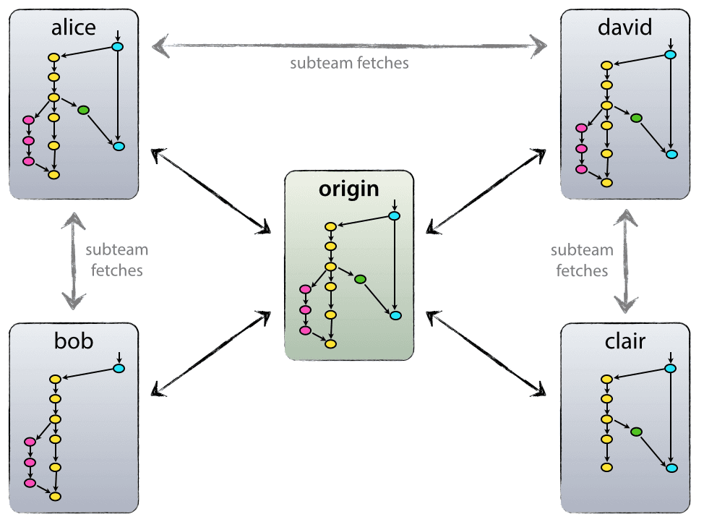
General Workflow
Notes:
https://nvie.com/posts/a-successful-git-branching-model/

Slide 4
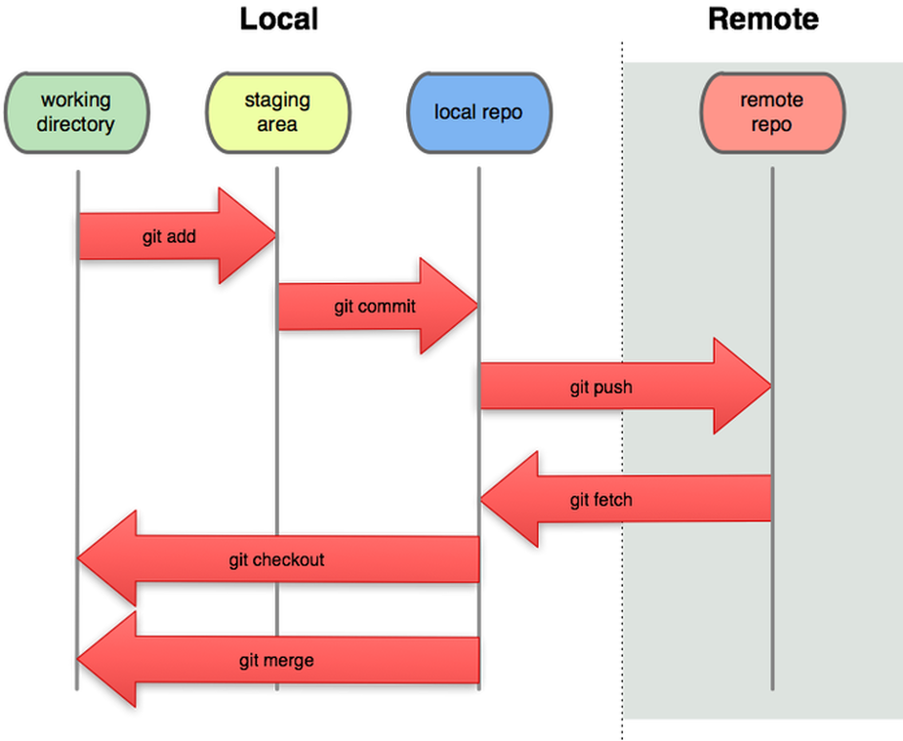

Slide 5
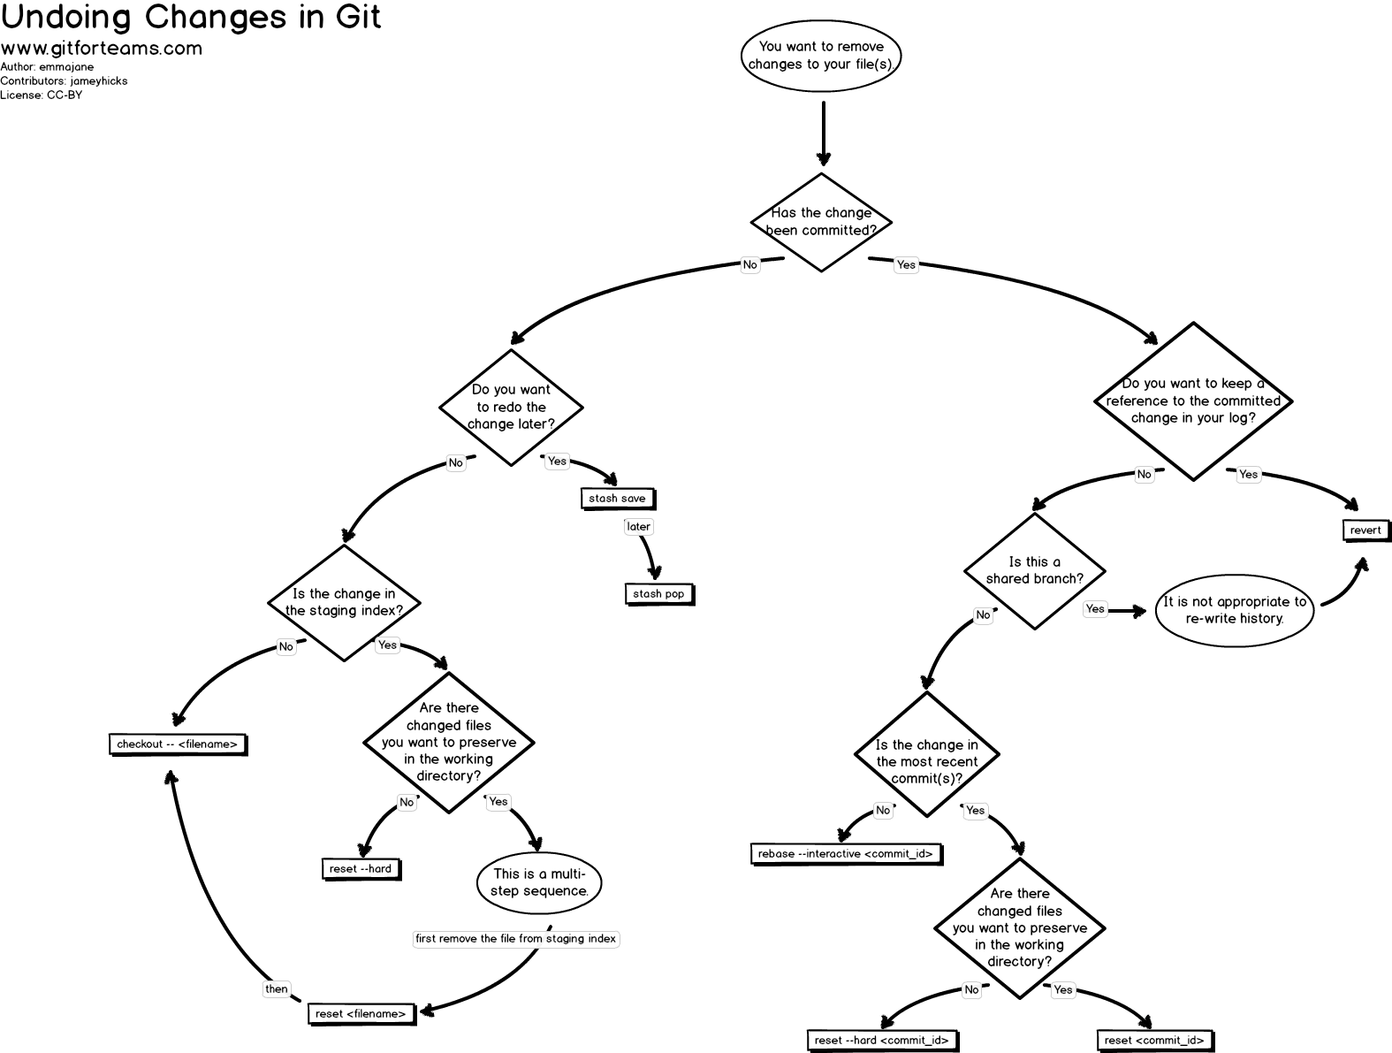

Slide 6
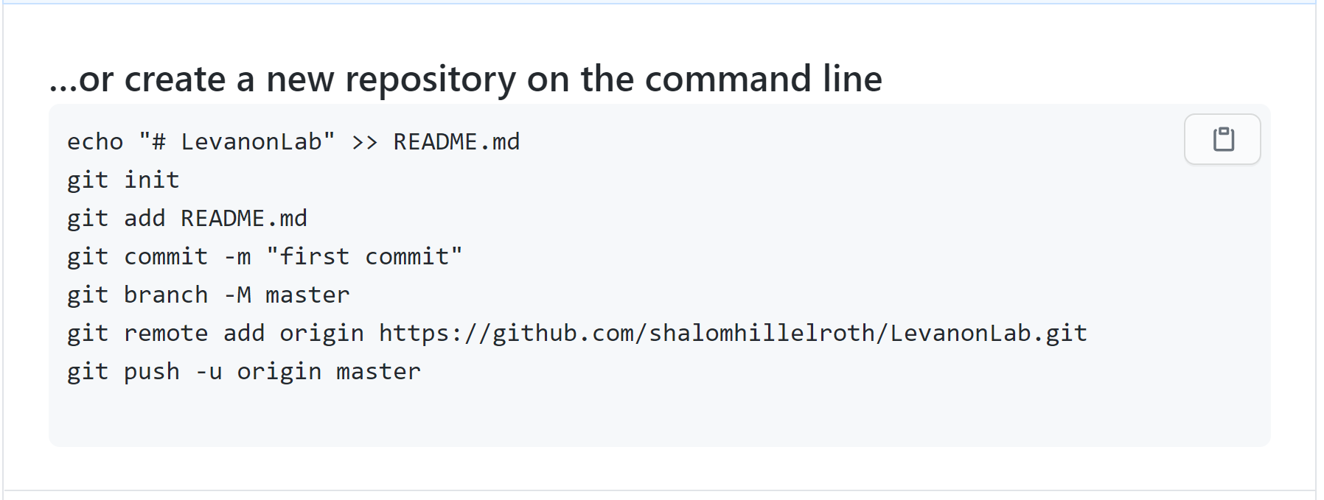
New Git Repository

Slide 7
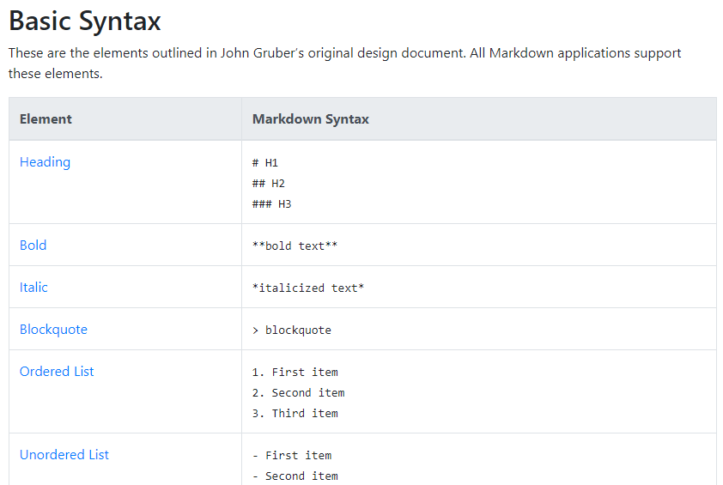
README.md (markdown language)
Notes:
https://www.markdownguide.org/cheat-sheet/

Slide 8
Branching- Let’s everyone “copy” our files into the git
Clone the git to your folders
git clone https://github.com/shalomhillelroth/LevanonLab
Make sure this is the current version
git pull
Create a new branch
git checkout –b <your name>Code
Now create a folder under UsersCode
cd UserCode
mkdir <your name>
Move your file(s) there
git add UserCode/<your name>/*
git commit
Press “insert” and write a commit message “<your name> first code commit ☺”
Press “escape” and then :wq and enter.
Or – git commit –m “your message”
git push
Merge to main:
git checkout master
git merge <your name>Code
?

Slide 9


