Slide 1
Purchase Pattern Analytics
What customers buy together, and what to do about it
Market Basket Analysis with Apriori | CDACL-005
Notes:
Introduce the project: market basket analysis on a year of retail transactions to find products bought together and turn them into actions.

Slide 2
Customers buy in families, and the cake stand is the hub
17,750
926
12.1x
bills analysed after cleaning (2,559 products)
association rules found at lift 1 or higher
highest lift: Bakelike alarm clock colours bought together
Product variants are collected: alarm-clock colours and cake-case designs show lift of 7 to 12.
Party, baking and kitchen items all lead to the REGENCY CAKESTAND 3 TIER (lift 2.1 to 2.5).
Revenue peaks in November; buying peaks at midday and mid-afternoon.
2
Notes:
Three messages: variants are collected, the cakestand is the cross-sell hub, and timing matters.

Slide 3
From raw transactions to rules in five steps
Acquire
Explore
Clean
Basket matrix
Apriori
522,064 rows read from MySQL
Statistics, charts, quality checks
7 logged steps, 94.8% of rows kept
17,750 bills × 2,559 products
Support ≥ 1.5%, itemsets up to 3
How to read a rule A → B: support = how common, confidence = how often B follows A, lift = how much more often than chance (above 1 is positive).
3

Slide 4
Cleaning removed 5.2% of rows, mostly rare products
522,064
raw rows
494,747
clean rows (94.8%)
Unit of analysis is the bill; 1 bill = 1 basket.
4

Slide 5
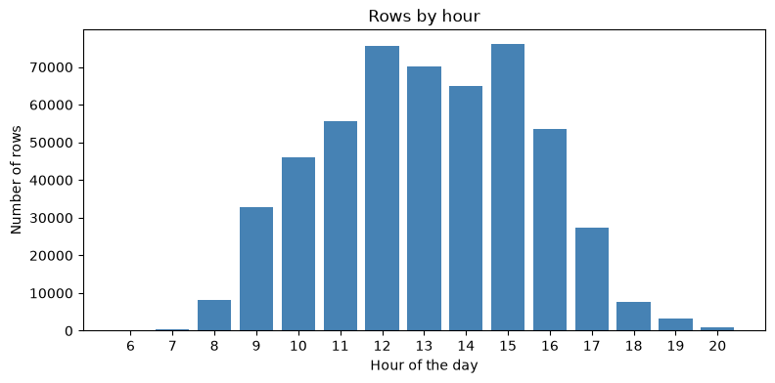
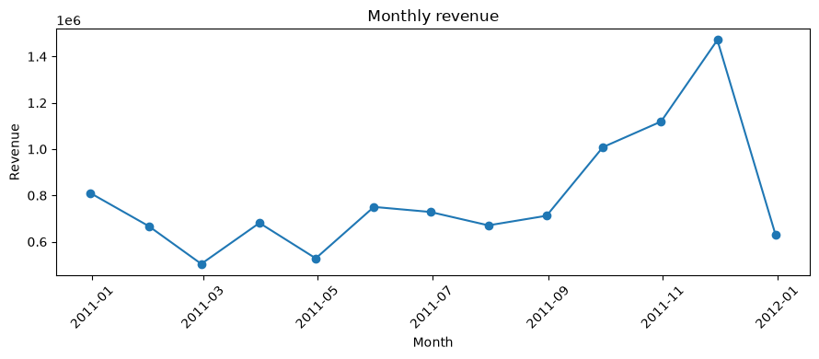
Demand builds from September and peaks in November
Revenue peaks in Nov 2011 (about 1.47M); December is a partial month.
Buying peaks at 12:00 and 15:00, mostly between 10:00 and 16:00.
Raw data, including returns; hourly chart counts rows.
5

Slide 6
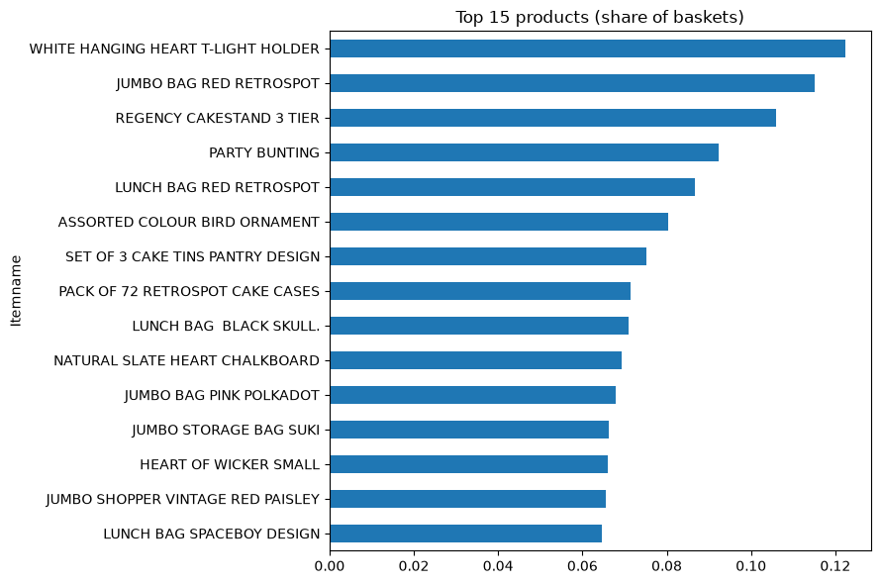
A few best-sellers anchor the baskets
T-light holder: in 12.2% of baskets
Jumbo Bag Red Retrospot: 11.5%
Regency Cakestand: 10.6%
Average bill: 27.6 products after cleaning (median 13 before)
6

Slide 7
Variants of one design show the strongest links
Rule | Confidence | Lift
Pink Paisley Cake Cases → 60 Teatime Cake Cases | 0.40 | 9.0
60 Teatime Cake Cases → 72 Retrospot Cake Cases | 0.54 | 7.6
Alarm Clock Chocolate → Alarm Clock Green | 0.66 | 12.1
Alarm Clock Chocolate → Alarm Clock Red | 0.68 | 11.8
890
frequent itemsets
926
rules (lift ≥ 1)
890 frequent itemsets and 926 rules at support ≥ 1.5%. Customers who buy one colour or design often buy another: collections, not just complements.
7

Slide 8
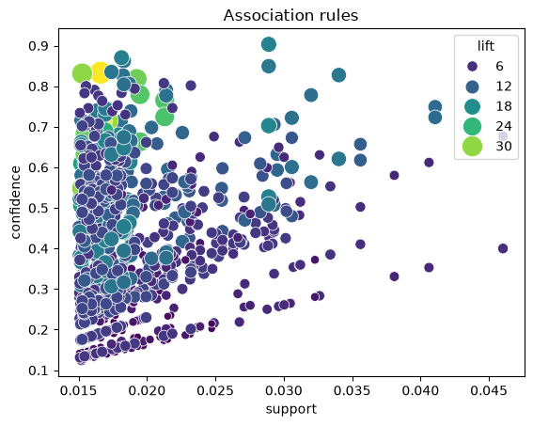
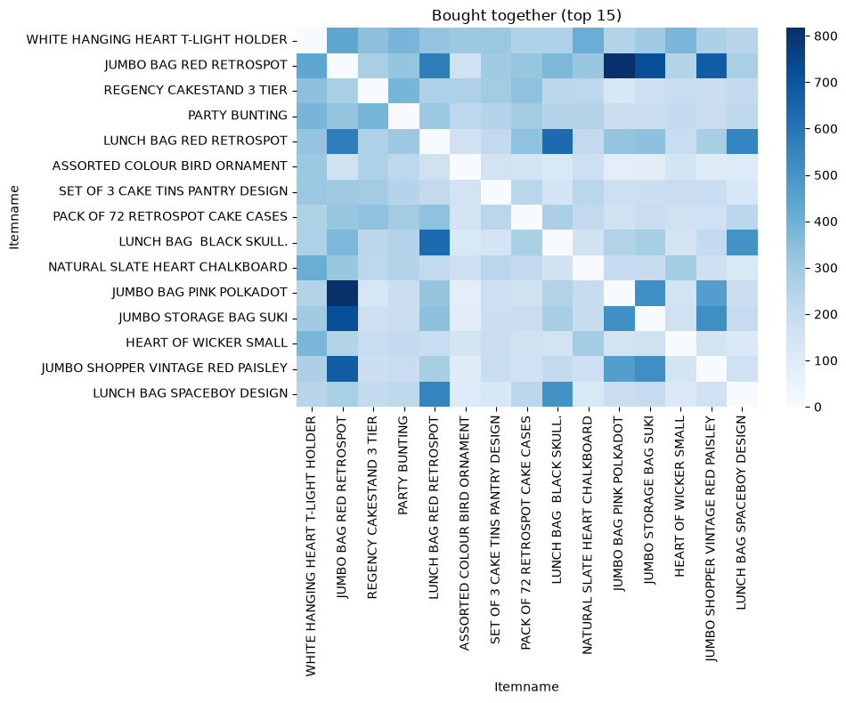
Co-purchase and lift show where bundles are natural
Left: how often the top 15 products share a bill. Right: most rules have support of 1.5% to 3% and confidence of 0.2 to 0.7; higher lift tends to occur at lower support.
8

Slide 9
Ten biggest opportunities all lead to the cake stand
If basket has | Conf. | Lift | Action | Potential*
Party Bunting | 0.24 | 2.2 | Cross-sell | 15,989
Set of 3 Cake Tins | 0.22 | 2.1 | Cross-sell | 13,273
72 Retrospot Cake Cases | 0.27 | 2.5 | Cross-sell | 11,870
Jam Making Set Printed | 0.25 | 2.4 | Cross-sell | 10,557
T-light Holder | 0.16 | 1.5 | Promotion | 23,320
Jumbo Bag Red Retrospot | 0.14 | 1.3 | Promotion | 22,504
143.8k
modelled upper bound, top 10 rules (7.2k at 5% uptake)
Bundle if lift ≥ 3 and confidence ≥ 0.5; cross-sell if lift ≥ 2; otherwise promote.
Suggested item in every row: REGENCY CAKESTAND 3 TIER. *Upper bound at 100% uptake: about 7,200 at 5%, and rows overlap. Use for ranking, then A/B test.
9

Slide 10
Three plays for the next quarter
Bundle
Cross-sell
Time it
Baking Essentials: cakestand + cake cases + cake tins
Multi-colour alarm-clock sets
Mixed cake-case collection
Suggest the cakestand on bunting, tins, cases, jam and recipe-box pages
Add at checkout
Stock and campaign plan for Sep to Nov
Emails and on-site offers 11:00 to 15:00
Place related items together
10

Slide 11
Limits and next steps
Keep in mind
Next
Association is not causation
One year of data; no hold-out test
Variants inflate the highest lifts
Revenue figures are upper bounds
A/B test cakestand suggestions and one bundle
Group variants into families; re-run Apriori
Split by season and country
Publish rules in the Power BI dashboard

