Slide 1


SMART INDIA HACKATHON 2025
VidyaGyan
Problem Statement ID - SIH25094
Problem Statement Title - One-Stop Personalized Career and Education Advisor
Theme - Smart Education
PS Category - Software
Team ID - P161
Team Name - Blastorz

Slide 2











VidyaGyan
BLASTORZ
Problem Statement:
The fall in enrollment in Govt. colleges is not due to infrastructure or teaching quality but mainly a lack of awareness. Students and parents often do not understand the value of graduation, the opportunities linked with different degree courses, or how to select a subject stream based on interests and future prospects. This confusion after Class 10/12 leads to poor academic decisions, dropouts, or migration to private institutions.
Our Features
Aptitude & interest-based course
suggestions
Course-to-career path mapping with visual charts
Nearby government colleges directory by area
Timeline tracker for admissions, scholarships, and exams
AI-personalized recommendations on courses, colleges, and careers
Access to open learning resources and skill materials
Scholarships and entrance exam alerts
Roadmaps and study groups (highlighted as USPs)
Problem Scope
VidyaGyan
Innovation and Uniqueness
Lack of awareness about the graduation benefits
Confusion in choosing stream /courses after Class 10/12
Limited information on the nearby government colleges
Short-term job / skill courses appear more attractive
Leads to dropouts and also migration to private colleges
VidyaGyan is a one - stop personalized career and education advisor that will guide students through the aptitude - based assessments, course-to-career mapping, and government college discovery. It ensures informed the choices by tracking admissions, scholarships, and exams, while providing AI-driven personalized recommendations.
AI-powered personalized course, college, and career recommendations
Visual flowcharts for degree-to-career mapping
Timeline reminders for admissions, exams, and scholarships
Location-based government college search
Scalable platform with potential government integration

Slide 3
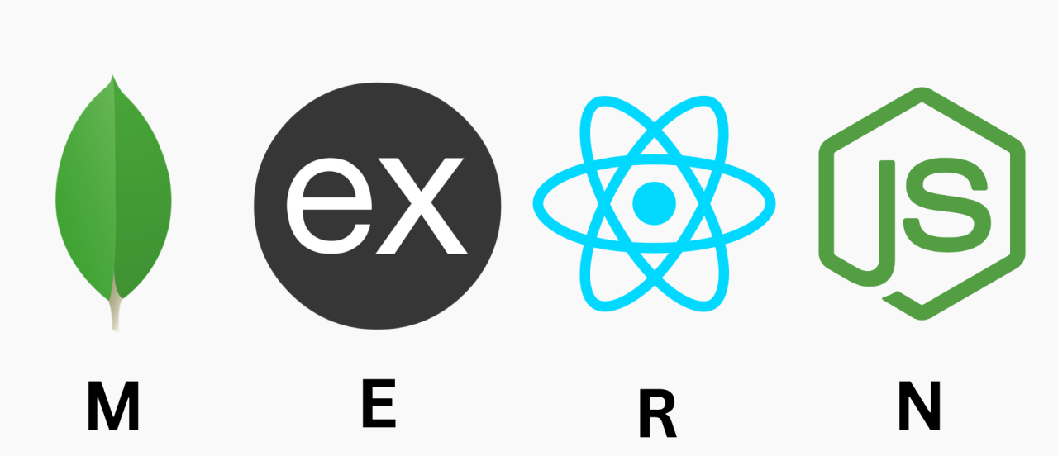






TECHNICAL APPROACH
BLASTORZ
Tech Stack
Workflow Diagram
Student registers and creates profile
Completes aptitude & interest quizzes
AI engine analyzes results
Recommends suitable streams, courses & careers
Shows nearby Govt. colleges and eligibility
Provides roadmaps & study group suggestions
Sends alerts for admissions, scholarships, exams
Tracks progress and updates personalized guidance
Chat in groups and discuss topics /subjects

Slide 4
FEASIBILITY AND VIABILITY
BLASTORZ
Risks
Solution
Awareness Feasibility
Students & parents lack clarity on graduation value. Huge demand for structured career guidance post Class 10/12. Platform can bridge awareness and decision-making gaps
Low awareness →
fewer users initially
School campaigns, teacher/counselor partnerships, demo sessions
Technical Feasibility
Mobile + web - based development possible with current tools. AI-based recommendations feasible with open datasets. Location-based college search easy to integrate with maps/APIs. Offline features can support low-internet areas
Wrong/incomplete college/scholarship/
exam data
Verified govt. sources, regular updates, API integrations
Financial Feasibility
Open-source tools & free APIs reduce cost. Student cloud credits minimize infra expenses. Govt. & CSR tie-ups make scaling affordable. Low maintenance cost after setup
Lack of funds for large-scale rollout
Phase-wise implementation, CSR funding and also government sponsorship
Operational Feasibility
Multi-language support widens reach (English, Hindi, etc.). Simple UI ensures even rural students can use it. Study groups encourage peer learning & engagement. Roadmaps make career options easy to understand. Can be piloted in small regions before scaling
Digital literacy gaps among students & parents
Step-by-step onboarding, awareness workshops, easy visuals/infographics

Slide 5
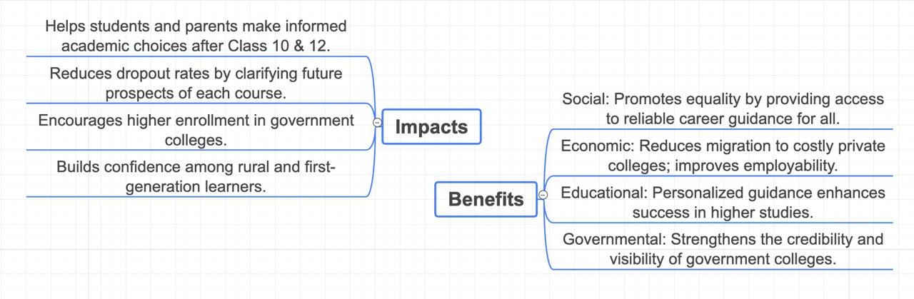
IMPACT AND BENEFITS
BLASTORZ

Slide 6
RESEARCH AND REFERENCES
BLASTORZ
Shiksha – Career Guidance & Courses https://www.shiksha.com/careers
JKBOPEE – J&K Board of Professional Entrance Exams https://www.jkbopee.gov.in/
Directorate of Colleges, J&K (Higher Education Dept.) https://directorcollegesjk.in/
J&K Higher Education Dept. – Colleges List https://www.jkhighereducation.nic.in/colleges.html
JKAA – J&K Academic Affairs Portal https://jkaa.directorcollegesjk.in/
CollegeDunia – College & Course Comparison https://collegedunia.com/
Careers360 – Exams, Colleges & Career Guidance https://www.careers360.com

