Slide 1
WELCOME

Slide 2
FACES-finder:An Automatic Face Detection system
Shalumol Maniraj

Slide 3
introduction
A face detection project typically involves using image processing techniques and machine learning algorithms to detect faces in images or video streams. The project may involve using a face detection library or developing a custom algorithm to identify faces based on various features such as the shape of the face, the position of the eyes, and the presence of facial hair or accessories. The output of the project may include a bounding box around the detected face, the location of facial landmarks, and/or the identification of the person in the image. The project may have various applications, such as security systems, social media, or medical diagnosis.

Slide 4
PROBLEM DEFINITION
FACE DETECTION:FACES IN THE IMAGES ARE DETECTED USING MACHINE LEARNING APPROACH.

Slide 5
INTERFACE
PROCESSOR : INTEL I3 or above
RAM :4gb or above
Language :Python
IDLE :Python 3.6.0
Packages :opencv-python 4.5.1.48
face-recognition 1.3.0
os-sys 2.1.4
Operating System : windows 10

Slide 6
Identified Modules
Face detection and blurring module:
Image-preprocessing : The input image is resized and converted into Gray scale format.
Feature Extracttion : Haar features are extracted from images.
Face detection : Faces in the images are detected using machine learning approach.

Slide 7
ALGORITHM IMPLEMENTATION
FACE DETECTION
Viola-Jones Algorithm
Implementing the viola-jones face detection algorithm by Ole Helving Jensen.
openCV:Implemented as ,
Haar casecade detection in openCV,Casecade classifier training in openCV.

Slide 8
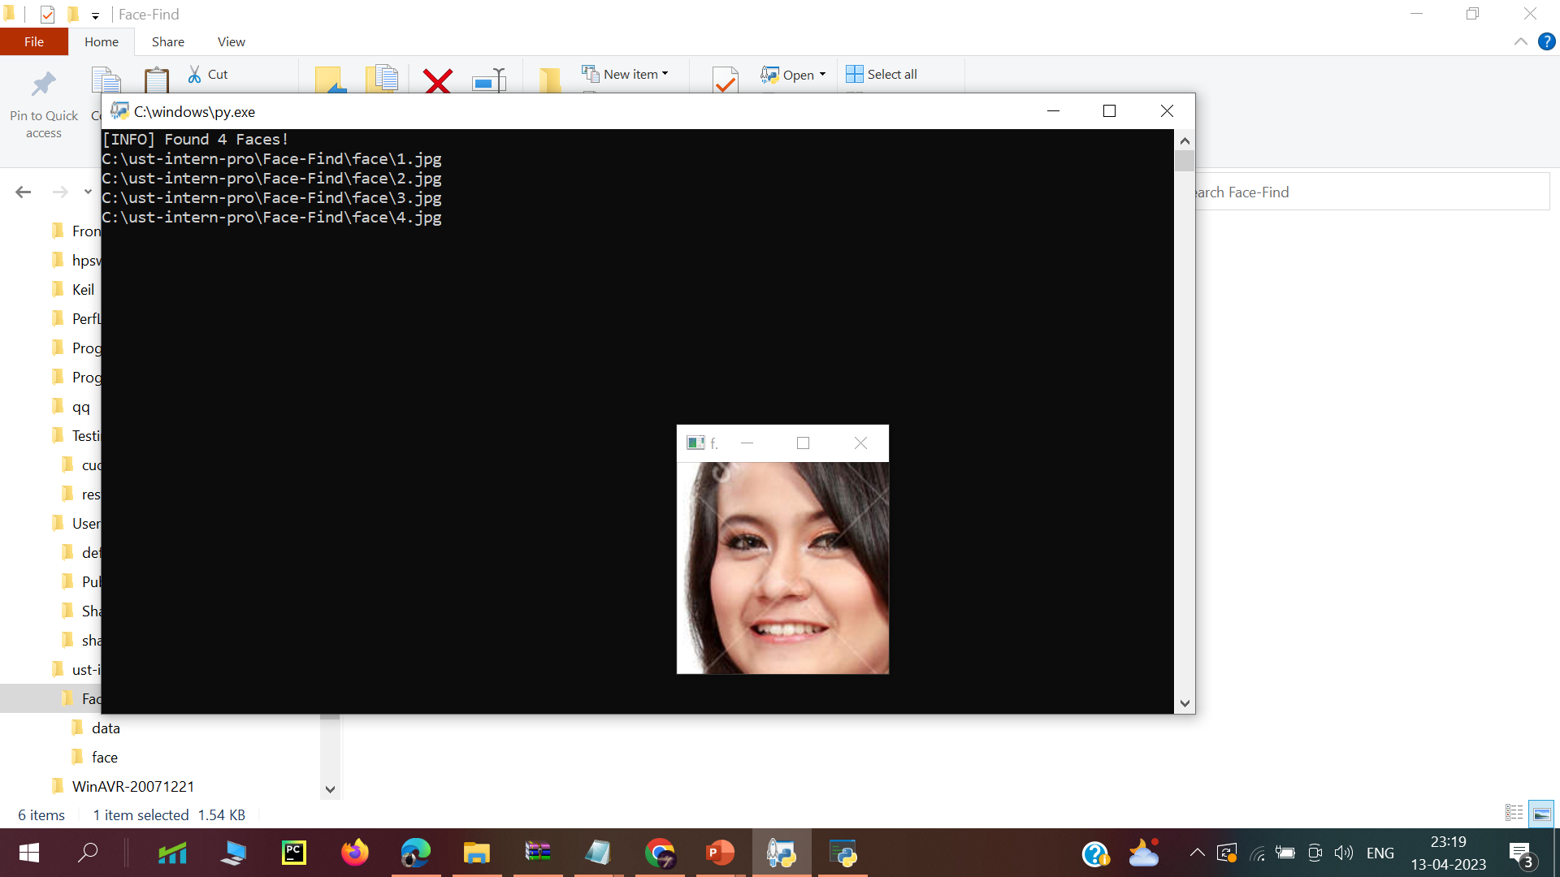
SCREENSHOTS

Slide 9
testing
UPLOAD IMAGE TO DETECT THE FACE

Slide 10
THANK YOU…

