Slide 1
Problem Statement Worksheet (Hypothesis Formation)
How Big Mountain can maximize it’s returns , relative to its position in the market.
a. Big mountain needs to come up with a pricing model to get a sense of what facilities matter most
to the visitors in order to support the ticket price and revenue
b. Big Mountain Resort needs to review some potential scenarios for cutting down costs like closing down some
Least used runs
H
1
Context
4
Constraints within solution space
Big mountain is a ski resort in Montana State with summit Elevation of 6817, vertical drop 2353, and base elevation 4464.
Big Mountain wants to maximize its returns by increasing the ticket price relative to its position in the market and what all facilities or properties boasted by the resort
In order to maximize its return by increasing the ticket price they need to consider the cost of adding more facilities for the visitors
5
Stakeholders to provide key insight
2
Criteria for success
Executive and Management team of Big Mountain
IF Big Mountain come up with a model that will be used to provide guidance for pricing and future facility investment plans.
6
Key data sources
file:Ski_resort_data.csv ,
Link to get Population and area data for the US states 'https://simple.wikipedia.org/w/index.php?title=List_of_U.S._states&oldid=7168473'
3
Scope of solution space
A pricing model for big mountain relative to its position the market and facilities or properties boasted by the resort
H
D
E
I
P
Notes:
Hypothesis: Create a Hypothesis with an emphasis on SMART principles. (S – Specific, M – Measurable, A – Achievable, R – Realistic, T – Timebound). If you cannot do this, you do not have a good grasp on the business problem.
Context: With context, we have clearly identified the problem at hand and have elucidated on how our initiative may solve this problem, alongside the commercial implications this will have on the business.
Criteria for Success: Clearly defining the criteria for success ensures that the scope of your work is clearly defined and understood. Otherwise, if this isn’t defined – your work will never end which will result in mismatched expectations.
Scope of Solution Space: Scoping out the solution space ensures that the business initiative is SPECIFIC for a certain segment or area. This prevents solutions that have been developed being scaled and applied for all other business units that the solution may not be responsible or scalable for.
Constraints within Solution Space: Looking forward, what are the foreseeable problems we are likely to encounter? Could this be stakeholder resistance? Could this be we don’t have access to the right data?
Stakeholders to provide key insight: Who are the people I need to speak to, to get the answers I need for my data analysis?
What key data sources are required?
Based off my discussions with the key stakeholders – can we clearly list out all the data sources we need so we can make a highly targeted request as opposed to a scatter-gun approach where we ask for a bit of everything?

Slide 2
Some key findings by the pricing model:
Big Mountain sits at the higher position in the distribution of almost all the features for which visitors are willing to pay more for. According to the model Big Mountain’s ticket price could be $95.86 with a mean error of $10.39. So , there is certainly a room for increase in ticket price with current price as $81.
Below are the facilities which matter most to the visitors as per the model:
vertical_drop
Snow Making_ac
total_chairs
fastQuads
Runs
LongestRun_mi
trams
SkiableTerrain_ac

Slide 3
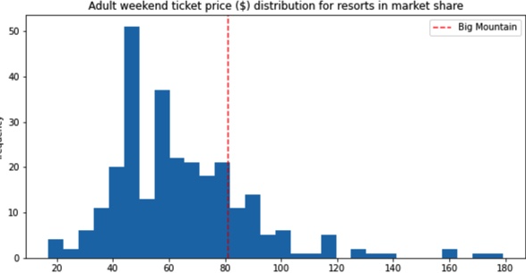
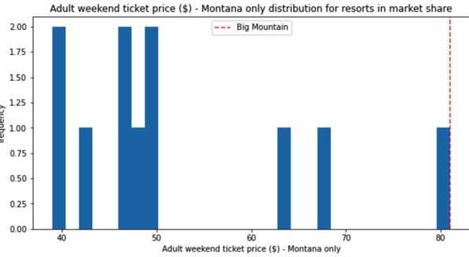
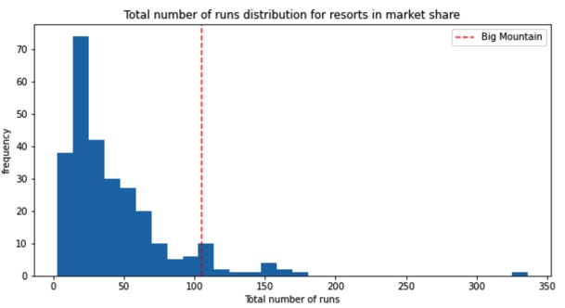
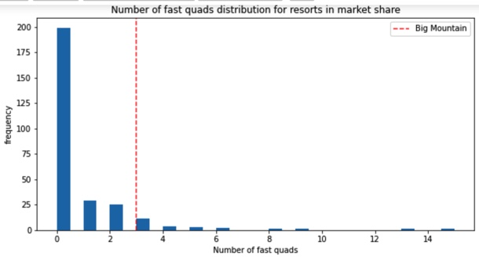
Red dotted vertical line shows Big Mountain in distribution of Ticket price among all the resorts in US, resorts in Montana state only ,Number of fast quads and total number of runs in market share

Slide 4
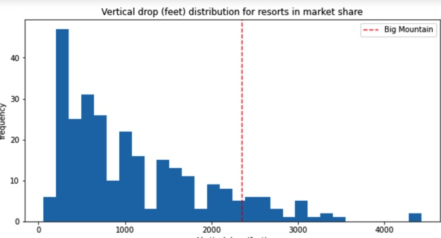
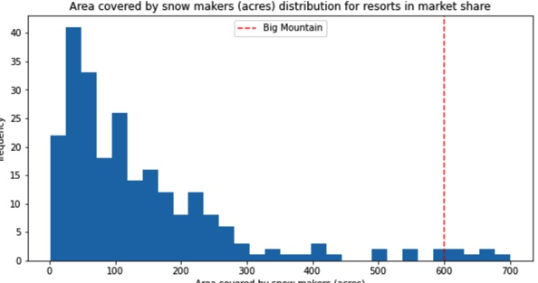
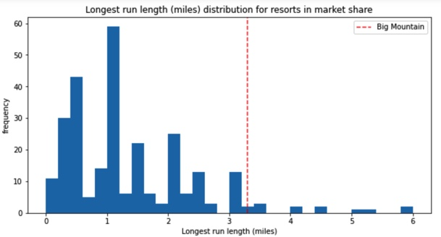
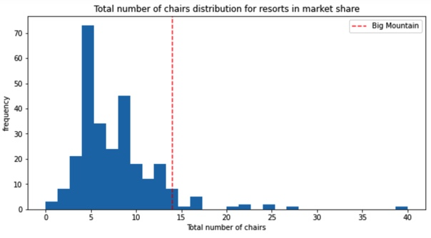
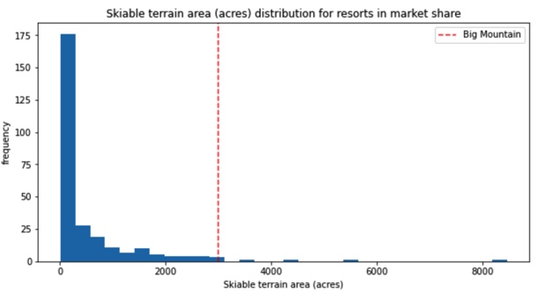
Red dotted line presents Big Mountain’s Vertical drop , area covered by snow makers, longest run Total no. of chairs , Skiable terrain in market share

Slide 5
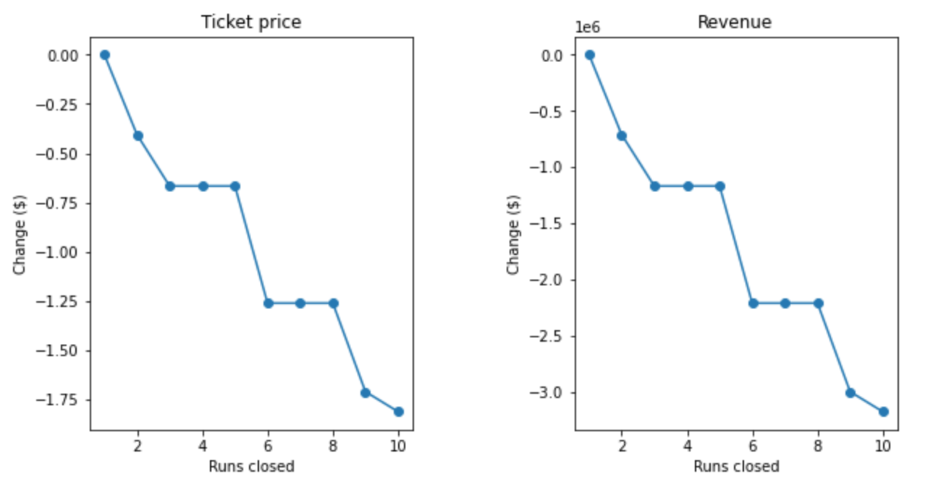
Here are some key recommendations and summary according to the pricing model:
Considering some of the scenario options and expected 3,50,000 number of visitors on average and visitors ski for five days:
1. Permanently closing down up to 10 of the least used runs.
As shown in the graph , Closing 2 and 3 successively reduces support for ticket price and so revenue. If Big Mountain closes down 3 runs, it seems they may as well close down 4 or 5 as there's no further loss in ticket price. Increasing the closures down to 6 or more leads to a large drop.

Slide 6
Option 2nd, 3rd and 4th shortlisted by Big Mountain Resort for either cutting costs or increasing revenue (from ticket prices)
2.In this scenario Big Mountain is adding a run, increasing the vertical drop by 150 feet, and installing an additional chair lift.
This scenario increases support for ticket price by $1.99 Over the season, this could be expected to amount to $34746383.
3. In this scenario Big Mountain is adding a run, increasing the vertical drop by 150 feet, and installing an additional chair lift along with adding 2 acres of snow making.
As per the model prediction this scenario makes no difference from the previous scenario in terms of ticket price and revenue
4. In this scenario Big mountain is increasing the longest run by .2 miles and guaranteeing its snow coverage by adding 4 acres of snow making capability.
As per the model prediction this scenario absolutely makes no difference from the previous 2 scenarios

Slide 7
Summary as per the findings by Ticket Pricing Model
In summary business can decide to close down 1 run , increase the vertical drop by 150 and adding additional chair lift which support the ticket price by $1.99 and revenue by $3474638 as increasing the longest run by .2 miles and adding 2 acres of snow making have no impact on ticket price and revenue

