Slide 1
HEALTHCARE PROVIDER FRAUD DETECTION ANALYSIS

Slide 2
Goal of project
The goal of this project is to " predict the potentially fraudulent providers " based on the claims filed by them along with this
Some of the most common types of frauds by providers are:
a) Billing for services that were not provided.
b) Duplicate submission of a claim for the same service.
c) Misrepresenting the service provided.
d) Charging for a more complex or expensive service than was actually provided.
e) Billing for a covered service when the service actually provided was not covered.

Slide 3
Dataset
A) Inpatient Data
This data provides insights about the claims filed for those patients who are admitted in the hospitals. It also provides additional details like their admission and discharge dates and admit d diagnosis code.
B) Outpatient Data
This data provides details about the claims filed for those patients who visit hospitals and not admitted in it.
C) Beneficiary Details Data
This data contains beneficiary KYC details like health conditions,regioregion they belong to etc.

Slide 4
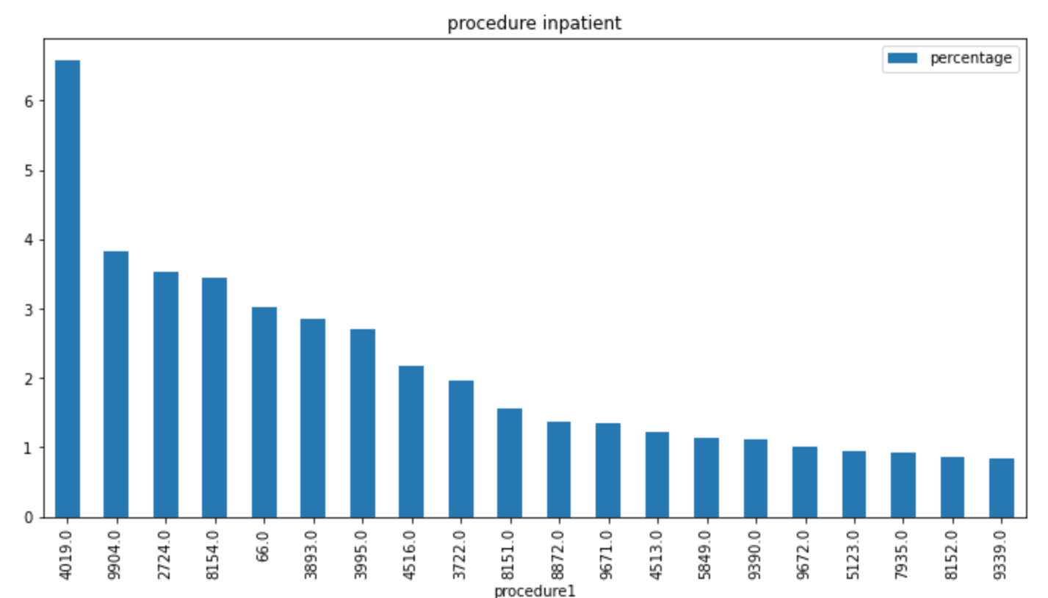
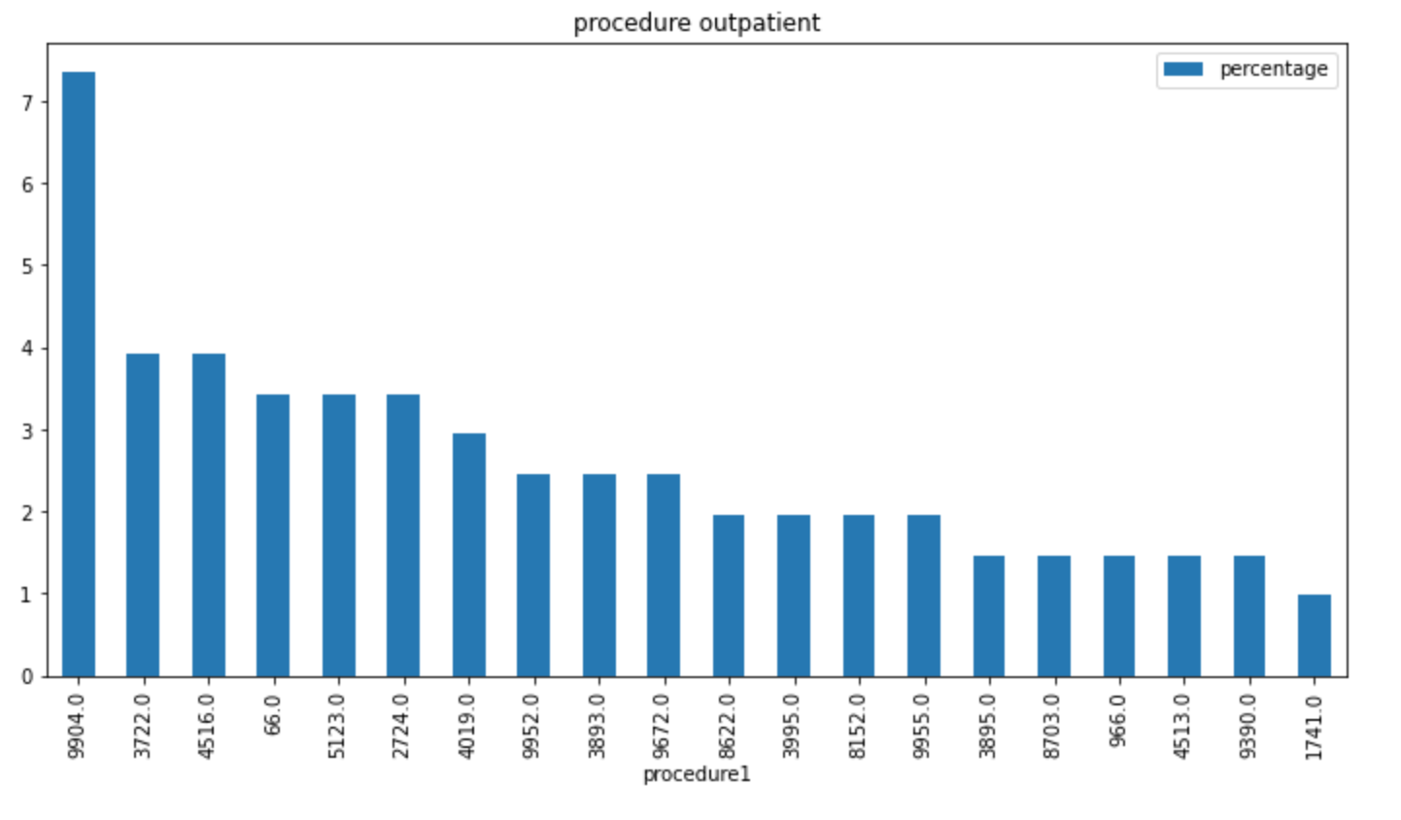
Most common Procedure codes used in inpatient data and outpatient data We see that for inpatient the most common procedure used is 4019, 9904, 2724, 8154 among others and for outpatient codes are 9904, 3722, 4516 among others

Slide 5
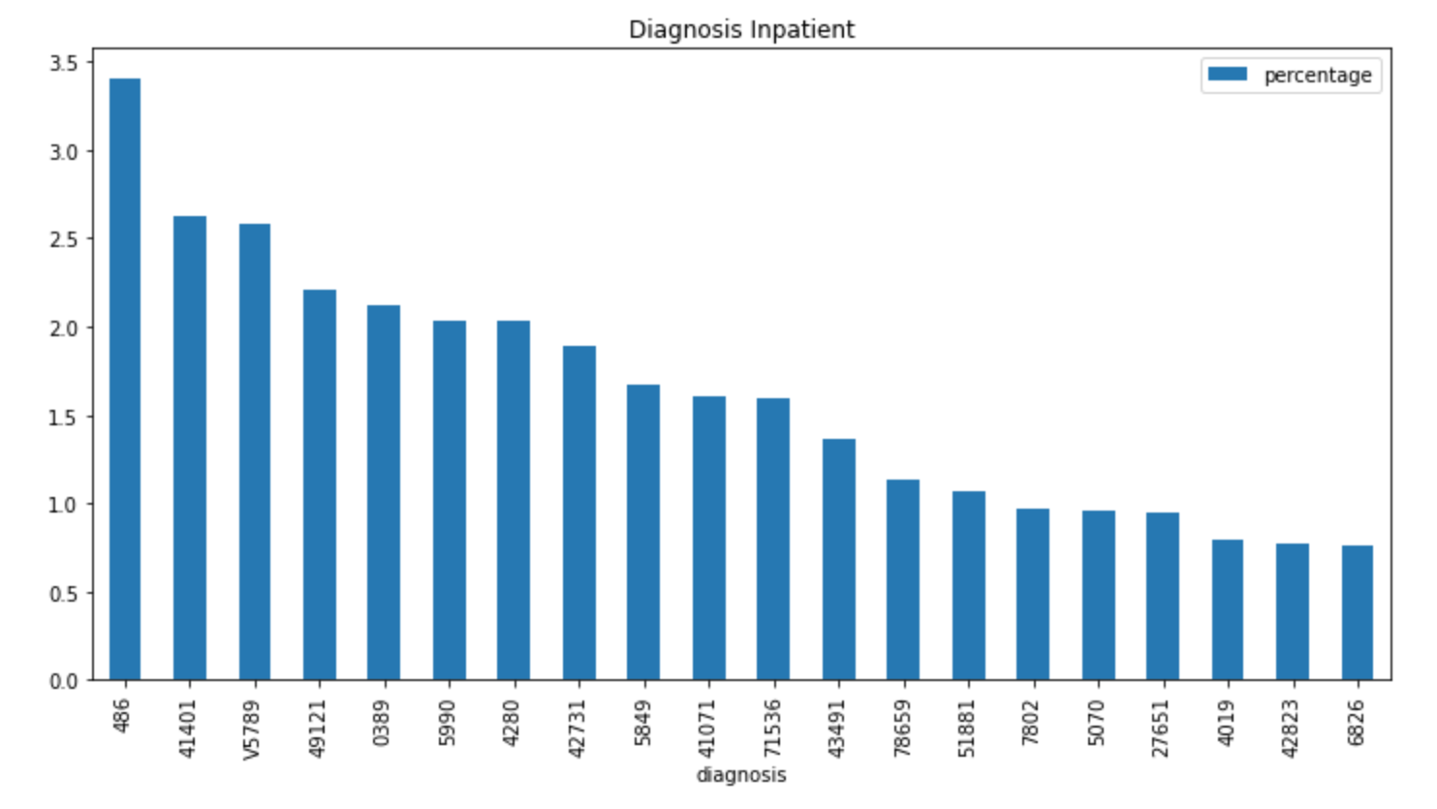
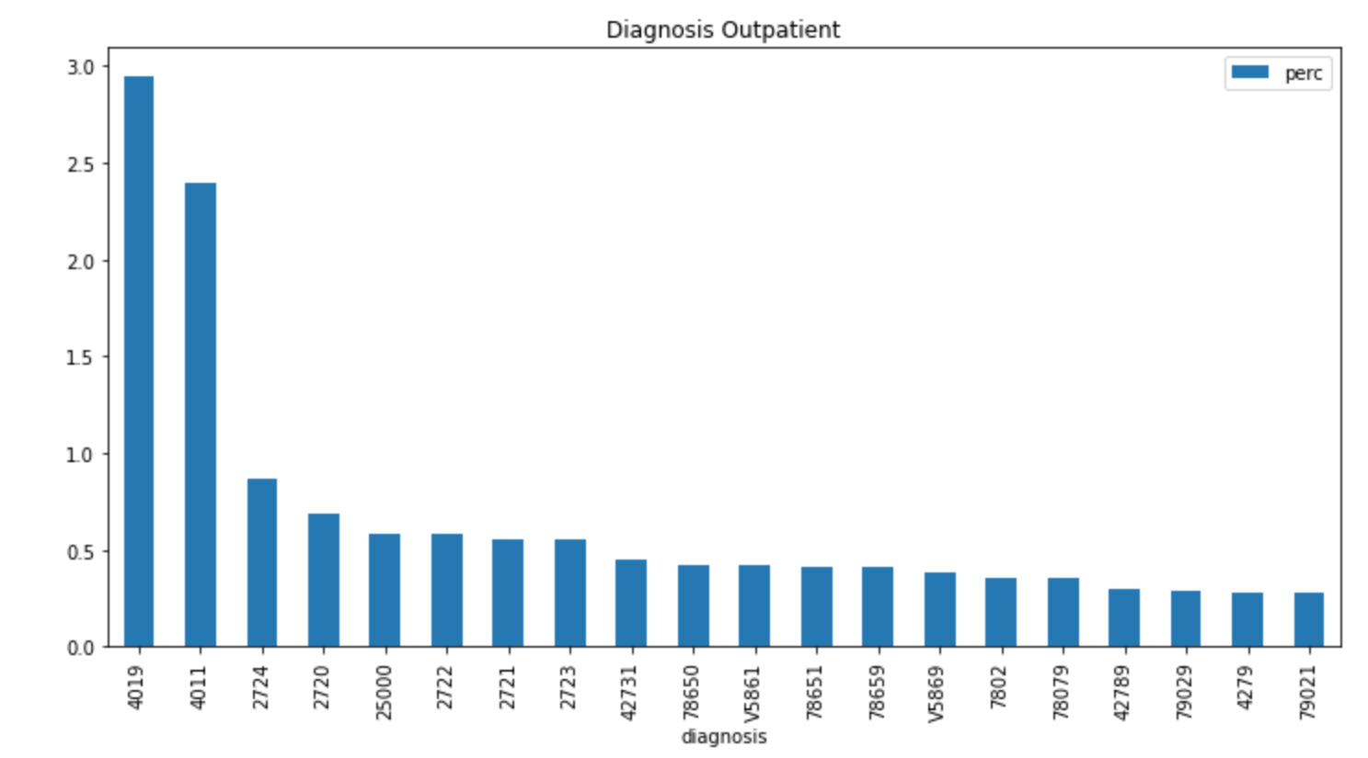
There is a minor difference between the most used diagnosis codes between inpatient and outpatients The most common Diagnosis codes used is inpatient are 486, 41401, V5789 among others and for outpatient it is 4019, 4011, 2720 among others

Slide 6
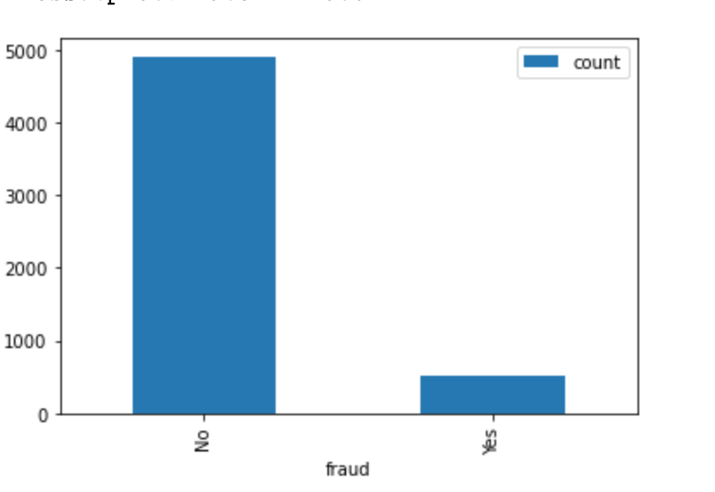
Potential fraud providers

Slide 7
Most common codes used by fraud providers:
Merging train with outpatient data
(len(potential_fraud_out)/len(outpatient))*100 = 36.58112130290089
This means from our outpatient dataset for training we can have - 36% are potential fradulent encounters
Merging train with inpatient data
(len(potential_fraud_in)/len(inpatient)) *100 = 57.81983495577408
This means from our inpatient dataset for training we can have fradulent activities on more than half of them - 58% are potential fradulent encounters

Slide 8
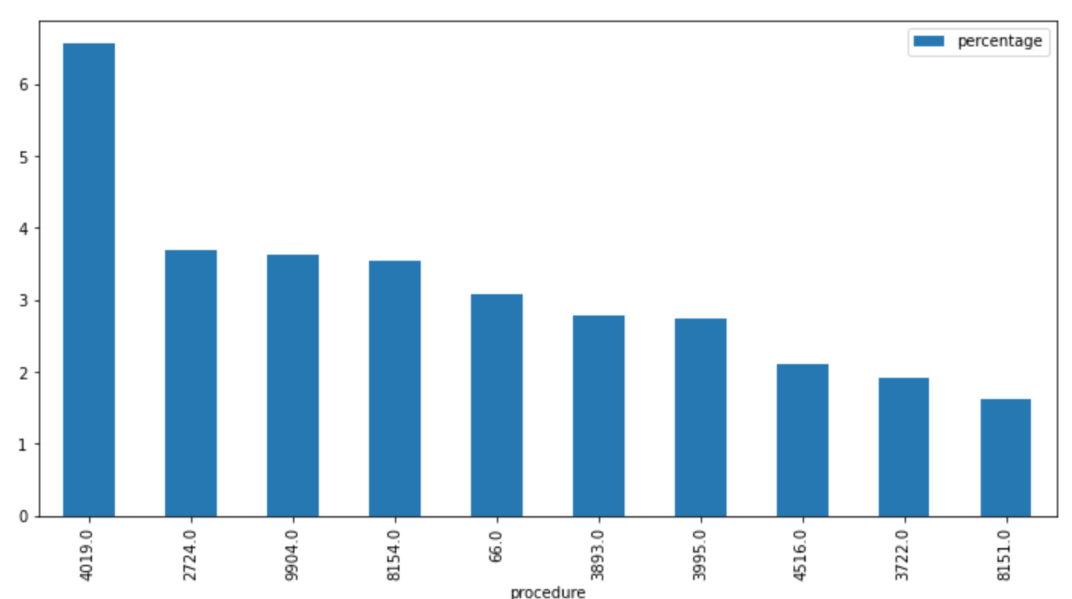
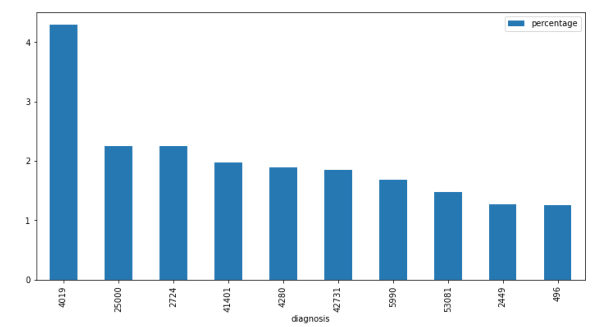
After merging train and inpatient dataset : most common procedure and diagnosis codes used by Frauds in Inpatient dataset

Slide 9
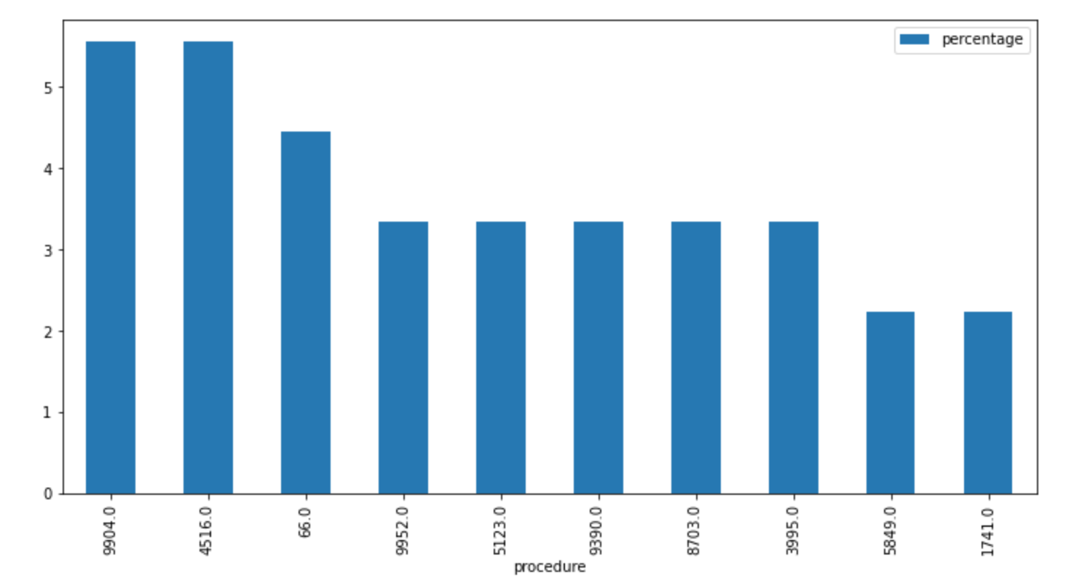
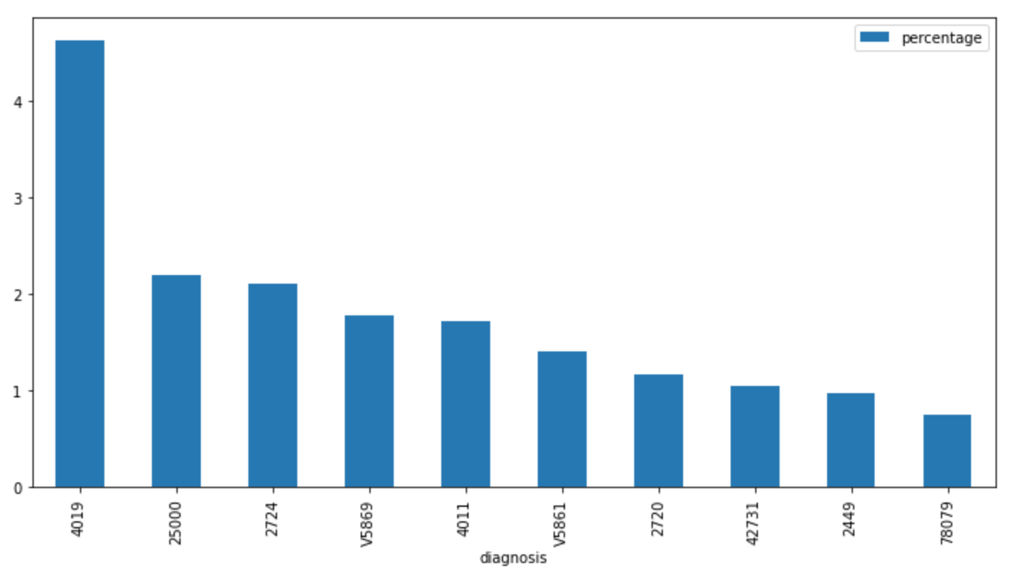
After merging train and outpatient dataset : most common procedure and diagnosis codes used by Frauds in outpatient dataset. In summary there is no pattern found between codes used by providers in fraudulent activities

Slide 10
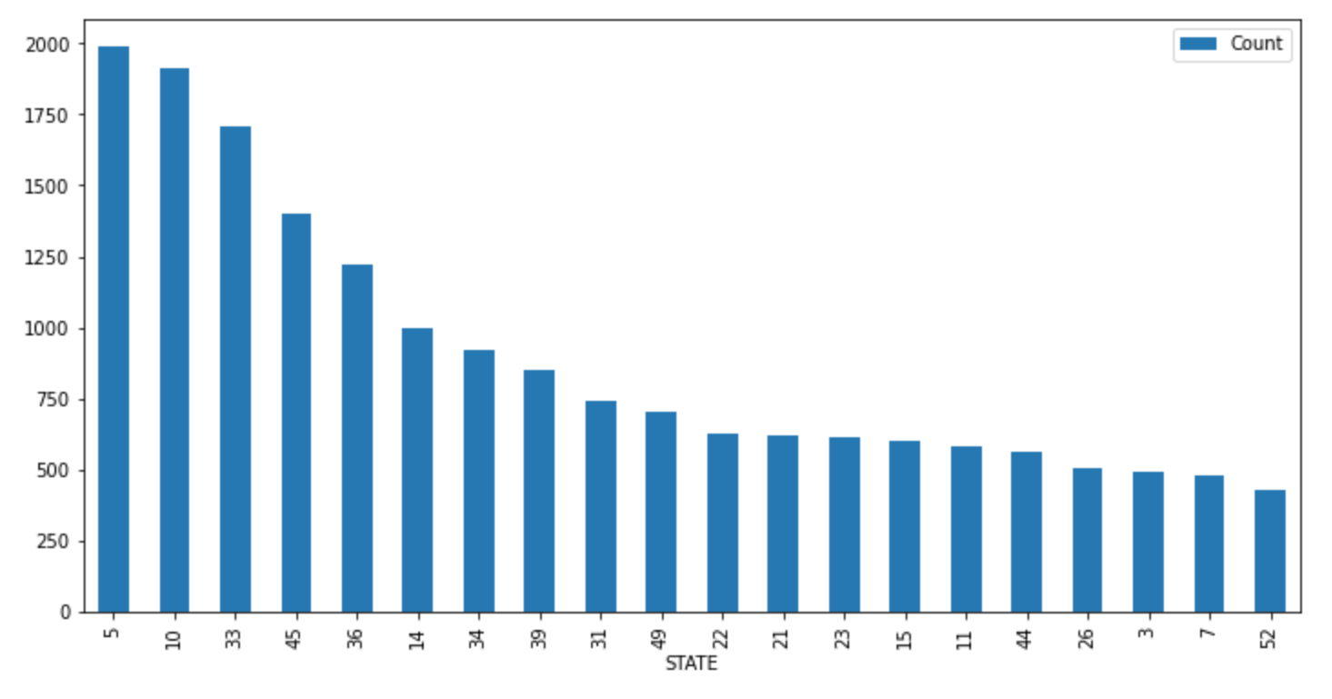
Which states/localities have the highest number of potential frauds

Slide 11
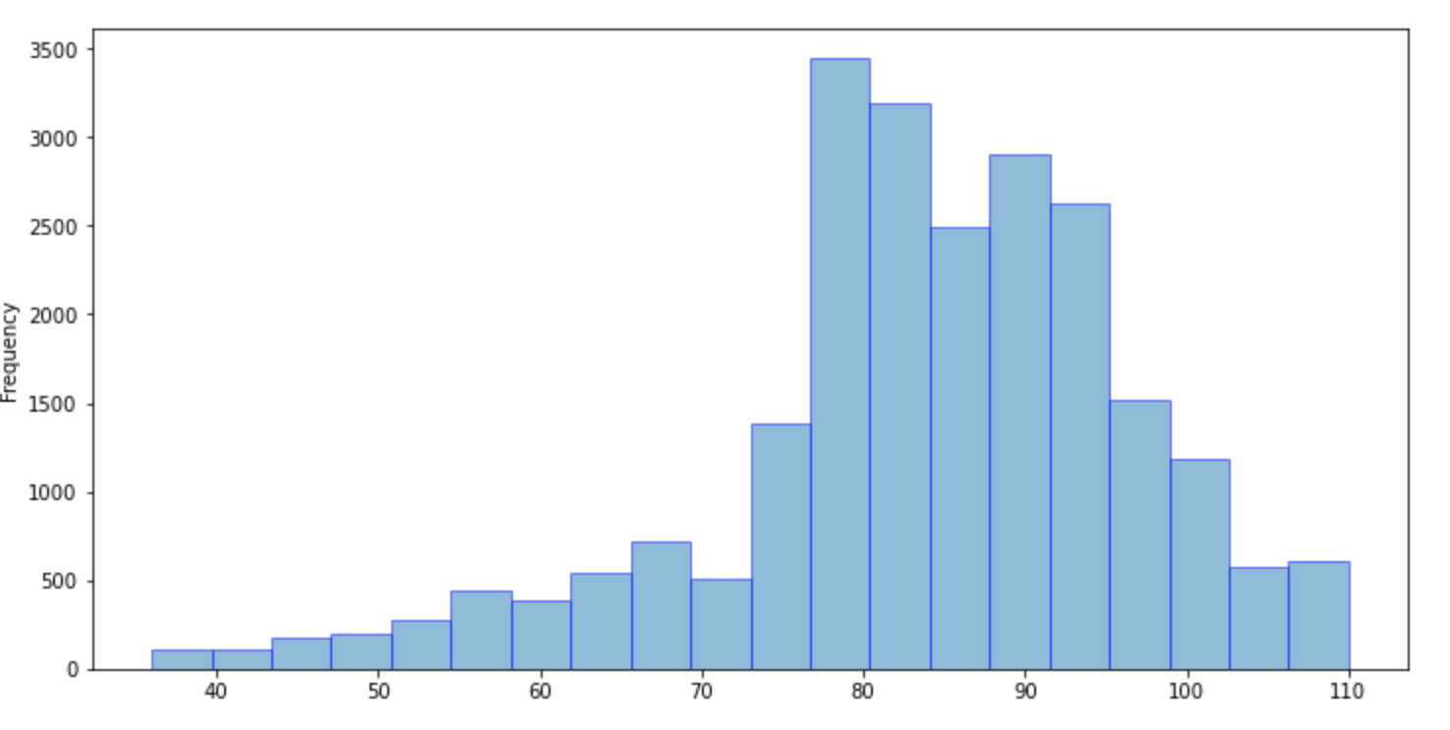
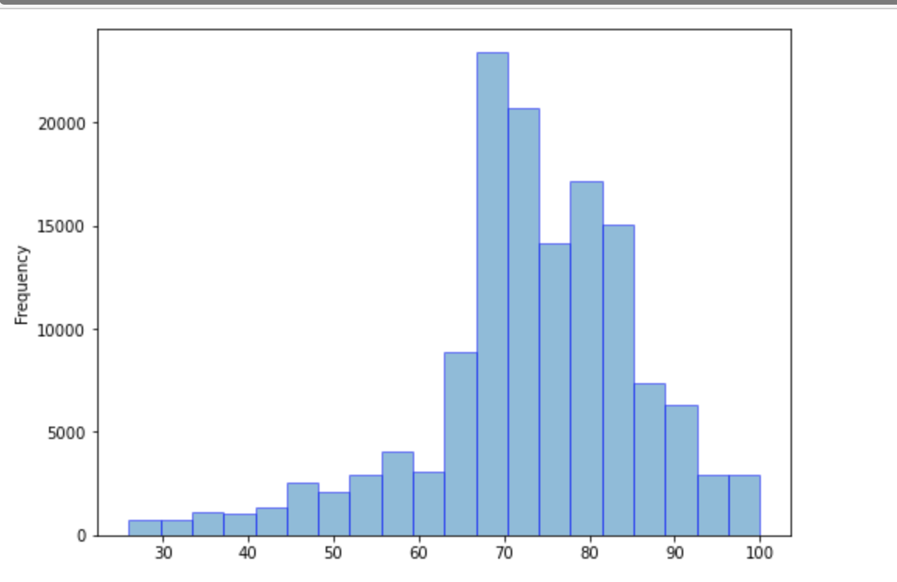
Average Age for the data set and as a comparison for the probable fraudulent activities applied on what age range, average as per the beneficiary dataset

Slide 12
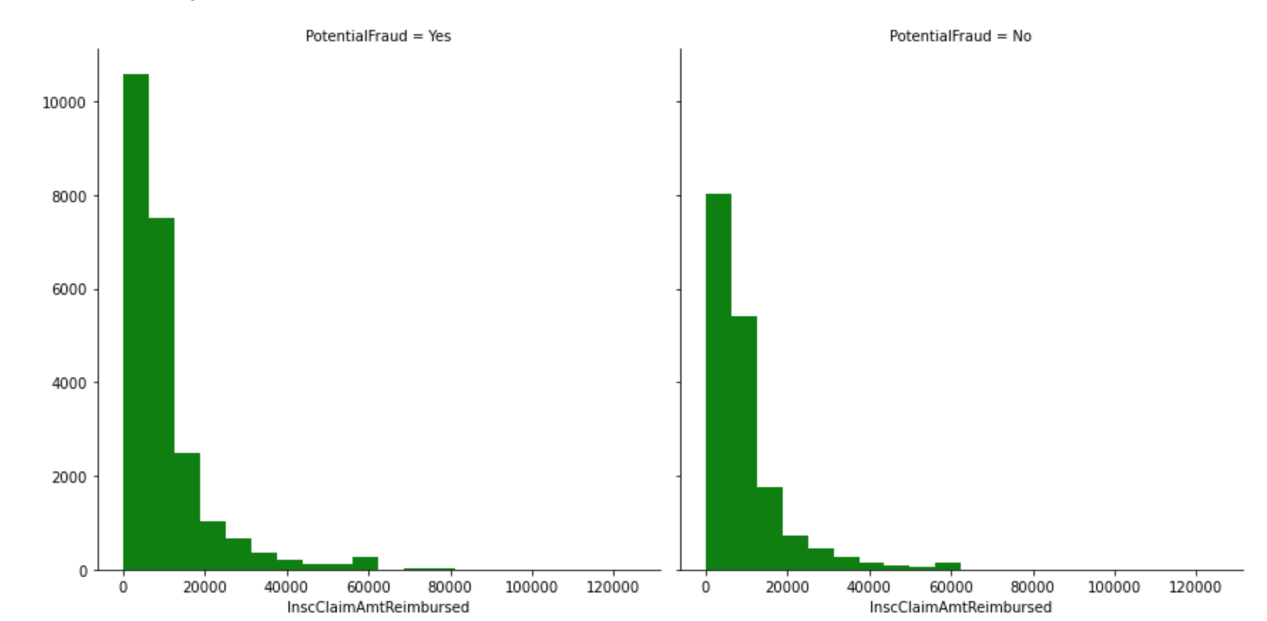
Merging inpatient with train data and checking claim amount . Around 240 Million dollars worth of claim might have some fraudulent activity.

Slide 13
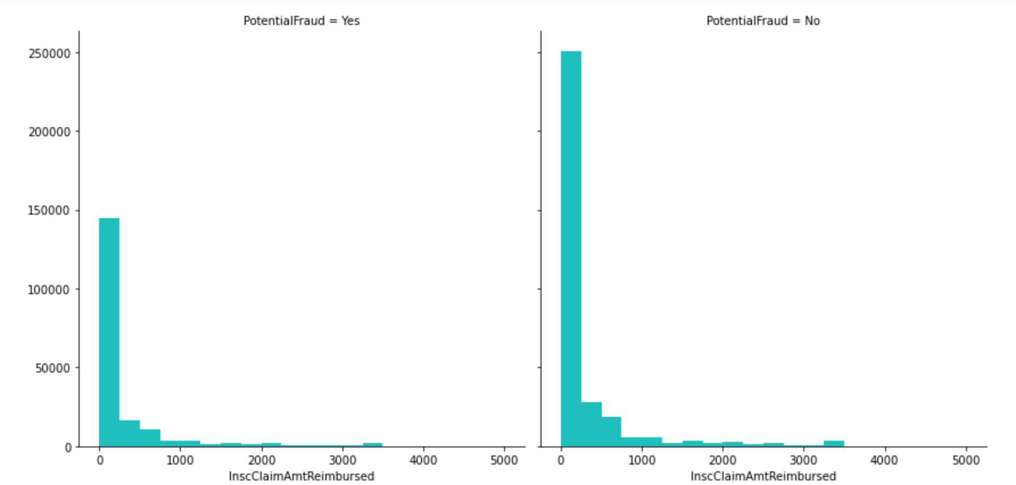
Merging outpatient with train data and checking claim amount . Around 240 Million dollars worth of claim might have some fraudulent activity.

