Slide 1


LEVERAGING k- ANONYMITY FOR DATA SAFEGUARDING AND
ENHANCING CONFIDENTIALITY IN GENERATIVE AI
1

Slide 2
PROBLEM STATEMENT
The data sets used in Generative AI model carry confidential reports, employee or customer sensitive information and due-diligence reports of contracts which needs to be protected and privacy needs to be safe guarded against unauthorised access and exploitation.
This brings the need to develop a privacy preserving technique.
2

Slide 3
OBJECTIVE
A well-implemented standards.
privacy-preserving AI system upholds ethical data usage
Establishing privacy in AI is essential for public trust, preventing discriminatory outcomes, and mitigating financial, social, and security harms from emerging technologies.
Propose to build a privacy preservation algorithm based on
k-anonymity
l diversity and t-closeness over k-anonymized data
Feeding the un-anonymised and anonymised dataset to Generative Adversarial network
These techniques work by generalizing, perturbing, or restricting data to make individual records less identifiable while retaining overall patterns.
We have implemented anonymisation using Mondrian and generalisation.
3

Slide 4
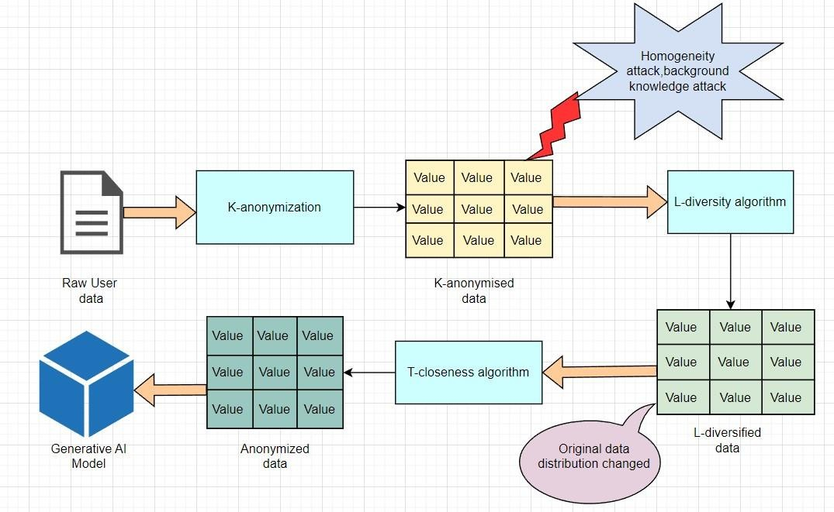
PROPOSED SYSTEM MODEL
Original data distribution restored
4

Slide 5
LIST OF MODULES
Data Aggregation, Preprocessing, Sensitive Feature Selection
K-Anonymisation of data set
L-diversification of data set by choosing appropriate value of l
t-closeness technique introduction to maintain the original distribution of data
5

Slide 6
DATASET USED
Adult Census Income Dataset
It has 48,842 instances and 14 features
It has a mixture of both numerical and categorical features.
link : https://archive.ics.uci.edu/dataset/2/adult

Slide 7
ABOUT MONDRIAN ALGORITHM
It is a top-down data anonymization algorithm that uses greedy partitioning to anonymize relational datasets.
It recursively partitions a dataset by finding the median of the quasi-identifier with
the highest number of unique values.
The algorithm continues to partition until the equivalence class size is less than 2k-1.
It is the fastest local recording algorithm, while also preserving good data utility.
The partitions are then examined to check whether they satisfy the k-anonymity, l- diversity and t-closeness criterion.

Slide 8
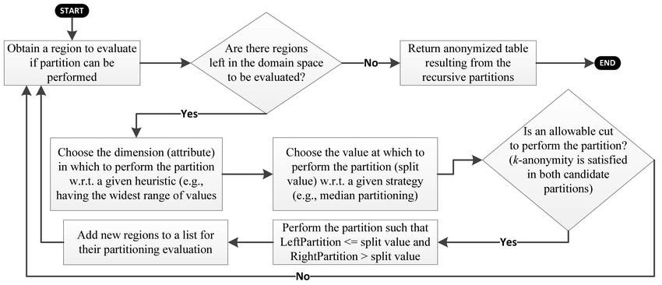
FLOW CHART OF MONDRIAN ALGORITHM
Depiction of flow chart of Mondrian algorithm used for anonymisation

Slide 9
ALGORITHM OF K-ANONYMITY
Input: Original Dataset; quasi-identifier QI = (𝐴₁, 𝐴₂,…,𝐴_{𝑛})
Output: Data frame having anonymised dataset with optimal k value.
Method :
1. 𝑃_{𝑓𝑖𝑛𝑖𝑠ℎ𝑒𝑑} ← {} where 𝑃_{𝑓𝑖𝑛𝑖𝑠ℎ𝑒𝑑} denotes the finished set of partitions.
2. 𝑃_{𝑤𝑜𝑟𝑘𝑖𝑛𝑔} ← {{1, 2,… ,N}} where 𝑃_{𝑤𝑜𝑟𝑘𝑖𝑛𝑔} denotes the working set of partitions which is initialized to the entire dataset.
while there exists partitions in the working set , do
p ← pop one partition from partitions
Calculate the relative spans of all columns in the partition p.
3.3 Sort the resulting columns by their span (in descending order)
for each column in columns of partition p
split the partition along that column using the median of the column values as the split point.

Slide 10
ALGORITHM FOR K-ANONYMITY (CONTD ..)
if the resulting partitions are valid according to our k-anonymity criteria then
add the two new partitions to the working
set and break out of the loop.
else if no column produced a valid split then,
add the original partition to the 𝑃_{𝑓𝑖𝑛𝑖𝑠ℎ𝑒𝑑}
Return the finished set of partitions 𝑃_{𝑓𝑖𝑛𝑖𝑠ℎ𝑒𝑑}
Display the data points in a plot with rectangular subplots to demarcate partitions and show the distribution of data within the partitions.
Display the anonymised table with quasi and sensitive identifiers for each partition

Slide 11
ALGORITHM FOR L-DIVERSITY
Input: Original Dataset; quasi-identifier QI = (A1,A2,…, An)
Output: Data frame having anonymised dataset with optimal l value.
Method :
1. 𝑃_{𝑓𝑖𝑛𝑖𝑠ℎ𝑒𝑑} ← {} where 𝑃_{𝑓𝑖𝑛𝑖𝑠ℎ𝑒𝑑} denotes the finished set of partitions.
2. 𝑃_{𝑤𝑜𝑟𝑘𝑖𝑛𝑔} ← {{1, 2,… ,N}} where 𝑃_{𝑤𝑜𝑟𝑘𝑖𝑛𝑔} denotes the working set of partitions which is initialized to the entire dataset.
while there exists partitions in the working set , do
p ← pop one partition from partitions
Calculate the relative spans of all columns in the partition p.
3.3 Sort the resulting columns by their span (in descending order)
for each column in columns of partition p
split the partition along that column using the median of the column values as the split point.

Slide 12
ALGORITHM FOR L-DIVERSITY (CONTD ..)
if the resulting partitions are valid according to our k-anonymity criteria and l-diversity criteria then
add the two new partitions to the working set if each partition contains at least l distinct values of sensitive data attribute, and break out of the loop.
else if no column produced a valid split then,
add the original partition to the 𝑃_{𝑓𝑖𝑛𝑖𝑠ℎ𝑒𝑑}
Return the finished set of partitions 𝑃_{𝑓𝑖𝑛𝑖𝑠ℎ𝑒𝑑}
Display the data points in a plot with rectangular subplots to demarcate partitions and show the distribution of data within the partitions.
Display the anonymised table with quasi and sensitive identifiers for each partition

Slide 13
ALGORITHM FOR T-CLOSENESS
Input: Dataset; quasi-identifier QI = (𝐴₁, 𝐴₂,…,𝐴_{𝑛}), sensitive Data Attribute SA
Output: Data frame after t-closeness applied.
Method:
^{1. 𝑃}𝑓𝑖𝑛𝑖𝑠ℎ𝑒𝑑
← {} where 𝑃_{𝑓𝑖𝑛𝑖𝑠ℎ𝑒𝑑} denotes the finished set of partitions.
𝑃_{𝑤𝑜𝑟𝑘𝑖𝑛𝑔} ← {{1, 2,… ,N}} where 𝑃_{𝑤𝑜𝑟𝑘𝑖𝑛𝑔} denotes the working set of partitions which is initialized to the entire dataset.
total_count: value ← total number of records in the dataset.
group_counts: Pandas series ← grouping of the data by the sensitive attribute and counts the
occurrences of each value.
for each value in group_counts:
proportion p ← Calculate the proportion of each value in the sensitive attribute
compared to the total count.
global_freqs: Stores the proportion (p) in the global_freqs dictionary with the corresponding value as the key.

Slide 14
ALGORITHM FOR T-CLOSENESS CONTD ..
while there exists partitions in the 𝑃_{𝑤𝑜𝑟𝑘𝑖𝑛𝑔} , do
part ← pop one partition from partitions
5.2 groups the data partition by the specified column and counts occurrences and store in group_counts.
for each value ,count in group_counts
. p ← the fraction of the count to the total count in the dataset.
d ← absolute difference d between the p and global_freq.
Updates d_max if the d is greater than the previously
observed maximum.
if the d_max is within some threshold value then add it to 𝑃_{𝑓𝑖𝑛𝑖𝑠ℎ𝑒𝑑}
else if d_max > threshold then,
add the original partition to the 𝑃_{𝑓𝑖𝑛𝑖𝑠ℎ𝑒𝑑}

Slide 15
ALGORITHM FOR T-CLOSENESS (CONTD..)
Return the finished set of partitions 𝑃_{𝑓𝑖𝑛𝑖𝑠ℎ𝑒𝑑}.
Display the data points in a plot with rectangular subplots to demarcate partitions
and show the distribution of data within the partitions.
Display the table after t-closeness with quasi and sensitive identifiers for each
partition

Slide 16
RESULTS OBTAINED
Following cases have been tested for different set of quasi identifiers to evaluate the discernability metric.
Two quasi identifiers both numerical
Two quasi identifiers one numerical , one categorical
Two quasi identifiers both categorical
Three quasi identifiers all numerical

Slide 17
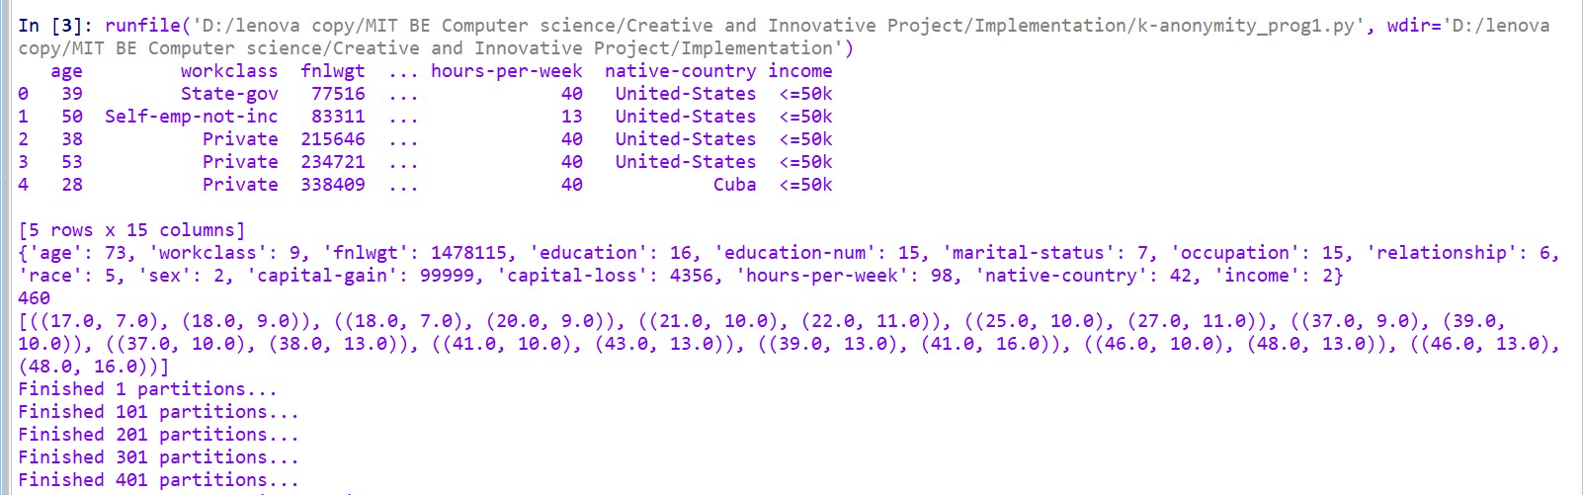
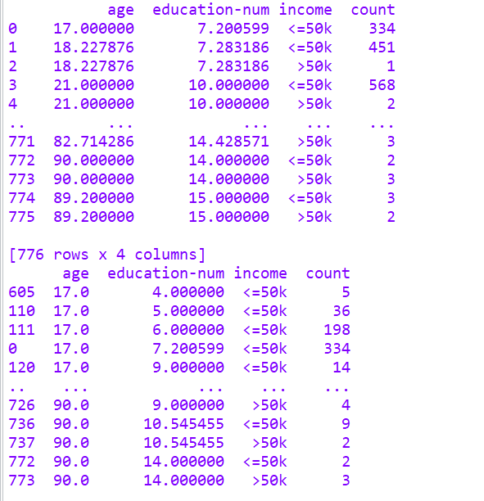
SCREENSHOTS OF THE RESULTS OBTAINED
Case 1 :When k=5 for 2 quasi identifiers, both numerical (age, education-num)

Slide 18
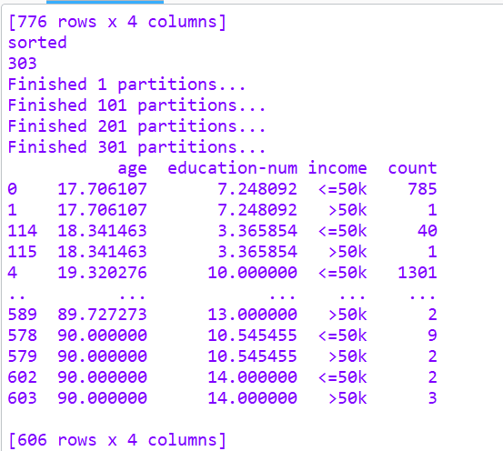
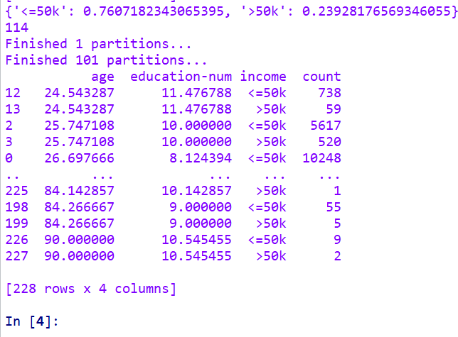
CASE 1 RESULTS CONTD …

Slide 19
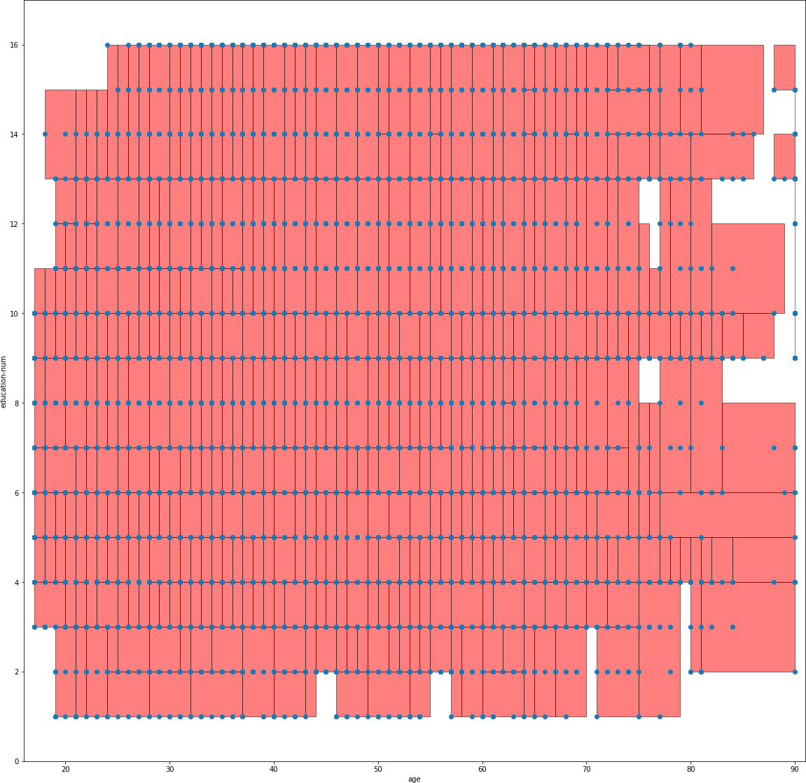
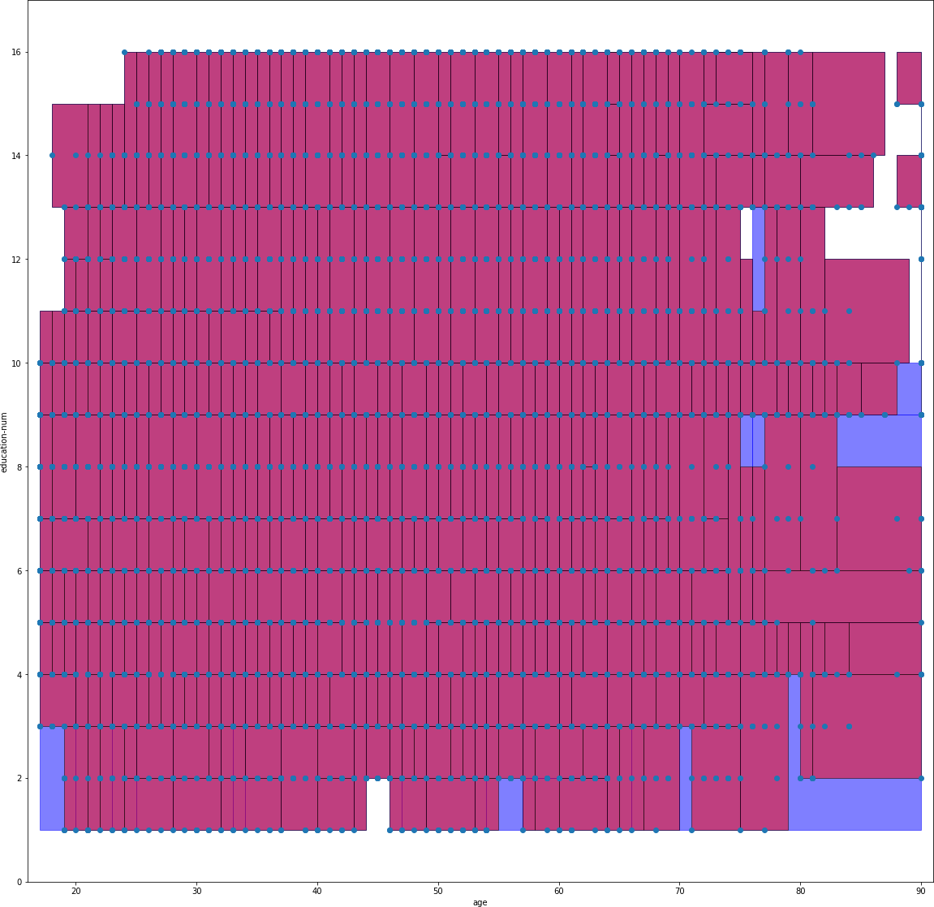
GRAPH FOR K-ANONYMITY AND L-DIVERSITY ( CASE 1)
Education_no
Education_no
age
age

Slide 20
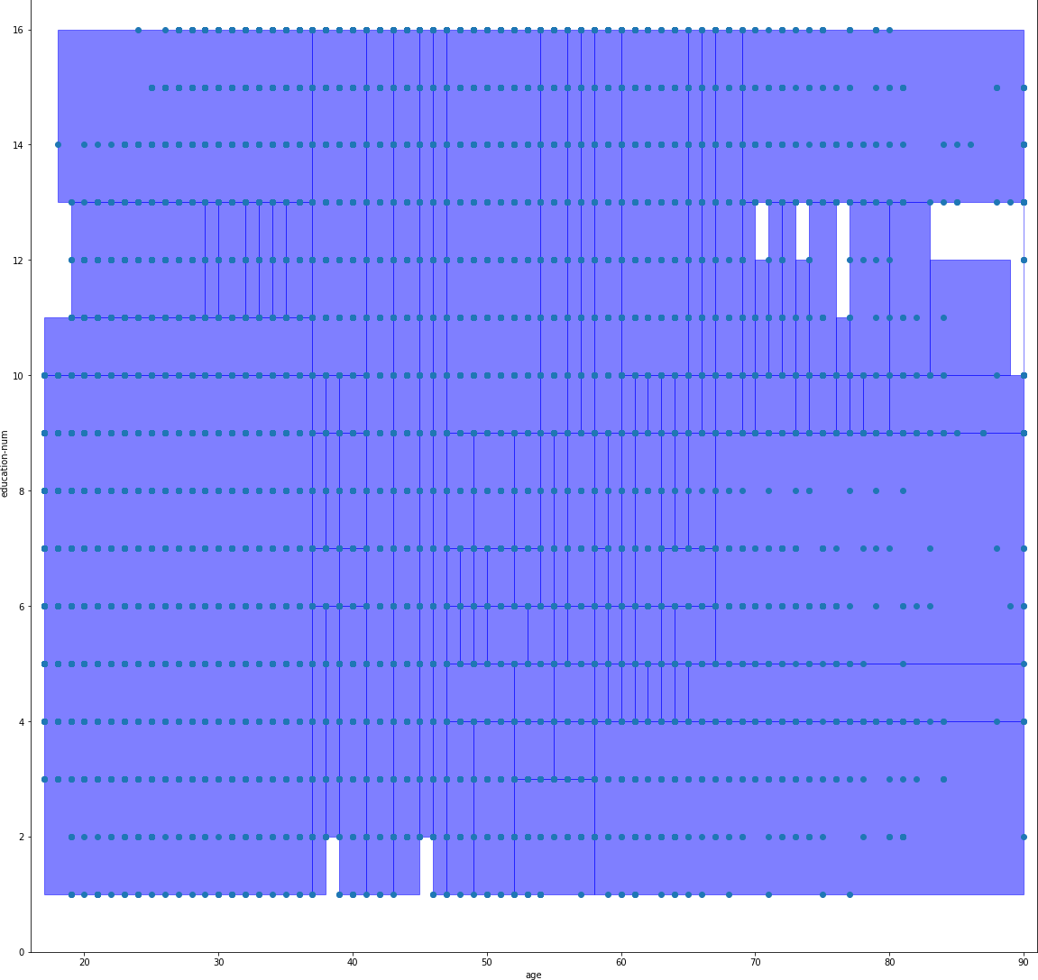
GRAPH FOR T-CLOSENESS ( CASE 1)
Anonymisation Technique | Discernability metric value
K-anonymisation | 547
L-diversity | 704
T-closeness | 893
Education_no
age

Slide 21
REFERENCES
1.Ahmed Abdeen Hamed, Malgorzata Zachara-Szymanska, XindongWu,Safeguarding authenticity for mitigating the harms of generative AI: Issues, research agenda, and policies for detection, fact-checking, and ethical AI, iScience ,Volume 27, Issue 2,2024.
2. J. -H. Weng and P. -W. Chi, "Multi-Level Privacy Preserving K-Anonymity," 2021 16th Asia Joint Conference on Information Security (AsiaJCIS), Seoul, Korea, Republic of, 2021, pp. 61-67.
3. Mei Yu, Yu Du, Tianyi Xu, Jian Yu and Yaqing Liu, "A K-anonymity model with strongly identifiable attributes," 2013 10th International Conference on Fuzzy Systems and Knowledge Discovery (FSKD), Shenyang, China, 2013, pp. 428-432 .
4. L.Sweeney.Achieving k-anonymity privacy protection using generalization and suppression. International Journal on Uncertainty,Fuzziness and Knowledge-basedSystems,10(5),2002;571588.
5. Jin Qian, Haoying Jiang, Ying Yu, Hui Wang, DuoqianMiao,Multi-level personalized k-anonymity privacy-preserving
model based on sequential three-way decisions, Expert Systems with Applications, Volume 239,2024.
6. Fadel M. Megahed, Ying-Ju Chen, Joshua A. Ferris, Sven Knoth & L. Allison Jones-Farmer (2024) How generative AI models such as ChatGPT can be (mis)used in SPC practice, education, and research? An exploratory study, Quality Engineering, 36:2, 287-315.
7. Huang, Weijie& Chen, Xi. (2024). A Levy Scheme for User-Generated-Content Platforms and Its Implication for
Generative AI Providers. 10.1007/978-981-97-0065-3_22.
8. Gangarde, Rupali & Shrivastava, Deepshikha & Sharma, Dr Amit & Tandon, Tanishka & Pawar, Dr. Ambika & Garg, Rachit. (2022). Data anonymization to balance privacy and utility of online social media network data. Journal of Discrete Mathematical Sciences and Cryptography. 25. 829-838. 10.1080/09720529.2021.2016225.

Slide 22
REFERENCES
9. Nah, Fiona & Zheng, Ruilin& Cai, Jingyuan & Siau, Keng & Chen, Langtao. (2023). Generative AI and ChatGPT: Applications, challenges, and AI-human collaboration. Journal of Information Technology Case and Application Research. 25. 1-28. 10.1080/15228053.2023.2233814.
10 . J. Cao et al., "Hiding Among Your Neighbors: Face Image Privacy Protection with Differential Private k-anonymity," 2022 IEEE International Symposium on Broadband Multimedia Systems and Broadcasting (BMSB), Bilbao, Spain, 2022, pp. 1-6.
11. Zhang, G., Liu, B., Zhu, T. et al. Visual privacy attacks and defenses in deep learning: a survey. Artif Intell Rev 55, 4347–4401
(2022). https://doi.org/10.1007/s10462-021-10123-y
12. Brijesh B. Mehta, Udai Pratap Rao,Improved l-diversity: Scalable anonymization approach for Privacy Preserving Big Data Publishing,Journal of King Saud University - Computer and Information Sciences,Volume 34, Issue 4,2022,Pages 1423-1430,ISSN 1319-1578
13. T. Xu and Z. Wei, "Waveform Defence Against Deep Learning Generative Adversarial Network Attacks," 2022 13th International Symposium on Communication Systems, Networks and Digital Signal Processing (CSNDSP), Porto, Portugal, 2022, pp. 503-508, doi: 10.1109/CSNDSP54353.2022.9907905.
14. Muthulakshmi, V., Francis H. Shajin, J. Dhiviya Rose, and P. Rajesh. “Generative Adversarial Networks Classifier Optimized with Water Strider Algorithm for Fake Tweets Detection.” IETE Journal of Research, (2023), 1–16. doi:10.1080/03772063.2023.2172466.
15. P. Cobelli, S. Nesmachnow and J. Toutouh, "A comparison of Generative Adversarial Networks for image super-resolution," 2022 IEEE Latin American Conference on Computational Intelligence (LA-CCI), Montevideo, Uruguay, 2022, pp. 1-6, doi: 10.1109/LA- CCI54402.2022.9981850.
16. Anande, T. J., Al-Saadi, S., & Leeson, M. S. (2023). Generative adversarial networks for network traffic feature generation. International Journal of Computers and Applications, 45(4), 297–305. https://doi.org/10.1080/1206212X.2023.2191072

Slide 23
REFERENCES
17. Z. Shi, J. Teng, S. Zheng and K. Guo, "Exploring the Effects of Various Generative Adversarial Networks Techniques on Image Generation," 2023 IEEE 11th Joint International Information Technology and Artificial Intelligence Conference (ITAIC), Chongqing, China, 2023, pp. 1796-1799, doi: 10.1109/ITAIC58329.2023.10409102.
18. V. s. Krishna Katta, H. Kapalavai and S. Mondal, "Generating New Human Faces and Improving the Quality of Images Using Generative Adversarial Networks(GAN)," 2023 2nd International Conference on Edge Computing and Applications (ICECAA), Namakkal, India, 2023, pp. 1647-1652, doi: 10.1109/ICECAA58104.2023.10212099.
19. Romero Moreno, F. (2024). Generative AI and deepfakes: a human rights approach to tackling harmful content. International Review of Law, Computers & Technology, 1–30. https://doi.org/10.1080/13600869.2024.2324540.
20. Jabar, M., Chiong-Javier, E., & Pradubmook Sherer, P. (2024). Qualitative ethical technology assessment of artificial intelligence (AI) and the internet of things (IoT) among filipino Gen Z members: implications for ethics education in higher learning institutions. Asia Pacific Journal of Education, 1–15. https://doi.org/10.1080/02188791.2024.2303048.
21. Long, William J., and Marc Pang Quek. “Personal Data Privacy Protection in an Age of Globalization: The US-EU Safe Harbor Compromise.” Journal of European Public Policy 9, no. 3 (2002): 325–44. doi:10.1080/13501760210138778.

