Slide 1
Building a Knowledge Graph for Scientists using Wikidata
Rajeev (20232-101
Shivam Chaturvedi
Manas Biswas
Niraj Gupta
Shalu Kumari

Slide 2
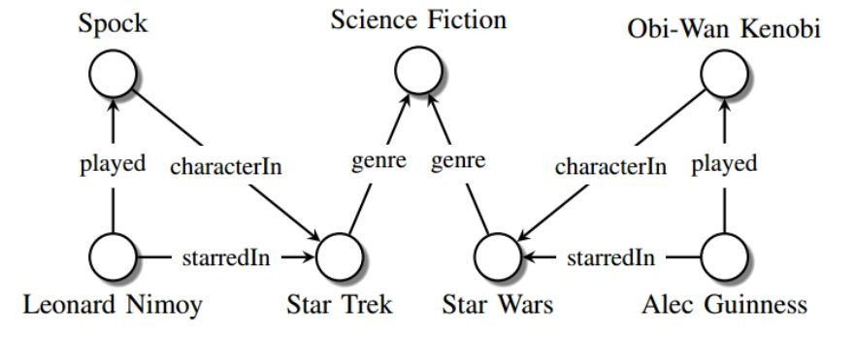
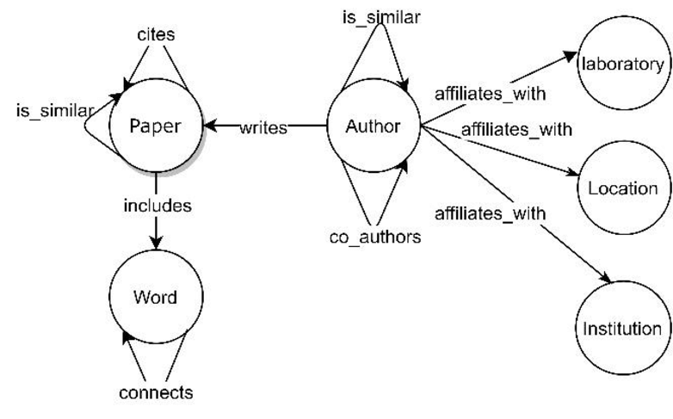
Knowledge Graphs
A knowledge graph (KG) represents a collection of interlinked descriptions of entities – real-world objects, events, situations or abstract concepts – where:
Descriptions have a formal structure that allows both people and computers to process them in an efficient and unambiguous manner.
Entity descriptions contribute to one another, forming a network, where each entity represents part of the description of the entities, related to it.

Slide 3
What is Wikidata?
A collaboratively edited knowledge base hosted by the Wikimedia Foundation
Common source of open data for Wikimedia projects and anyone else, under a public domain license
Primary data storage: JSON blobs in an SQL database, using specific IDs as the base of Wikidata
Entity ID structure:
Items: Prefixed with Q .The core entities in Wikidata, representing concepts, people, places, etc., identified by unique QIDs(e.g., Albert Einstein (Q937))
Properties: Prefixed with P . Define relationships between items, identified by PIDs(e.g., instance of (P31))
Lexemes: Prefixed with L. Represent linguistic entities like words or phrases, identified by LIDs, capturing language data such as grammar. (e.g., L1)
Wikidata Query Service: Uses an RDF triple store to allow SPARQL queries against current data

Slide 4
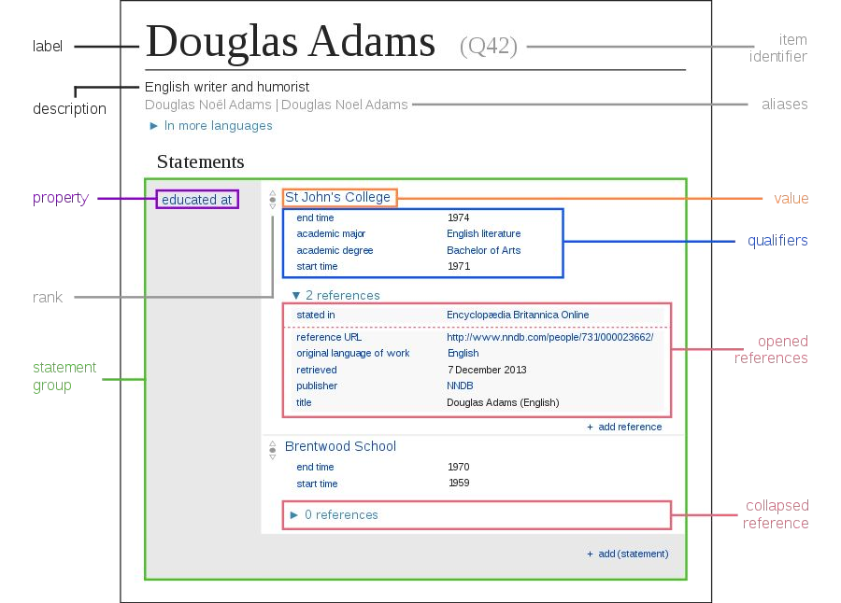
SPARQL Query Example:
SELECT ?human ?label WHERE
{
?human wdt:P31(instance of) wd:Q15632617(fictional being);
rdfs:label ?label.
FILTER(LANG(?label) = "en"). FILTER(STRSTARTS(?label, "Mr. ")).
}

Slide 5
Introduction
Objective:
The main objective of this project is to build a knowledge graph using data from Wikidata to organize detailed information about scientists. The knowledge graph is enhanced with:
Translation to Hindi for accessibility to non-English speakers.
Gender-specific sentence generation for grammatically correct and culturally appropriate descriptions.
Template-based sentence generation, providing structured, automated narratives for each scientist.

Slide 6
Motivation
Accessibility of Knowledge: A significant portion of India’s population speaks Hindi as their first language. By translating key scientific information into Hindi, this project aims to make knowledge about scientists accessible to a wider audience, especially students and educators.
Automation of Knowledge Representation: Manual entry of data into knowledge systems is time-consuming. Automating this process using NLP techniques and knowledge graphs makes large-scale data processing feasible.

Slide 7
Use Case
Educational Tools: The knowledge graph can be used to automatically generate scientific profiles in Hindi, assisting teachers and students in accessing accurate, structured knowledge.
Intelligent Systems: This work can be extended to chatbots, question-answering systems, or voice assistants that offer information in Hindi, making them useful for wider audiences.
Research and Data Insights: The graph provides a structured format that can be extended to track research contributions, collaborations, and educational lineages (e.g., doctoral advisors and students).

Slide 8
Work Done So Far
Studied Wikidata and learnt about it’s structure and chose a domain to work in so that we can create our Hindi Wikipedia Pages in that language
Below are the main steps :
Data Extraction
Data Preprocessing
Template Sentence Generation
Gender-Specific Language Handling
Feature Addition

Slide 9
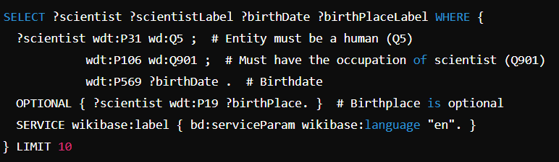
Data Extraction
Data extraction involves retrieving structured data from Wikidata using SPARQL queries. This allows us to gather information such as scientists' names, birth dates, birth places, occupations, awards, and academic relationships.
Key Points:
SPARQL: A query language for accessing and retrieving structured data from Wikidata.
The query extracts:
Name of the scientist.
Birthdate and birthplace.
Occupation (e.g., physicist, biologist).

Slide 10
Data Preprocessing
Data preprocessing involves structuring the extracted data into key-value pairs for further processing. It ensures that the data is consistent, properly translated, and ready for sentence generation.
Steps:
1. Key-Value Pair Extraction:
Extracted fields include the scientist’s name, birthdate, birthplace, occupation, awards, and academic lineage.
2. Translation to Hindi:
Automatic translation of extracted data into Hindi using the Google Translate API.

Slide 11
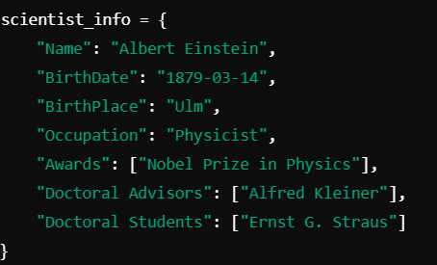
Step 1: Key-Value Pair Extraction
Step 2: Translation to Hindi:

Slide 12
Template Sentence Generation
Template sentence generation involves filling predefined sentence structures with the extracted key-value pairs to produce meaningful narratives about each scientist in both English and Hindi.
Example Template Sentence:
Template in English:
Template in Hindi:
Steps:
Use the key-value pairs extracted earlier to fill in the placeholders in the sentence.
Translate the final sentences into Hindi while respecting grammatical rules, sentence structures change based on the gender of the subject (e.g., gender-specific endings).
English Template → Filled with Key-Values → Translated Sentence in Hindi.

Slide 13
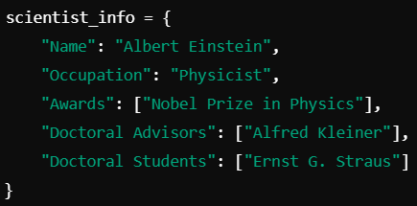
Feature Addition
Definition:
Additional features such as awards, degrees, doctoral advisors, and doctoral students were added to enrich the knowledge graph and provide more context about each scientist.
Example of Added Features:

Slide 14
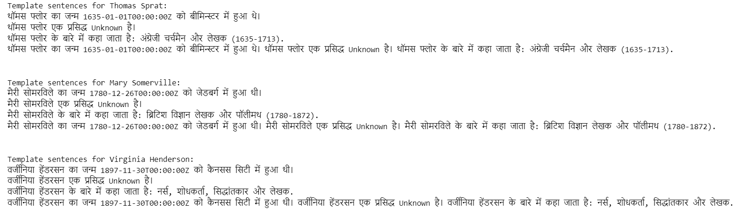
Output

Slide 15
Workflow Diagram
Data Extraction from
Preprocessing (Key-Value Pairs)
Translation to Hindi
Template Sentence Generation
Final Knowledge Graph
Gender-Specific Adjustments
Feature Addition

Slide 16
Challenges and Solutions
Data Extraction:
Handling incomplete or missing data from Wikidata.
Solution: Implement optional queries and fallback defaults (e.g., "Unknown")
Translation Accuracy:
The challenge of maintaining context when translating scientific terms.
Solution: Post-processing and validation with manual checks for critical translations
Gender-Specific Language:
Ensuring sentences respect Hindi grammar’s gender-based distinctions.
Solution: Automated rules that adapt sentence endings based on gender claims.

Slide 17
Work to Be Done by End of Semester
1. Optimization of Sentence Generation with NLG
Task: Refine sentence generation for complex data relationships
Role of NLG: Convert structured data into readable text
Impact: Enhance readability and user engagement
2. Extended Feature Set
Task: Incorporate new features (Research Fields, Collaborations)
Role of NLG: Generate detailed narratives
Impact: Provide insightful content on scientists' work and affiliations
3. Automation and Scaling
Task: Automate workflow for larger data sets
Role of NLG: Generate domain-specific content
Impact: Scale to other domains (e.g., historical figures, inventors)
4. Evaluation and Testing
Task: Evaluate accuracy of translations and sentence generation
Role of NLG: Assess quality in English and Hindi
Impact: Ensure cultural sensitivity and scientific correctness

Slide 18
THANK YOU !

