Slide 1

BUILDING A KNOWLEDGE GRAPH FOR SCIENTISTS USING WIKIDATA
Shivam Chaturvedi (2023201019)
Manas Biswas (2023201016)
Niraj Gupta (2023201013)
Shalu Kumari (2023201031)

Slide 2
Introduction
Objective:
The main objective of this project is to build a knowledge graph using data from Wikidata to organize detailed information about scientists. The knowledge graph is enhanced with:
Translation to Hindi for accessibility to non-English speakers.
Gender-specific sentence generation for grammatically correct and culturally appropriate descriptions.
Template-based sentence generation, providing structured, automated narratives for each scientist.

Slide 3
MOTIVATION
Accessibility of Knowledge: A significant portion of India’s population speaks Hindi as their first language. By translating key scientific information into Hindi, this project aims to make knowledge about scientists accessible to a wider audience, especially students and educators.
Automation of Knowledge Representation: Manual entry of data into knowledge systems is time-consuming. Automating this process using NLP techniques and knowledge graphs makes large-scale data processing feasible.

Slide 4
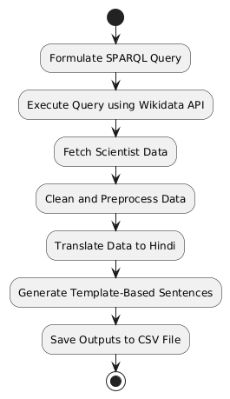
PROCESS OVERVIEW
SPARQL Query Execution to extract scientist data.
Fetch additional details using Wikidata API.
Clean and translate data to Hindi.
Generate template-based sentences.
Save outputs in CSV files.

Slide 5
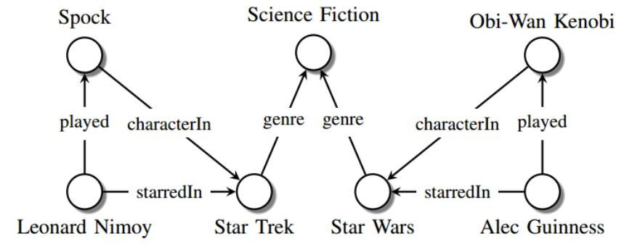
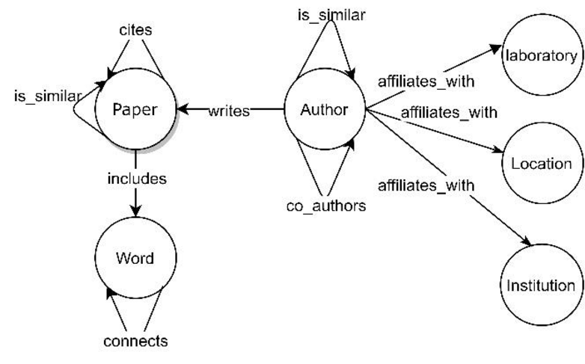
KNOWLEDGE GRAPHS
A knowledge graph (KG) represents a collection of interlinked descriptions of entities – real-world objects, events, situations or abstract concepts – where:
Descriptions have a formal structure that allows both people and computers to process them in an efficient and unambiguous manner.
Entity descriptions contribute to one another, forming a network, where each entity represents part of the description of the entities, related to it.

Slide 6
WHAT IS WIKIDATA?
A collaboratively edited knowledge base hosted by the Wikimedia Foundation
Common source of open data for Wikimedia projects and anyone else, under a public domain license
Primary data storage: JSON blobs in an SQL database, using specific IDs as the base of Wikidata
Entity ID structure:
Items: Prefixed with Q .The core entities in Wikidata, representing concepts, people, places, etc., identified by unique QIDs(e.g., Albert Einstein (Q937))
Properties: Prefixed with P . Define relationships between items, identified by PIDs(e.g., instance of (P31))
Lexemes: Prefixed with L. Represent linguistic entities like words or phrases, identified by LIDs, capturing language data such as grammar. (e.g., L1)
Wikidata Query Service: Uses an RDF triple store to allow SPARQL queries against current data

Slide 7
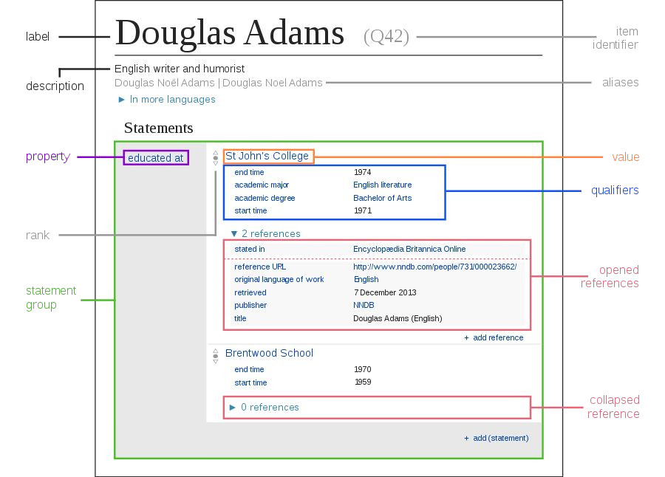
SPARQL Query Example:
SELECT ?human ?label WHERE
{
?human wdt:P31(instance of) wd:Q15632617(fictional being);
rdfs:label ?label.
FILTER(LANG(?label) = "en"). FILTER(STRSTARTS(?label, "Mr. ")).
}

Slide 8
USE CASE
Educational Tools: The knowledge graph can be used to automatically generate scientific profiles in Hindi, assisting teachers and students in accessing accurate, structured knowledge.
Intelligent Systems: This work can be extended to chatbots, question-answering systems, or voice assistants that offer information in Hindi, making them useful for wider audiences.
Research and Data Insights: The graph provides a structured format that can be extended to track research contributions, collaborations, and educational lineages (e.g., doctoral advisors and students).

Slide 9
DATA EXTRACTION
Data extraction involves retrieving structured data from Wikidata using SPARQL queries. This allows us to gather information such as scientists' names, birth dates, birth places, occupations, awards, and academic relationships.

Slide 10
DATA EXTRACTION
Key Points:
SPARQL: A query language for accessing and retrieving structured data from Wikidata.
The query extracts:
Name of the scientist.
Birthdate and birthplace.
Occupation (e.g., physicist, biologist).
Awards
Educational Institutions
Death dates
Descriptions
Occupations
Labels

Slide 11
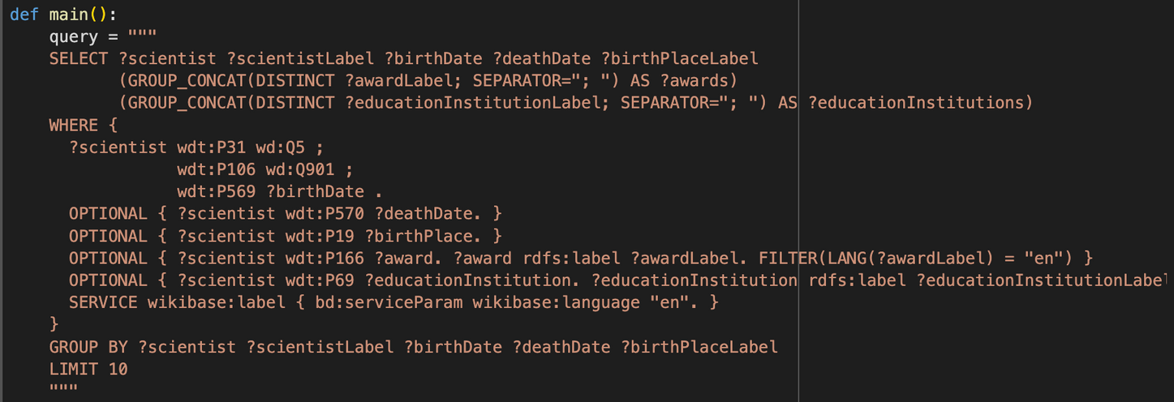
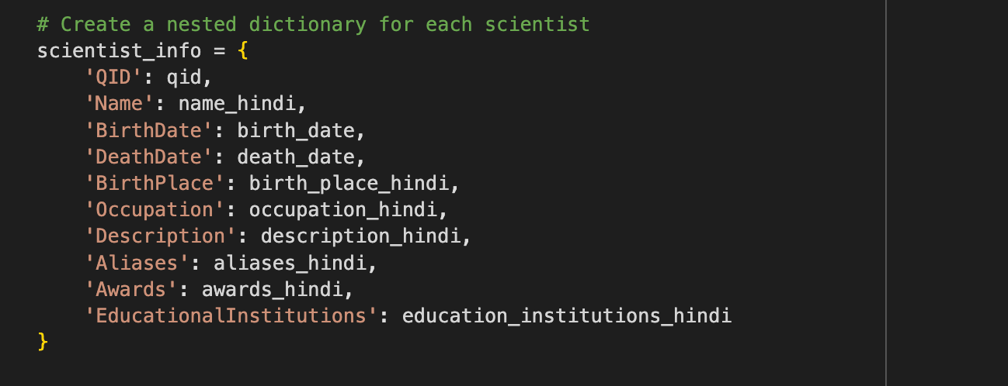

Slide 12
Data Preprocessing & Cleaning
Data preprocessing involves structuring the extracted data into key-value pairs for further processing. It ensures that the data is consistent, properly translated, and ready for sentence generation.
Why Clean Data?
Raw data often contains timestamps, unknown values, or inconsistencies.
Example: Convert 1940-05-20T00:00:00Z to 1940 (Hindi: १९४०).
STEPS:
1. KEY-VALUE PAIR EXTRACTION:
Extracted fields include the scientist’s name, birthdate, birthplace, occupation, awards, and academic lineage.
2. TRANSLATION TO HINDI:
Automatic translation of extracted data into Hindi using the Google Translate API.
Notes:
Why Clean Data?
Raw data often contains timestamps, unknown values, or inconsistencies.
Example: Convert 1940-05-20T00:00:00Z to 1940 (Hindi: १९४०).

Slide 13
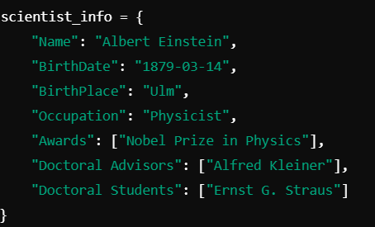
STEP 1: KEY-VALUE PAIR EXTRACTION
STEP 2: TRANSLATION TO HINDI:
Notes:
we are using google translator for translation so it give much better output .

Slide 14
USING TF-IDF TO PRIORITIZE KEY-VALUE PAIRS
What is TF-IDF?
A statistical method to measure the relevance of words in a document.
Combines:
Term Frequency (TF): Frequency of a term in a document.
Inverse Document Frequency (IDF): How unique a term is across documents.
Why TF-IDF?
Helps identify the most relevant attributes (key-value pairs) for each scientist.
Ensures important details like doctoral advisor, awards, and fields of work are included.
How it Works:
Calculated for each key-value pair:
High TF-IDF score → Highly relevant to the scientist.
Low TF-IDF score → Less relevant or common across scientists.
Example:
"Doctoral Advisor" appears rarely but has high relevance.
Notes:
we focused on generating template sentences, but first, we identified the crucial Key
Value pairs for the Scientist Domain. Key
attributes such as Doctoral Advisor, Student,
Doctoral Student, Awards Won, and Field of
Work were considered essential. To extract
these pairs, TF-IDF is one of the highly effective algorithm.

Slide 15
Template Sentence Generation
Template sentence generation involves filling predefined sentence structures with the extracted key-value pairs to produce meaningful narratives about each scientist in both English and Hindi.
Example Template Sentence:
Template in English:
Template in Hindi:
Steps:
Use the key-value pairs extracted earlier to fill in the placeholders in the sentence.
Translate the final sentences into Hindi while respecting grammatical rules, sentence structures change based on the gender of the subject (e.g., gender-specific endings).
English Template → Filled with Key-Values → Translated Sentence in Hindi.

Slide 16
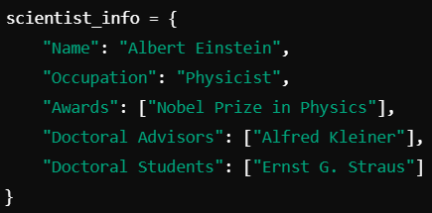
Feature Addition
DEFINITION:
Additional features such as awards, degrees, doctoral advisors, and doctoral students were added to enrich the knowledge graph and provide more context about each scientist.
EXAMPLE OF ADDED FEATURES:

Slide 17
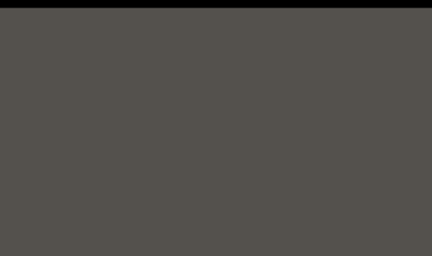
WORKFLOW DIAGRAM
Preprocessing (Key-Value Pairs)
Data Extraction
Translation to Hindi
Final Knowledge Graph
Template Sentence Generation
Feature Addition

Slide 18
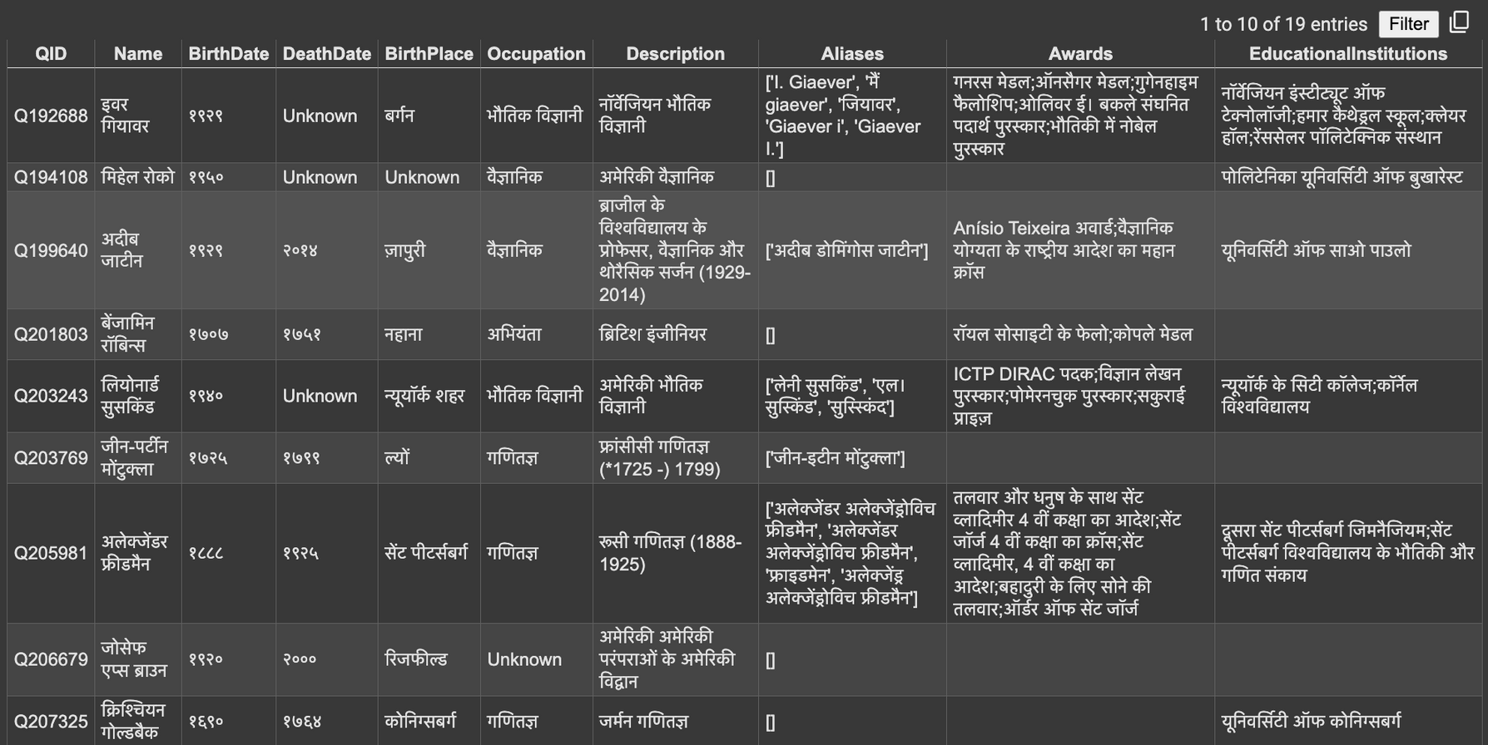
OUTPUT FILES
Notes:
this output shows the tanslated data in form of dictionary from which the sentences will be generated.

Slide 19
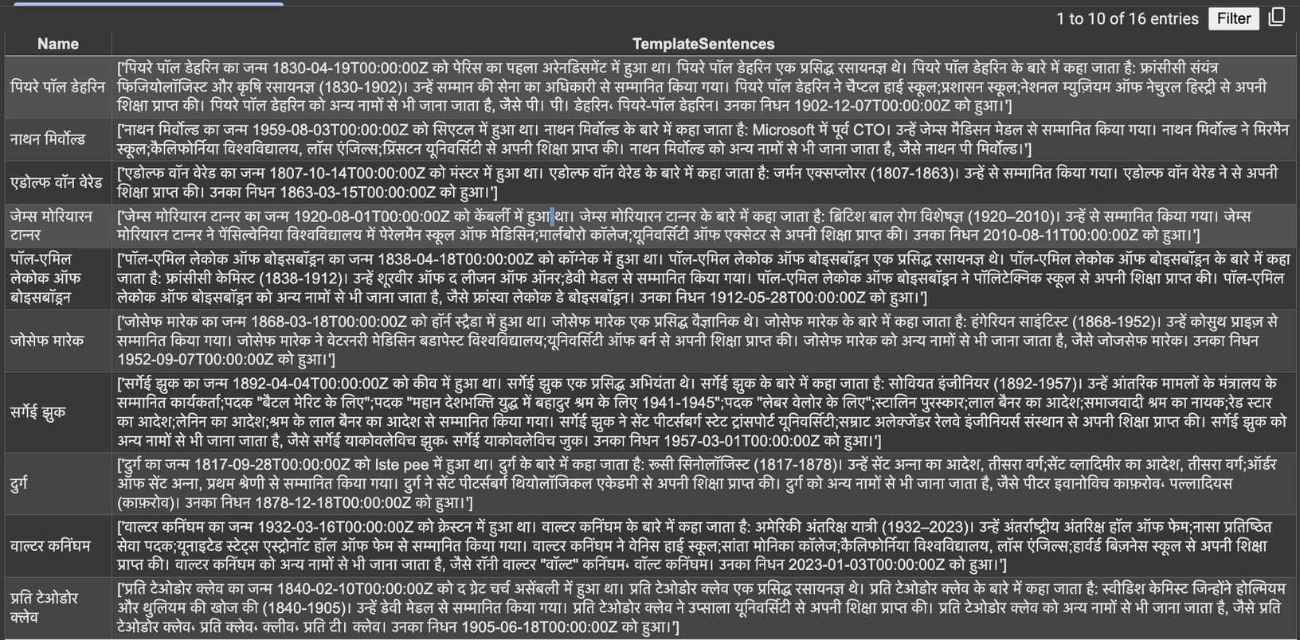
SENTENCE GENERATION OUTPUT

Slide 20
Challenges and Solutions
DATA EXTRACTION:
Handling incomplete or missing data from Wikidata.
Solution: Implement optional queries and fallback defaults (e.g., "Unknown")
TRANSLATION ACCURACY:
The challenge of maintaining context when translating scientific terms.
Solution: Post-processing and validation with manual checks for critical translations

Slide 21
Link
Github Repo Link for the code and PPT
https://github.com/shaluKm/Automatic-Hindi-Wikipedia-Generation

Slide 22
References
https://github.com/shaluKm/Automatic-Hindi-Wikipedia-Generation
https://aclanthology.org/2023.ranlp-1.2.pdf
https://jena.apache.org/tutorials/sparql.html
https://en.wikipedia.org/wiki/Wikipedia:Wikidata
https://www.wikidata.org/wiki/Help:Linking_Wikipedia_pages
https://github.com/aditya3498/Automatic_Hindi_Wikipedia_Generation
https://github.com/aditya3498/WikiData-To-WikiPages

Slide 23
THANK YOU !

