Slide 1
Natural Language Inference Intro to NLP - CS7.401
Group 21
Radhika Garg (2023201030)
Shalu Kumari (2023201031)
Shoaib Ahmed (2023201080)
May 9th, 2024
​

Slide 2
TABLE OF CONTENT
1. Introduction TO NATURAL LANGUAGE INFERENCE
2. DATASETS
3. IMPLEMENTATION TECHNIQUES
LOGISTIC REGRESSION
BIDIRECTIONAL LSTM
BIDIRECTIONAL GRU
BERT
4. QUANTITATIVE ANALYSIS
5. IMPLEMENTATION CHALLENGES
6. LIMITATIONS AND FUTURE WORK
7. CONCLUSION
8. REFERENCES

Slide 3
Introduction
Natural Language Inference (NLI) is the task of determining the logical relationship between two given sentences - a premise and a hypothesis. The goal is to identify whether the hypothesis is entailed, contradicted, or neutral with respect to the premise.
Contradiction occurs when both the premise and the hypothesis cannot be simultaneously true, entailment when the hypothesis can be inferred from the premise, and neutral when there is insufficient information in the premise to infer or derive the hypothesis.
Significance:
NLI has many practical applications, including text classification, sentiment analysis, and question answering. It is also important for natural language understanding, as it requires the model to reason and comprehend the semantics of text.

Slide 4
DATASET I : SNLI
SNLI stands for Stanford Natural Language Inference. It is a benchmark dataset for natural
language inference tasks.
All the premises are the image captions from Flicker30 dataset and hence it makes SNLI somewhat genre restricted.
All the hypotheses are written by Crowd-workers i.e., corresponding to a premise, crowd workers will write 3 sentences one for each class.
Total of 550152 train examples with 10,000 as dev samples and 10,000 as test samples, balanced equally across 3 classes.
Mean token length in SNLI dataset i.e., the average number of words per sentence
For premise - 12.9
For hypothesis - 7.4

Slide 5
DATASET Ii : MULTI-NLI
It contains 570k sentence pairs for training and validation, and 10k sentence pairs for testing.
The Multi-Genre Natural Language Inference (MultiNLI) corpus is an extension of the SNLI corpus, designed to address its limitations in genre and domain coverage.
MultiNLI contains sentence pairs from 10 different genres, such as fiction, government, and telephone, providing a more diverse and challenging dataset for natural language inference.
Similar to SNLI, the task is to predict whether the hypothesis is entailed, contradicted, or neutral with respect to the premise

Slide 6
DATASET Iii : e-SNLI
e-SNLI is a dataset for Natural Language Inference (NLI) tasks, similar to SNLI but more comprehensive.
It consists of 569,033 sentence pairs, each annotated with one of three relationships: "contradiction," "entailment," or "neutral.“
Each pair includes a premise sentence and a hypothesis sentence, covering diverse scenarios and contexts.
. Its comprehensive annotations, diverse scenarios, and rigorous quality control measures make it a cornerstone for developing and evaluating NLI models.
Here is what a sample from the e-SNLI dataset looks like:
Premise: A person in a blue shirt and tan shorts getting ready to roll a bowling ball down the alley. Hypothesis: A person is napping on the couch.
Predicted label: contradiction
Explanation: A person cannot be napping and getting ready to roll a bowling ball at the same time.

Slide 7
IMPLEMENTATION

Slide 8
MODELS
Logistic Regression: a simple baseline model that uses bag-of-words features to predict the relationship between two sentences.
BiLSTM: a model that uses bidirectional LSTMs to capture contextual information from both sentences and make the final decision based on the concatenation of the last hidden states.
BiGRU: a similar model to BiLSTM, but using GRUs instead of LSTMs, which are faster and have fewer parameters.
BERT: a transformer-based model that uses a multi-layer bidirectional
architecture to learn contextual representations of words and sentences. It has
achieved state-of-the-art results on many NLP tasks.

Slide 9
MODELS
T5: (Text-To-Text Transfer Transformer) is a versatile language model developed by Google, capable of performing various text-to-text tasks by framing them uniformly. It employs a transformer architecture and achieves state-of-the-art performance across a wide range of natural language processing tasks through pre-training and fine-tuning.
We selected these models to encompass a spectrum of techniques employed in NLP, spanning from conventional bag-of-words methods to cutting-edge deep learning architectures. This decision enabled us to examine the merits and limitations of each approach while facilitating direct performance comparisons. Furthermore, their extensive usage in prior research on natural language inference facilitated our analysis and facilitated result comparison.

Slide 10
LOGISTIC REGRESSION
The code performs text classification using logistic regression on the SNLI (Stanford Natural Language Inference) dataset, which consists of sentence pairs labeled with their entailment relationship (entailment, neutral, contradiction).
It preprocesses the dataset by converting text to lowercase, tokenizing, removing stopwords, and limiting the number of features to 5000 using CountVectorizer from scikit-learn.
The logistic regression model is instantiated and trained on the training features and labels. It uses a maximum iteration of 1000 for convergence.
After training, the model's accuracy is evaluated on both the validation and test sets using accuracy_score from scikit-learn. Additionally, a classification report is printed to show precision, recall, and F1-score for each class.
Finally, a confusion matrix is generated based on the validation set predictions, and a heatmap visualization of the confusion matrix is plotted using seaborn and matplotlib. This helps to visualize the model's performance in predicting each class and where it might be making errors.

Slide 11
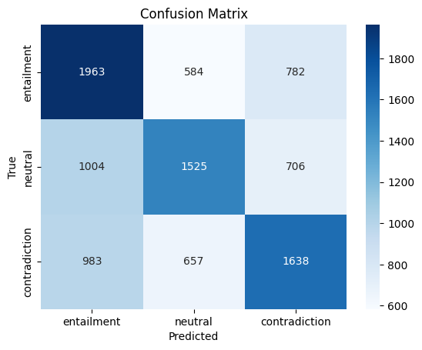
LOGISTIC REGRESSION : ANALYSIS
1.eSNLI
Train Accuracy: 0.53
Validation Accuracy: 0.52
Test Accuracy: 0.52
Classification Report:
precision recall f1-score support
0 0.50 0.59 0.54 3329
1 0.55 0.47 0.51 3235
2 0.52 0.50 0.51 3278
accuracy 0.52 9842
macro avg 0.52 0.52 0.52 9842
weighted avg 0.52 0.52 0.52 9842

Slide 12
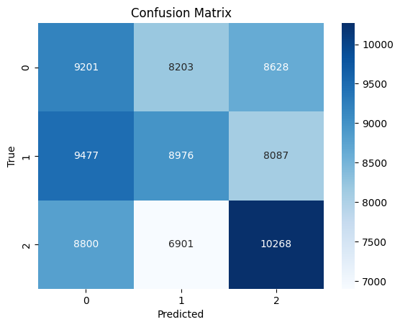
LOGISTIC REGRESSION : ANALYSIS
2.MultiNLI
Train Accuracy: 0.42
Test Accuracy: 0.36
Classification Report:
precision recall f1-score support
0 0.33 0.35 0.34 26032
1 0.37 0.34 0.35 26540
2 0.38 0.40 0.39 25969
accuracy 0.36 78541
macro avg 0.36 0.36 0.36 78541
weighted avg 0.36 0.36 0.36 78541

Slide 13
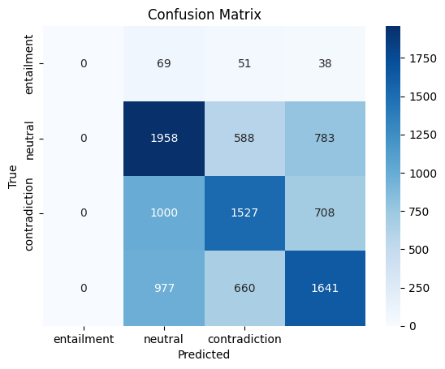
LOGISTIC REGRESSION : ANALYSIS
3.SNLI
Train Accuracy: 0.53
Validation Accuracy: 0.51
Test Accuracy: 0.52
Classification Report:
precision recall f1-score support
-1 0.00 0.00 0.00 158
0 0.49 0.59 0.53 3329
1 0.54 0.47 0.50 3235
2 0.52 0.50 0.51 3278
accuracy 0.51 10000
macro avg 0.39 0.39 0.39 10000
weighted avg 0.51 0.51 0.51 10000

Slide 14
BIDIRECTIONAL LSTM
The code utilizes a bidirectional LSTM (BiLSTM) model for text classification on the SNLI dataset.
Data preprocessing involves converting text to lowercase, tokenizing, building a vocabulary, and padding sequences to a maximum length of 100 tokens.
The BiLSTM model architecture consists of an embedding layer, bidirectional LSTM layer, fully connected layer, and dropout layer.
The BiLSTM class defines a neural network architecture for text classification, specifically designed to capture contextual information from both directions in the input sequences.
It utilizes an embedding layer to convert input tokens into dense vectors, allowing the model to learn representations that capture semantic information.
The bidirectional LSTM layer processes input sequences in both forward and backward directions, enabling the model to capture dependencies and contextual information from both preceding and succeeding tokens. Finally, the output of the LSTM layers is concatenated and passed through a fully connected layer to produce the final classification predictions.

Slide 15
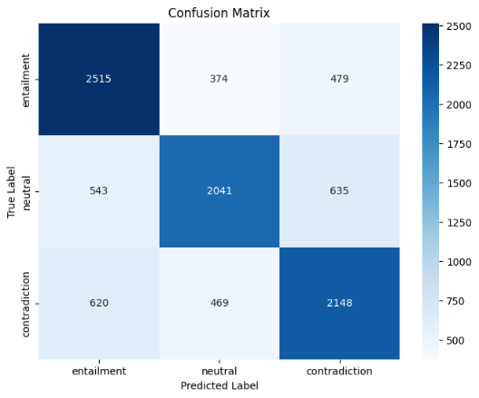
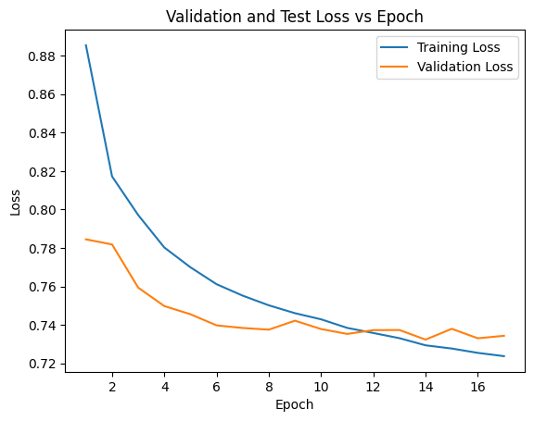
BIDIRECTIONAL LSTM: ANALYSIS
1.eSNLI
Test Loss: 0.740, Test Accuracy: 68.24%
precision recall f1-score support
entailment 0.68 0.75 0.71 3368
neutral 0.71 0.63 0.67 3219
contradiction 0.66 0.66 0.66 3237
accuracy 0.68 9824
macro avg 0.68 0.68 0.68 9824
weighted avg 0.68 0.68 0.68 9824

Slide 16
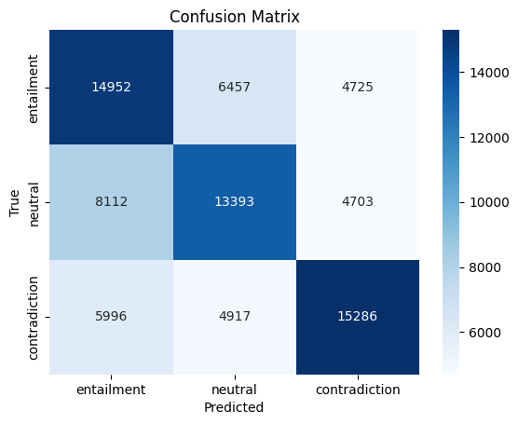
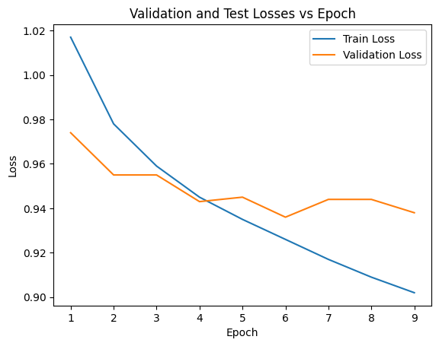
BIDIRECTIONAL LSTM: ANALYSIS
2.multiNLI
Test Loss: 0.949, Test Accuracy: 55.55%
precision recall f1-score support
entailment 0.51 0.57 0.54 26134
neutral 0.54 0.51 0.53 26208
contradiction 0.62 0.58 0.60 26199
accuracy 0.56 78541
macro avg 0.56 0.56 0.56 78541
weighted avg 0.56 0.56 0.56 78541

Slide 17
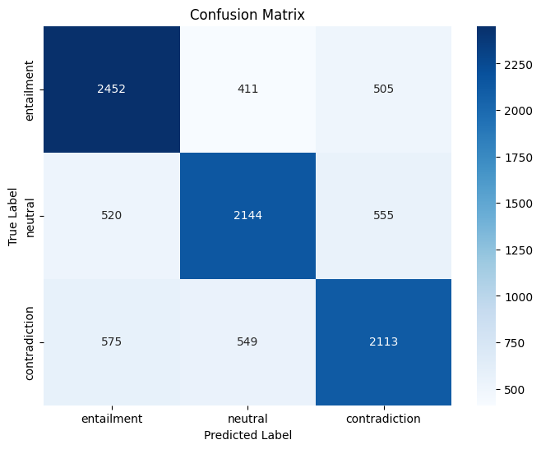
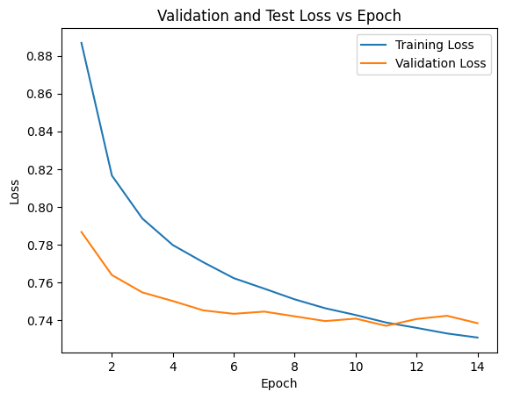
BIDIRECTIONAL LSTM: ANALYSIS
3. SNLI
Test Loss: 0.743, Test Accuracy: 68.29%
precision recall f1-score support
entailment 0.69 0.73 0.71 3368
neutral 0.69 0.67 0.68 3219
contradiction 0.67 0.65 0.66 3237
accuracy 0.68 9824
macro avg 0.68 0.68 0.68 9824
weighted avg 0.68 0.68 0.68 9824

Slide 18
BIDIRECTIONAL GRU
The BiGRU class is designed to construct a neural network architecture specifically tailored for text classification tasks.
It utilizes bidirectional gated recurrent units (GRUs), which are a type of recurrent neural network (RNN) that can capture sequential information from both forward and backward directions.
The model architecture begins with an embedding layer which transforms input tokens into dense vectors of fixed size. This embedding layer enables the model to learn representations that capture the semantic meaning of words in the input sequences.
The bidirectional GRU layer processes the embedded input sequences in both forward and backward directions. This bidirectional processing allows the model to capture dependencies and contextual information from both preceding and succeeding tokens in the input sequences.
The output of the bidirectional GRU layer is concatenated and passed through a fully connected layer. This layer combines the information from both forward and backward directions of the GRU layers and maps it to the output space for classification.
Additionally, a dropout layer is applied after the embedding layer and before the fully connected layer. Dropout is a regularization technique that randomly sets a fraction of input units to zero during training, preventing overfitting by reducing the model's reliance on specific neurons.

Slide 19
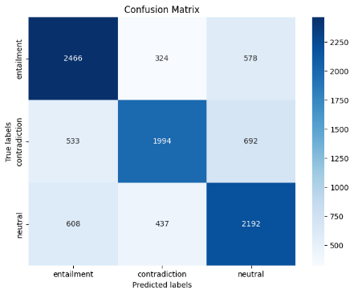
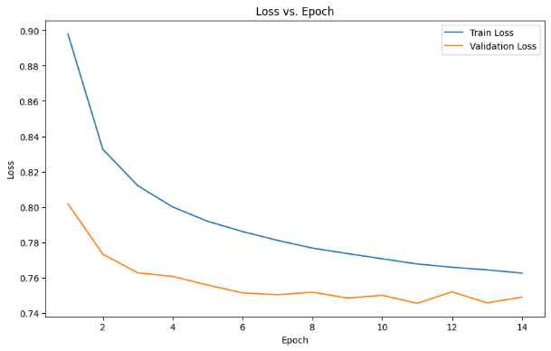
BIDIRECTIONAL GRU: ANALYSIS
1.eSNLI
Test Loss: 0.749, Test Accuracy: 67.71%
precision recall f1-score support
0 0.68 0.73 0.71 3368
1 0.72 0.62 0.67 3219
2 0.63 0.68 0.65 3237
accuracy 0.68 9824
macro avg 0.68 0.68 0.68 9824
weighted avg 0.68 0.68 0.68 9824

Slide 20
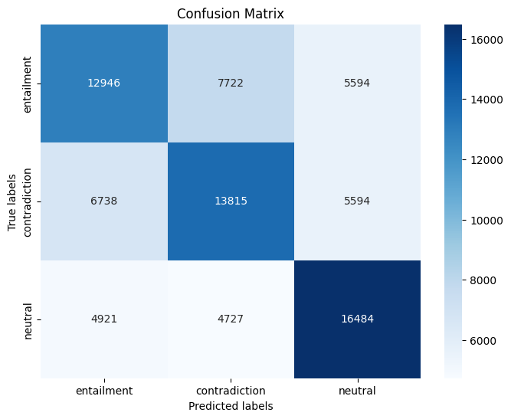
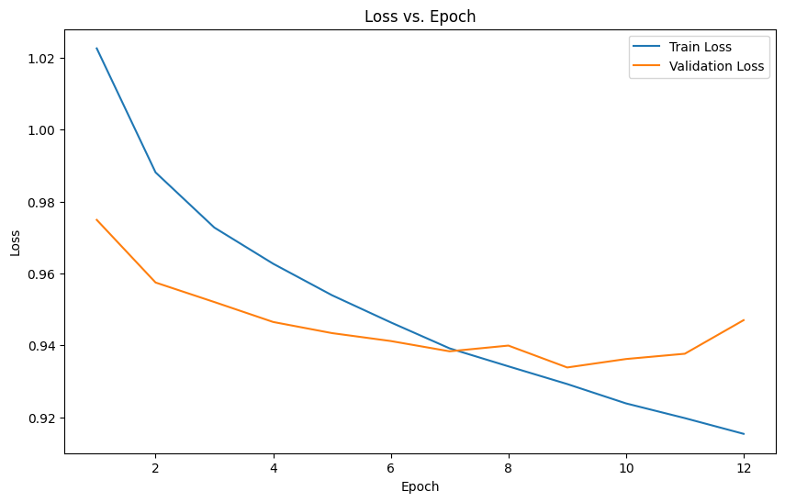
BIDIRECTIONAL GRU: ANALYSIS
2.MultiNLI
Test Loss: 0.949, Test Accuracy: 55.06%
precision recall f1-score support
0 0.53 0.49 0.51 26262
1 0.53 0.53 0.53 26147
2 0.60 0.63 0.61 26132
accuracy 0.55 78541
macro avg 0.55 0.55 0.55 78541
weighted avg 0.55 0.55 0.55 78541

Slide 21
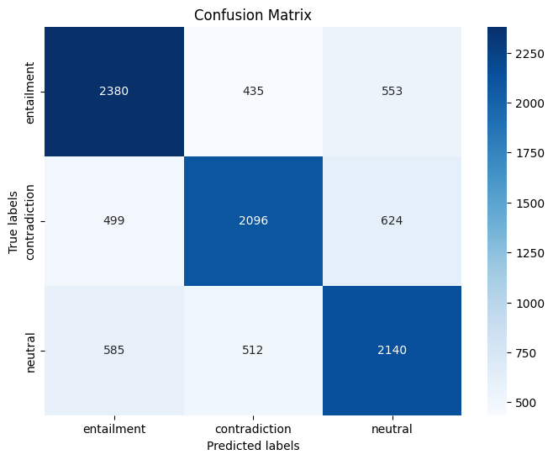
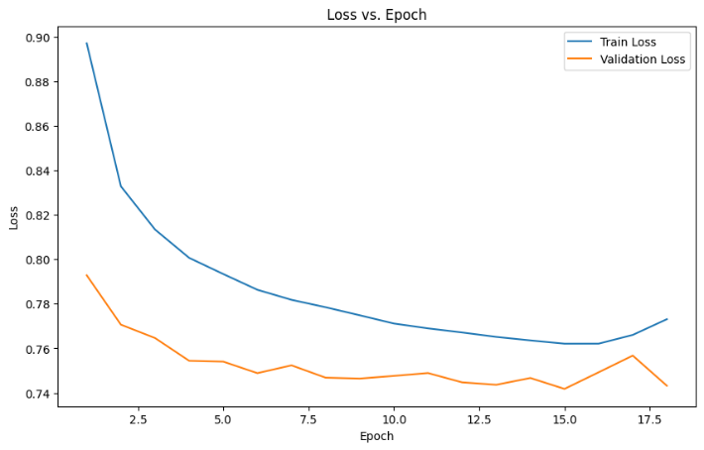
BIDIRECTIONAL GRU: ANALYSIS
3.SNLI
Test Loss: 0.753, Test Accuracy: 67.35%
precision recall f1-score support
0 0.69 0.71 0.70 3368
1 0.69 0.65 0.67 3219
2 0.65 0.66 0.65 3237
accuracy 0.67 9824
macro avg 0.67 0.67 0.67 9824
weighted avg 0.67 0.67 0.67 9824

Slide 22
BERT
The BertForSequenceClassification pretrained model is initialized with pre-trained bert-base-uncased weights, a powerful language representation model from the Hugging Face transformers library.
Built on Google's BERT architecture, the model is specifically configured for sequence classification tasks with num_labels=3, indicating three output classes for classification (entailment, neutral, contradiction).
Utilizing bidirectional encoding through Transformer blocks, the model captures contextual information from input tokens, enhancing its understanding of text sequences.
The provided code preprocesses the eSNLI dataset, converting text to lowercase, extracting labels, and performing tokenization using the BERT tokenizer for uniform input formatting.
The model is trained with AdamW optimizer and a linear scheduler with warmup, followed by evaluation on the test set to assess its performance in classifying sequences accurately.

Slide 23
BERT : ANALYSIS
Train Loss: 0.414 Train Accuracy: 83.90%,
Val Loss: 0.310 Val Accuracy: 88.54%
As seen, an accuracy of 89% has been achieved through BERT based model.
Note:- Due to the resource scarcity, the BERT based model is trained only for 2 epochs.

Slide 24
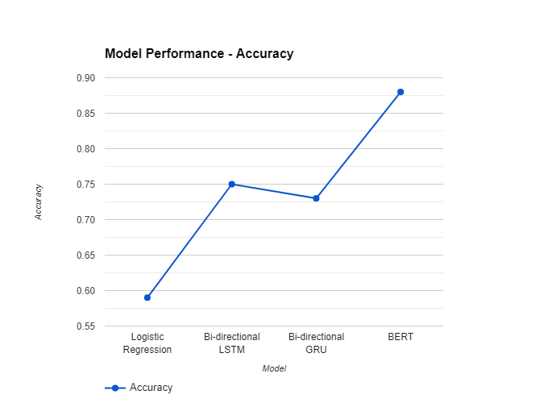
Qualitative ANALYSIS : GRAPHS
Model | Precision |  |  | Recall |  |  | F1-Score |  |  | Accuracy
 | L0 | L1 | L2 | L0 | L1 | L2 | L0 | L1 | L2
Logistic Regression | 0.50 | 0.55 | 0.52 | 0.59 | 0.47 | 0.50 | 0.54 | 0.51 | 0.51 | 52.31%
Bi-directional LSTM | 0.68 | 0.61 | 0.66 | 0.75 | 0.63 | 0.66 | 0.71 | 0.67 | 0.66 | 68.24%
Bi-directional GRU | 0.68 | 0.72 | 0.63 | 0.73 | 0.62 | 0.68 | 0.71 | 0.67 | 0.65 | 67.71%
BERT |  |  |  |  |  |  |  |  |  | 88.54%

Slide 25
Qualitative ANALYSIS
1. Logistic Regression:
Precision: Relatively low across all labels.
Recall: Varied, with higher recall for L1.
F1-Score: Generally low, indicating a balance between precision and recall.
Accuracy: 52.31%, comparatively low.
2. Bi-directional LSTM:
Precision: Higher than Logistic Regression, indicating fewer false positives.
Recall: Higher, especially for L1 and L2.
F1-Score: Highest among listed models, indicating a good balance.
Accuracy: 68.24%, significantly higher than Logistic Regression.
3. Bi-directional GRU:
Precision: Higher than Logistic Regression.
Recall: Higher, especially for L1.
F1-Score: Slightly lower than LSTM but higher than Logistic Regression.
Accuracy: 67.71%, comparable to LSTM.

Slide 26
Qualitative ANALYSIS
4. BERT:
Accuracy: Achieves the highest accuracy of 88.54%.
No precision, recall, or F1-score values provided for detailed comparison.
5. Summary:
Deep learning models (Bi-directional LSTM and Bi-directional GRU) outperform Logistic Regression.
Bi-directional LSTM slightly outperforms Bi-directional GRU.
BERT achieves the highest accuracy, but detailed comparison is challenging without precision, recall, and F1-score values.

Slide 27
IMPLEMENTATION CHALLENGES
Finding the best settings for each model's hyperparameters was tough. We had to try out lots of different combinations to see what worked best, and this took a lot of time and computer power.
We also ran into problems with some of the model we were using like BERT as it needed a lot of memory to run, so we had to make our code better to avoid crashes caused by running out of memory.
Due to above issue , we only trained for only small number of epochs and reduced the dataset on which we are training wherever required .Result can be better if we train for more epochs or use full dataset for training.
We also tried pretrained T5 model for explanation generation along with the labels . We first tried to fine tune it on subset of e-SNLI dataset for NLI task. For the label generation we got an accuracy of around 51 percent which is quite less than expected . Also for the explanation generation part, the generated explanation were not much coherent.

Slide 28
LIMITATIONS
The current project aimed to explore the effectiveness of various neural network models for natural language inference. We evaluated four models, including baseline models based logistic regression, and more advanced models based on BiLSTM, GRU, and BERT.
The models like BERT, did better than the simpler ones like Regression.
We only used three dataset and for some models only one dataset due to compute challenges so our results might not be true for all kinds of data for those models.
Also, we only used models that were already trained. Maybe training them again for more epochs and for our specific task would make them work even better.

Slide 29
FUTURE WORK
Looking ahead, we can work on fixing the issues we found and trying out more advanced models like GPT. One more idea is to adjust pre-trained models using transfer learning for tasks like understanding natural language.
Another idea is to look into different types of neural network models, like the different variations of Transformers, and see how well they perform compared to the models we studied here.
To investigate alternative approaches for fine-tuning the T5 model on the e-SNLI dataset, exploring different training strategies and techniques to improve label generation accuracy and enhance the coherence of generated explanations.
To wrap up, our project tells us a lot about how different neural network models do when it comes to understanding natural language. This information could help make better models for things like understanding text, tasks like question-answering and other applications of NLI.

Slide 30
CONCLUSION
Explored natural language inference using five models: Logistic Regression, BiLSTM, BiGRU, BERT, T5.
Discovered that pre-trained models like BERT outperformed traditional models like Logistic Regression.
Identified challenges and proposed solutions to improve models, including incorporating external knowledge sources and fine-tuning on domain-specific datasets.
Explored T5 model for explanation generation alongside the natural language inference task.
Initially fine-tuned T5 on a subset of the e-SNLI dataset for NLI, achieving around 51% accuracy for label generation, lower than expected. Generated explanations were not very coherent, indicating a need for further refinement or exploration of alternative approaches.
In summary, our results highlight the significance of leveraging pre-trained models and deep learning methods for tasks in natural language inference. These findings carry substantial implications for a wide array of applications including text classification, sentiment analysis, and question-answering systems.

Slide 31
REFERENCES
Bowman, S. R.; Angeli, G.; Potts, C. Manning, C. D. (2015), A large annotated
corpus for learning natural language inference, in ’Proceedings of the 2015
Conference on Empirical Methods in Natural
Narang, S., Raffel, C., Lee, K., Roberts, A., Fiedel, N., & Malkan, K. (2020). WT5?! Training Text-to-Text Models to Explain their Predictions. arXiv preprint arXiv:2004.14546
Devlin, J., Chang, M., Lee, K., & Toutanova, K. (2018). BERT: Pre-training of Deep Bidirectional Transformers for Language Understanding. arXiv preprint arXiv:1810.04805
Lee, K., Lin, H., & Chen, Y. (2019). NCUEE at MEDIQA 2019: Medical Text Inference Using Ensemble BERT-BiLSTM-Attention Model. In Proceedings of the ACL-BioNLP Workshop 2019 (pp. 50-58). Association for Computational Linguistics. ACL Anthology

Slide 32
Thank you

