Slide 1



Introduction to Metric Studio 8.4.1
Version No. :1.2
Prepared On :09-Oct-2012
Last Revised On :10-Oct-2012
Notes:
1

Slide 2
Topics to be covered
Introduction to Metric Studio
Terminologies used in Metric Studio
Metric Studio
Steps involved in creation of a Metric Studio Application
New features in Metric Studio version 10.1.0

Slide 3
Introduction
Cognos 8 BI is a Business Intelligence tool consisting of a suite of modules which transforms raw data into useful information for business decision making process. It is used for creation, management and deployment of queries, reports, scorecards, dashboards etc.
Cognos 8 BI Modules:
Metric Studio:
Metric Studio is a performance tool for managing, monitoring and analyzing metrics, projects, and other performance measures within an organization. A user who has access to metric studio is referred to as a Business Manager.
Report Studio:
Report Studio is a Web-based tool used to build multiple-page, multiple-query reports against multiple databases. With Report Studio, one can create any report that an organization requires, such as invoices, statements, and weekly sales and inventory reports. A user who has access to report studio is referred to as a Professional Author.

Slide 4
Introduction (contd..)
Event Studio:
Event Studio is a tool which monitors the user defined events and executes the tasks accordingly. The access to event studio is included for Professional Authors.
Analysis Studio:
Analysis Studio is a tool used for complex data analysis to forecast and observe the data trends. A user who has access to analysis studio is referred to as a Business Analyst.
Query Studio:
Query Studio is an adhoc query tool which allows the user to access information easily. The user can create reports; view them in a variety of formats using the multiple options that are available in the query studio. For example, one can group the data, sort, filter the data, create summaries, display charts, export the data and perform calculations. A user who has access to query studio is referred to as a Business Author.

Slide 5
Introduction (contd..)
Framework Manager:
Framework Manager is a metadata modeling tool.
The Framework manager has the following namespaces that can be viewed in the Project viewer:
Data Access layer: Includes tables, rows from the database.
Business layer: Includes functions for calculations, remove/edit columns, filters etc.
Presentation layer: Includes packages that are migrated from Business layer of Framework Manager and visible to end users.
Metric Designer:
Metric Designer maps the data from Cognos content store to metric store or scorecard. A metric designer creates extracts that map the relation between a database item and a metric studio item. These extracts appear as scorecards in the metric studio.
Notes:
Accenture

Slide 6
Introduction (contd..)
Cognos Content Store:
Content Store is a database which stores the metadata for the Cognos components. Content Store can be accessed directly with the Framework Manager.
Metric Store:
A metric store is a database that contains content for metric packages. A metric store also contains scorecarding application settings, such as user preferences.

Slide 7
Terminologies used in Metric Studio
Package:
A package contains information about the reports, Cognos connection and metric types for an application
Metrics:
Metrics measure performance in key areas of a business. They compare actual values derived from operational data against target values.
Metrics also measures the following:
Variance/Tolerance: This value defines an acceptable range for a result that deviates from a set target.
User-defined column: A user-defined column value measures the performance of a metric against a comparable metric.
Metric Type:
A Metric Type defines a set of characteristics or a specific measure for a collection of metrics. Example: Average Revenue.

Slide 8
Terminologies used in Metric Studio
Key Performance Indicators (KPI):
Key Performance Indicators are the quantifiable measurements which reflect the organizational goals. Example: Average Revenue per Employee.
A metric with the following characteristics can be termed as a KPI:
The metric has a timescale associated to it.
The metric has a benchmark.
The metric has a reason to be reported.
The metric has an associated action surrounding it if a problem occurs.
Thus a KPI provides a context, echoes organizational goals and leads to an action.
Although a KPI and a metric are used interchangeably, it is important to note that a KPI is a Metric but a Metric is not necessarily a KPI.
Dashboards:
A dashboard displays the information pertaining to the business of an organization in a readable format.

Slide 9
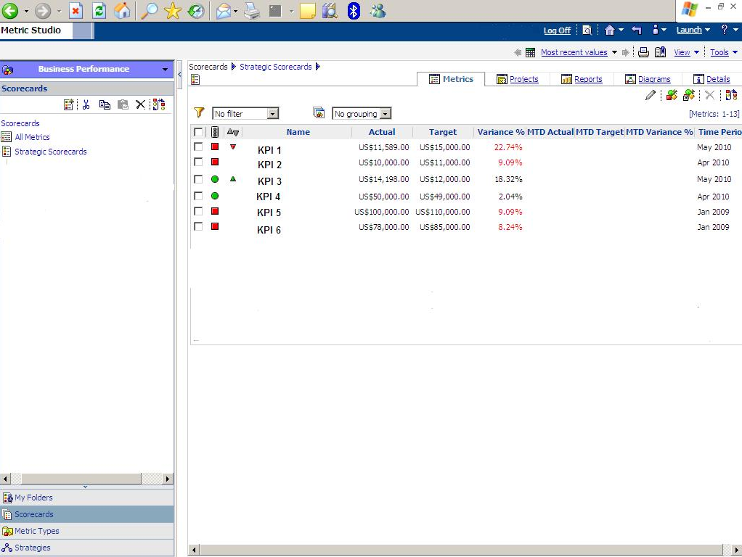
Scorecards:
A scorecard allows the user to view the KPIs and analyze the performance to determine whether the organizational goals have been met.

Slide 10
Differences between a scorecard and a dashboard:
A scorecard displays measures collected over a period of time (Monthly or Quarterly), base-lined against specific goals, either in absolute terms or improvements Vs a prior period. Whereas, a dashboard displays measures at the exact instant it is viewed or refreshed.
Scorecard can access the quality of execution whereas dashboards provide tactical guidance.
Scorecards inherently measure against goals, dashboards need not.

Slide 11
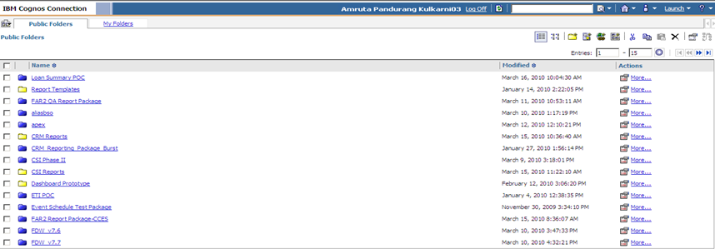
Metric Studio
When a user logs in to the Cognos 8 BI suite, he/she is taken to the home page which is shown in the Figure below:

Slide 12
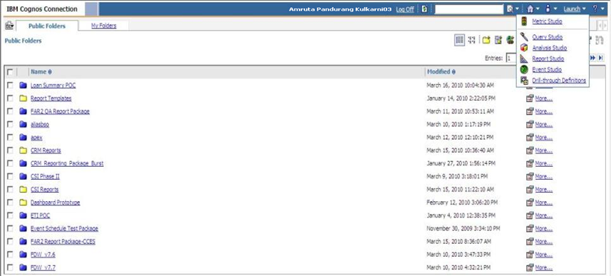
To go to the metric studio, the user has to click on the ‘Launch’ tab which is present at the right end of the screen which is as shown below:

Slide 13
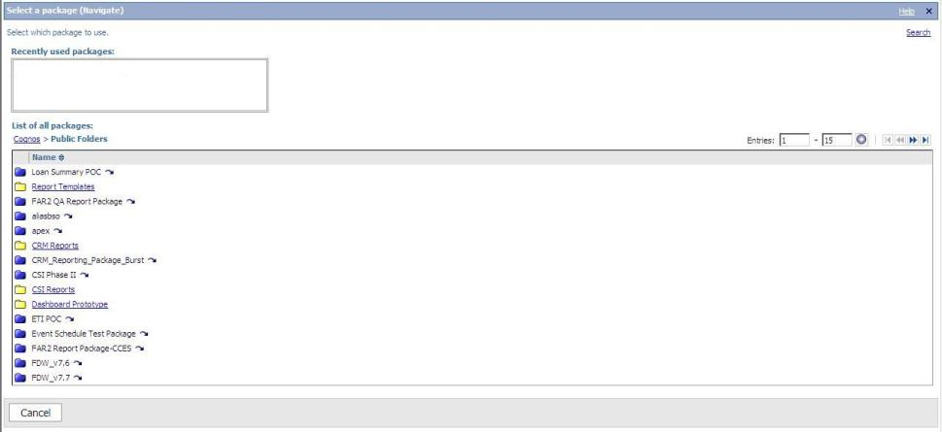
When the user launches metric studio, he/she navigates to the following screen which displays a list of packages available in the public folder.

Slide 14
The user can then choose the package to work upon. Upon clicking on the desired package, the metric studio home page appears.
The metric studio has the following tabs displayed:
Metrics Tab
Projects Tab
Reports Tab
Diagrams Tab
History Tab
Details Tab
Metrics Tab:
The scorecard is displayed in the Metrics tab of the metric studio. The user can create a scorecard by clicking on the ‘Scorecards’ appearing at the bottom of the left pane and clicking on ‘New Scorecards’ under a parent scorecard. The data from the Cognos content score is mapped to a scorecard by a metric designer.
Watch List: A user can add the KPIs that he/she wants to monitor for analysis in the Watch List.

Slide 15
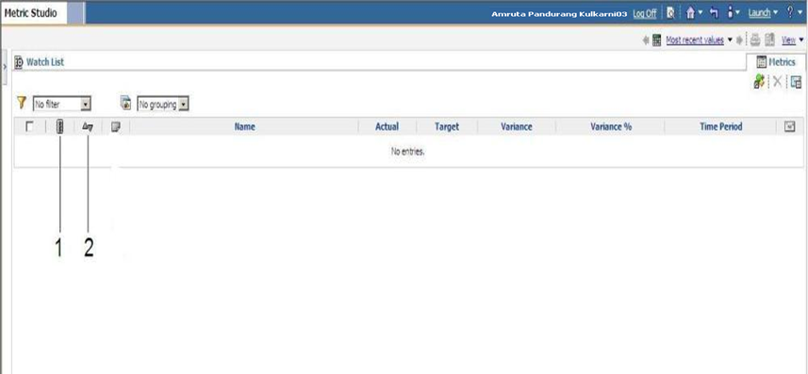
The figure below shows the columns in a scorecard.
Traffic Light Indicator/Status
Trend Arrows

Slide 16
Traffic Light Indicator/Status: It highlights the performance of each KPI. It can be displayed in various colours (red, green and yellow) and shapes to indicate whether the KPI’s performance is good or bad.
Trend Arrows: Trend arrows display the trend of a KPI between current and previous period values. An up arrow indicates increase in the performance of a KPI as compared to its previous performance. A down arrow indicates decrease in the performance of a KPI as compared to its previous performance.
Name: This indicates the name of a KPI.
The other columns like actual, target and variance represent the obtaine01d, expected and deviation from expected values to measure the performance of a KPI.
The Filter drop down which appears at the upper left corner of metric studio scorecard displays various options to filter the data based on desired criteria and view the scorecard accordingly. The default selected value for Filter option is “No Filter”.

Slide 17
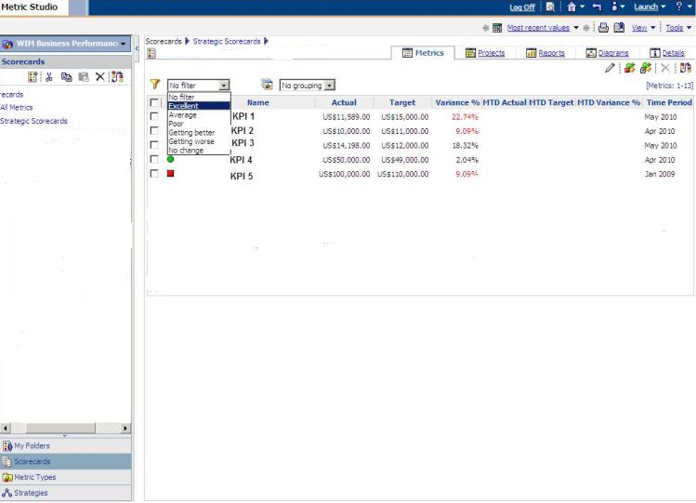
In the below figure, the user can view KPI data by filtering it according to its performance criteria like excellent, average, poor etc.

Slide 18
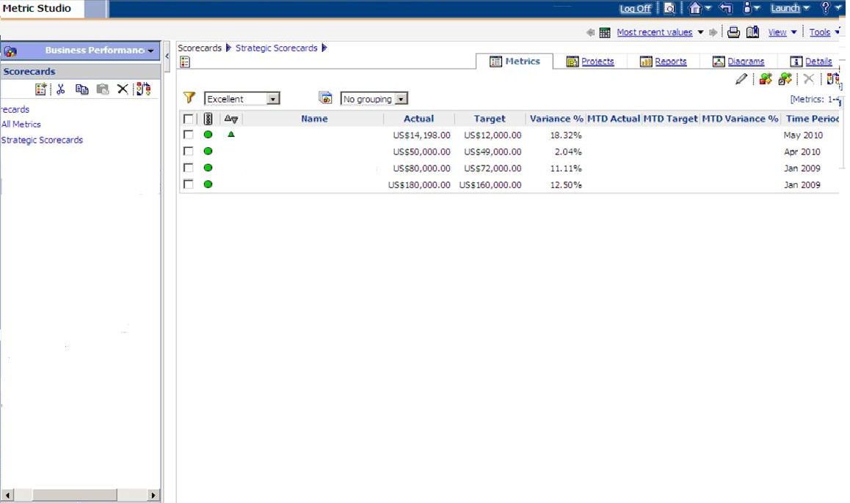
Suppose a user selects “Excellent” as a criteria, he/ she can view KPI data whose performance, indicated by traffic lights is excellent. This has been illustrated in the below figure.

Slide 19
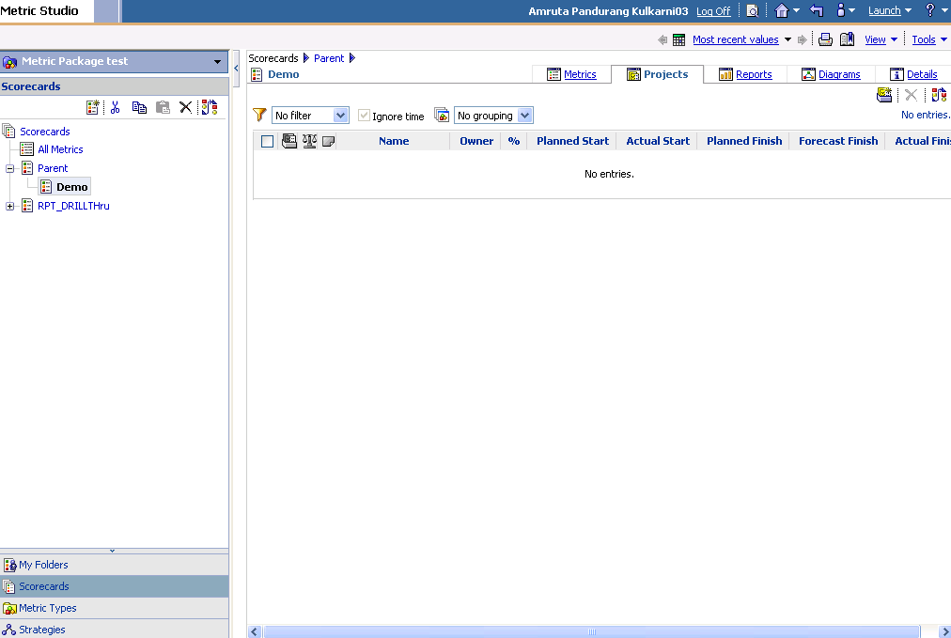
Projects Tab:
A project is used to track long term goals of an organization using metrics. The Project tab allows the user to create a project which contains the details relevant to a project like planned start date, planned finish, percentage of completion etc.

Slide 20
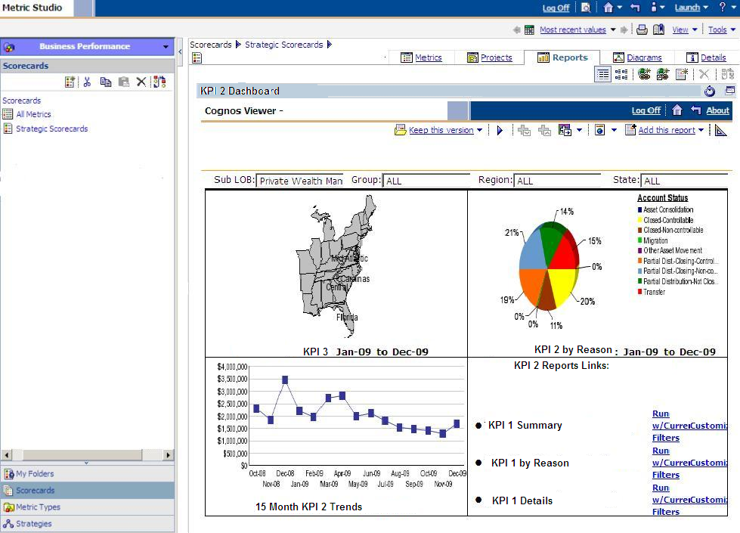
Reports Tab:
Reports tab displays reports which give certain information about the scorecard or a metric. The KPI data can be viewed as a report directly or we can link a report to the scorecard or a KPI.

Slide 21
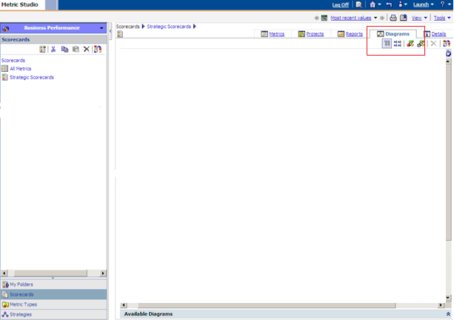
Diagrams Tab:
A diagram in metric studio is a visual representation of data for a given KPI. When a user clicks on a KPI in the navigation pane of the screen, the control goes to the Diagrams tab. In the Diagrams tab, we can see two types of diagrams, namely, Strategy maps and Impact diagram.

Slide 22
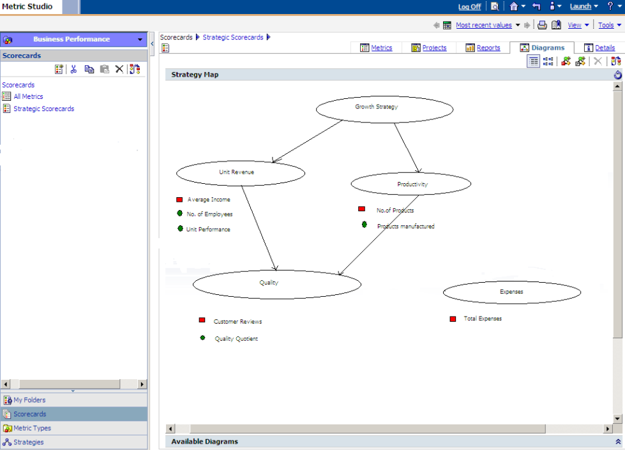
Strategy Maps:
The Strategy Maps display the KPIs/Metrics grouped into various perspectives of an organization. Example: Financial, Growth and Process Perspective. The Strategy Maps display the cause and effect relation between the various perspectives in a diagram format. The cause and effect relation between the metrics in various perspectives are indicated using arrows to show the relationships.

Slide 23
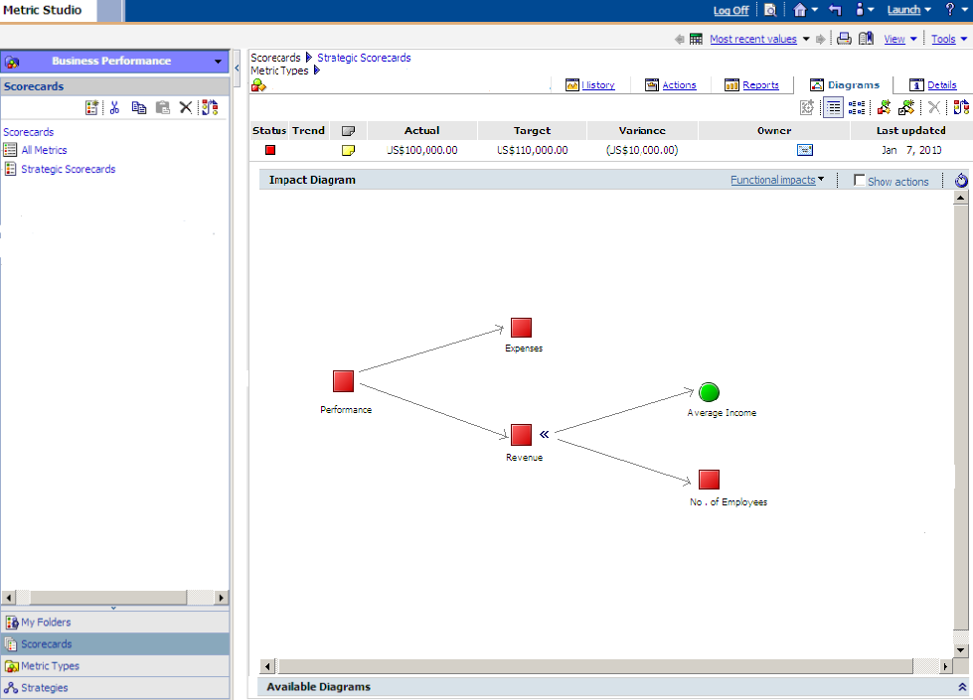
Impact Diagrams:
The impact/drill thru diagrams display all the KPIs or metrics that constitute or affect the KPI in the subsequent drill thru levels. The drill thru feature for a KPI is activated on single click on the KPI from the scorecard list.
The drill thru levels for a KPI is presented visually using impact diagram as shown below:

Slide 24
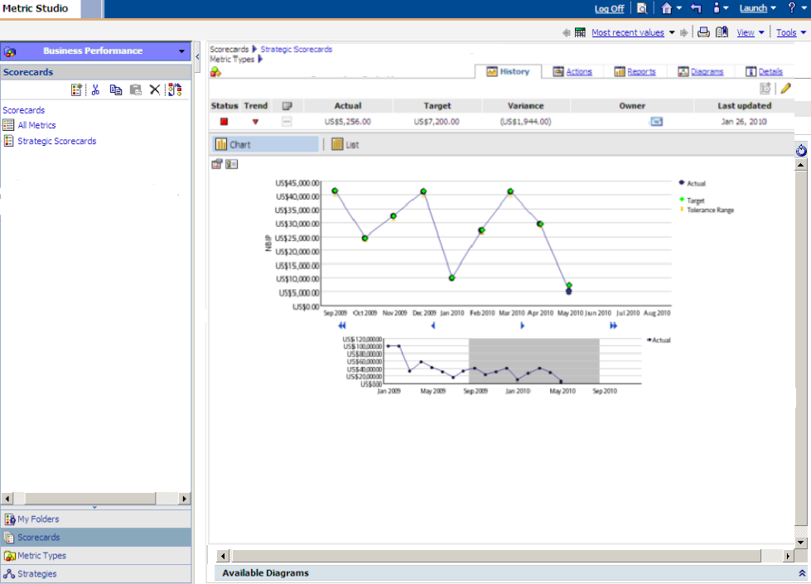
History Tab:
The history tab for a selected KPI will display a trend analysis chart that includes the ability to scroll the reporting period displayed. The trend compares the KPI’s current performance with previous performance with respect to time.

Slide 25
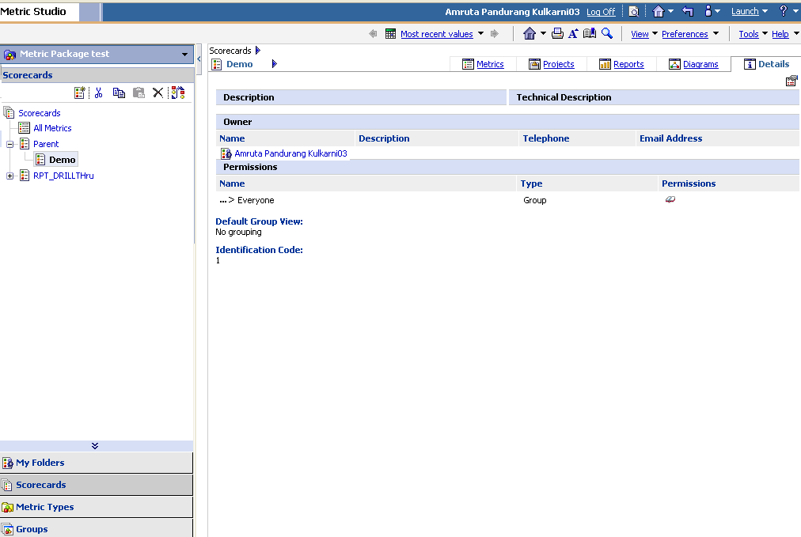
Details Tab:
Details tab allows us to modify an existing metric. To modify the metric, click the metric name appearing on the scorecard and then click the set properties button under the Details tab.

Slide 26
Steps involved in creation of a Metric Studio Application:
Create Metric Store
Create Datasource Connection
Create Metric package
Create Scorecard
Create Metric Type and Metric
Setup Score Calculations and Other Settings under Tools
Recalculate metric derived values
Transfer data from staging into metric store
Performance Analysis and Monitoring by Watch Lists, Strategy Maps, Impact Diagrams, History Charts, etc.
The steps listed above to create an application in Metric Studio are illustrated with the figures as shown in the following slides.

Slide 27
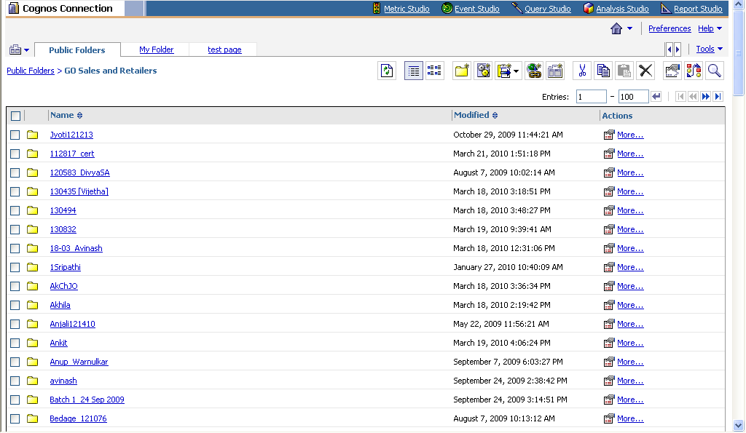
When the user logs in to Cognos, a home page appears with a list of packages in the public folder. The public folder contains packages which can be viewed by users. This is shown as below:

Slide 28
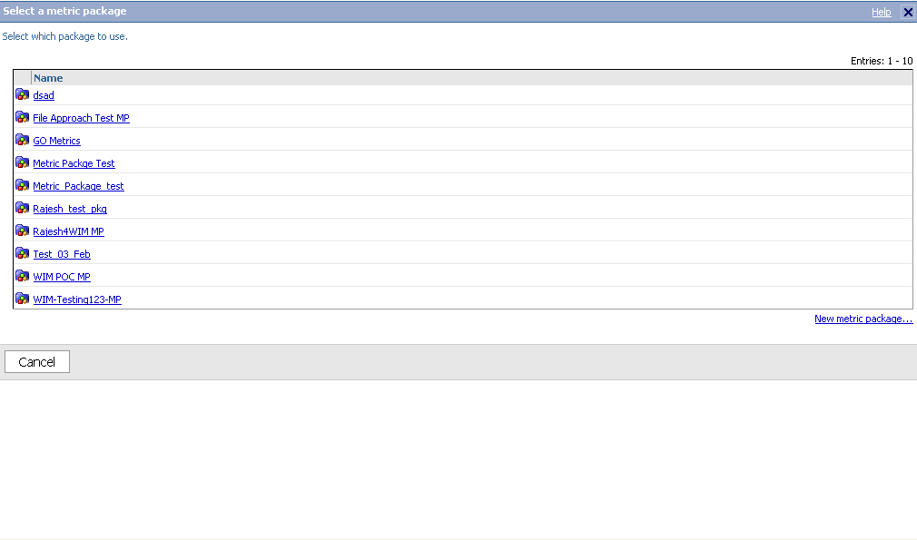
When the user clicks on the Metric studio appearing at the top of the screen, the following page appears.

Slide 29
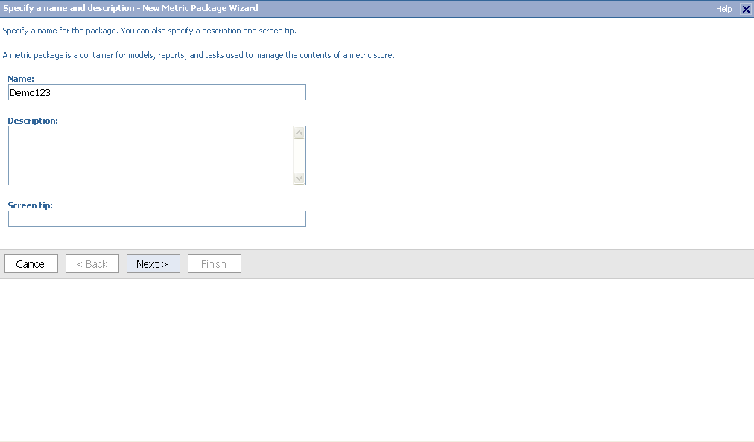
Creating a metric package:
The user is presented with a list of packages to select for creating an application. The user can also create a new metric package by clicking on the link that can be seen at the right bottom corner of the screen. When the user clicks on the ‘New Metric Package’ link, the following page appears.

Slide 30
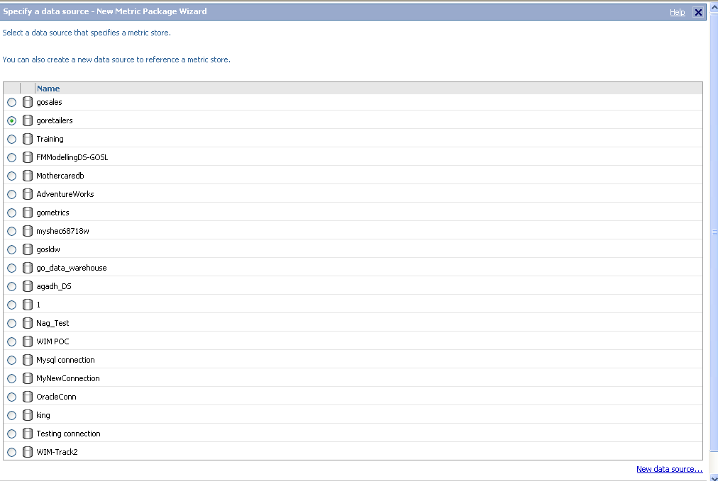
The user is required to specify a name for the package. The ‘Description’ and ‘Screen Tip’ fields are optional. After specifying the package details, click on ‘Next’ button appearing at the bottom of the screen. The user then goes to next page where he/she should choose the data source to obtain data from the metric store. The user can also create a new data source by clicking on the link appearing at the right bottom of the screen as shown in the figure below:

Slide 31
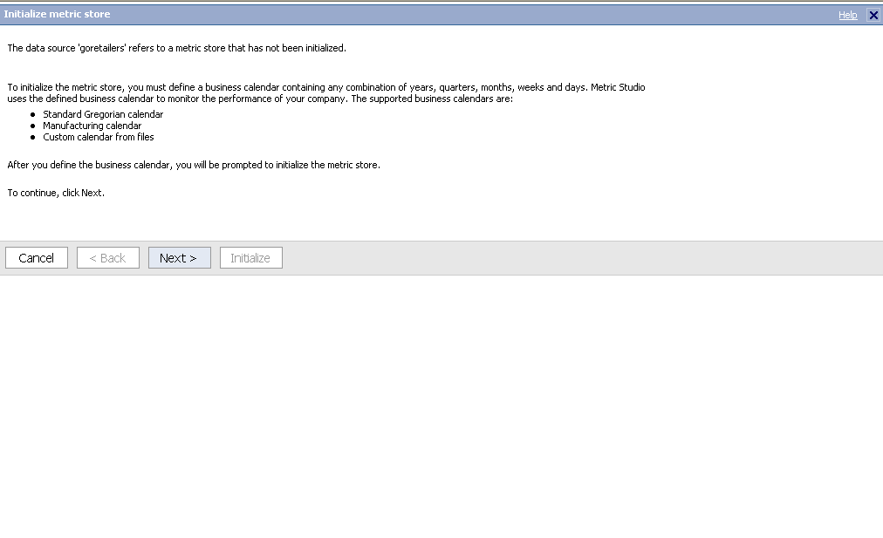
If the metric store has not been initialized, the following screen appears requiring the user to specify the business calendar settings.
Click on the ‘Next’ button to specify the business calendar settings.

Slide 32
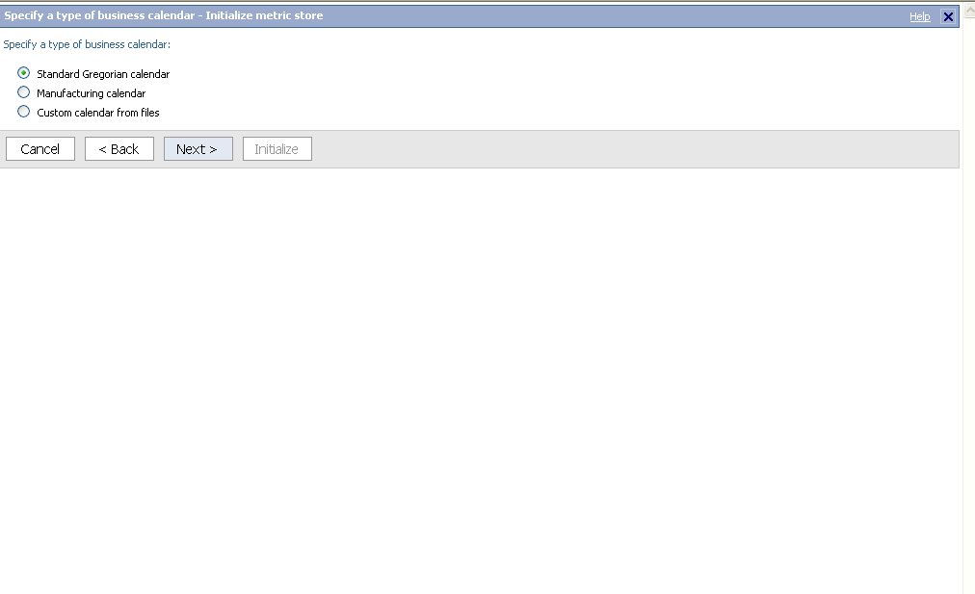
The business calendar settings contain a combination of years, months, weeks, days etc. Metric studio uses the business calendar defined to monitor the performance of the organization. The user should choose the type of business calendar. The business calendars supported in metric studio are Standard Gregorian calendar, Manufacturing calendar, Custom calendar from files
Choose the type of business calendar as shown in the figure below.

Slide 33
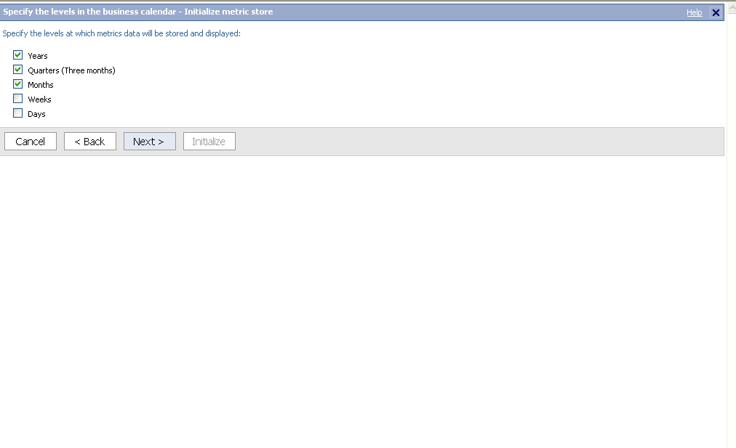
Once the business calendar type is chosen, click on the ‘Next’ button. The following screen appears where the user is required to choose the level in business calendar which can be Years, Quarters, Months, Weeks and Days. The user can also choose a combination of these levels. The metric store and data will be stored and displayed only for the specified levels.

Slide 34
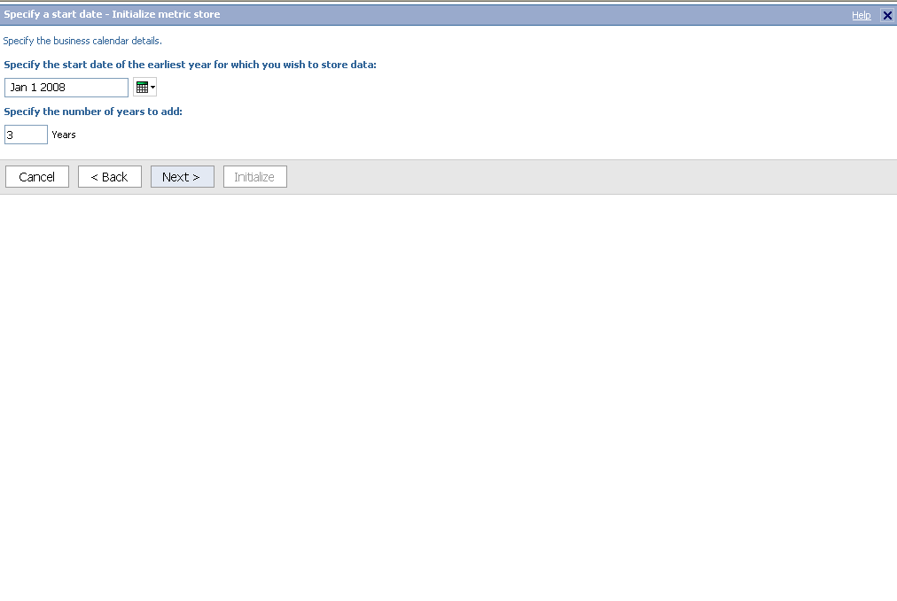
Click on the ‘Next’ button to specify business calendar details. This includes ‘Start date of the earliest year’ and the ‘Number of years to add’ to store the data.
This is illustrated with help of figure as shown below:

Slide 35
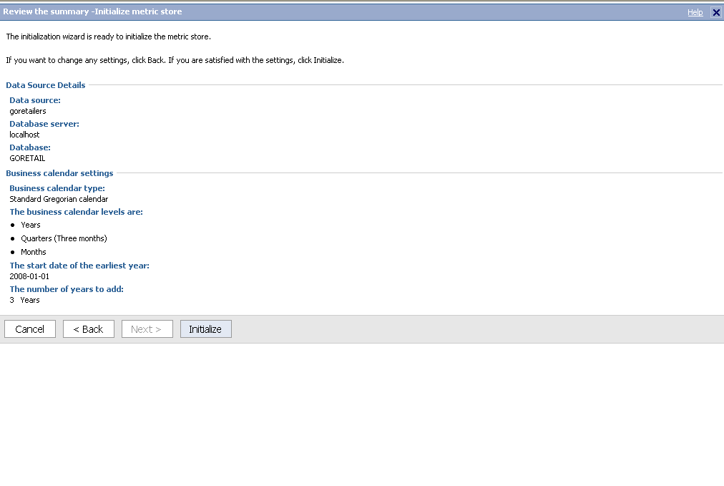
Click on the ‘Next’ button to view the summary to initialize the metric store. The following page appears which gives a summary of the settings defined so far viz., the data source details and business calendar settings. Click on ‘Initialize’ button. This will initialize the metric store. The user can change the settings by clicking on ‘Back’ button.

Slide 36
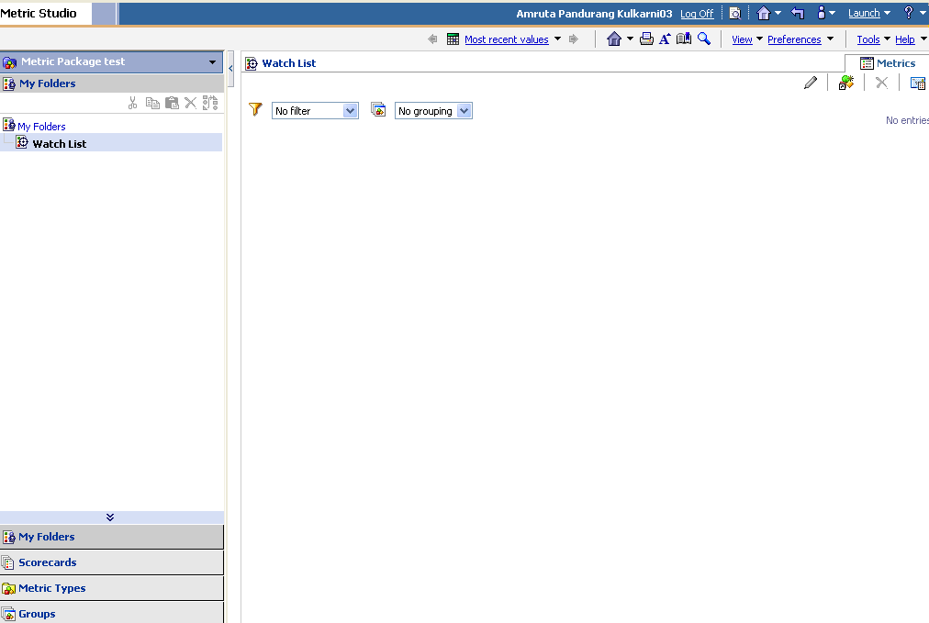
After the creation of a metric package, the user can create a scorecard and metric type by clicking on the ‘Scorecards’ and ‘Metric Types’ which appears at the left bottom corner of navigation pane in metric studio. Click on the metric package created. The following screen appears with the metric package name on the screen.

Slide 37
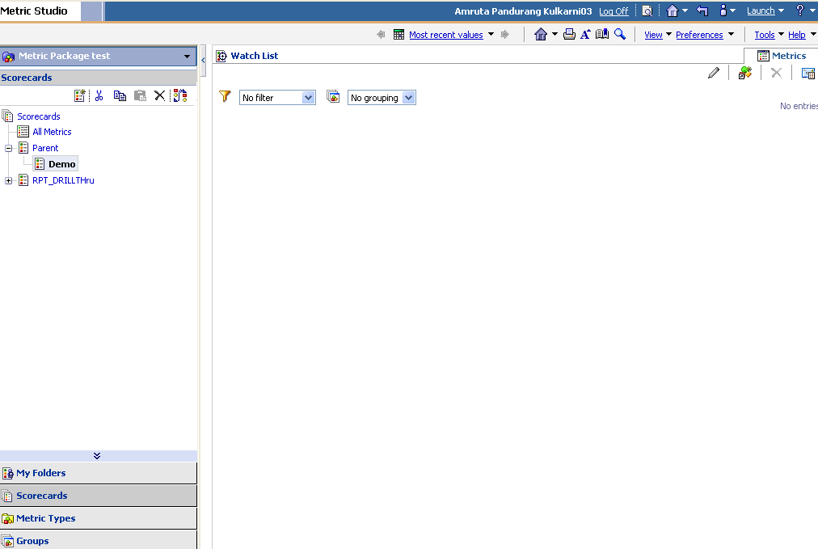
Creating a Scorecard:
To create a scorecard, click on the ‘Scorecards’ which appears at the left bottom corner of the navigation pane in metric studio. A list of scorecards already created, appear in the pane under the parent scorecard. This can be seen in the figure below:

Slide 38
The user can view the details of a scorecard by clicking on the desired scorecards. The user can see the scorecard description, owner of the scorecard as well as permissions for other users in the ‘Details’ tab. This is illustrated in the figure below:

Slide 39
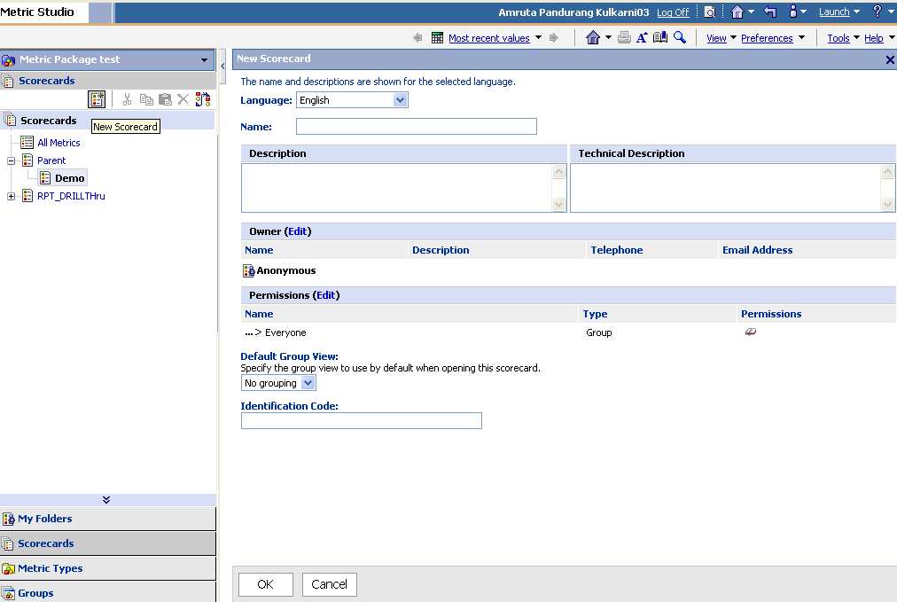
To create a new scorecard, click on ‘New Scorecard’ symbol appearing at the top in the navigation pane below the ‘Scorecards’ tab.The user should provide name and description for the scorecard. The description could include technical details like data source information. He/she can also choose the language to display the scorecard, change the owner of the scorecard and set permissions to define the security for the scorecard. The figure also shows a field ‘Identification code’ for the scorecard. The user can type a code for his scorecard. If the user does not specify any code, then the Identification code for a scorecard is automatically generated by the Metric studio. Click on ‘Ok’ to create the scorecard.

Slide 40
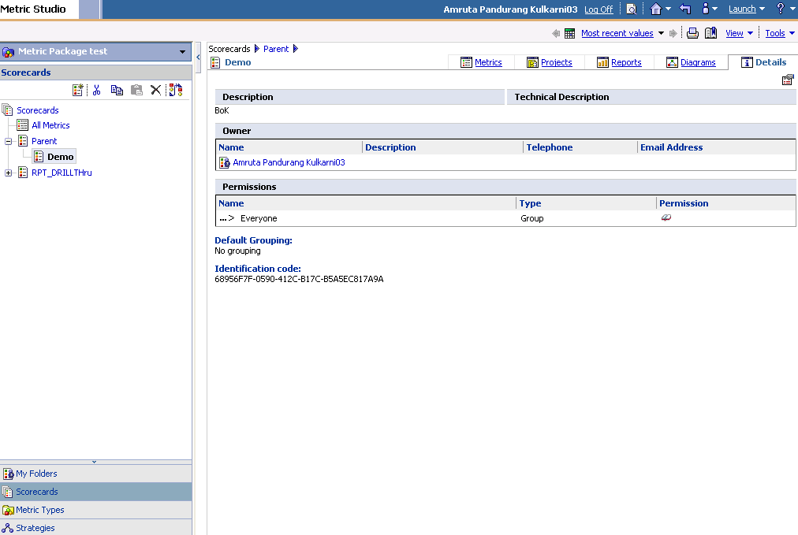
We can now see the scorecard with the specified name in the left pane of the metric studio. Clicking on the name of the scorecard will display the scorecard details defined by the user as shown below:

Slide 41
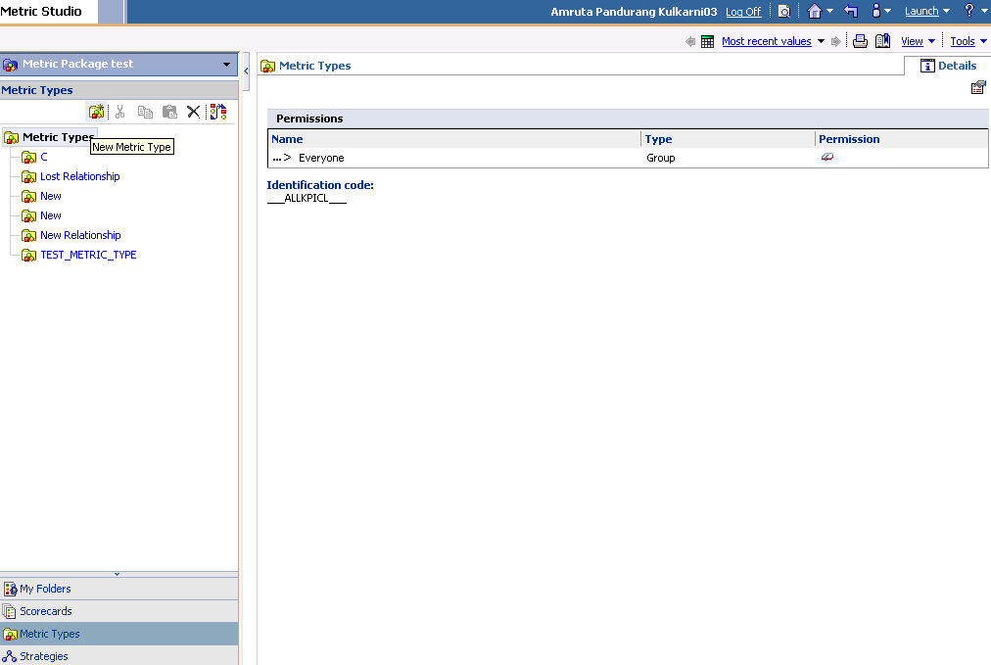
Creating a Metric Type:
To create a metric type, click on the ‘Metric Types’ which appears at the left bottom corner of the navigation pane in metric studio. A list of metric types already created, appear in the navigation pane. This can be seen in the figure below:To create a new metric type, click on ‘New Metric Type’ symbol appearing at the top in the navigation pane below the ‘Metric Types’ tab.

Slide 42
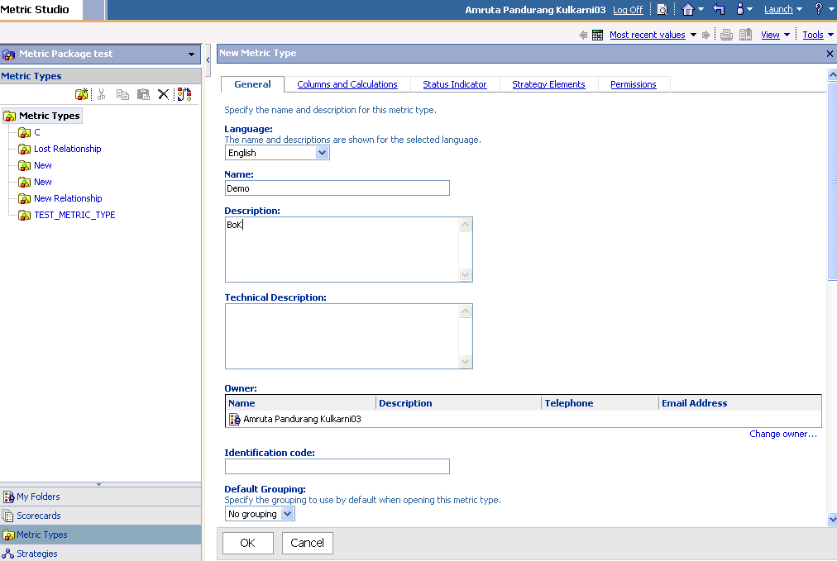
The user should provide name and description for the metric type. The description could include technical details like data source information. He/she can also choose the language to display the metric type, change the owner of the metric type. These details are entered in the ’General’ tab of Metric Types. This is illustrated in the figure below.

Slide 43
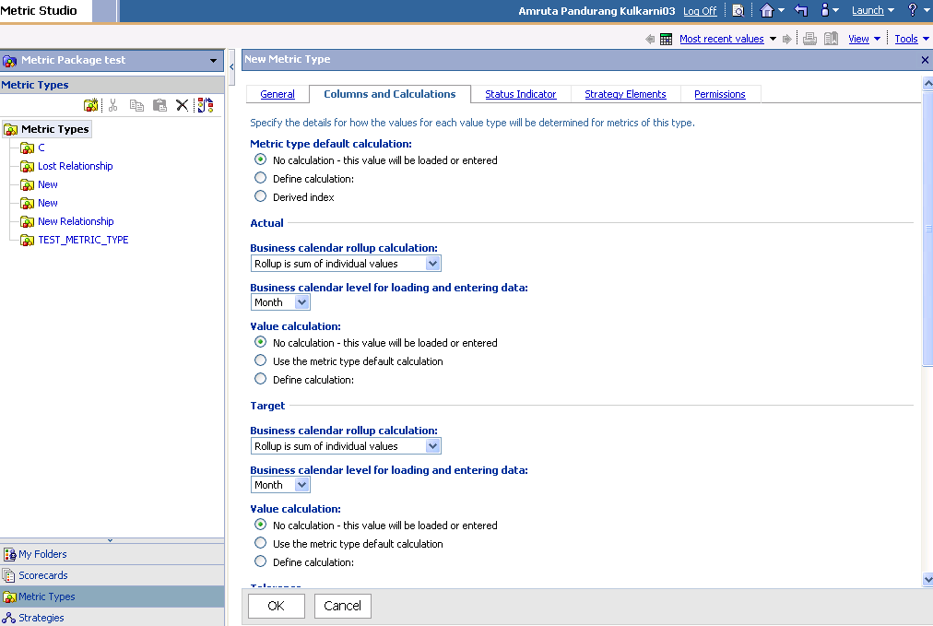
The ‘Columns and Calculations’ tab allows the user to define calculation for the metric type as well as the calendar settings and calculation to obtain actual, target and tolerance values.

Slide 44
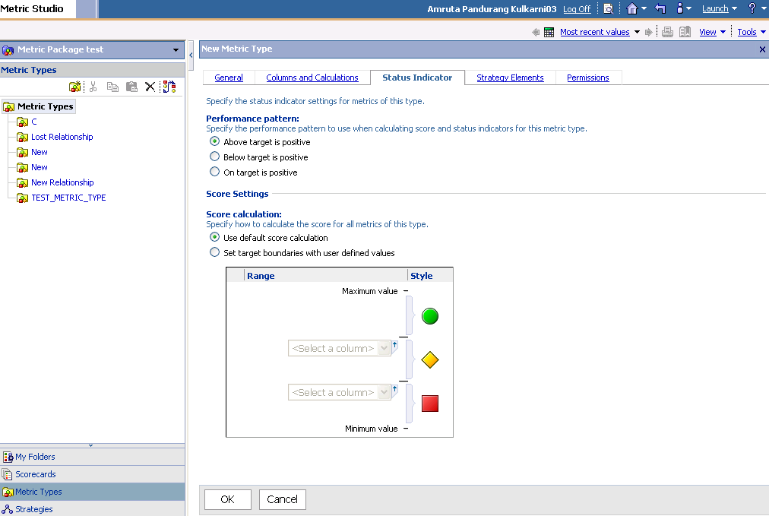
Metric studio allows us to monitor the performance through the status indicators defined in the ‘Status Indicators’ tab of Metric Type. The user can choose the performance pattern to calculate the score and status indicator for the metric type. We can define score settings for calculation. Metric studio provides us with two options to define score settings as illustrated in the figure below:
Default score calculation
User can specify the range for calculating the score

Slide 45
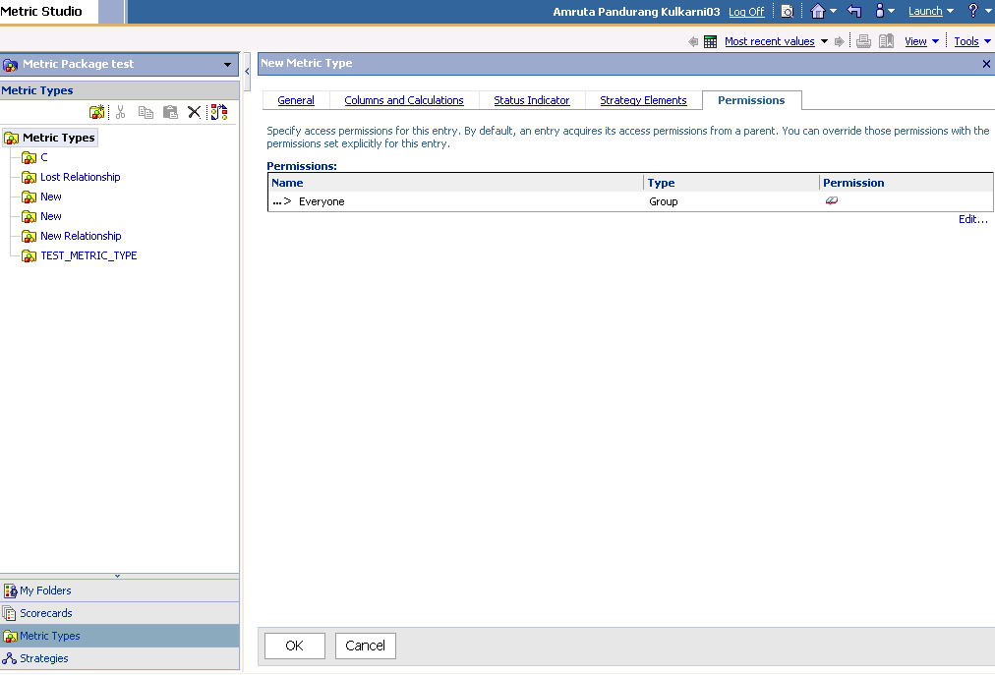
The ‘Strategy Elements’ tab allows us to specify the strategy elements for the metric type. The strategy element can also be defined in the ‘Strategies’ tab in the navigation pane.
We can also set permissions to define the security for the metric type. This is done in the ‘Permissions’ tab of the Metric Type. This is shown below in the figure:

Slide 46
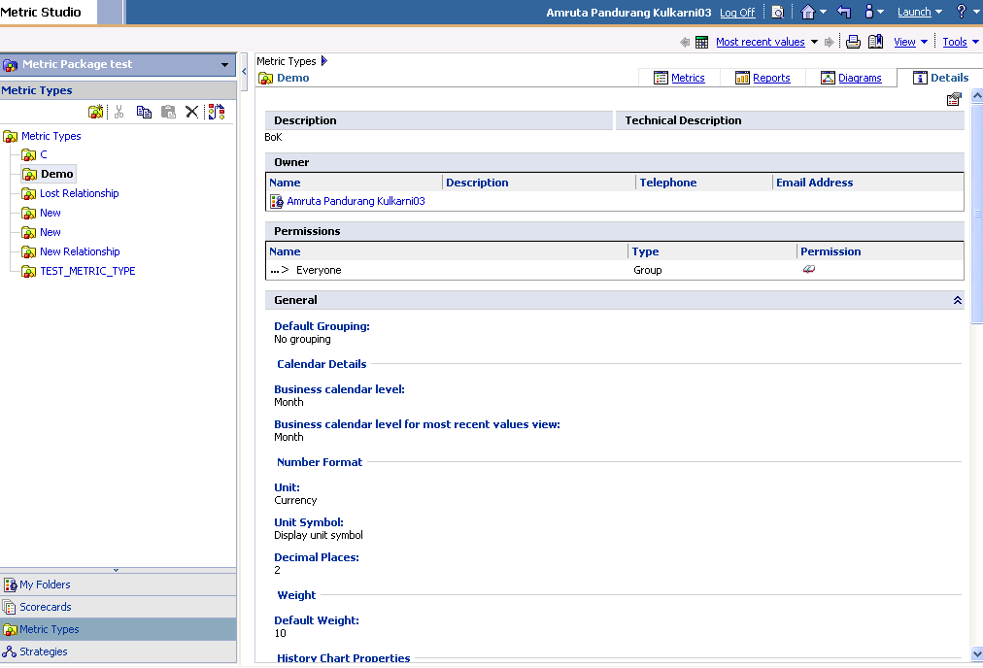
Click on ‘Ok’. The metric type is now created. We can see the metric type details including the permission and status indicator settings in the ‘Details’ tab. This is illustrated in the figure below:

Slide 47
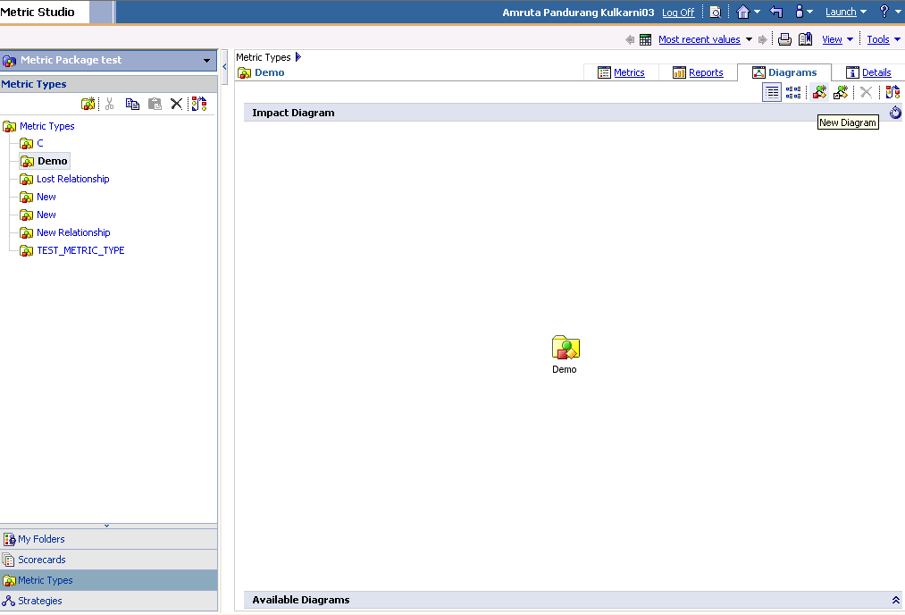
Creating a diagram in metric type:
To create an impact diagram, go to ‘Diagrams’ tab and click on ‘New Diagram’ button as shown in the figure below:

Slide 48
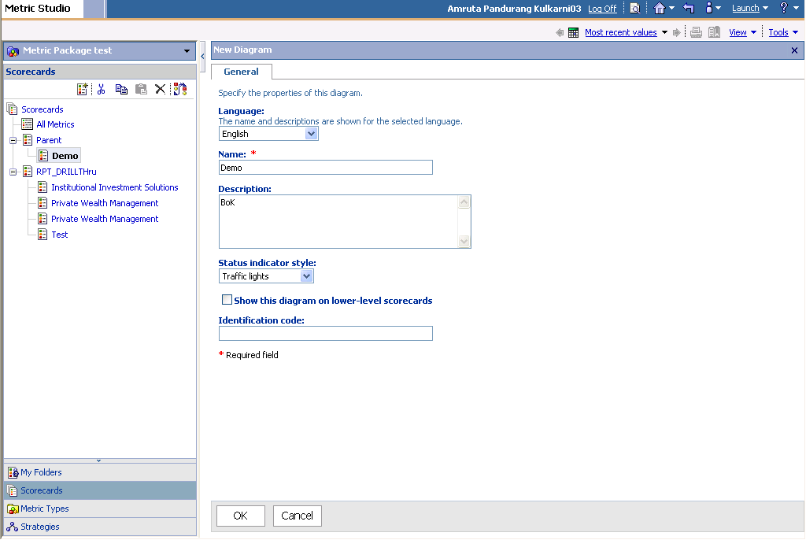
The user is expected to define the properties of a diagram. This includes defining the name of the diagram and the description for the selected language as well as status indicator type. This can be illustrated as below:

Slide 49
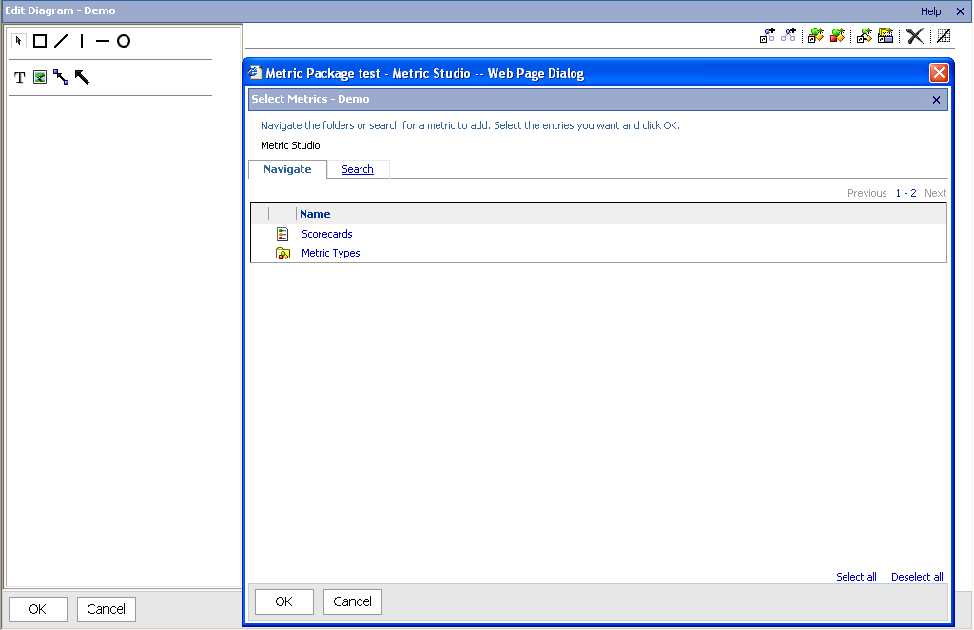
Once this is done, we map the metric types to the metric package. If you want to add specific metrics, click the ‘Add shortcuts to metrics button’ on the toolbar, and click the ‘Metrics’. If you want to add metric placeholders, click the ‘Add metric placeholder button’ on the toolbar, and click the ‘Metrics’. We can choose either a scorecard or a metric type to add a metric.
On a scorecard diagram, metric placeholders are metric types.
On a metric type diagram, metric placeholders are scorecards.
The following figure shows adding a metric placeholder in the diagram editor.

Slide 50
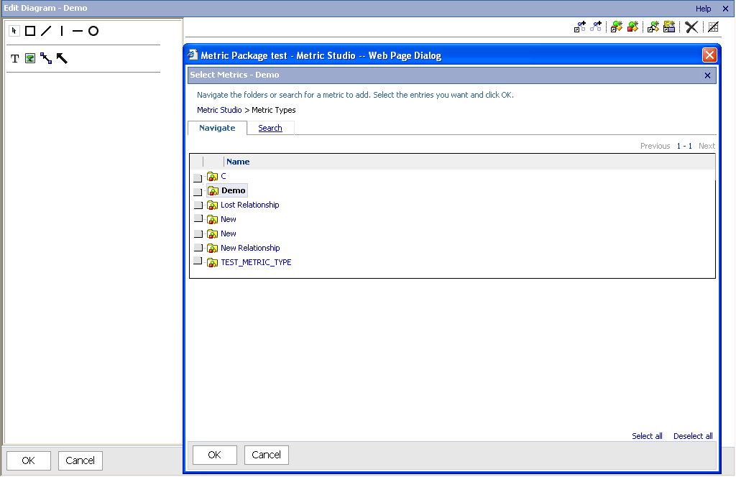
We can now choose a metric type or a scorecard from a list of metric types or scorecards to add a metric as shown below.

Slide 51
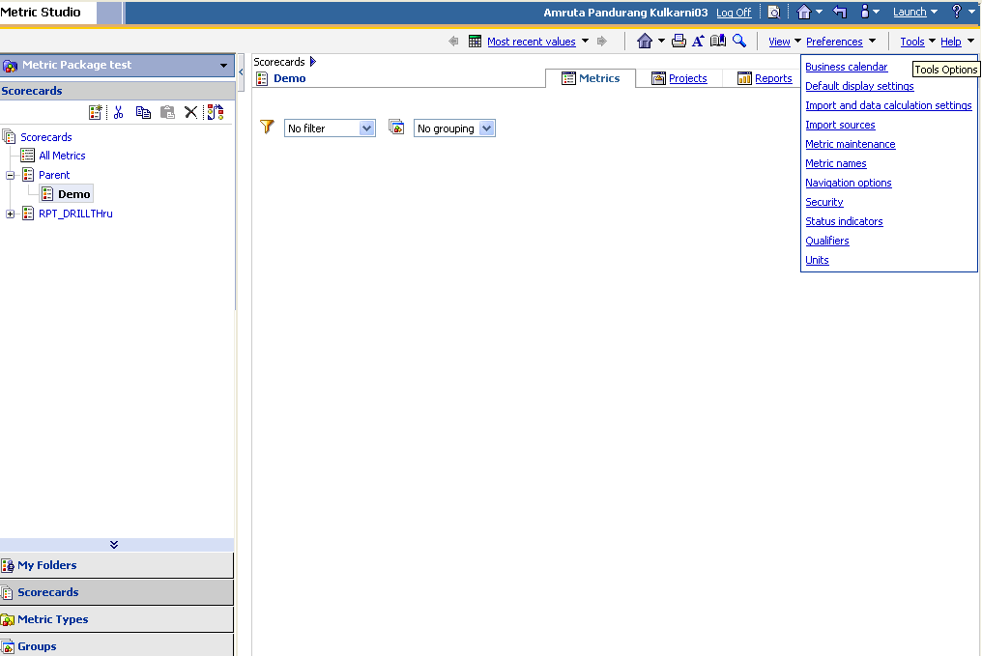
Once this is done, go to ‘Scorecards’ in the navigation pane. Click on the ‘Tools’ option appearing on the right upper corner of the screen as shown below:

Slide 52
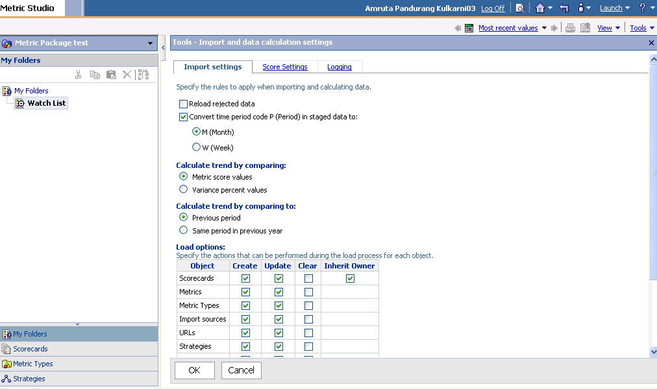
Setup Score Calculations and Other Settings under tools by clicking on the ‘Import and Data collection settings’, if any.

Slide 53
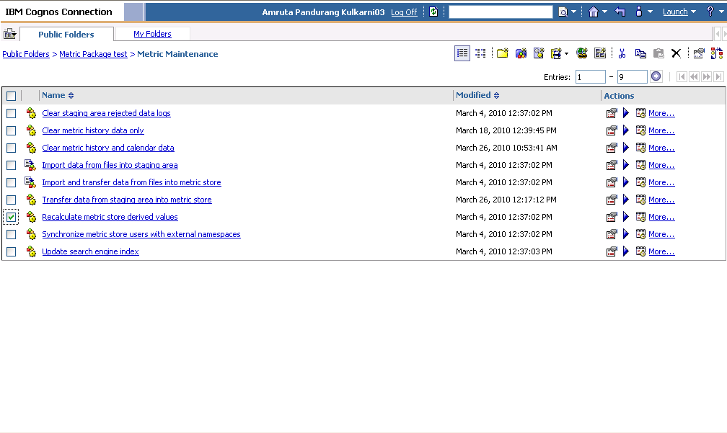
Click on the ‘Metric maintenance’ option under tools
Run the ‘Recalculate metric store derived values’ job.

Slide 54

Run the job to transfer the data from staging area to metric store.
After these jobs are run, we can view the data in the scorecard. We can also view the impact diagrams in the ‘Diagrams’ tab.
The Performance Analysis and Monitoring can now be done by Watch Lists, Strategy Maps, Impact Diagrams, History Charts, etc.

Slide 55
New features in Metric Studio version 10.1.0
Report Model Enhancements
The report model that is included with IBM Cognos Metric Studio was enhanced to include diagrams. This allows report authors to add interactive data-driven diagrams in reports.
The package published from the report model now includes diagrams in the following tables or folder:
Metrics table, which contains diagrams that use data from the latest time period available for the metric in question
Metrics History table, which contains diagrams that use time-period-specific data
Diagrams folder, which contains custom diagrams
Accessible Report Output for IBM Cognos Business Insight
In this version,we can create accessible report output.
Accessible reports contain features, such as alternate text, that allow users with disabilities to access report content using assistive technologies, such as screen readers. With accessibility support enabled, Metric Studio reports can be used in IBM Cognos Business Insight which supports accessibility features.

Slide 56
Thank You
www.infosys.com

