Slide 1

GERMAN HOUSE PRICES ANALYSIS
DSC 424 Final Project Presentation
Ayesha Sajid Ali, Shalvika Mishra, Shreyas Puttaraju

Slide 2
Introduction
The goal of this project:
Predict the prices of houses in Germany
Analyze the dataset
Techniques we used:
Regularized Regression
Random Forest
Principal component Analysis
Clustering

Slide 3
Data Source
Source Website: Kaggle(https://www.kaggle.com/datasets/scriptsultan/german-house-prices)
Before Data Cleaning:
25 variables
10552 observations

Slide 4
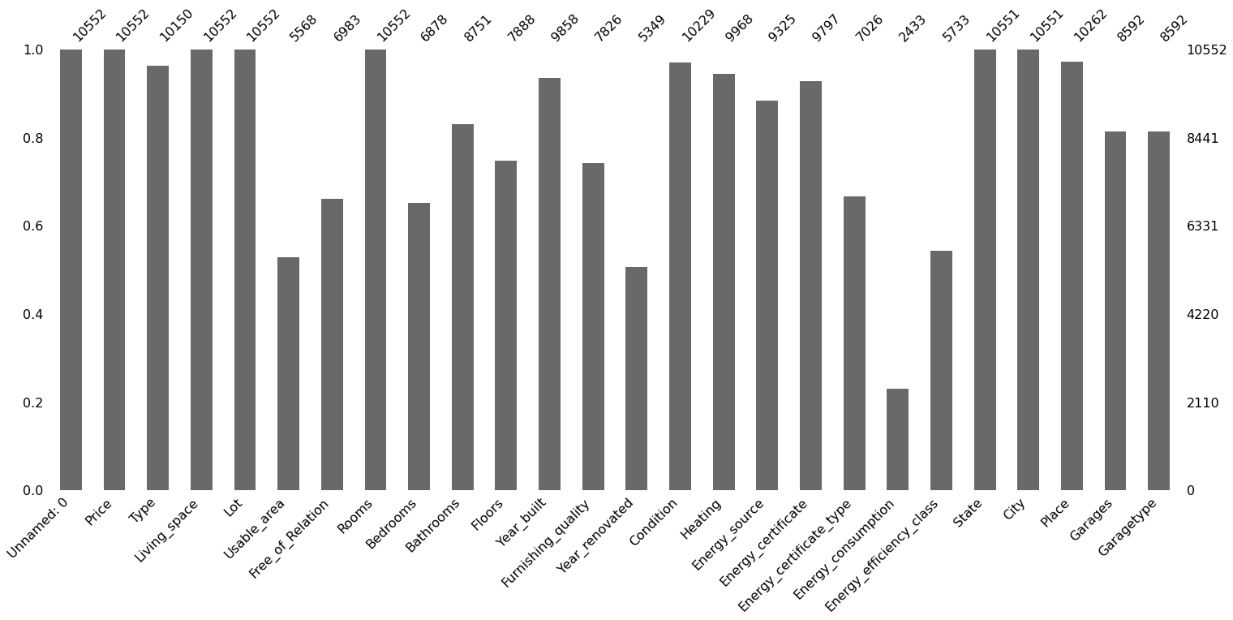
Data Information
12 numericals
13 categorical

Slide 5
Data Information contd.
Dependent variables: Price (Numeric variable)
Independent variables: 11 numerical, 13 categorical.
Numerical
Living space (sq m)
Lot
Usable Area
Rooms
Bedrooms
Floors
Garages
Date
Year Built
Year renovated

Slide 6
Categorical variables
Type( Multiple dwelling,Mid-terrace house, farmhouse, Duplex, Single dwelling)
Free of relation
Furnishing quality (Normal, Basic, Refined)
Condition (Modernized, dilapidated, Fixer-Upper, Refurbished)
Heating ( Central Heating, Stove Heating, Floor heating, Oil Heating, Cogeneration, Heat pump)
Energy source
Energy certificate (Available, Not required by law, Available for inspection)
Energy certificate type ( Demand certificate, Consumption certificate,
Energy Efficiency class (A+, A, B, C, D,E , F, G, H)
State
City
Place
Garage Type( Parking lot, Garage, Outside Parking lot, Carport, Underground parking lot

Slide 7
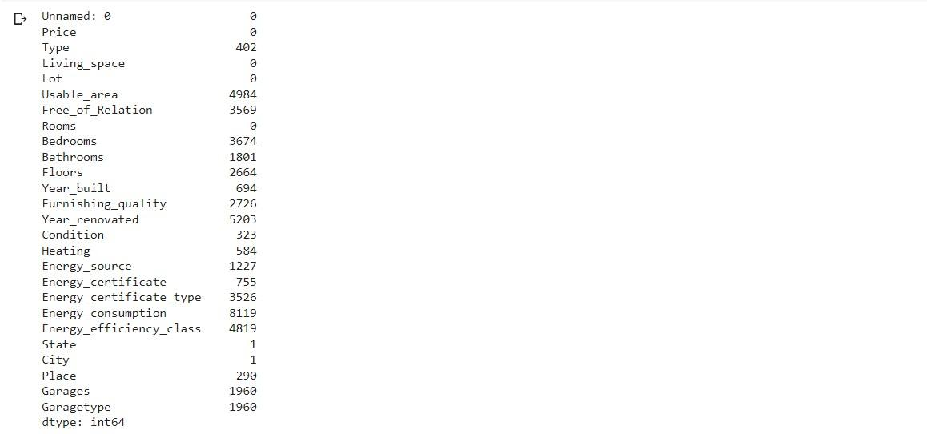
Data Preprocessing - First Attempt
Missing values : 49282
NA values replaced by mean in numerical variables.
NA values replaced by frequent occurrences in categorical variables
Removed following columns: Unnamed, State,Free of relation, Place, Usable area, Energy consumption,Year renovated.

Slide 8
Data Preprocessing - First Attempt
Changed following categorical variables to dummy variables :
Type, Furnishing_quality, Condition, Heating, Energy_source, Energy_certificate, Energy_certificate_type, Energy consumption, Energy_efficiency_class, Garage_type
Plotted histograms , shown none of them are normally distributed.
Using VIF to detect multicollinearity, Living_space and bedrooms are found to be highly correlated.

Slide 9
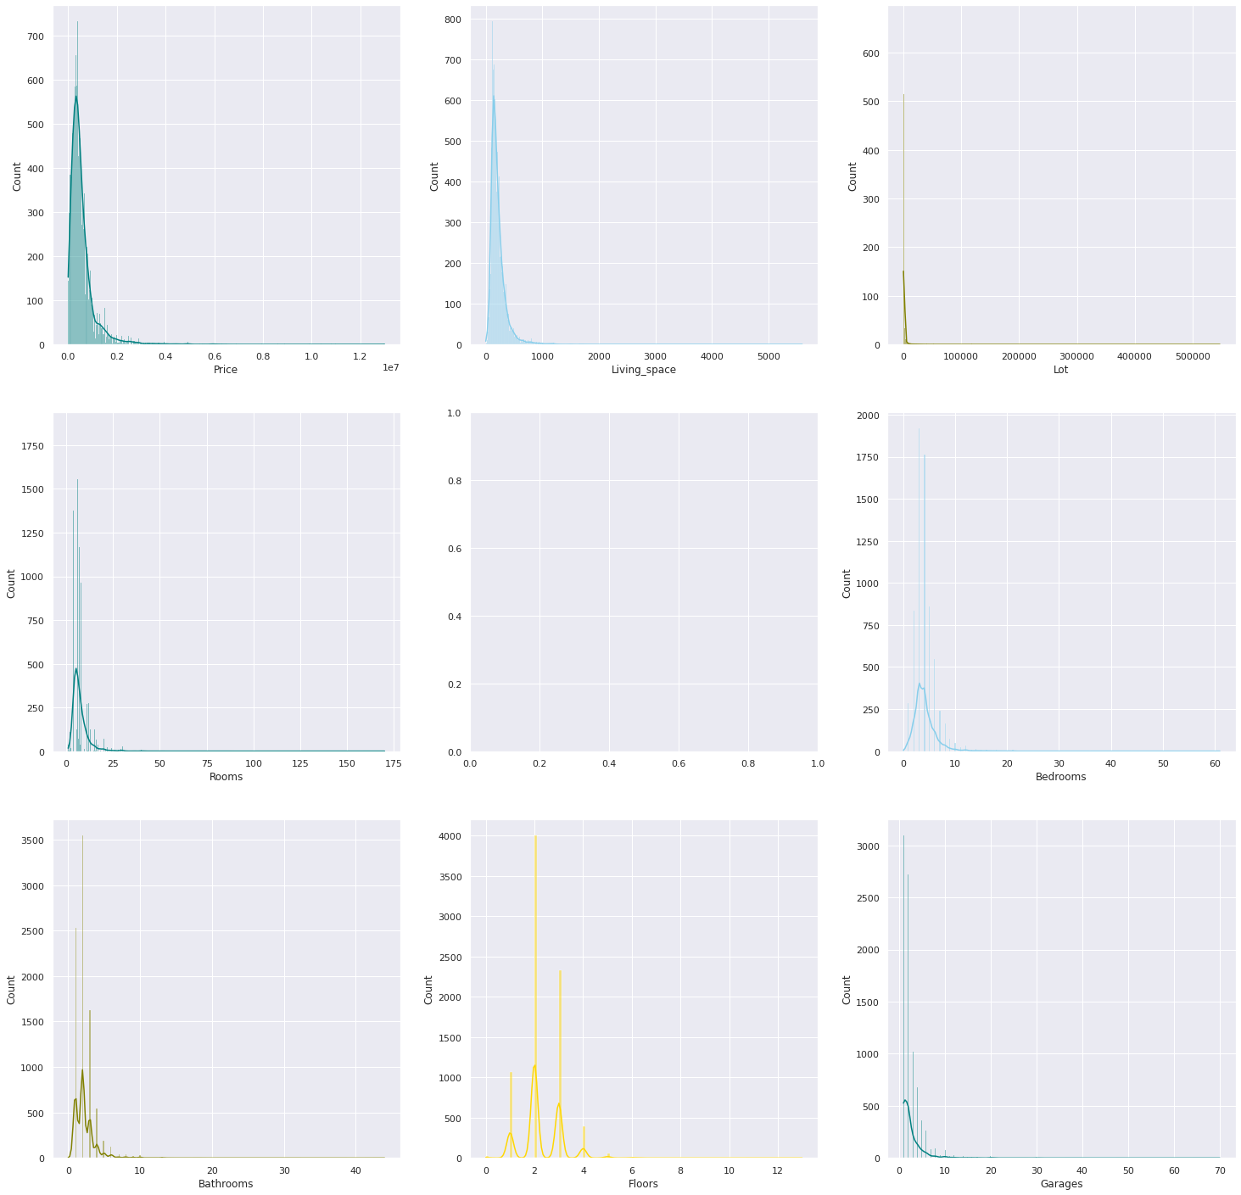

Slide 10
OLS Regression
Initially Performed OLS Regression on 7 independent numerical variables only and price as dependent variable.
Pretty bad, Just ok
Generated R square of 0.59.
The training and test data mean square error shows 521881 and 569995, which indicated overfitting.
Adding dummy variables to the OLS regression, contributed to high beta coefficients ( thought not the right approach).
Ridge and Lasso had high inaccuracy.

Slide 11
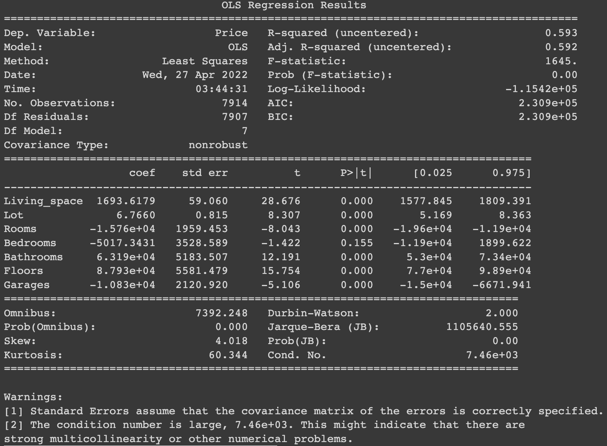
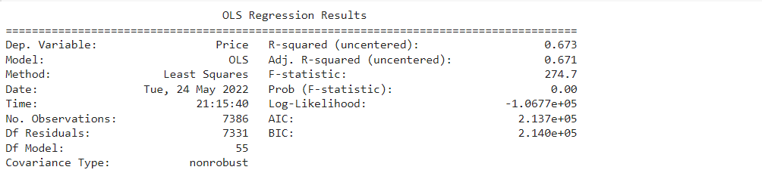

Slide 12
Data Preprocessing - Second Attempt
We related back to real world examples and thought of including City and Place in the dataset
City and Place has a lot of unique values and resulted in a big no of dummy variables
Hence we dropped City,Place,Unnamed and Free_of_Relation
To replace NA in numerical variables, filled with 0s, instead of mean except for Year built, Garages
For the columns 'Usable_area', 'Bedrooms', 'Bathrooms', 'Floors', 'Furnishing_quality', 'Year_renovated', 'Energy_source', I replaced the Na’s with 0’s

Slide 13
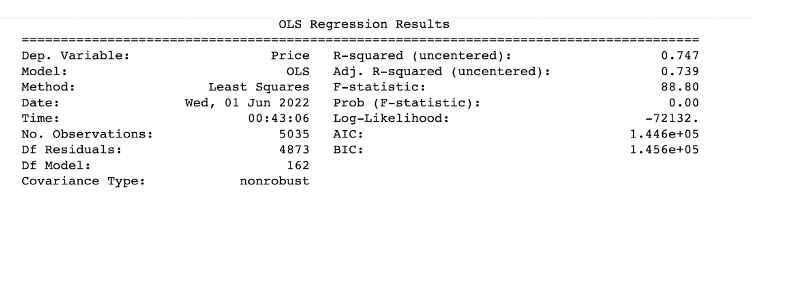
Considerable improvement
R squared increased from 67% to 74%
Adjusted R square increased from 67% to 73%.

Slide 14
Random Forest Regression
The first question arises is why Random Forest ?
Because we didn’t have much idea about the dataset and we wanted to make most of Feature Importance application of Random Forest
We also used Random Forest because the model score for Random Forest was better than the decision tree (which is as expected)
In Random Forest can be thought of as running many decision trees and then taking the majority vote and giving that value as a prediction

Slide 15
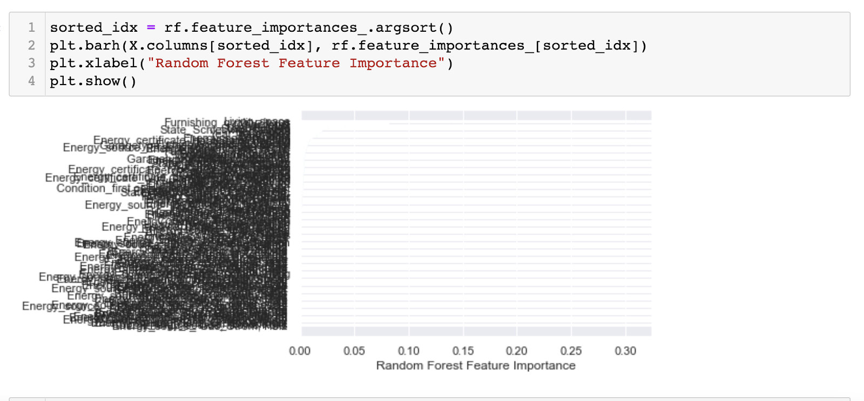
Random Forest Feature Importance -Issue Faced
Main Purpose we RF was for feature selection but because we had 171 columns (including that are dummies)
The resulted graph was really difficult to comprehend

Slide 16
Principal Component Analysis
Main purposes : Dimensionality reduction and Feature Extraction.
With 170 variables, PCA is a good technique for Dimensionality reduction.
Attempt to gain maximum variable with lowest possible loss of information.
Resulted in 170 components in the screeplot, basing on the knee bend we can choose 50 components.
PC1 captures 2.6% and PC2 captures 2.2 % and rest between 1.5 to 0.5%.

Slide 17
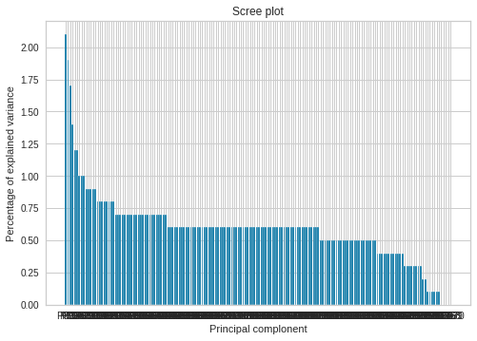
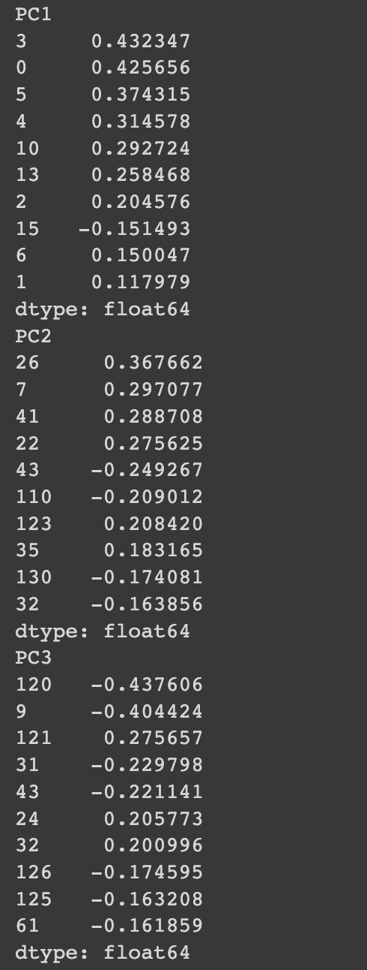
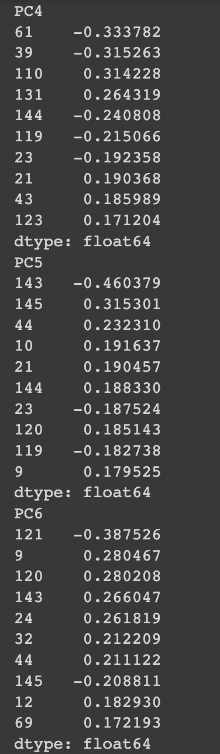
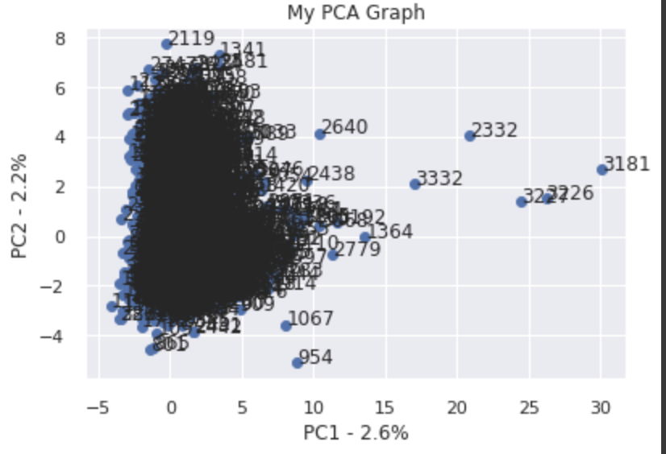
Scree plot
Loadings

Slide 18
Its complex to interpret and time consuming to interpret the components, but have achieved lower dimensional projection of the dataset.
Performed Feature extraction on numerical variables to analyze hidden patterns in the dataset.
Living space, Lot , Rooms , Bedrooms, Bathrooms, Floors, Garages.
Scaled the data before PCA.
The scree plot has the components sorted based on their eigen values with its proportional variance percentages all accumulating to 100%.

Slide 19
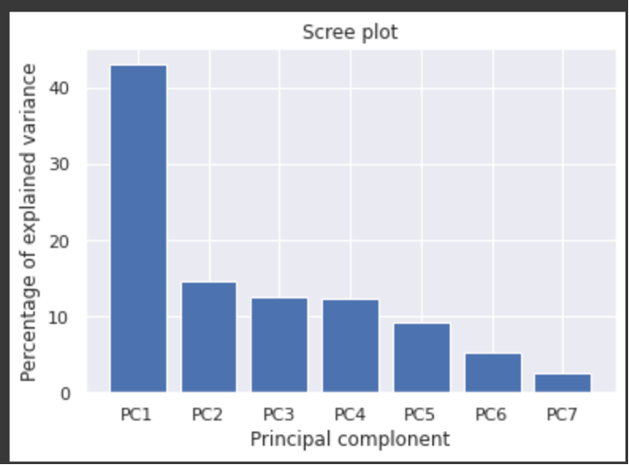
We can choose 4 principal components based on the bend, capturing 80.5% variance.
First component responsible for 43% of variance and PC2 15%, PC3 capturing 11% ,PC4 10% approximately.

Slide 20
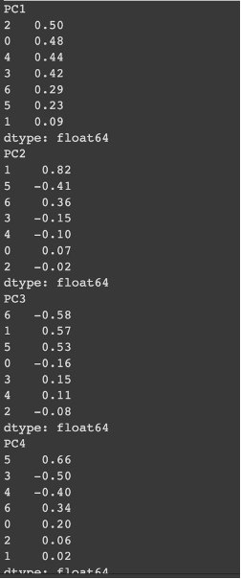
Loading scores
PC1- Spacious houses
PC2- Outdoor spaces
PC3- Houses with lot and floors with no Garages.
PC4- Empty floors may for designing.

Slide 21
Clustering
Can yield new categorical variables aka clusters.
Goal maximize inter mean classes and minimize intra mean within classes.
Perform k-means clustering method which is an unsupervised machine learning technique.
Find optimal number of clusters using elbow method.
Used Euclidean distance to classify data to either clusters.
Helps identify Meaningfulness and Usefulness of data.

Slide 22
Clustering Analysis
We tried normalizing data before clustering. Standard scaler, MinMax Scaler and Normalizer were performed separately on the data before clustering. Since we could not get even a single well defined cluster, we decided to perform clustering without normalization. These were the results that we got.
We further used the elbow method to determine the optimal K value.
The elbow was at K= 3 hence we did clustering taking the K value as 3. We got 3 clusters and as depicted below i.e., PRICE vs CLUSTER
The clusters indicated that cluster 0 has the most values and we can consider them as the low-priced houses and cluster 2 as medium-priced and cluster 1 as high priced.

Slide 23
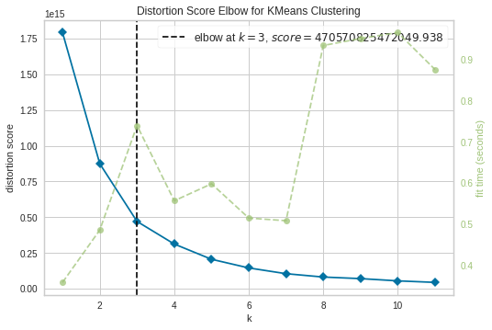
Score elbow for k means clustering

Slide 24
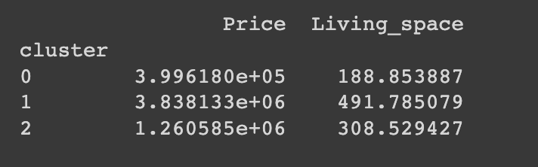
Centroids

Slide 25
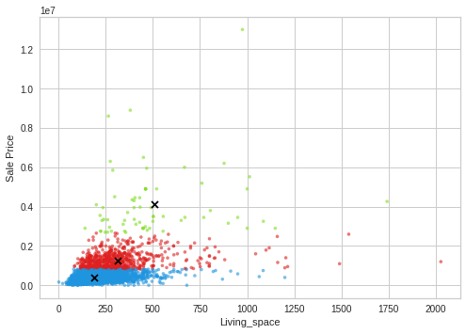
Sale price vs Living space

Slide 26
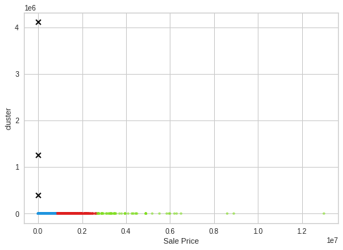
Cluster vs Sale price

Slide 27
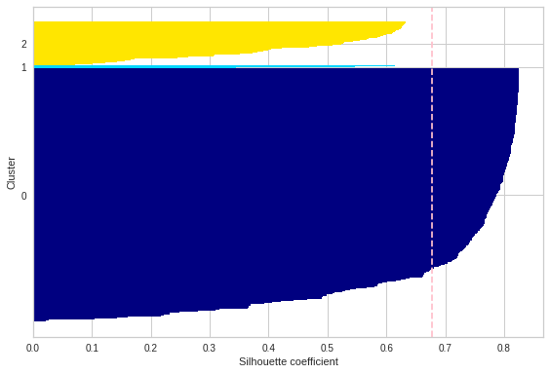
We evaluated clustering results by calculating the silhouette score and it was approximately 67%.

Slide 28
THANK YOU

