Slide 1
End of term project
Shalymova Aigerim

Slide 2
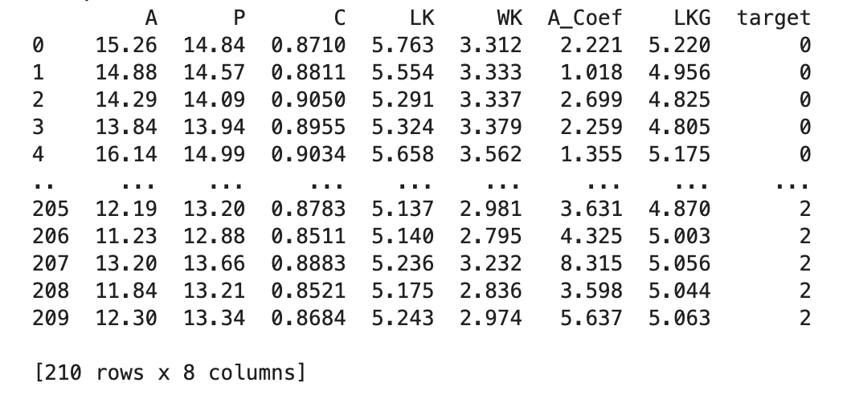
Dataset
Dataset contains measurements of geometrical properties of kernels belonging to three different varieties of wheat. So there are 7 features and 3 classes.

Slide 3
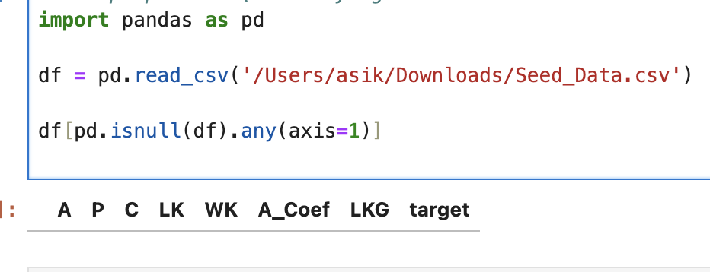
Data preparation
Here I'm identifying all locations in the data that have null (missing or NaN) data values. We received an empty table so we don't have any.

Slide 4
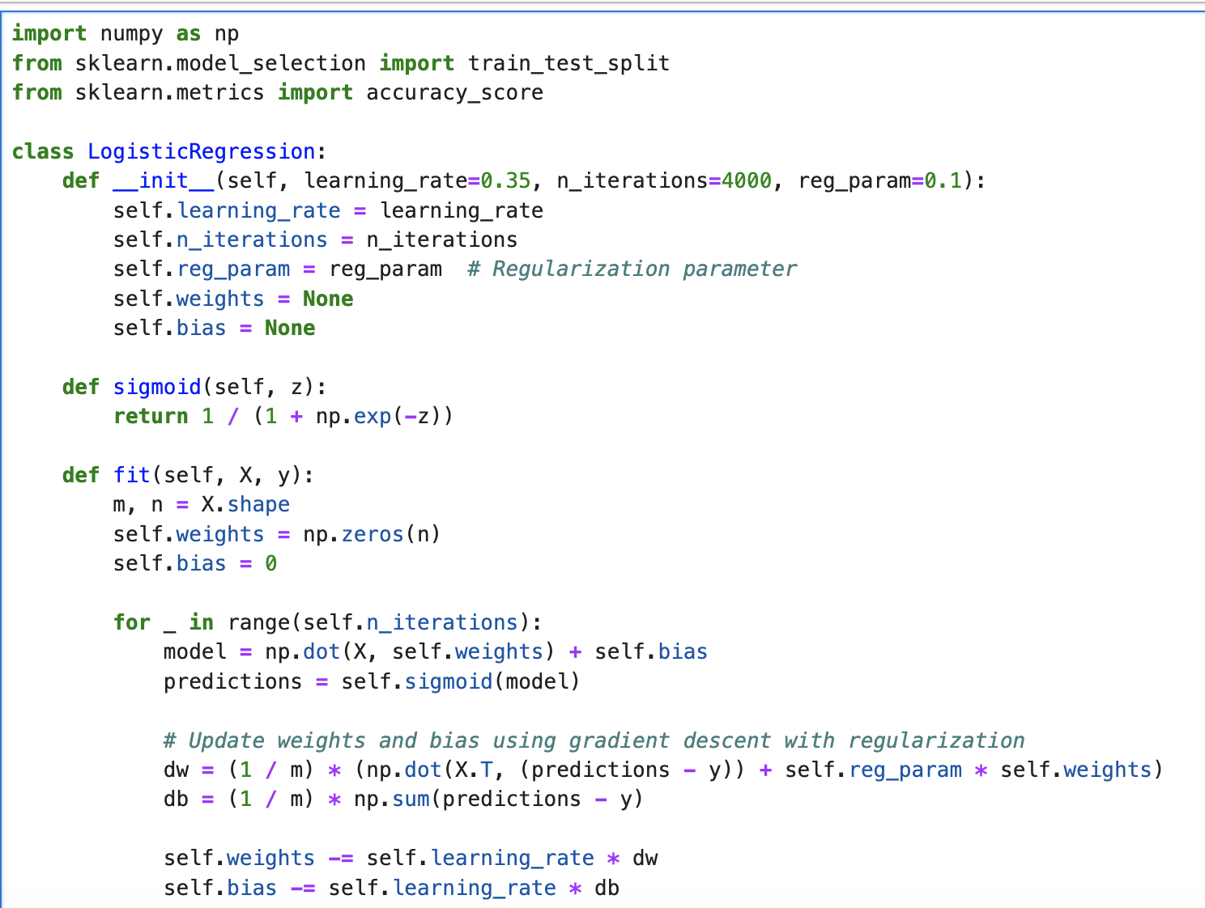
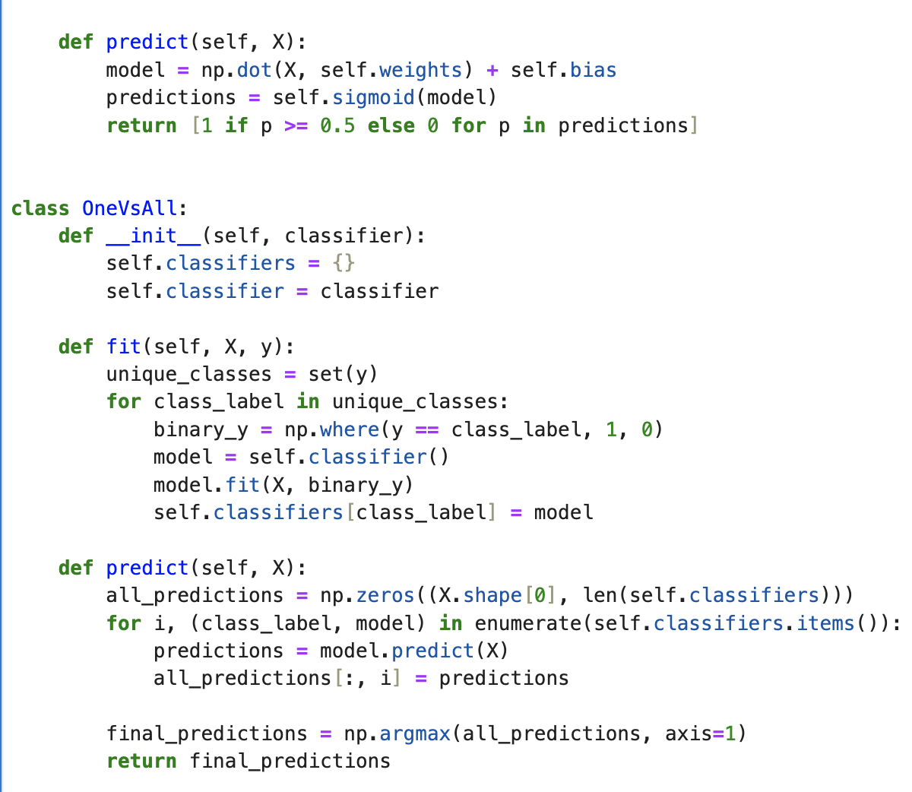
One vs All

Slide 5
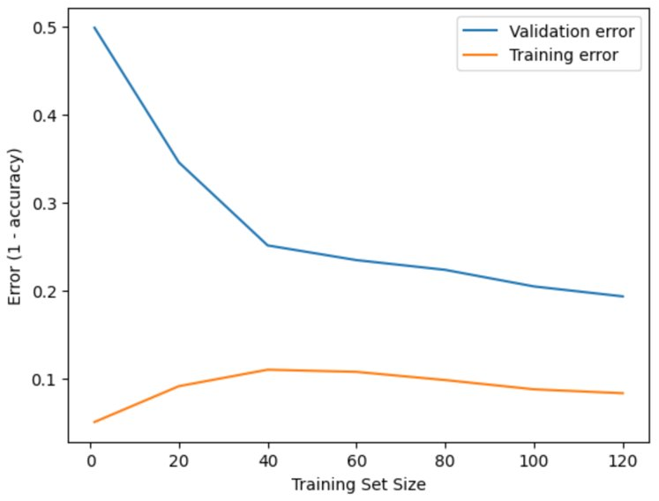
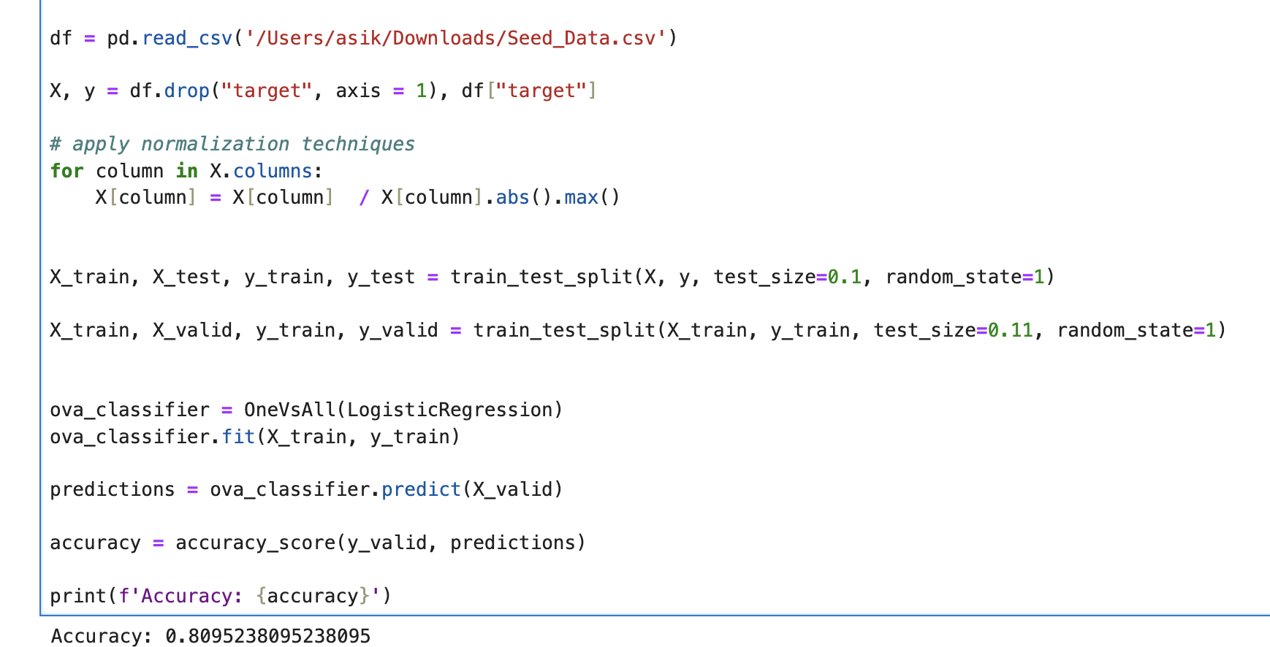
One vs All
I divided the data into three parts : training(80%), cross validation(10%), testing(10%)
In order to improve accuracy I used normalization, because the data was in different ranges.

Slide 6
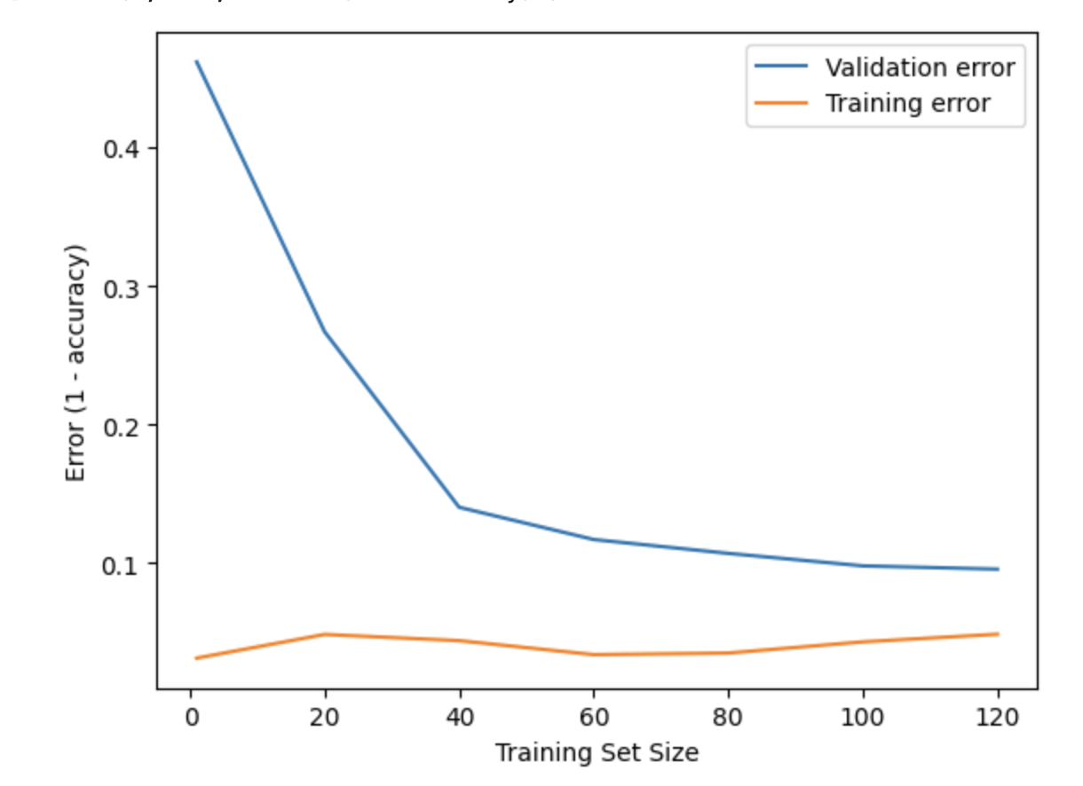
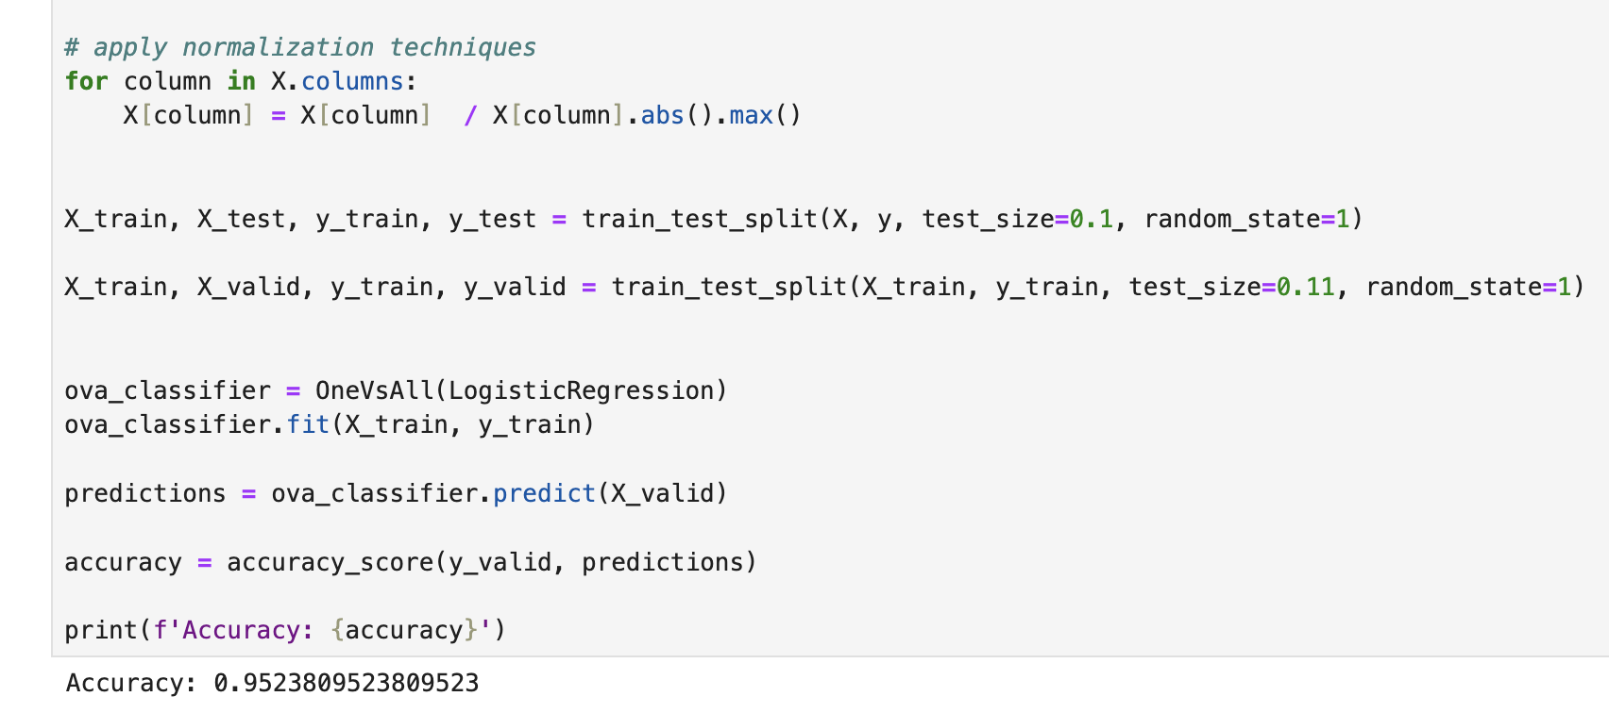
One vs All
Then I played with learning rate and regularization parameter and improved accuracy up to 95%. And thus learning curve changed.

Slide 7
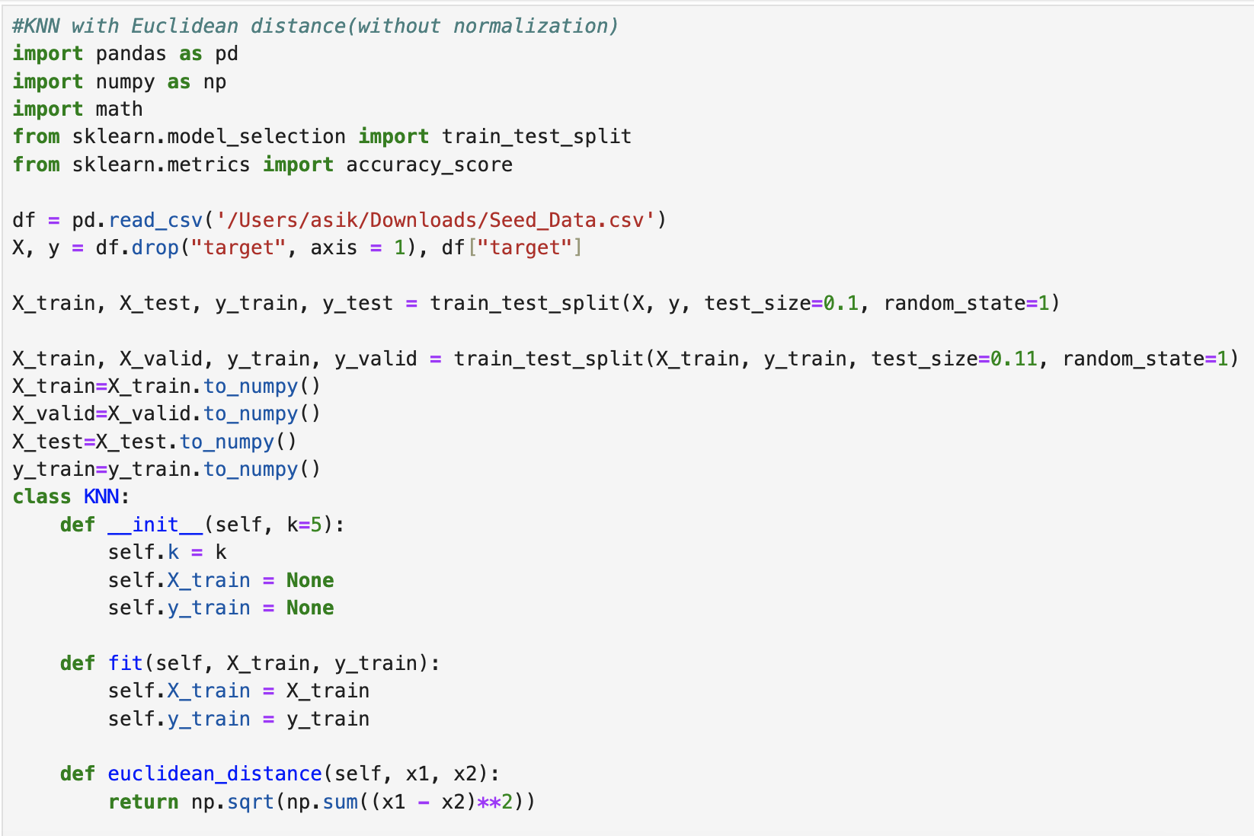
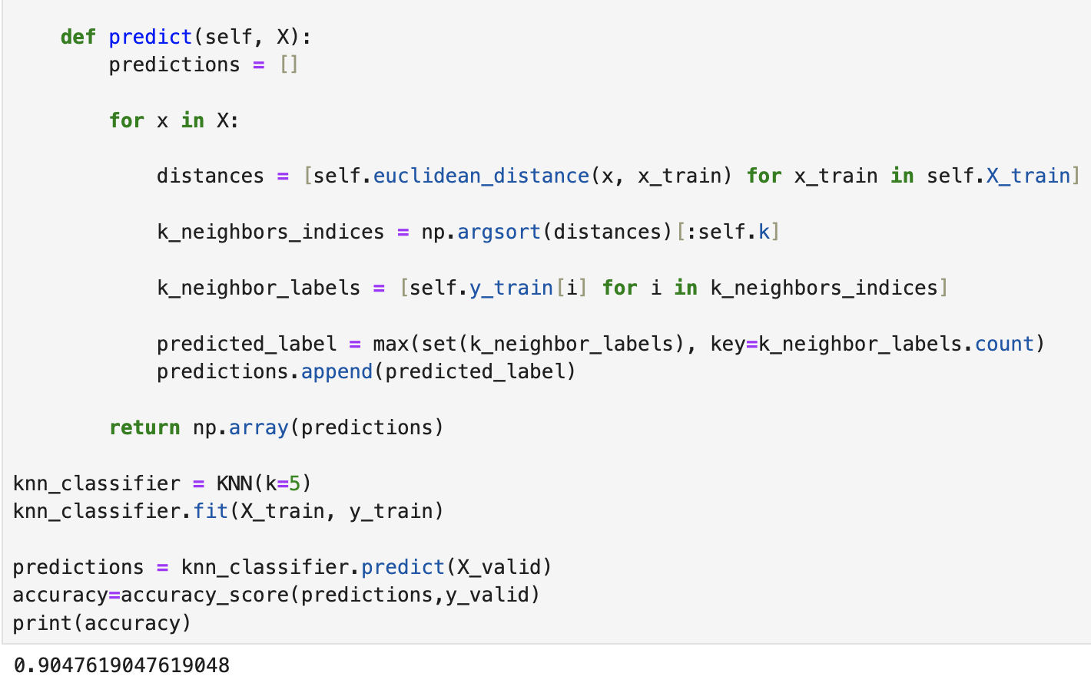
KNN with Euclidean distance

Slide 8
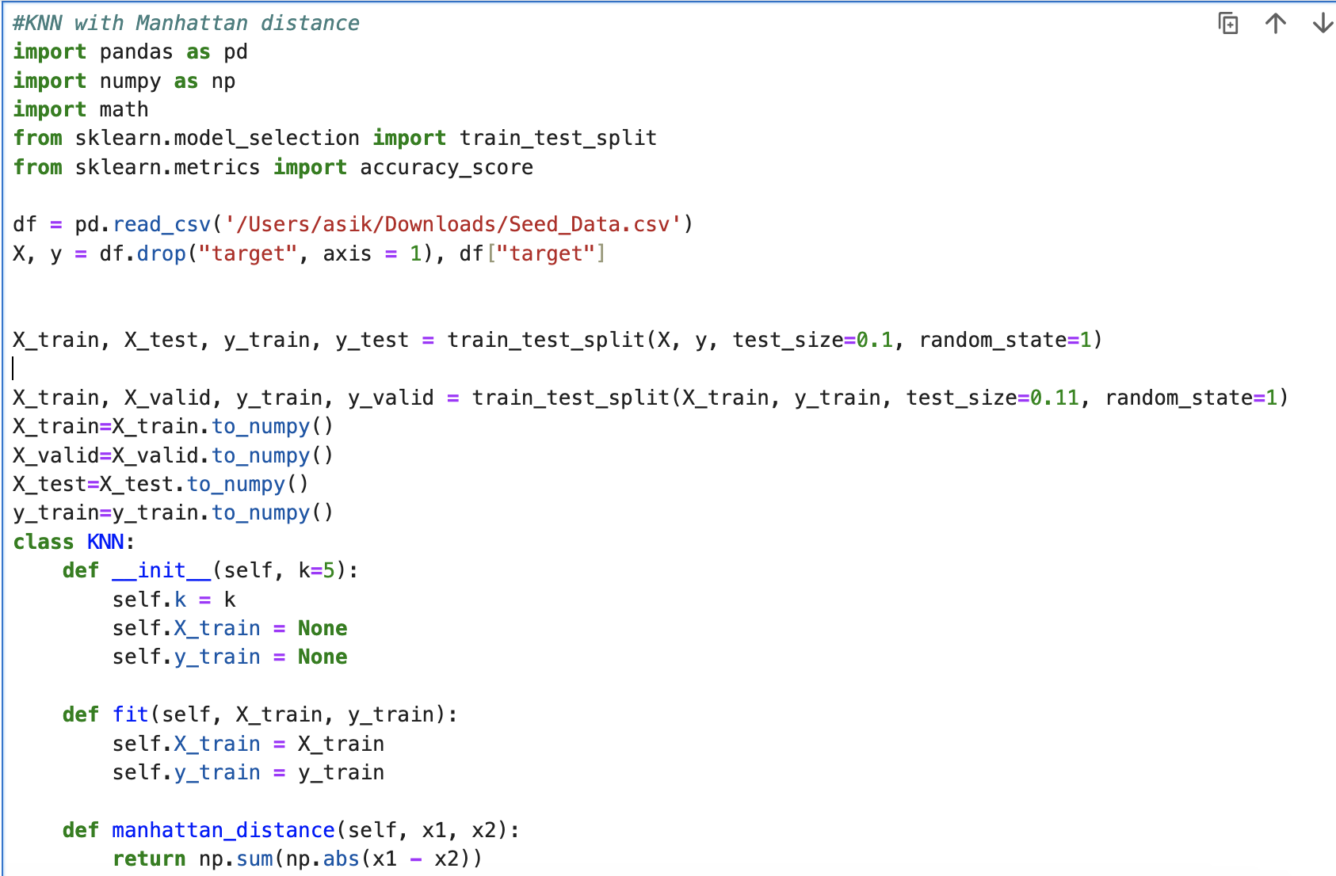
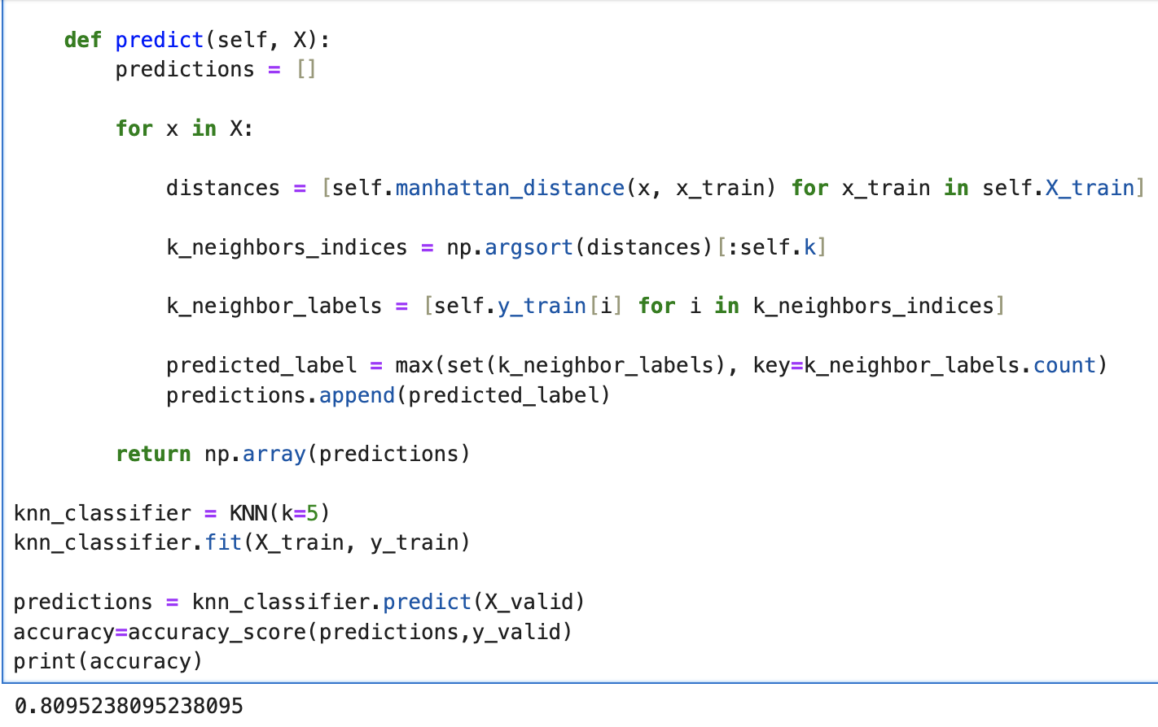
KNN with Manhattan distance

Slide 9
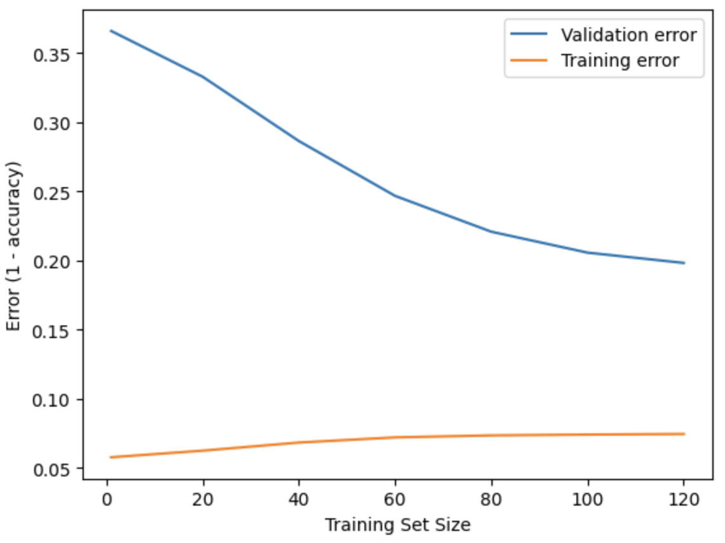
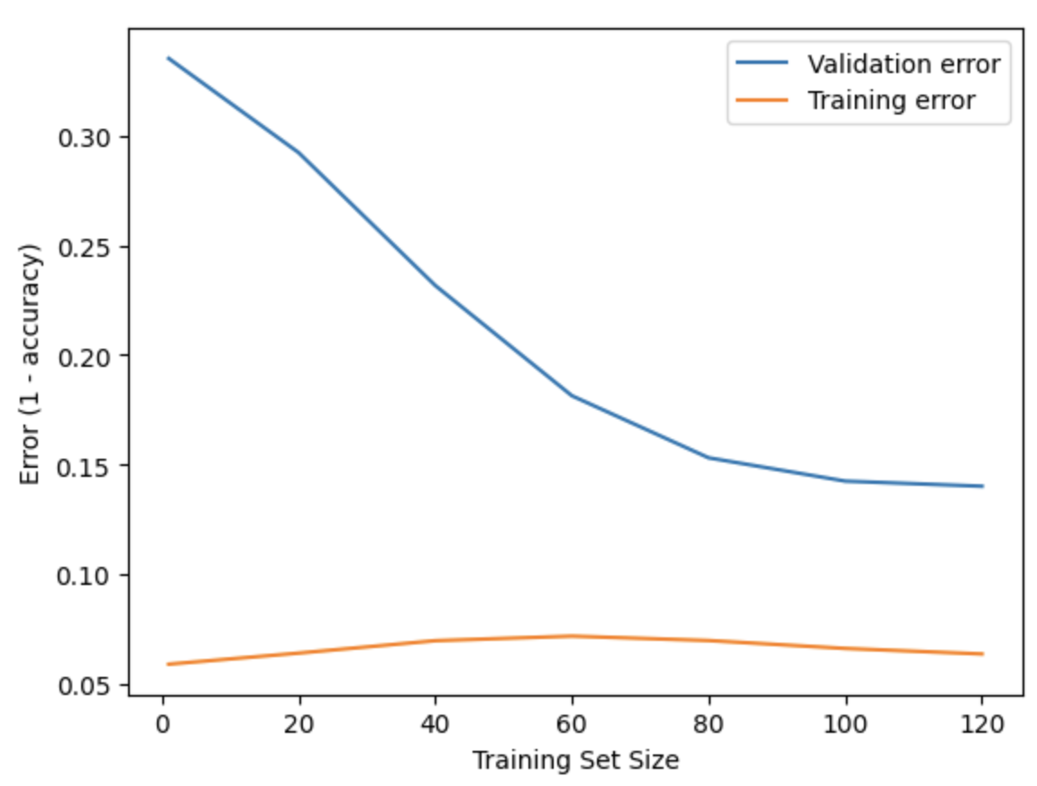
Learning curve
KNN with Euclidean dist.
KNN with Manhattan dist.

Slide 10
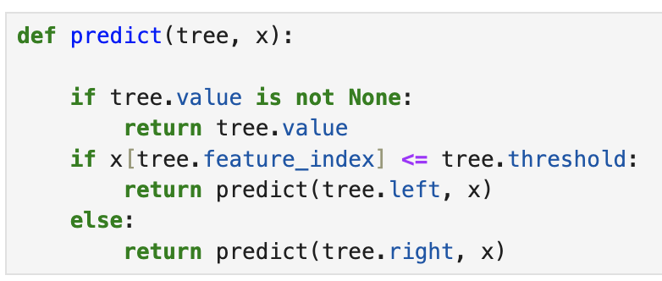
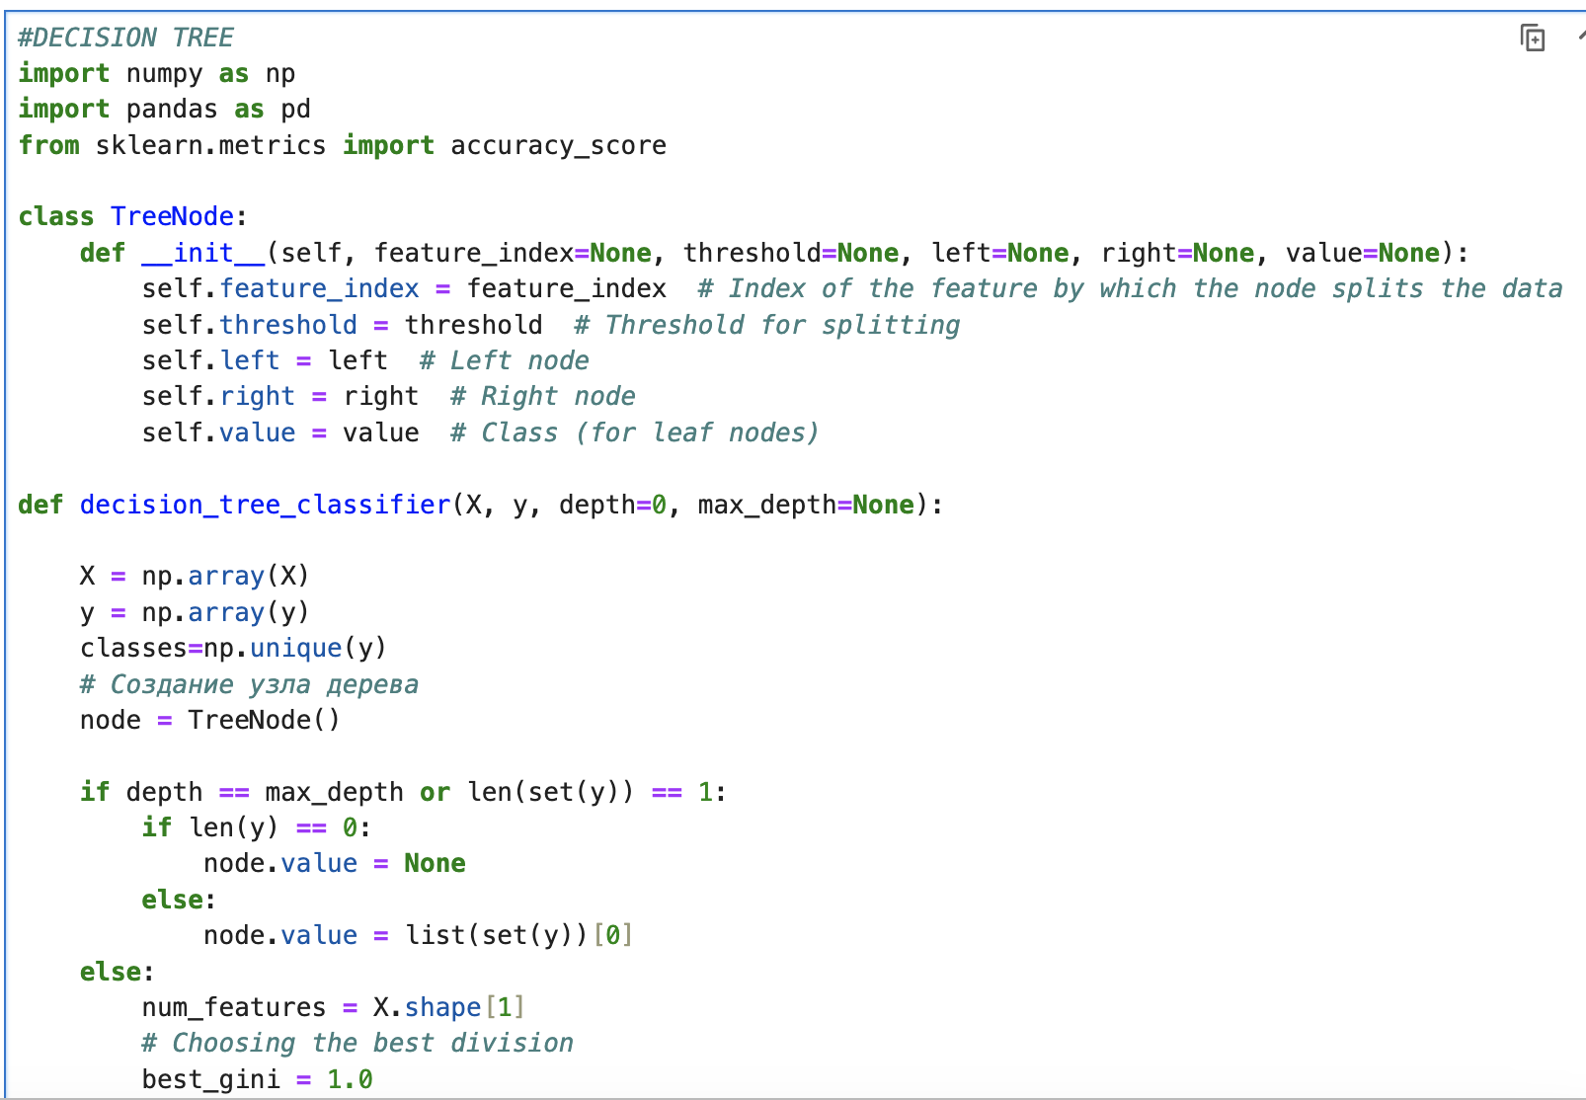
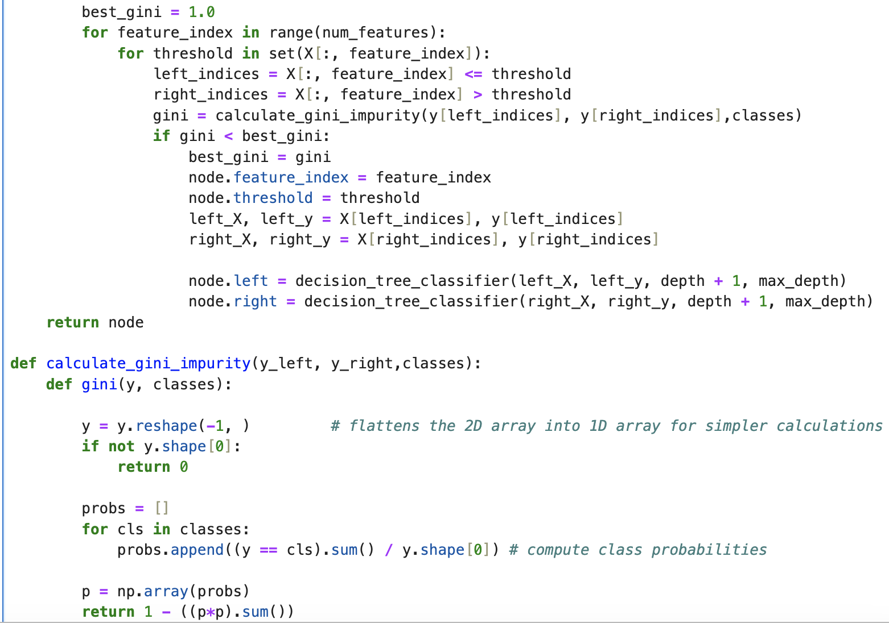
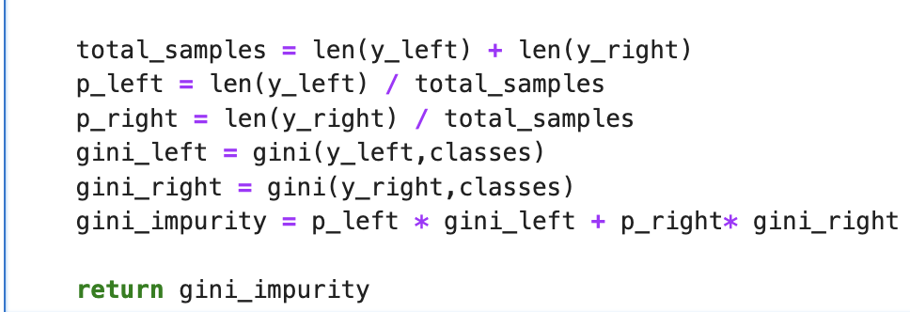
Decision tree

Slide 11
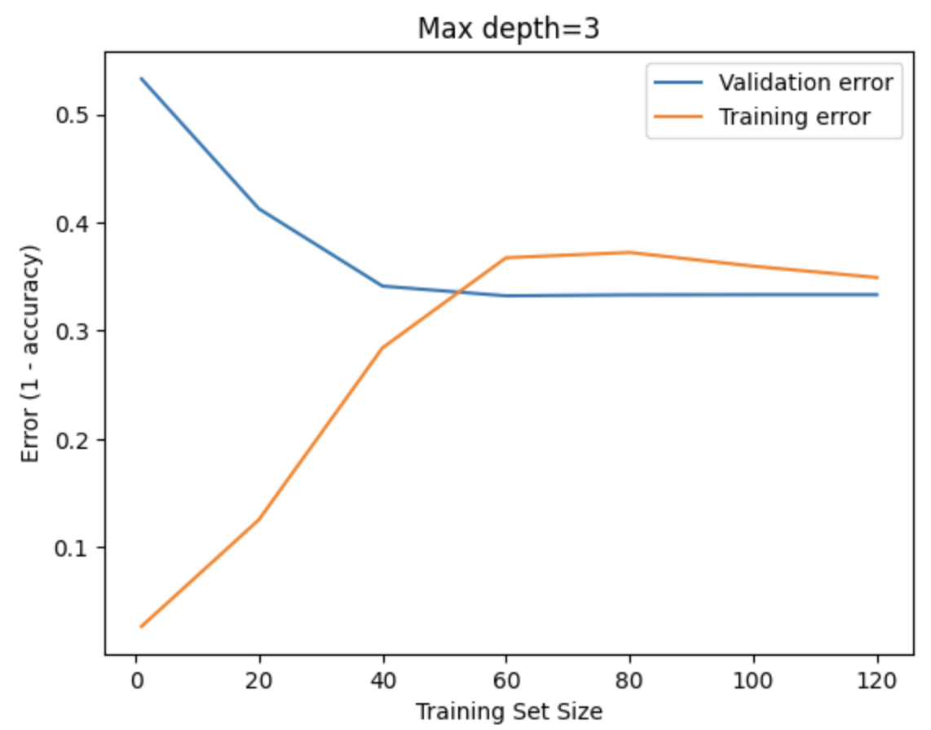
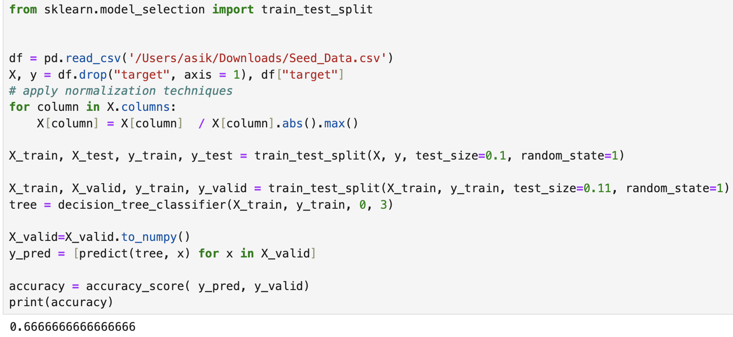
Decision tree with max depth=3
With max depth=3 , I get 66% accuracy, so in order to improve accuracy and learning curve, I increased the depth to 4 and 5

Slide 12
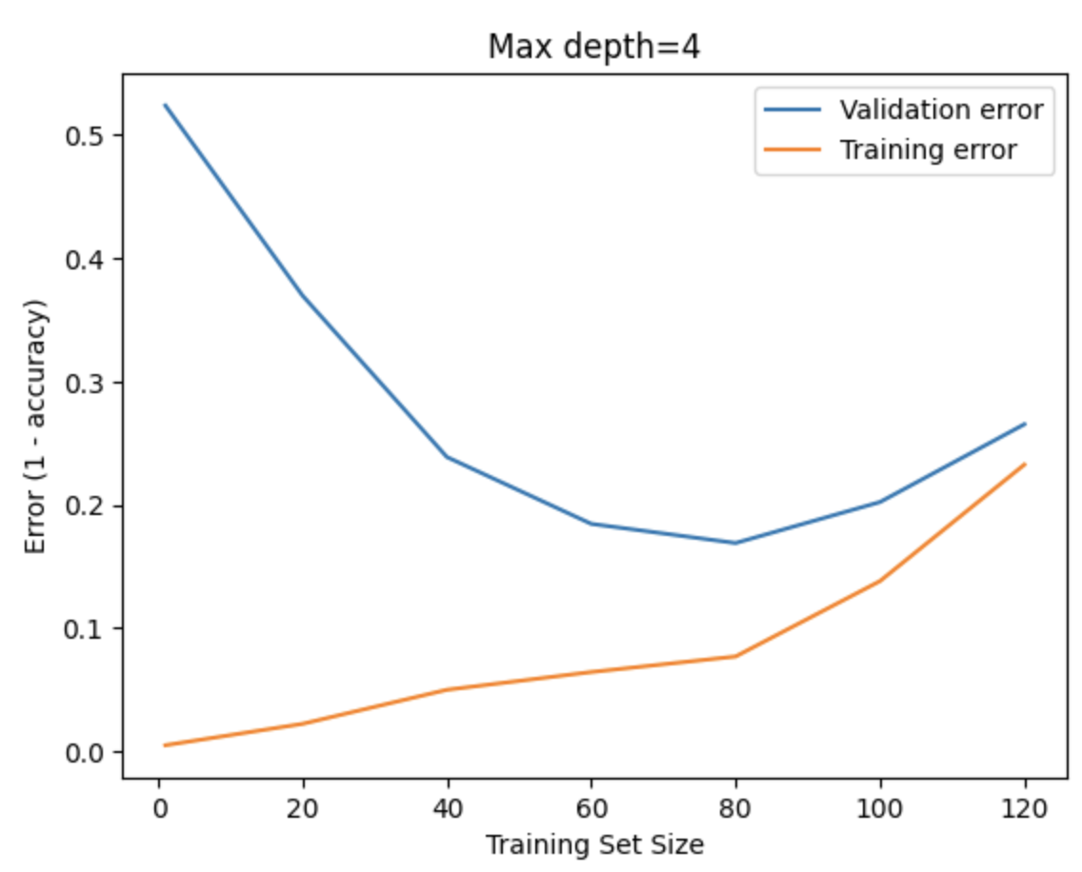
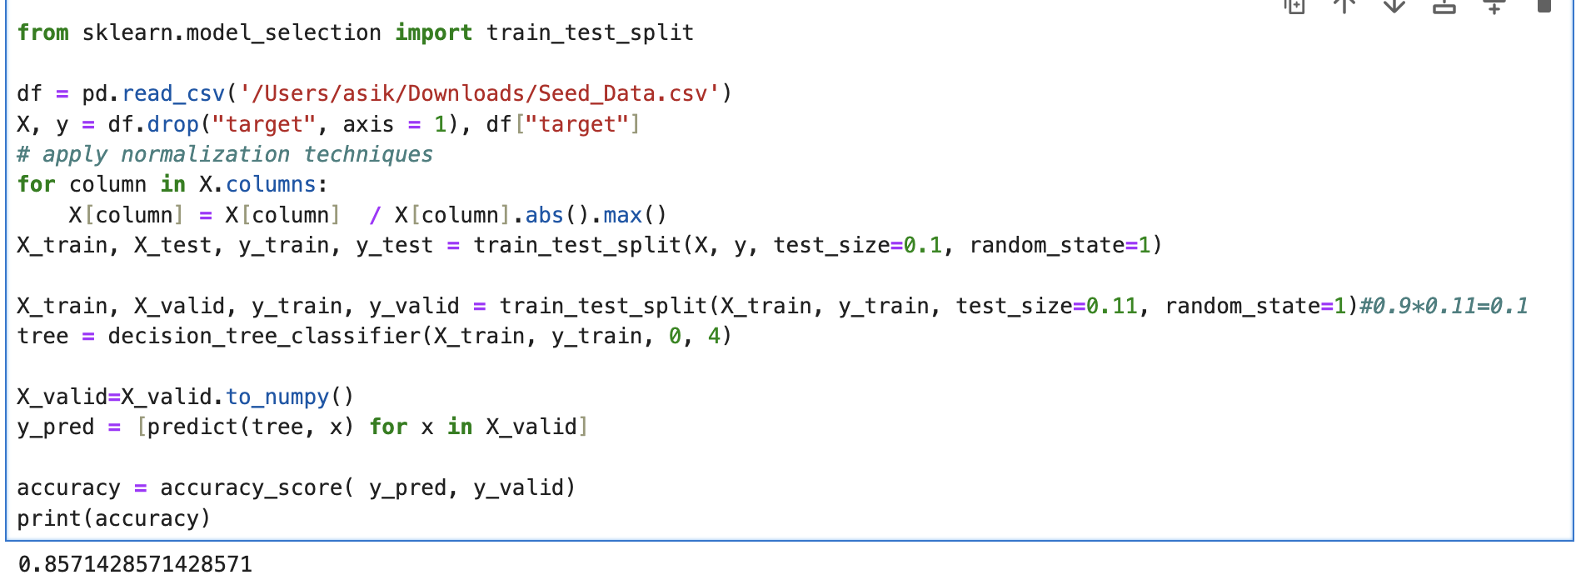
Decision tree with max depth=4
With max depth=4, I get 86 % accuracy

Slide 13
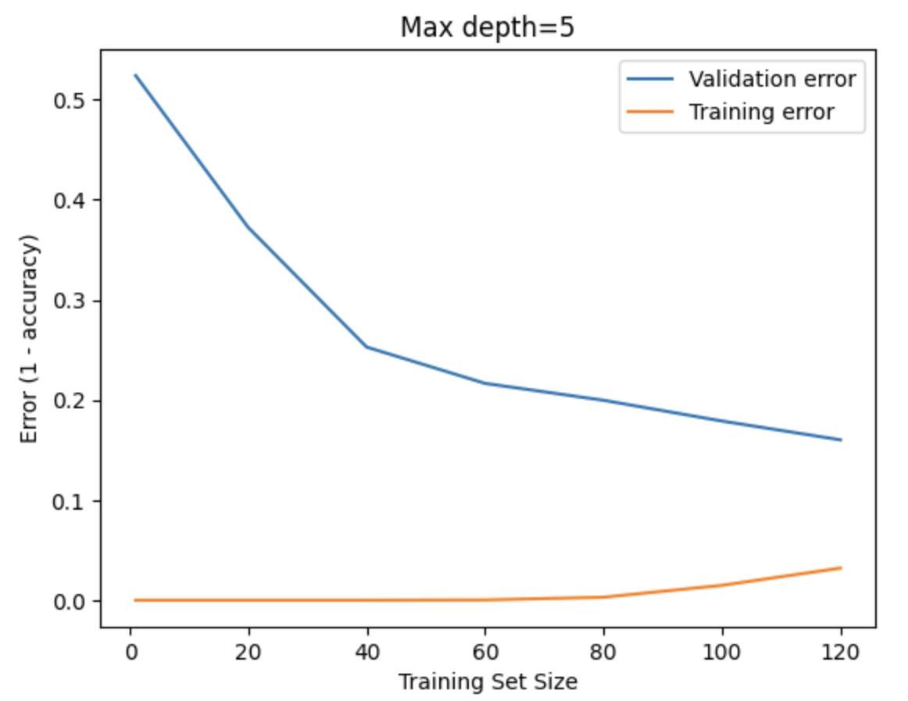
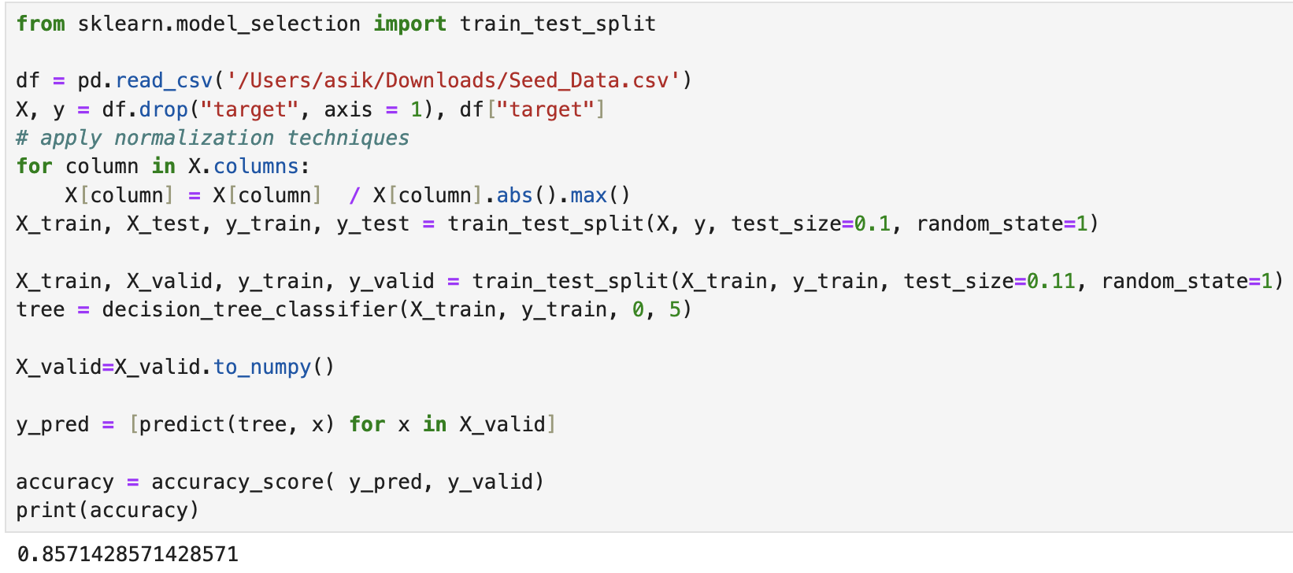
Decision tree with max depth=5
With max depth=5, I get the same accuracy as with depth=4, but more improved learning curve.I think that if there was more data then the learning curve would be perfect

Slide 14
Comparison table
One vs All | Without normalization | With normalization | With different learning parameter and regularization parameter
Accuracy | 0.76 | 0.80 | 0.95
KNN | With Manhattan dist | With Euclidean dist
Accuracy | 0.80 | 0.90
Decision tree | Max depth=3 | Max depth=4 | Max depth=5
Accuracy | 0.66 | 0.86 | 0.86

