Slide 1

Who I am
Shyam Savania
Engineering Manager at Xeneta
Leading technology change, from cloud to AI · Hamburg
2016 · On-premise
2019 · To the cloud
2023 · Freight data
Now · Teams and AI
Infrastructure admin, Phillips 66: servers, NetApp, VMware
IT architect, JET: moving workloads to AWS and Azure
Software architect, Xeneta: data ingestion
Engineering Manager, Xeneta: Indexing and rate management
Rolling out SDD/ADD AI-assisted engineering; building AI agents for internal and external products
Notes:
My career follows today's story: started racking servers and running VMware on-premise, then moved Phillips 66 and JET workloads to AWS and Azure, now building freight data platforms at Xeneta. Over the last year: rolling out SDD/ADD AI-assisted engineering across the organisation and building AI agents for internal and external products, which is why AI use is allowed in this module as long as you can explain it. That's why the module is built around logistics data. Then ask: who has used a cloud console before? Which provider?

Slide 2
How this module works
WEEK 1
WEEK 2
WEEK 3
WEEK 4
WEEK 5
Foundations, storage
Kubernetes, Kafka
Streaming, Spark, Databricks
Production, the brief
Redesign, the board
Notes:
Each session adds one layer to your team's platform; the workshops are the project. Week 4 ends with a brief that changes the requirements; week 5 you redesign and defend it at the architecture board. Marking: 10% attendance, 45% team project (build 30%, redesign 15%), 10% peer rating (the other teams score each presentation at the board), 35% individual at the board (questions on your part and your AI use). Workshop checkpoints aren't marked: they tell you you're on track. No written exam. Everything is in the course repo: README, setup guides, session folders. Week 1 is individual; teams form in session 4.

Slide 3
Cloud architecture
and GCP fundamentals
CLOUD COMPUTING AND DATA ARCHITECTURES · SESSION 1
Compute, network, storage, and how they moved
Shyam Savania · SRH Hamburg · 16 November 2026
Notes:
Welcome and intros. How the module works first (15 min), then this deck. The story today: each step solves the previous step's problem. Slides are deliberately technical; I add the business side as we go.

Slide 4

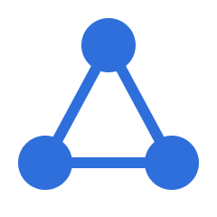
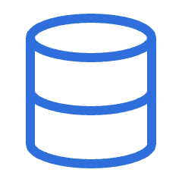
Every system is three building blocks
Compute
Network
Storage
CPU and memory.
Runs the code.
Switches, routers, firewalls.
Moves the data.
Disks, file servers, databases.
Keeps the data.
Notes:
The cloud doesn't change these three. It changes who owns them and how you get them. Every service we use this module is one of these, or a bundle of them.

Slide 5
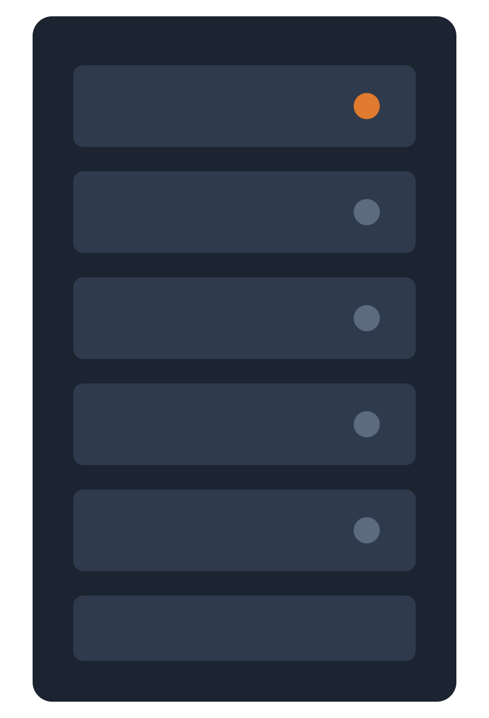
On-premise: you own all of it
Buy hardware for the peak
Weeks to add capacity
You power, cool and patch it
Most of it sits idle
Notes:
The rack: one server busy (orange), the rest idle. Capital spend up front, sized for the worst day. Business context here: peak season, procurement cycles.

Slide 6
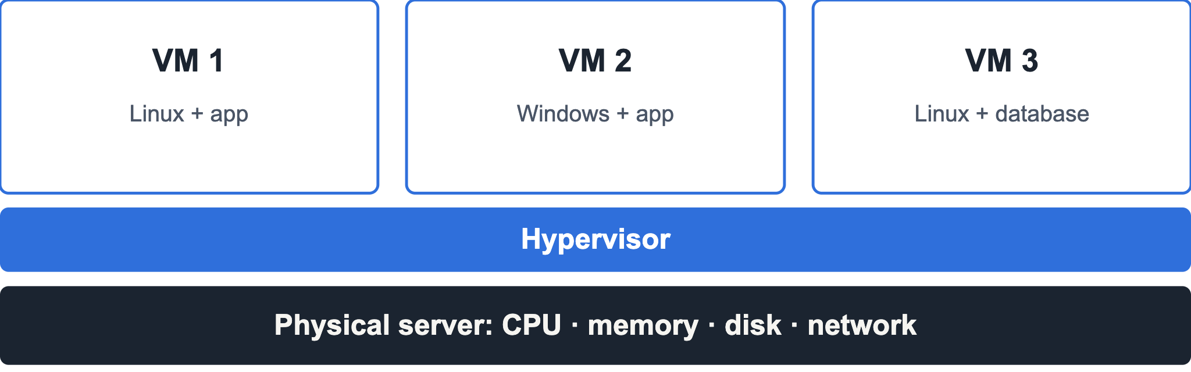
Virtualisation: one machine becomes many
Isolated · better use of hardware · a new machine in minutes
Notes:
A hypervisor slices one physical server into isolated virtual machines, each with its own OS. This is the trick that makes the cloud possible: providers rent you slices of huge fleets.

Slide 7

Lift and shift: rent it instead
Google Cloud
AWS
Azure
Notes:
Lift and shift: move the same VMs into a provider's data centre. Quick, but you keep the old design and its costs; cloud-native comes later. Three big providers, same ideas, different names. We use Google Cloud; I'll map names to AWS as we go.

Slide 8
What makes it cloud computing
On demand
Network
Pooled
Elastic
Metered
No ticket, no wait
Reached from anywhere
Shared hardware
Up and down fast
Pay for what you use
If one is missing, it's just someone else's server.
Notes:
These are NIST's five essential characteristics (SP 800-145): on-demand self-service, broad network access, resource pooling, rapid elasticity, measured service. Quick check: is a rented server in a colocation data centre "cloud"? Which of the five does it miss?

Slide 9
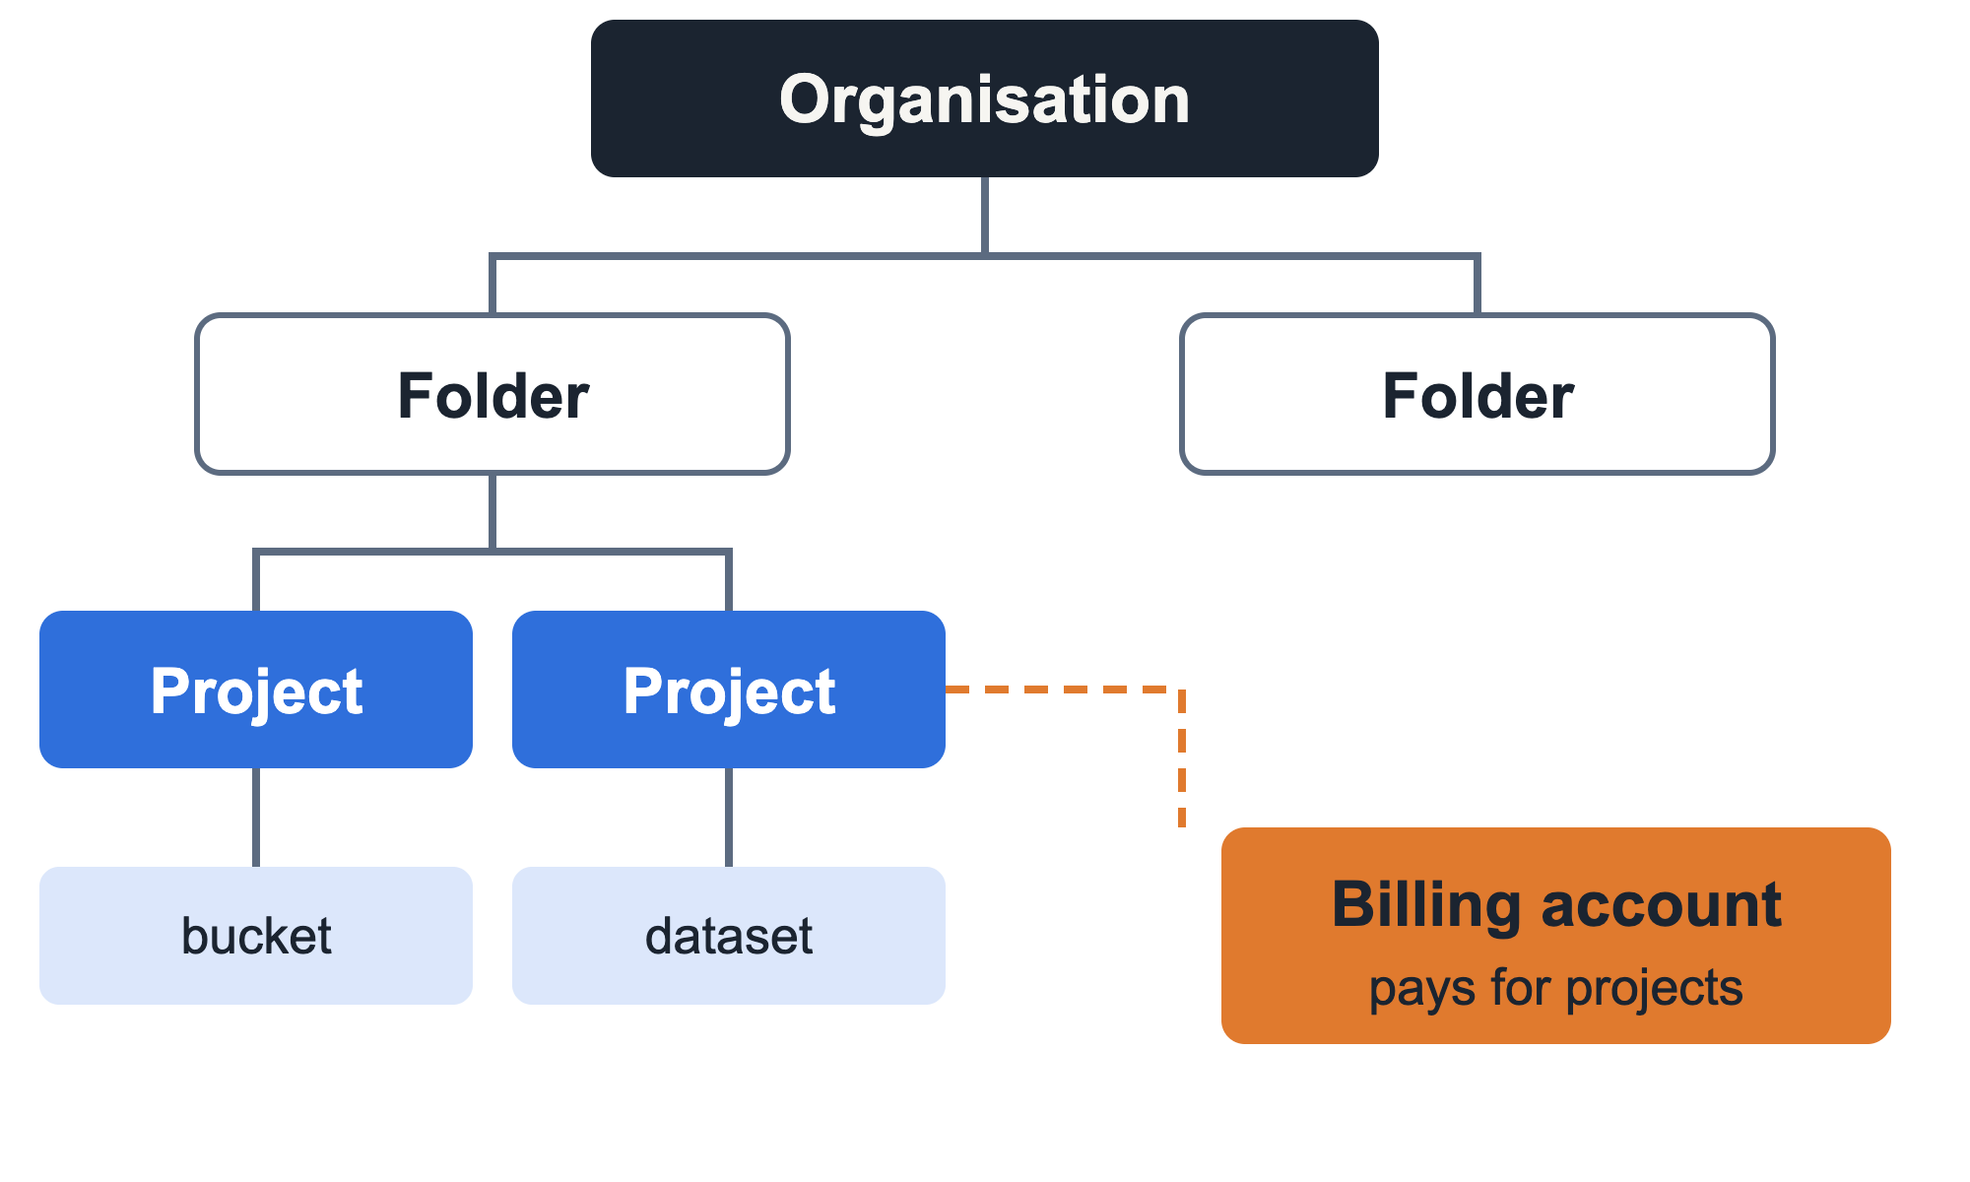
Google Cloud: where everything lives
Region
europe-west3, Frankfurt
Zones
a, b, c: separate data centres
Notes:
Everything you create belongs to a project; the project is the unit of billing, permissions and quotas. Companies group projects into folders under an organisation, and set policies at the top that flow down. Your free trial has no organisation: just your projects and one billing account. A region is a geographic area, zones are isolated data centres inside it: spread across zones to survive one failing. We use Frankfurt to keep data in Germany: data residency matters for EU shippers. AWS: accounts and organizational units, same idea.

Slide 10
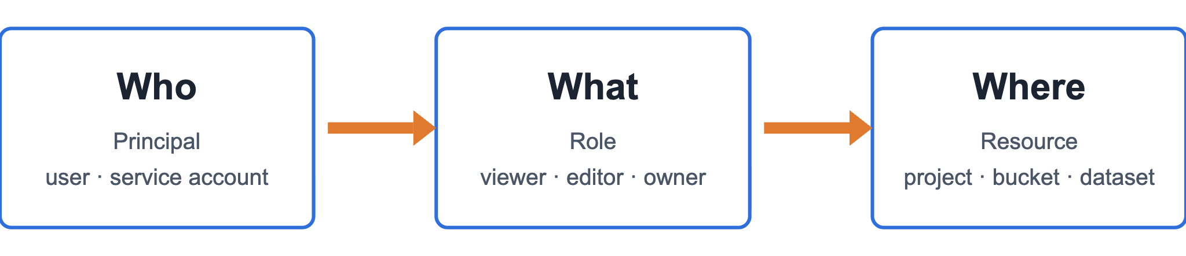
IAM: who can do what, on which resource
Least privilege: grant the minimum that works.
Notes:
On-premise, access was mostly the network perimeter: if you were inside, you were trusted. In the cloud everything is reachable over the internet, so identity is the perimeter. Service accounts are identities for code, not people; our pipelines will run as them. Workshop: students add their neighbour to their project with a role.

Slide 11
People and code: two kinds of identity
User account
Service account
A person
An application
gcloud auth login
pipeline@project.iam
Console, Cloud Shell
Attached to what runs the code
Never download service account keys
Notes:
Code finds credentials through Application Default Credentials: in Cloud Shell that's you, so Terraform runs as your user today. In production, a pipeline runs as a service account attached to it (a VM, a Cloud Run service, a GKE workload), with only the roles it needs. Downloaded JSON keys are long-lived passwords that end up committed to Git; the repo's gitignore blocks *.json.key for that reason. CI pipelines use workload identity federation instead: we touch that in session 10.

Slide 12
Storage: pick by access pattern
Type | Good for | Google Cloud | AWS
Object | Files of any size, cheap | Cloud Storage | S3
Block | A VM's disk | Persistent Disk | EBS
File | Shared folders | Filestore | EFS
Database | Transactions (OLTP) | Cloud SQL | RDS
Warehouse | Analytics (OLAP) | BigQuery | Redshift
Notes:
Same three building blocks, now as services. The question is never "where do I put data" but "how will it be read". OLTP vs OLAP lands here: many small writes vs big scans. We use Cloud Storage and BigQuery from session 2.

Slide 13
Compute: how much do you want to manage?
Virtual machines
Containers
Serverless
You manage the OS
You manage the app
You manage the code
Compute Engine
GKE
Cloud Run · Cloud Functions
AWS: EC2
AWS: EKS
AWS: Lambda
Notes:
Left to right you hand more of the stack to the provider. More control means more work: patching, scaling. Managed data services like Dataflow and Dataproc sit at the right end; we meet them in week 3. Kubernetes in sessions 4 and 5.

Slide 14
A modern data platform on Google Cloud
Ingest
Store
Process
Serve
Pub/Sub
App Engine
Kafka on GKE
Cloud Storage
BigQuery
Dataflow
Dataproc
Databricks
BigQuery
Dashboards
APIs, agents
Underneath: IAM · Terraform · monitoring · cost control
Notes:
This is the map of the whole module. Every session adds one box to your team's platform: storage and BigQuery Wednesday, Kafka and Kubernetes next week, Pub/Sub and Dataflow the week after. The cloud's role in data engineering is that each box is a managed service you rent by the hour instead of a cluster you run yourself: that's what lets a team of three build what used to need a data centre.

Slide 15
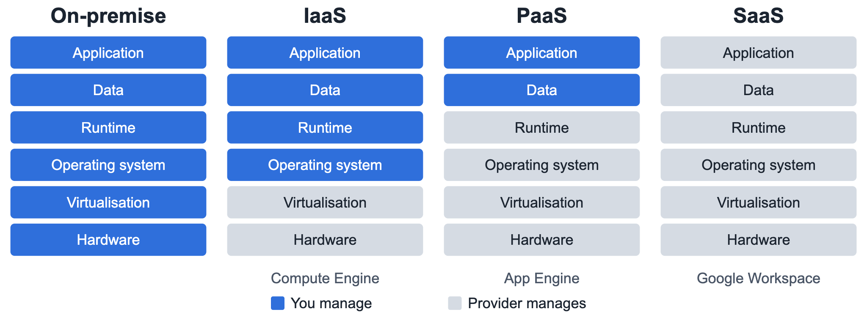
Service models: how much you hand over
Notes:
Each step right hands another layer to the provider. Serverless (Cloud Run, Cloud Functions) sits between PaaS and SaaS: you only hand over code. Quick exercise: call out a service, students shout IaaS, PaaS or SaaS. BigQuery? Gmail? A VM?

Slide 16
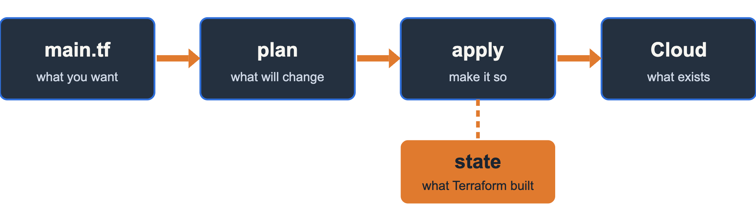
Infrastructure as code: describe it, don't click it
Same code, any account: dev, test, production.
Notes:
Once infrastructure is an API, you can write it down. Terraform compares the code with its state to work out what to change. State is per environment: everyone keeps their own and never commits it (it's in the repo's gitignore). This sets up the workshop: each student runs the same Terraform against their own project. Then 10 minutes on the SDLC: dev to test to production.

Slide 17
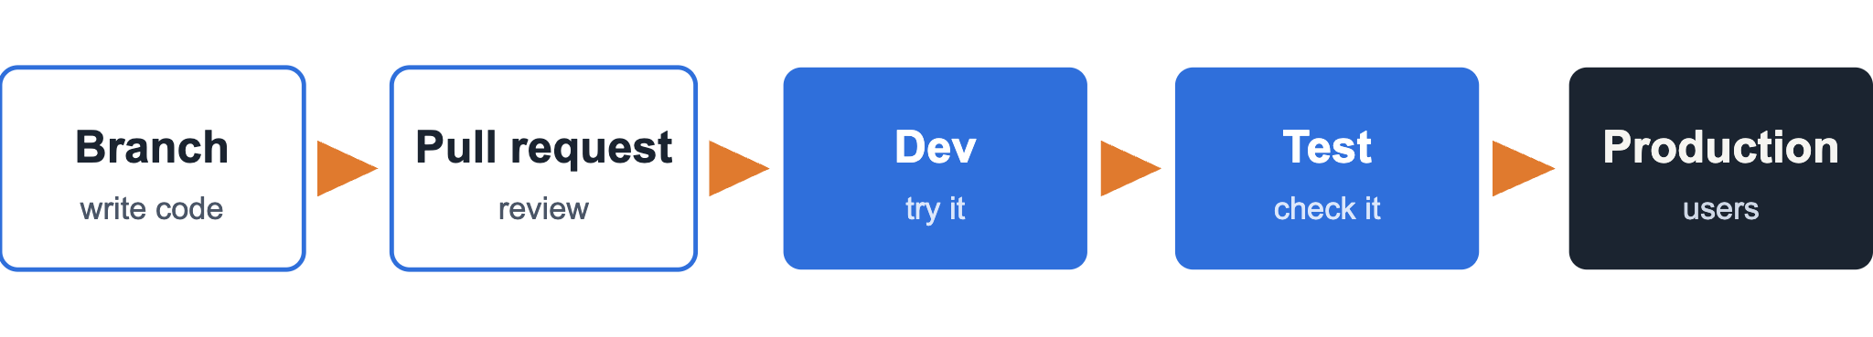
The SDLC: how code reaches production
Your project = dev
Team's project = production
Notes:
How companies ship: nobody edits production by hand. Code goes on a branch, a teammate reviews the pull request, then it's deployed through environments, each one closer to real users. Same Terraform, different project: that's why IaC matters. In session 10 we automate this with CI/CD: deploy on merge. Business context: what a bad deploy to production costs.

Slide 18
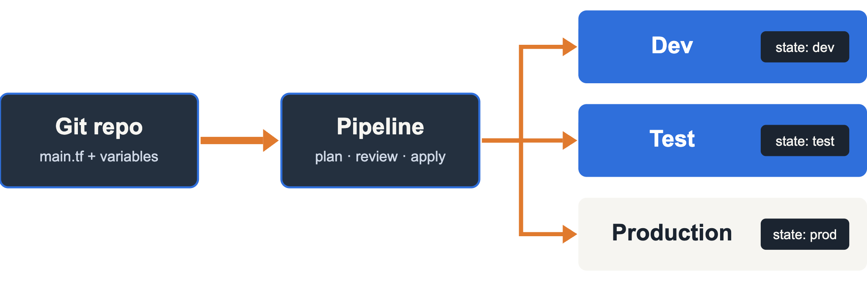
One repo, every environment
Same code · different variables · separate state
Notes:
This ties the last two slides together. The SDLC says code moves dev, test, production. IaC makes that safe: the same Terraform runs against each environment, only the variables change (project ID, sizes), and each environment keeps its own state so they never overwrite each other. A pipeline runs plan, someone reviews, then apply. In this module: everyone deploys the team repo to their own project as dev; the team's chosen project is production. We automate the pipeline in session 10.

Slide 19
Workshop: your first cloud project
1
2
3
4
Sign up for the GCP free trial
Set a €50 budget alert
Create a bucket with Terraform
Add your neighbour in IAM
CHECKPOINT
terraform apply works in your own project
Steps: setup/gcp.md and sessions/01 in the course repo
Notes:
55 minutes. Everyone works in their own account; pair up only for step 4. Step 3 uses the starter Terraform in sessions/01: copy terraform.tfvars.example to terraform.tfvars and set your project ID and your neighbour's email, then terraform init, plan, apply. Watch for: card verification failing (try another card or come back later), wrong project selected, forgetting terraform init. Tick off checkpoints as you walk round. Stretch: move Terraform state into a bucket.

Slide 20
Three things to take home
1
Cloud is rented compute, network and storage, on demand
2
Identity is the perimeter: least privilege, always
3
Infrastructure is code: same code, every environment
Next · Wednesday 18 November · Storing data in the cloud
Notes:
Recap the three points. Before Wednesday: make sure your GCP trial works and your budget alert is set; anyone stuck, message me on Teams. Wednesday we load freight rate files into Cloud Storage and BigQuery.

