Slide 1
Batch, streams
and architecture patterns
CLOUD COMPUTING AND DATA ARCHITECTURES · SESSION 3
Lambda, Kappa, and the platform you'll build
Friday 20 November 2026
Notes:
Today the module turns into a project: each of you gets a shipper profile today; teams form on Monday. First half: batch vs stream and the two classic architectures. Second half: you design your own platform.

Slide 2
Last time: storing data in the cloud
1
Pick storage by how the data will be read
You built
2
A raw zone with a month of data
A freight dataset in BigQuery
Partitioned, clustered tables
Three exec answers in SQL
Columns beat rows for analytics
3
In BigQuery, every byte scanned costs: partition it
Notes:
Warm-up: ask who found the cheapest ocean carrier, and who found the most reliable. Don't confirm the answers. If the room agrees they're different carriers, hold on to that: it's what today's shipper profiles are about. Quick check: why doesn't LIMIT reduce the bytes scanned?

Slide 3
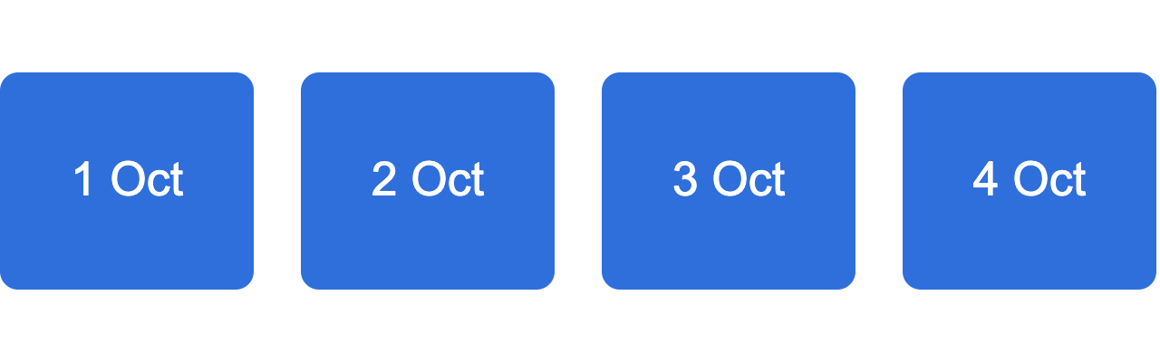
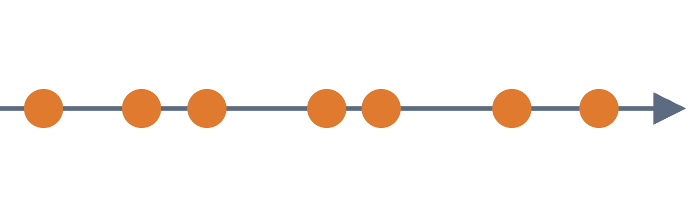
Batch and stream: bounded or unbounded
Batch
Stream
A known set of data. It ends.
Events keep arriving. It never ends.
Good at: complete, correct, cheap
Good at: fresh, reacts in seconds
Notes:
Batch: Wednesday's rate files, a day at a time, processed once the day is complete. Stream: shipment events, one at a time, as they happen. The two shipper questions from Monday: "where is my container right now" is a stream question; "what did we spend in Q3" is a batch question. Most real platforms need both.

Slide 4
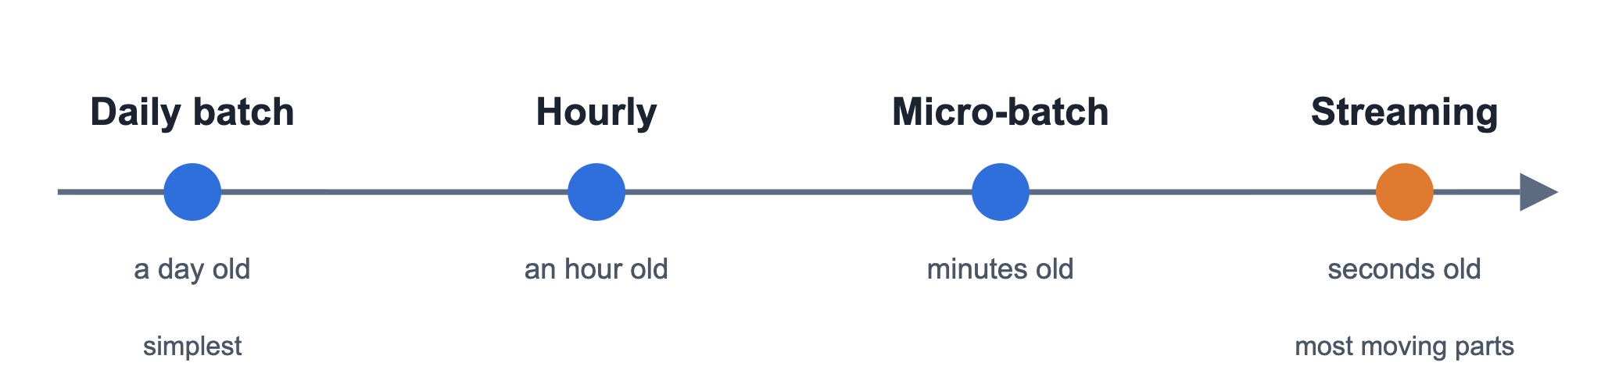
Fresher data costs more
Ask what freshness the user actually needs.
Notes:
Real-time is not free: always-on compute, harder testing, harder recovery. An exec spend report is fine a day old; a container delay alert is useless a day old. Your shipper's targets today put a number on this: e.g. ops data no more than 60 seconds old. Pick the slowest option that meets the target.

Slide 5
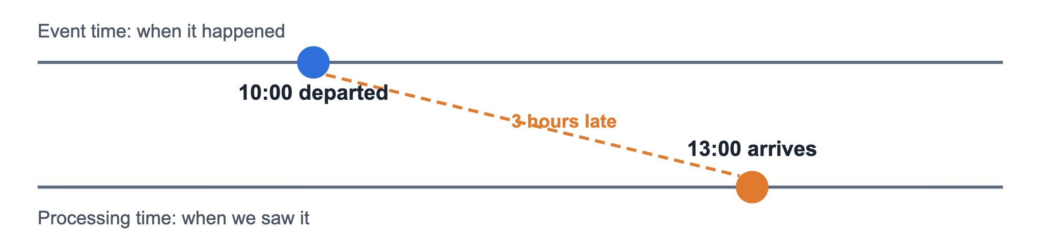
Event time vs processing time
Late and out-of-order data is what makes streaming hard.
Notes:
A ship loses connection mid-ocean and its events arrive hours later, out of order. If you count "departures per hour" by processing time, you get the wrong hour. Stream processors group by event time in windows, and decide how long to wait for stragglers (a watermark). We build this in Dataflow in session 7, and the generator can make late events on purpose.

Slide 6
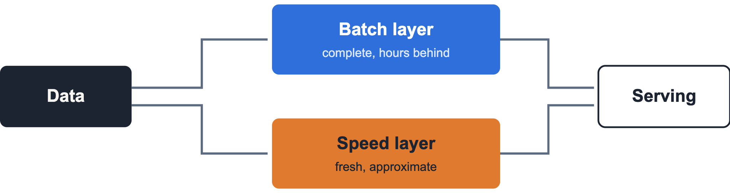
Lambda: two paths, one answer
+ Fresh and correct
− Same logic written twice
Notes:
Nathan Marz's pattern from around 2011. The batch layer recomputes everything from the full history; the speed layer covers the gap since the last batch run; the serving layer merges both. The catch: two codebases for one metric, and they drift apart. Example: delay per lane computed in SQL nightly and in a stream job live, with slightly different rules.

Slide 7
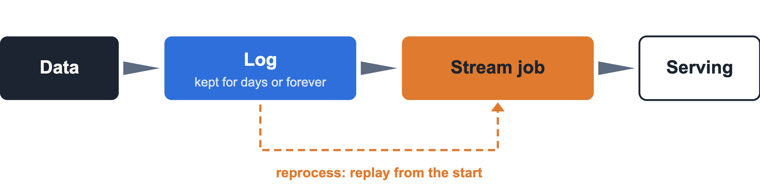
Kappa: one stream, replay to rebuild
+ One codebase
− Everything must stream
Notes:
Jay Kreps' answer to Lambda, 2014. Keep every event in a durable log like Kafka. One stream job computes everything. Need to fix a bug or add a metric? Start a new version of the job from the beginning of the log, let it catch up, switch over. You saw replay from an offset in the generator; we do it for real with Kafka in session 5. The cost: long retention, and some analytics are awkward as streams.

Slide 8
Which one, when
 | Lambda | Kappa
Code paths | Two | One
Reprocessing | Rerun the batch | Replay the log
Data arrives as | Files and events | Events
Hardest part | Keeping both in sync | Running a log well
Fits when | Sources are mixed | Everything is an event
Notes:
Neither is "the modern one": it depends on your sources. Freight is a good example of mixed sources: carriers still send rate sheets as files, while tracking arrives as events. Tools like Dataflow and Spark blur the line by running the same code in batch or streaming mode. Ask the room: which fits each of your shipper profiles, and why?

Slide 9
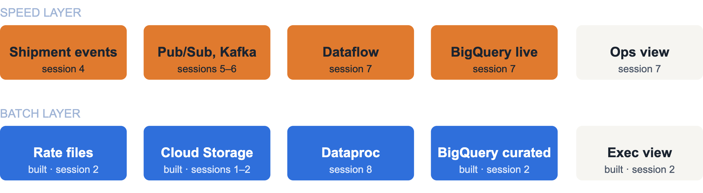
Your starting point: a Lambda platform
You've built the batch boxes marked built. The rest come session by session.
Notes:
This is the reference architecture everyone starts from. It's deliberately Lambda: tracking events stream because ops needs them live, rate files arrive daily because that's how carriers send them. The batch row is mostly built already: files, Cloud Storage, BigQuery and the exec SQL from Wednesday; Dataproc comes in session 8. The speed row starts Monday. Session 10 makes the whole thing production-ready. Your design today can change it, as long as you can justify the change for your shipper.

Slide 10
Architecture decision records: write down why
Context
Decision
Options
Consequences
What problem, what limits
What we chose
What else we considered
What gets easier, what harder
One page. One decision. Numbered, never deleted.
Notes:
Michael Nygard's format. In a year nobody remembers why you chose Kafka over Pub/Sub; the ADR does. They live in the repo next to the code: docs/adr/001-....md. Superseded decisions stay, marked superseded, so the history is readable. Your ADRs are the backbone of your 4-page report and what I'll question you on at the board.

Slide 11
Workshop: your first design
1
2
3
4
Get your shipper profile
Fork the course repo
Sketch architecture v1, write ADR 001
Build delay per lane in batch
CHECKPOINT
Diagram and ADR 001 in your fork
Steps: sessions/03 in the course repo
Notes:
Everyone works alone today. Hand out the shipper profiles first; three of you share each one, but design on your own. Most time goes on step 3. ADR 001 is the big one: Lambda, Kappa or something else for your shipper, and why. Step 4 is SQL on Wednesday's tables: average arrival delay per trade lane; you rebuild it as a stream in session 7. Walk round and challenge designs: what happens when a carrier's events are three hours late?

Slide 12
Three things to take home
1
Choose freshness by what the user needs, not what's possible
2
Lambda runs two paths; Kappa replays one log
3
Write down why: one decision, one ADR
Next · Monday 23 November · Docker and Kubernetes, and teams form
Notes:
Before Monday: your diagram and ADR 001 committed in your fork. On Monday the three of you with the same shipper become a team. You start by comparing your three designs and agreeing on one. Then we containerise the event generator and run it on Kubernetes.

