Slide 1
Storing data
in the cloud
CLOUD COMPUTING AND DATA ARCHITECTURES · SESSION 2
Object storage, file formats and BigQuery
Wednesday 18 November 2026
Notes:
Today: from Monday's empty bucket to answering business questions in SQL. Two halves: object storage and formats, then why warehouses exist and how BigQuery works.

Slide 2
Last time: from servers to the cloud
1
Cloud is rented compute, network and storage, on demand
You built
Your own GCP project
A budget alert
A bucket, with Terraform
Viewer access for a neighbour
2
Identity is the perimeter: least privilege, always
3
Infrastructure is code: same code, every environment
Notes:
Five-minute warm-up. Ask the room rather than tell: what's the difference between IaaS and PaaS? What's Terraform state, and why don't we commit it? Who is a service account for? Quick show of hands: whose terraform plan says No changes? Anyone who isn't there yet: pair them with someone who is.

Slide 3
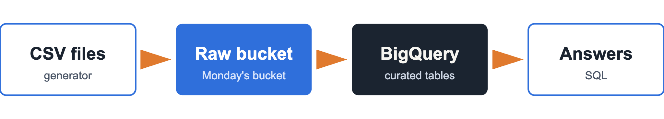
Today: from files to answers
Your raw zone already exists: <project-id>-raw
Notes:
Today's path: generate freight files, land them in the raw bucket, load them into BigQuery, answer exec questions in SQL.

Slide 4
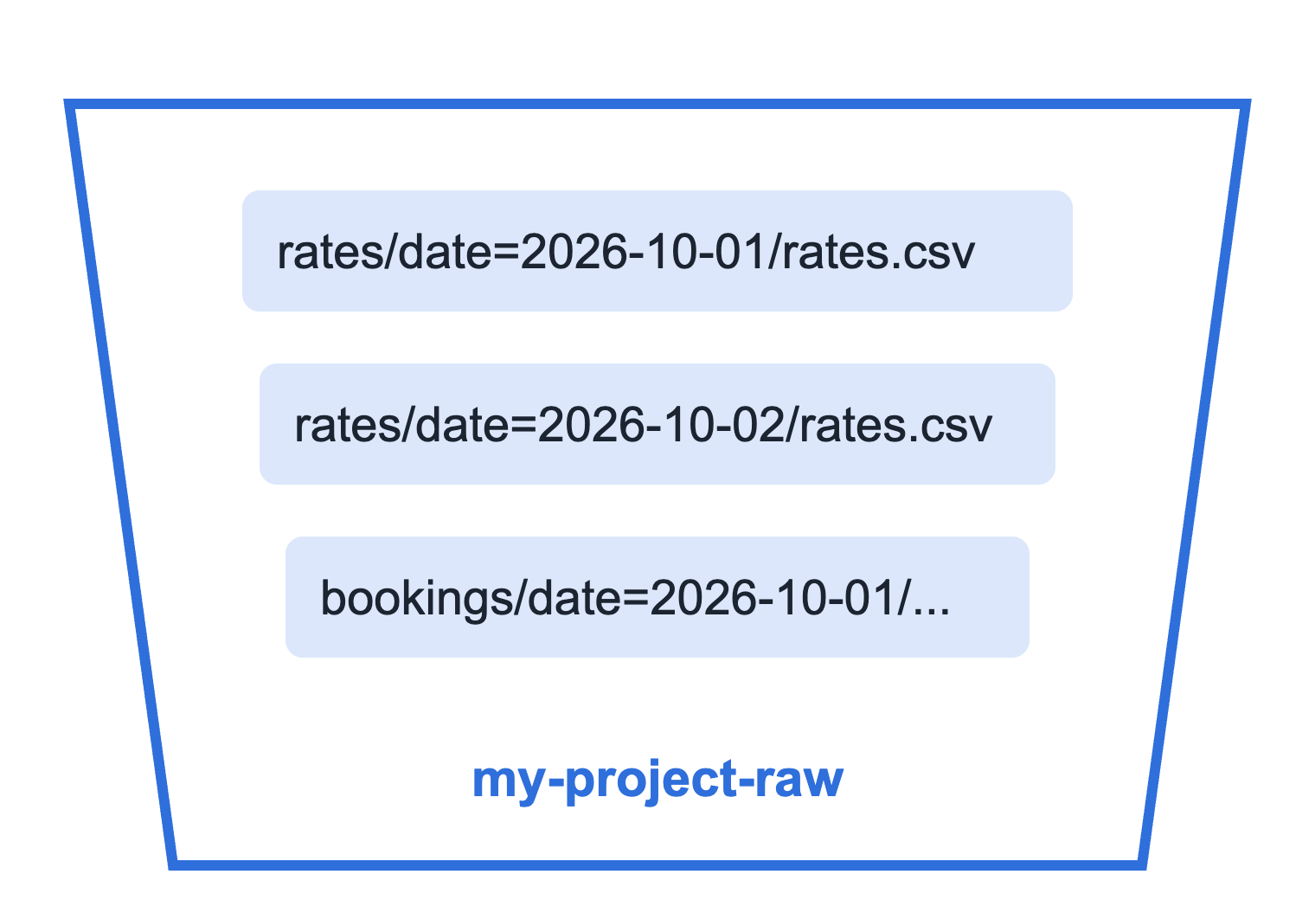
Object storage: buckets and keys
A flat namespace: no real folders
Write once, read many
Any size, practically unlimited
Built for very high durability
Notes:
A bucket is a flat list of objects; the slashes are just part of the key, the console shows them as folders. Objects are replaced, not edited in place. Google designs Cloud Storage for 99.999999999% (eleven nines) annual durability. The date= keys are a convention BigQuery and Spark understand as partitions: you'll see it in the generator output.

Slide 5
Storage classes: pay by how often you read
Class | Read it | Minimum stay | Storage cost
Standard | Often | None | Highest
Nearline | About monthly | 30 days | Lower
Coldline | About quarterly | 90 days | Lower still
Archive | Yearly or never | 365 days | Lowest
Colder = cheaper to keep, dearer to read.
Notes:
Same API, same speed to first byte for all four classes; the tradeoff is price. Colder classes charge for retrieval and have minimum storage durations: delete early and you pay for the rest. AWS equivalents: S3 Standard, Standard-IA, Glacier tiers. Check current prices on the GCS pricing page rather than quoting numbers.

Slide 6
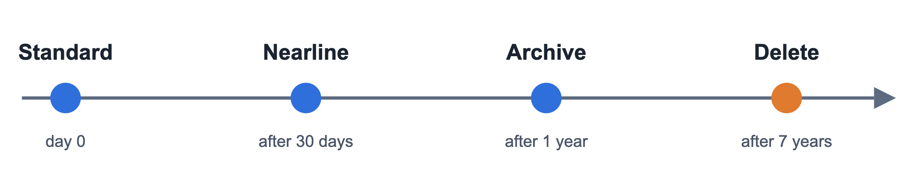
Lifecycle rules: set once, runs forever
Rules match on age, class, prefix and more.
Notes:
A lifecycle rule is a condition plus an action: if age is over 30 days, set class to Nearline. It runs automatically on every object. Raw files are rarely read again once loaded, so this saves real money at scale. The seven years is an example retention period: business and legal decide that, not engineering. This is the stretch task today, in Terraform.

Slide 7
File formats: rows or columns
Format | Layout | Schema | Good for
CSV | Rows, text | None | Exchanging data
JSON | Rows, text | Loose | Events, APIs
Avro | Rows, binary | Embedded | Streaming, writes
Parquet | Columns, compressed | Embedded | Analytics
Notes:
Our generator writes CSV because it's readable and universal, which is how most freight data actually arrives. But CSV has no types: is 2026-10-01 a date or a string? Parquet stores each column together and compressed, so a query reading two columns skips the rest. That idea is exactly how BigQuery stores tables, which is why the next slide matters.

Slide 8
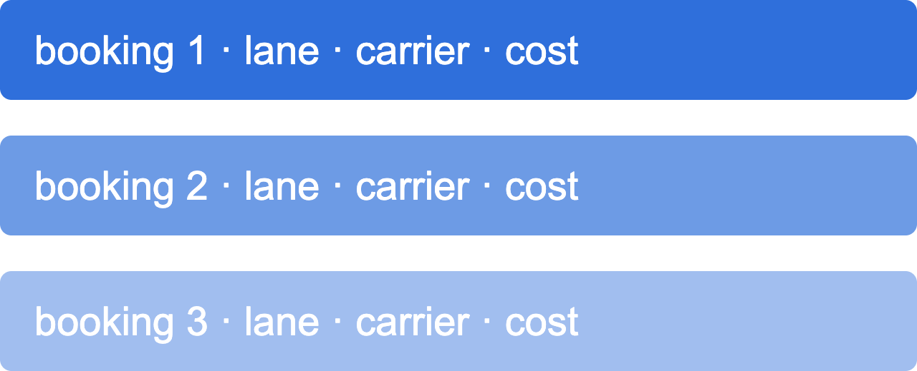
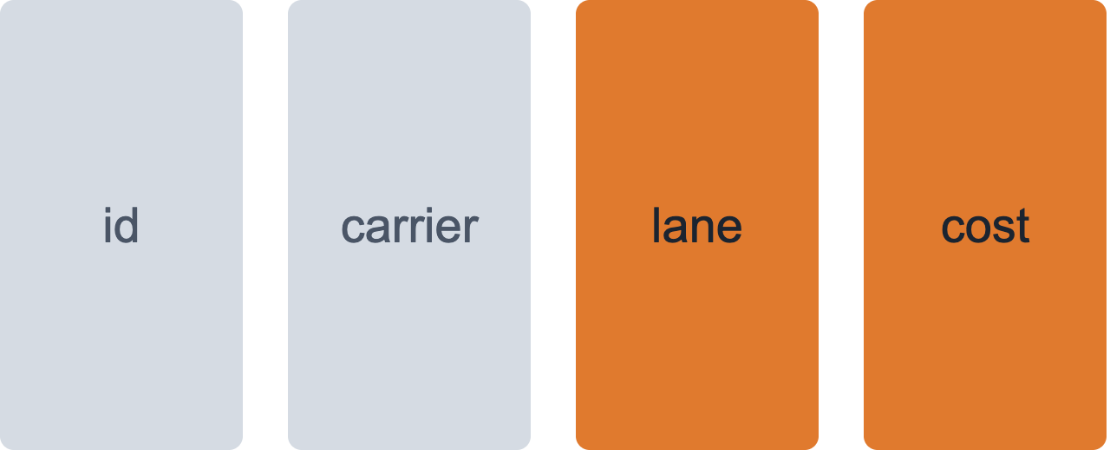
OLTP vs OLAP: two ways to store a table
OLTP · row store
OLAP · column store
Many small reads and writes
"Save this booking"
Few big scans of few columns
"Total spend per lane"
Use for: running the business: apps, orders, payments
Use for: understanding the business: reports, dashboards, ML
Notes:
Row stores (Postgres, Cloud SQL) keep each record together: perfect for fetching or updating one booking. Column stores keep each column together: to sum cost per lane you read just two columns (orange) and skip the rest. That's why we copy operational data into a warehouse instead of running analytics on the production database.

Slide 9
Lake, warehouse, lakehouse
Data lake
Warehouse
Lakehouse
Files in object storage
Typed tables, SQL
Table formats on files
Schema on read
Schema on write
Both, with transactions
Cloud Storage
BigQuery
Delta, Iceberg
Our platform: raw zone in the lake, curated zone in the warehouse.
Notes:
Lake: cheap, keeps everything in its original form, but nobody guarantees what's inside. Warehouse: clean typed tables, fast SQL, but you decide the structure up front. Lakehouse: open table formats like Delta Lake and Iceberg add tables and transactions on top of lake files; we meet Delta in Databricks in session 9. Students covered lakes and warehouses in data engineering, so keep this quick.

Slide 10

BigQuery: storage and compute apart
No servers, no clusters: you only write SQL.
Notes:
Classic warehouses bundle storage and compute in one cluster you size and pay for 24/7. BigQuery splits them: data sits in managed columnar storage (Google calls the file system Colossus), and each query borrows compute from a shared pool (the Dremel engine) over Google's network. Organised as project, dataset, table. This is the serverless end of the compute spectrum from Monday.

Slide 11
You pay for bytes scanned, not rows returned
SELECT *
FROM rates
LIMIT 10
SELECT trade_lane, rate_usd
FROM rates
WHERE rate_date = '2026-10-01'
Reads every column of every row
Reads two columns of one day*
Dry run first: BigQuery tells you the bytes before you run it.
* only if the table is partitioned by date. Next slide.
Notes:
On-demand pricing charges per TiB processed, with the first 1 TiB per month free, plus storage per GB. LIMIT doesn't reduce the scan: it trims the output after BigQuery has read everything. Show the dry run in the console: the query editor shows "This query will process X MB" before you click Run. Our data is small, so it stays free, but the habit is what matters at company scale.

Slide 12

Partitioning and clustering: scan less
Partition by date: skip whole days
Cluster by lane: skip blocks inside a day
Notes:
Partitioning splits the table into separate chunks, usually by a date column; a WHERE on that column prunes the rest. Clustering sorts data inside each partition by up to four columns, so filters on them skip blocks. In the workshop you'll dry-run the same query against an unpartitioned and a partitioned table and compare the bytes.

Slide 13
Workshop: freight data into BigQuery
1
2
3
4
Generate a month of freight data
Upload it to your raw bucket
Create tables with Terraform
Load, then dry-run and compare
CHECKPOINT
Three exec questions answered in SQL
Steps: sessions/02 in the course repo
Notes:
Work in Cloud Shell again. The three questions: total spend per trade lane last month; the cheapest ocean carrier on Asia-North Europe for a 40HC; the share of each ocean carrier's sailings that arrived no more than 24 hours late. Everyone uses seed 42, so answers match: easy to tick off. Stretch: lifecycle rule on the raw bucket in Terraform.

Slide 14
Three things to take home
1
Pick storage by how the data will be read
2
Columns beat rows for analytics
3
In BigQuery, every byte scanned costs: partition it
Next · Friday 20 November · Batch, streams and architecture patterns
Notes:
Recap. Before Friday: keep your BigQuery tables, Friday's batch metric builds on them. Friday we cover batch, streams, Lambda and Kappa, and each of you gets a shipper profile. Teams form on Monday.

