Slide 1
Digital Portfolio
STUDENT NAME: SHAM.R
REGISTER NO AND NMID: 20324U18060 and 22058105556B799BA7B438E1ECF9D204
DEPARTMENT: B.SC.COMPUTER SCIENCE
COLLEGE: Dr.M.G.R.CHOKALINGAM ARTS COLLEGE
TIRUVALLUVAR UNIVERSITY

Slide 2
PROJECT TITLE
Personal Branding Portfolio

Slide 3


AGENDA
Problem Statement
Project Overview
End Users
Tools and Technologies
Portfolio design and Layout
Features and Functionality
Results and Screenshots
Conclusion
Github Link
3/21/2024 Annual Review

Slide 4

PROBLEM STATEMENT
Lack of a clear professional identity among students.
Difficulty in showcasing skills and achievements effectively.
Increasing competition in job and internship opportunities.

Slide 5

PROJECT OVERVIEW
Portfolio highlighting resume, achievements, and skills.
Demonstrates academic, technical, and personal strengths.
Acts as a professional identity for career growth.

Slide 6

WHO ARE THE END USERS?
Recruiters & Employers (hiring decisions).
College placement officers.
Peers & mentors for collaboration.
Professional networks (LinkedIn, GitHub).

Slide 7

TOOLS AND TECHNIQUES
Resume builders (Canva, Overleaf, MS Word).
Portfolio websites (GitHub Pages, WordPress).
Design tools (Canva, Figma).
Professional networking platforms (LinkedIn).

Slide 8
POTFOLIO DESIGN AND LAYOUT
Sections: Resume, Skills, Achievements, Projects.
Clean, modern layout with visuals.
Easy navigation for recruiters.
8

Slide 9
FEATURES AND FUNCTIONALITY
Showcases academic & extracurricular achievements.
Highlights technical & soft skills.
Includes projects, certifications, and experiences.
Regularly updated to reflect growth.

Slide 10
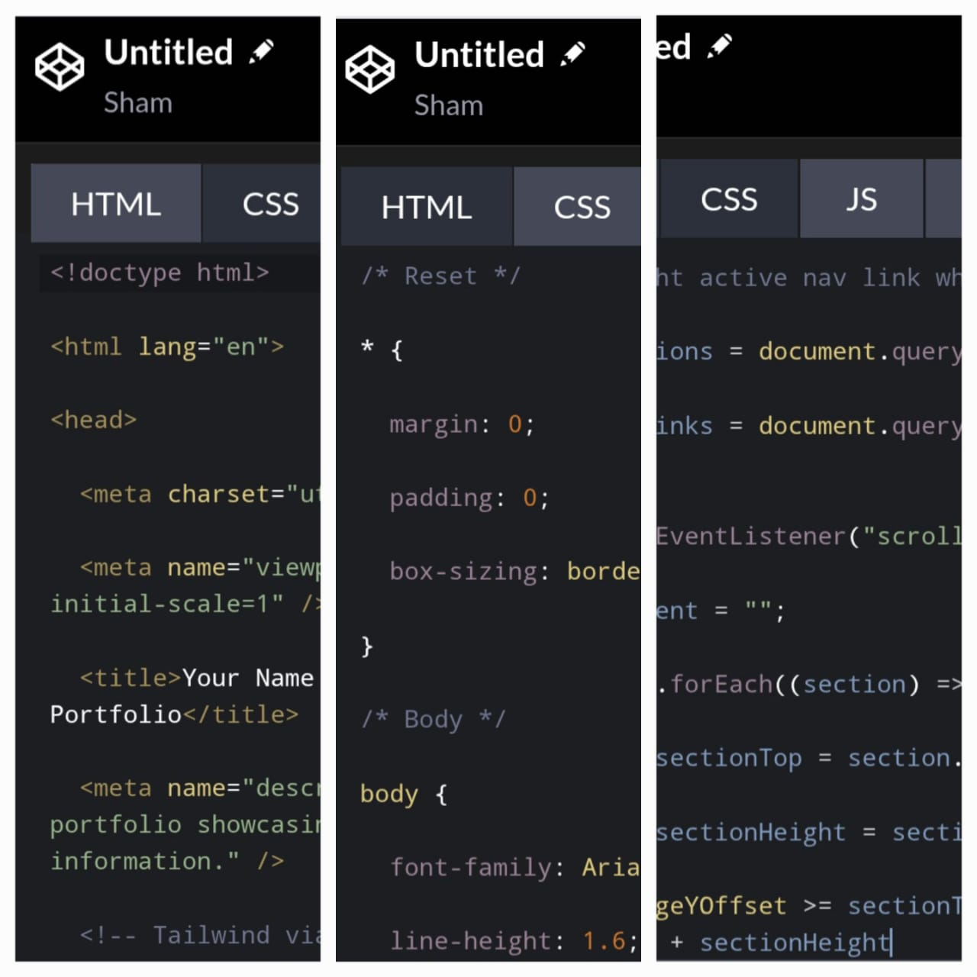

RESULTS AND SCREENSHOTS
3/21/2024 Annual Review
10

Slide 11
CONCLUSION
Personal branding portfolio builds professional identity.
Increases chances of recruitment & recognition.
Acts as a career development tool.
11

Slide 12
GITHUB LINK
https://github.com/sham20324u18060-jpg/Sham.git

