Slide 1






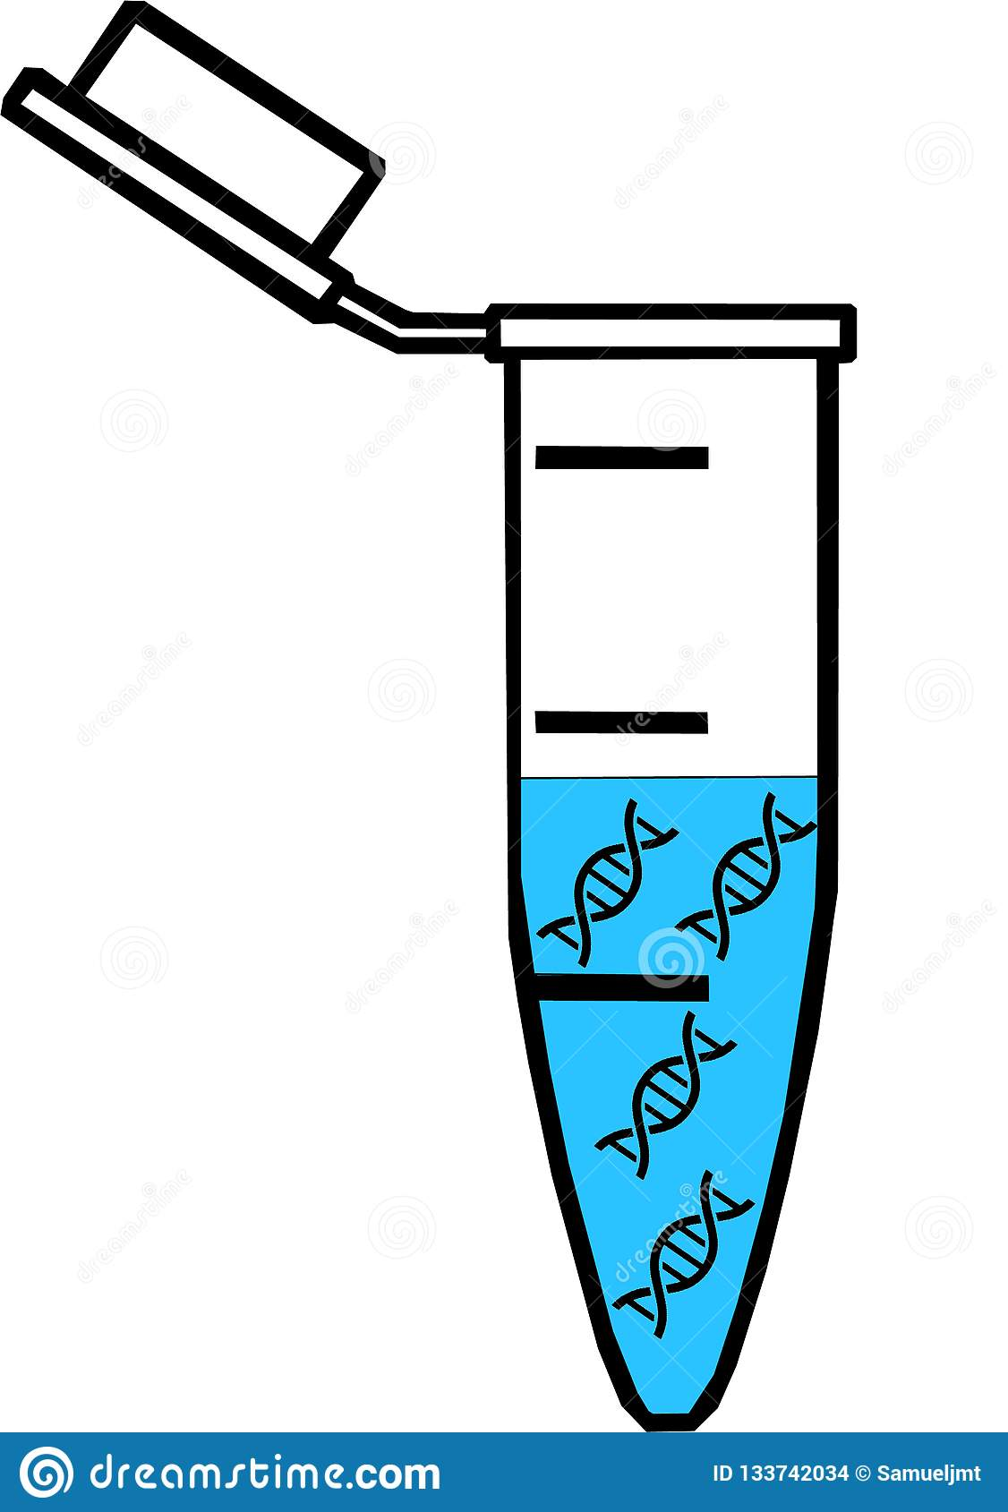
Control
Treatment
batch 1 batch 2 batch 3
batch 1 batch 2 batch 3
. . .
replicate 1
replicate 2
replicate 1
replicate 3
replicate 2
replicate 3

Slide 2
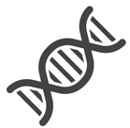

Wild type
Gene modified
Control
Treatment
Control
Treatment
batch 1 batch 2 batch 3
batch 1 batch 2 batch 3
batch 1 batch 2 batch 3
batch 1 batch 2 batch 3
. . .
smaple 1
sample 2
sample 3
smaple 1
sample 2
sample 3

Slide 3
Wild type
Gene modified
dose 1
dose 1
dose 2
dose 1
dose 2
dose 3
dose 2
dose 3
dose 1
dose 3

