Slide 1

Bengaluru– 560 038, Karnataka, INDIA
Presentation on
HOUSING PRICE PREDICTION
Submitted by:
ADITI GUPTA
Internal Guide
Khushboo Garg
Subject Matter Expert
Flip Robo Technologies,
Bengaluru
PGP Instructor
Dr. Deepika Sharma
Training Head
DataTrained, Bengaluru

Slide 2
Contents
Introduction
Problem statement
Objectives of the study
Literature review
Project execution
Results and discussions
Conclusions
Scope for future work

Slide 3
Introduction
Houses are one of the necessary need of each and every person around the globe and therefore housing and real estate market is one of the markets which is one of the major contributors in the world’s economy.
Data science comes as a very important tool to solve problems in the domain to help the companies increase their overall revenue, profits, improving their marketing strategies and focusing on changing trends in house sales and purchases. Predictive modelling, Market mix modelling, recommendation systems are some of the machine learning techniques used for achieving the business goals for housing companies.
This model will help to determine the price of houses with the available independent variables. This model will then be used by the management to understand how exactly the prices vary with the variables. They can accordingly manipulate the strategy of the firm and concentrate on areas that will yield high returns.

Slide 4
Statement of the problem
As we are working on the Housing project dataset we can easily understand that the data belongs to the Housing and Real Estate which will eventually involve several Financial, Costing, Are & Neighbourhood, Statistical, and Technical terms in the dataset. The company uses data analytics to purchase houses at a price below their actual values and flip them at a higher price. This model will help to determine the price of houses with the available independent variables. This model will then be used by the management to understand how exactly the prices vary with the variables. They can accordingly manipulate the strategy of the firm and concentrate on areas that will yield high returns.

Slide 5
Objectives of the study
Study & Exploratory Data Analysis (EDA) of House Price Prediction in dataset
To perform tasks of Summary Statistics & Correlation factor of the problem dataset.
To perform data pre-processing of the dataset and perform Mathematical/ Analytical Modeling of the Problem in order to train the model.
Formulate Model/s Development, Evaluation and Testing of Identified Approaches.
5. Visualizations , Interpretation of the Results and finalizing the model.

Slide 6
Literature Review
Chris Herbert et. Al., describes that household growth is now back from post-recession lows, but new home construction remains depressed, with additions to supply barely keeping pace with the number of new households. The most significant factors, however, are raising land prices and regulatory constraints on development. [Interactive Map] These constraints, largely imposed at the local level, raise costs and limit the number of homes that can be built in places where demand is highest.
Gordon Davis et. Al., describes that housing affordability is an economic and social problem that affects rich and poor countries alike. No respecter of nationalities or cultures, it arises whenever fewer units of housing are available for sale or rent, for whatever reasons - in a given price or rent range than the number of households looking to buy or rent that can afford housing at the given price or rent. In fact, housing affordability problems tend to migrate down the price/rent scale. Regardless of the price range where a housing shortage first arises, buyers in that price range will tend to bid up less expensive units, the end result being to drive the shortage to the lower end of the housing price range.

Slide 7
Literature Review
Nehal N Ghosalkar et. Al., describes that he real estate market is a standout amongst the most focused regarding pricing and keeps fluctuating. It is one of the prime fields to apply the ideas of machine learning on how to enhance and foresee the costs with high accuracy. There are three factors that influence the price of a house which includes physical conditions, concepts and location. The current framework includes estimating the price of houses without any expectations of market prices and cost increment. By breaking down past market patterns and value ranges, and coming advancements future costs will be anticipated. This examination means to predict house prices in the city with Linear Regression.
Elena Sliogeris et. Al., describes that incidence of the problem has spread from very low-income through low-income into moderate-income households. There is now a consistent call for housing schemes to retain ‘key workers’ and ‘the working poor’ in established areas to ensure access to employment, education, public transport and other facilities and amenities. Land com has a strategic position within this landscape and there exists a range of current and potential mechanisms land com might utilise to create and maintain a pool of affordable houses.

Slide 8
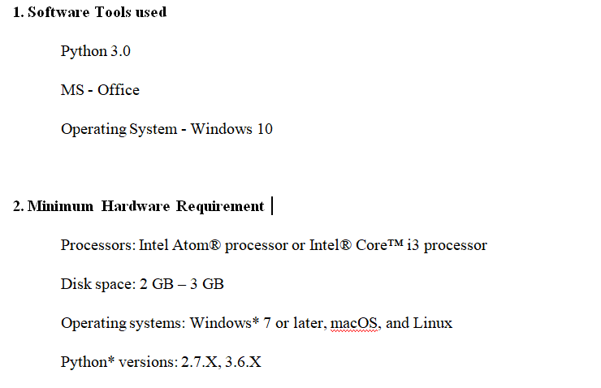
Hardware and Software Requirements and Tools Used

Slide 9
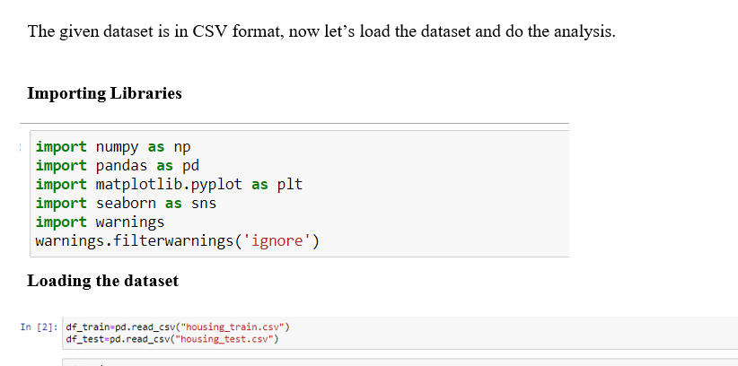
Working with the Dataset

Slide 10
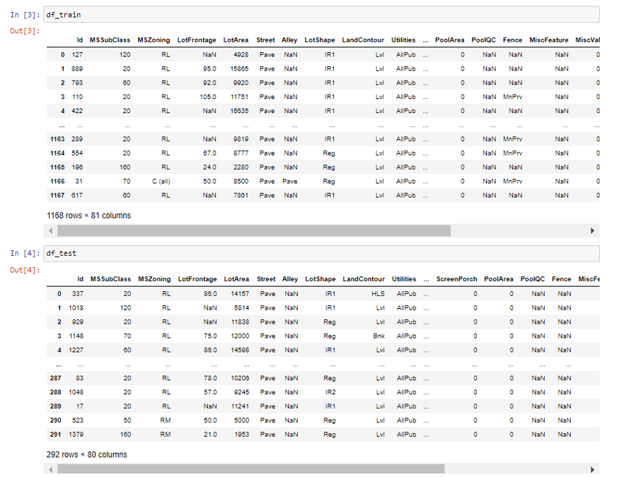

Slide 11
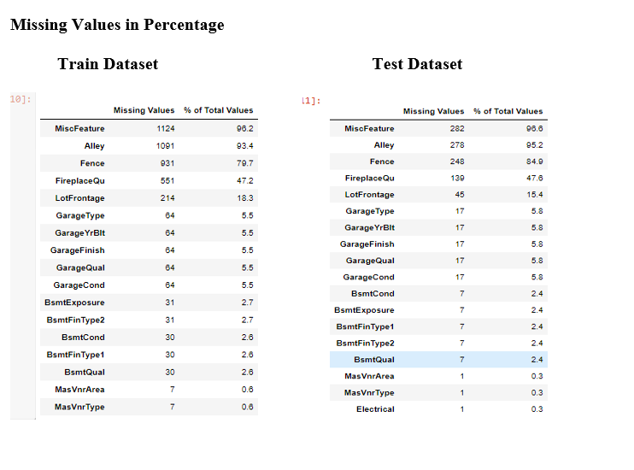
Checking the Null value

Slide 12
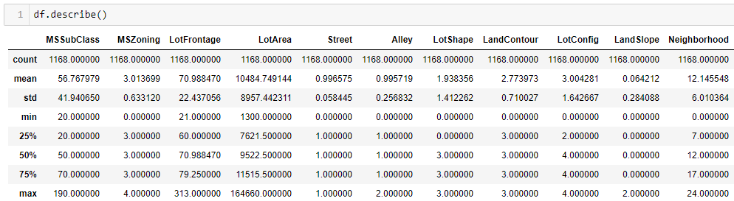
Summary Statistics
In descriptive statistics, summary statistics are used to summarize a set of observations, in order to communicate the largest amount of information as simply as possible. Summary statistics summarize and provide information about your sample data. It tells something about the values in data set. This includes where the average lies and whether the data is skewed.

Slide 13
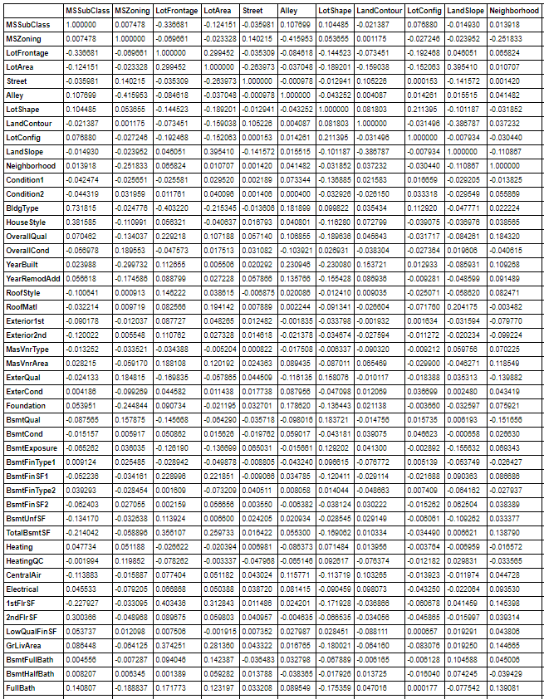
Correlation Factor
The statistical relationship between two variables is referred to as their correlation. The correlation factor represents the relation between columns in a given dataset.

Slide 14
Correlation Matirx
A correlation can be positive, meaning both variables are moving in the same direction or it can be negative, meaning that when one variable's value increasing, the other variable’s value is decreasing.
A correlation matrix is a tabular data representing the ‘correlations’ between pairs of variables in a given dataset. It is also a very important pre-processing step in Machine Learning pipelines. The Correlation matrix is a data analysis representation that is used to summarize data to understand the relationship between various different variables of the given dataset.

Slide 15
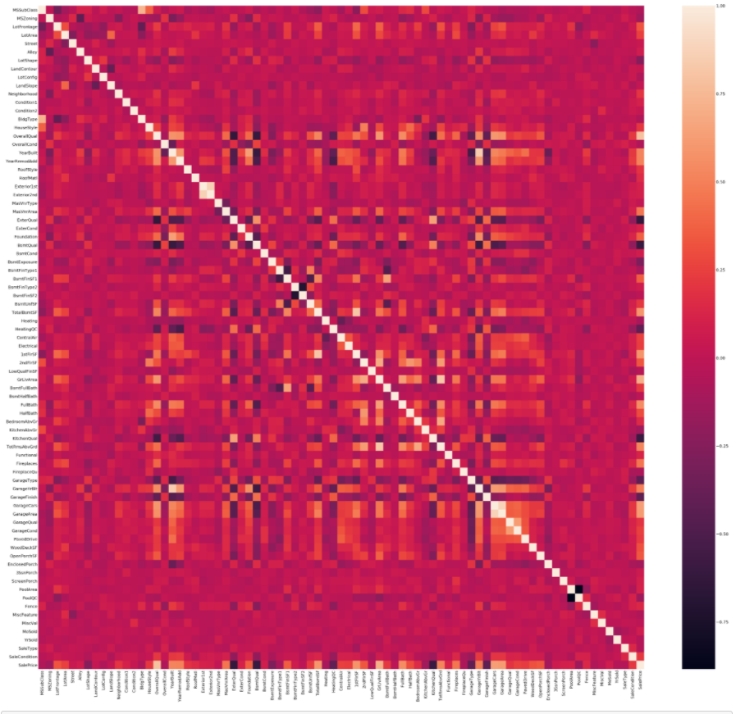
Correlation factor with visualization

Slide 16
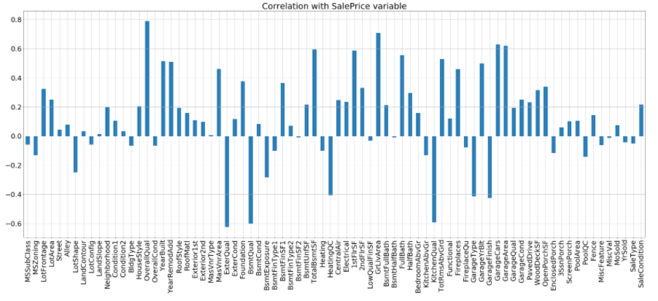
Correlation with target column (label)
Observation
In the Correlation with output column graph we can see that columns “LotShape, ExterQual, BsmtQual, BsmtExposure, HeatingQC” are negatively related with the Output column.
Also the columns “KitchenQual, GarageType, GarageFinish” are negatively related with the Output column.
All other columns are positively related with the output column and provide significant importance towards the model building.
4. However as we are predicting the price of Housing project and predicting the price of
Test dataset, the negatively co related columns are not dropped from the dataset.

Slide 17
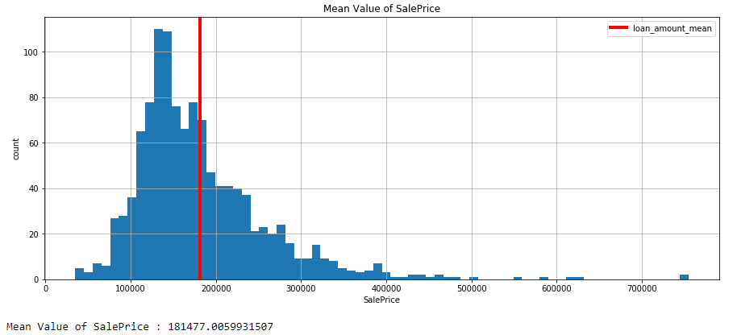
Data Visualization
Observation
The mean value of SalePrice column for the House Price Detection Train dataset is 181477.00599

Slide 18
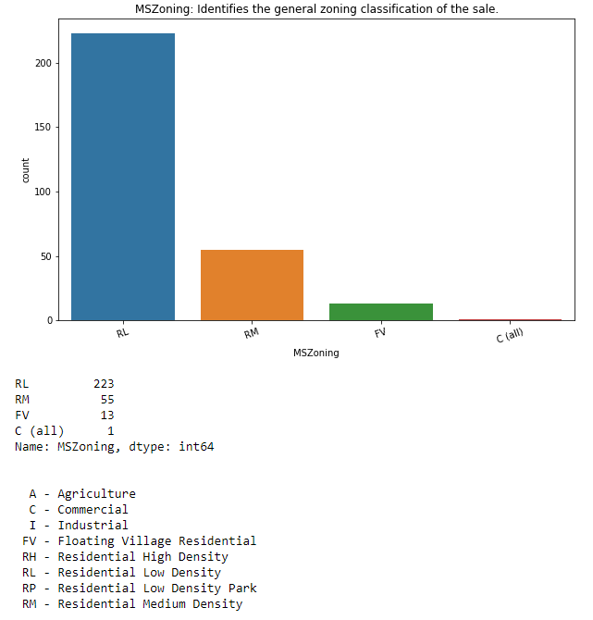
Identifying the general zoning classification of the sale

Slide 19
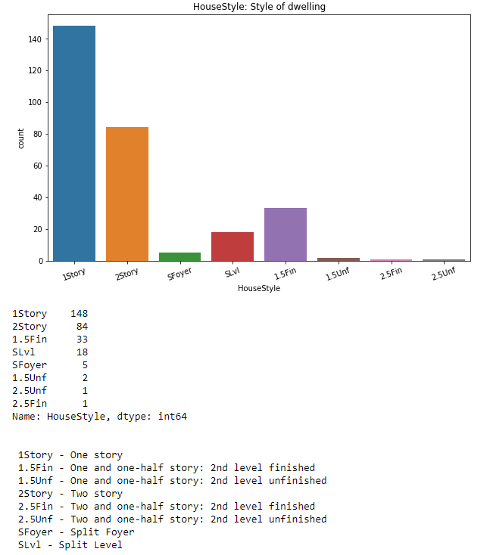
Graphical representation of “HouseStyle" column

Slide 20
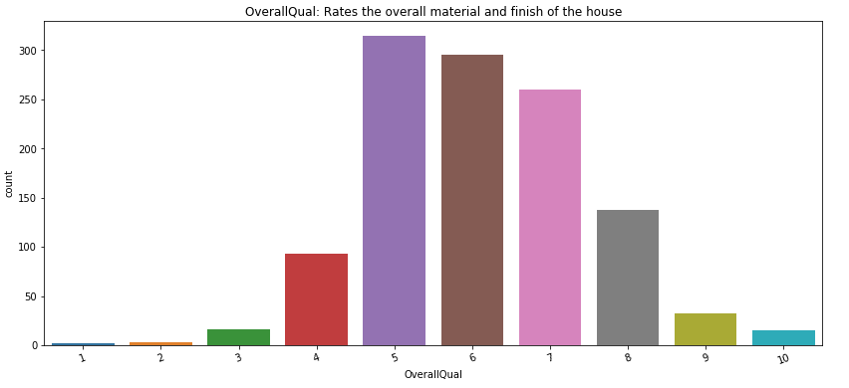
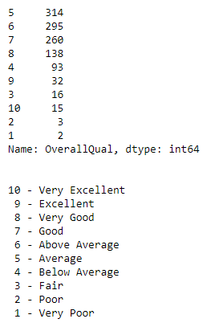
Graphical representation of “OverallQual" column

Slide 21
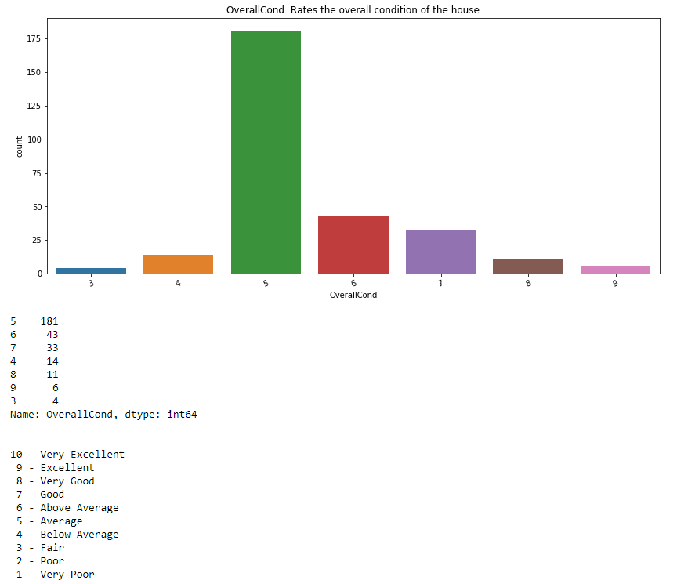
Graphical representation of “OverallCond" column

Slide 22
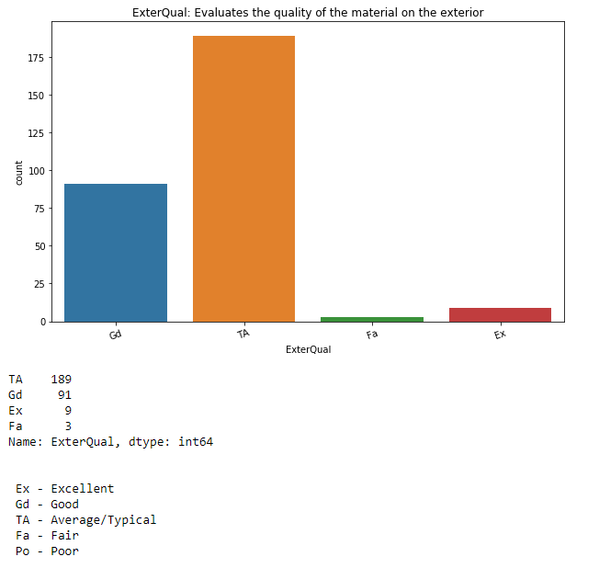
Graphical representation of “ExterQual" column

Slide 23
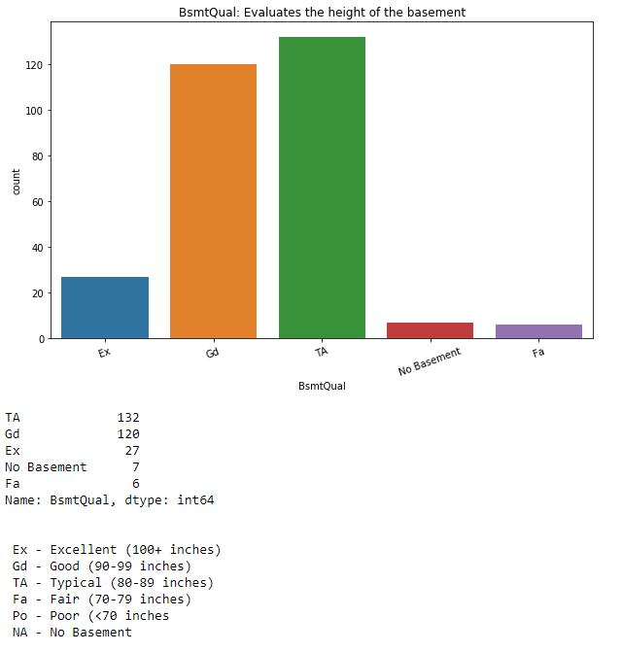
Graphical representation of "BsmtQual" column

Slide 24
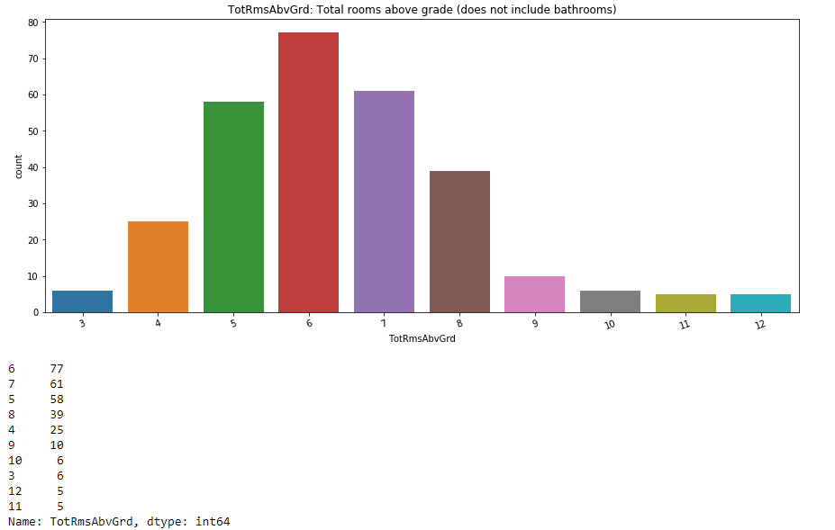
Graphical representation of “TotRmsAbvGrd" column

Slide 25
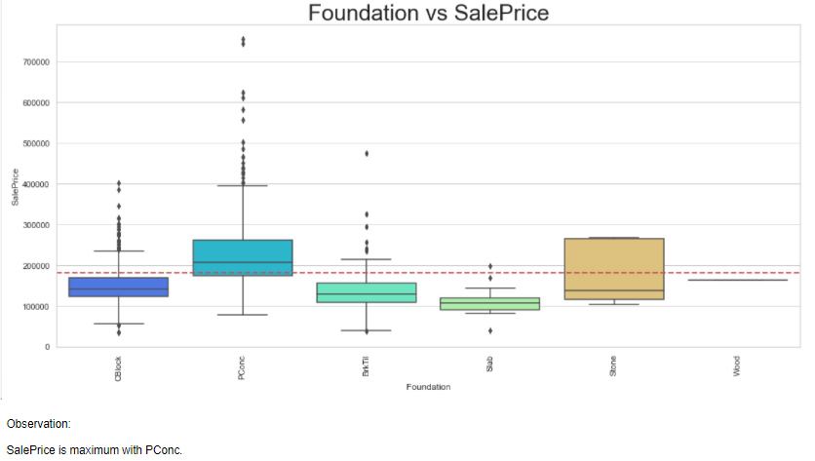
Graphical representation of “Foundation Vs Target" column

Slide 26
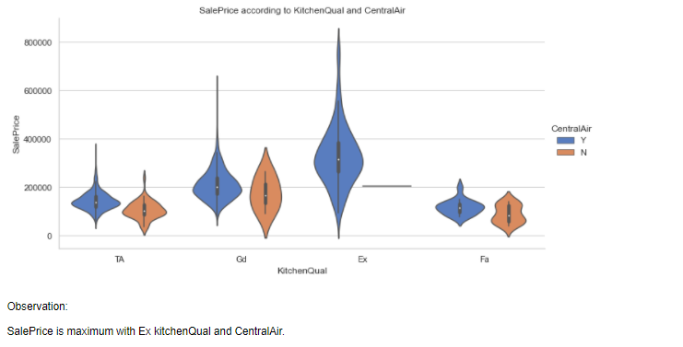
Graphical representation of “TotRmsAbvGrd" column

Slide 27
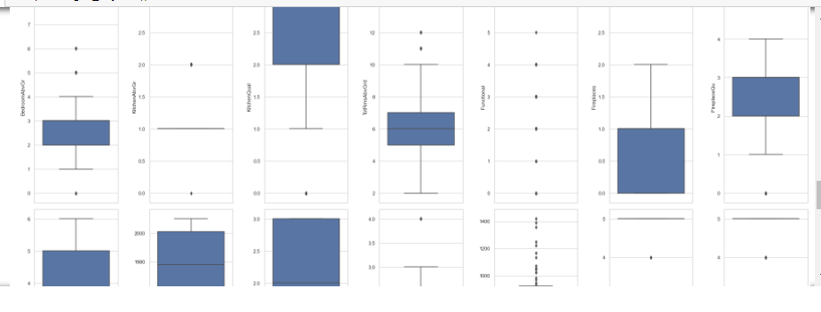
Plotting Outliers
An outlier is a data point in a data set which is distant or far from all other observations available. It is a data point which lies outside the overall distribution which is available in the dataset. In most cases a threshold of 3 or -3 is used i.e if the Z-score value is higher than or less than 3 or -3 respectively, that particular data point will be identified as outlier.

Slide 28
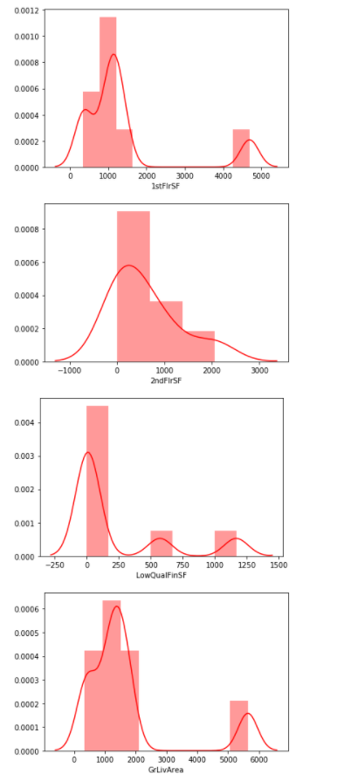
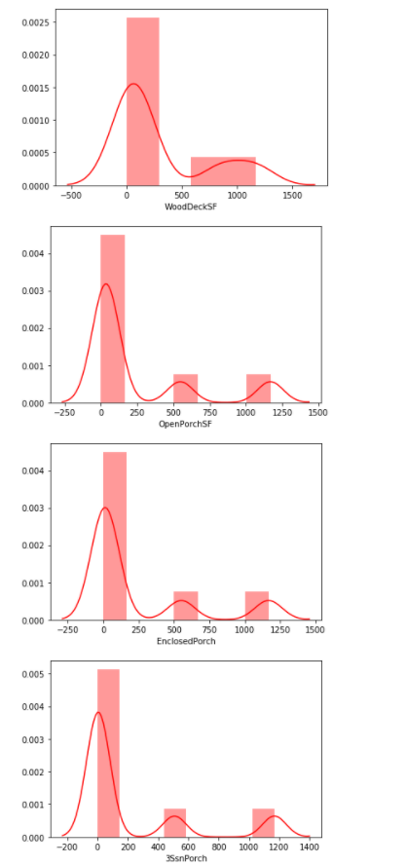
Skewness
Skewness refers to distortion or asymmetry in a symmetrical bell curve, or normal distribution in a set of data. Besides positive and negative skew, distributions can also be said to have zero or undefined skew. The skewness value can be positive, zero, negative, or undefined.

Slide 29
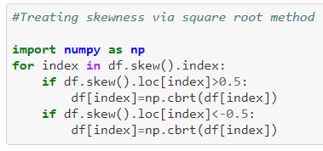
Treaing Skewness via Square root method
The square root, x to x^(1/2) = sqrt(x), is a transformation with a moderate effect on distribution shape: it is weaker than the logarithm and the cube root. So applying a square root transform inflates smaller numbers but stabilises bigger ones. The square root of an area has the units of a length. It is commonly applied to counted data, especially if the values are mostly rather small.

Slide 30
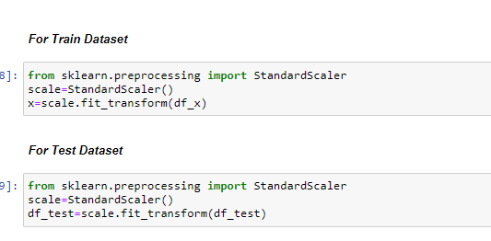
Scaling Input Variables
StandardScaler –
For each value in a feature, StandardScaler subtracts the minimum value in the feature and then divides by the range. The range is the difference between the original maximum and original minimum. StandardScaler preserves the shape of the original distribution.
Transform features by scaling each feature to a given range. This estimator scales and translates each feature individually such that it is in the given range on the training set, e.g. between zero and one. For every feature, the minimum value of that feature gets transformed into a 0, the maximum value gets transformed into a 1, and every other value gets transformed into a decimal between 0 and 1.

Slide 31
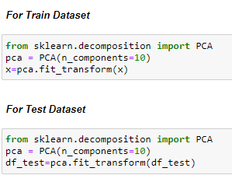

Applying PCA
Principal Component Analysis
It is an important machine learning method for dimentionality reduction. It uses simple matrix operations from linear algebra and statistics to calculate a projection of original data into same or fewer dimentions.
Splitting Input Variables
Train_Test_Split
It is a function in Sklearn model selection for splitting data arrays into two subsets: for training data and for testing data. The train_test_split function is for splitting a single dataset for two different purposes: training and testing. The testing subset is for building your model. The testing subset is for using the model on unknown data to evaluate the performance of the model.

Slide 32
Model/s Development and Evaluation
From the given Train & Test dataset it can be concluded that it is a Regression problem as the output column “SalePrice” has countinuous output. So for further analysis of the problem we have to import or call out the Regression related libraries in Python work frame.
The important machine learning libraries are.
Linear Regression
Lasso
Ridge
ElasticNet
KNeighborsRegressor
Decision Tree Regressor
Random Forest Regressor
Ada Boost Regressor
GradientBoosting Regressor
ExtraTrees Regressor
XGBoost Regressor

Slide 33

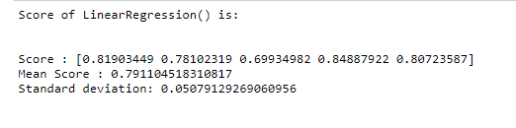
Linear Regression
Linear regression –
It is a linear model, e.g. a model that assumes a linear relationship between the input variables (x) and the single output variable (y). More specifically, that y can be calculated from a linear combination of the input variables (x). In statistics, linear regression is a linear approach to modelling the relationship between a scalar response and one or more explanatory variables. The case of one explanatory variable is called simple linear regression; for more than one, the process is called multiple linear regressions.
Cross Validation

Slide 34
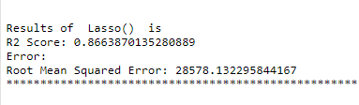
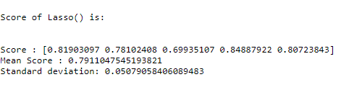
Lasso
Lasso
Lasso regression is a type of linear regression that uses shrinkage. Shrinkage is where data values are shrunk towards a central point, like the mean. The lasso procedure encourages simple, sparse models (i.e. models with fewer parameters). This particular type of regression is well-suited for models showing high levels of muticollinearity or when you want to automate certain parts of model selection, like variable selection/parameter elimination.
Cross Validation

Slide 35
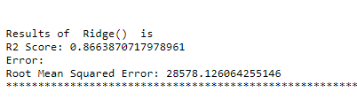
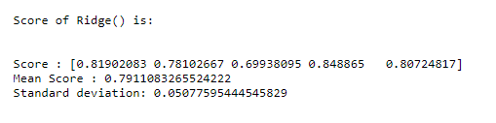
Ridge
Ridge
The regression is a way to create a parsimonious model when the number of predictor variables in a set exceeds the number of observations, or when a data set has multicollinearity (correlations between predictor variables). Ridge regression is particularly useful to mitigate the problem of multicollinearity in linear regression, which commonly occurs in models with large numbers of parameters
Cross Validation

Slide 36
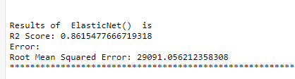
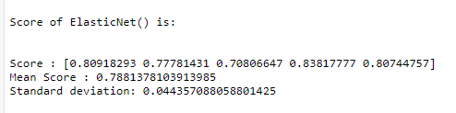
Elastic Net
Elastic Net
It is a popular type of regularized linear regression that combines two popular penalties, specifically the L1 and L2 penalty functions. Elastic net linear regression uses the penalties from both the lasso and ridge techniques to regularize regression models. The technique combines both the lasso and ridge regression methods by learning from their shortcomings to improve on the regularization of statistical models.
Cross Validation

Slide 37
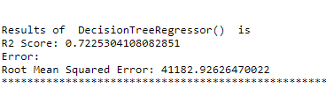
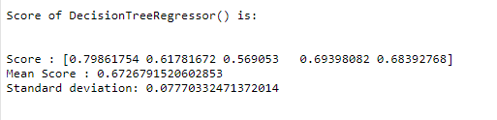
Decision Tree Regressor
Decision Tree
Decision Tree is one of the most commonly used, practical approaches for supervised learning. It can be used to solve both Regression and Classification tasks with the latter being put more into practical application. It is a tree-structured classifier with three types of nodes.
Cross Validation

Slide 38
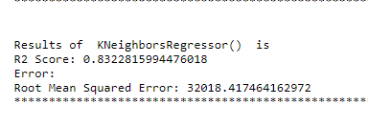
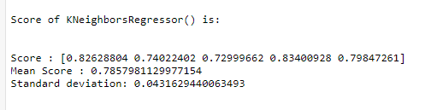
KNeighbors
KNeighbors
KNN algorithm can be used for both classification and regression problems. The KNN algorithm uses 'feature similarity' to predict the values of any new data points. This means that the new point is assigned a value based on how closely it resembles the points in the training set.
Cross Validation

Slide 39

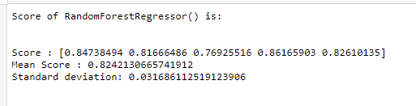
Random Forest Regressor
Random Forest Regressor
It is a meta estimator that fits a number of classifying decision trees on various sub-samples of the dataset and uses averaging to improve the predictive accuracy and control over-fitting. A Random Forest's nonlinear nature can give it a leg up over linear algorithms, making it a great option. The algorithm operates by constructing a multitude of decision trees at training time and outputting the mean/mode of prediction of the individual trees.
Cross Validation

Slide 40
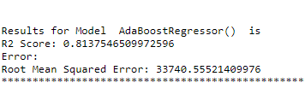
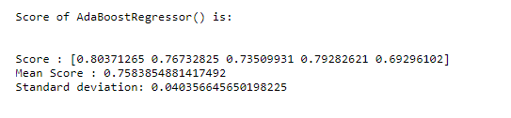
AdaBoost Regressor
AdaBoost Regressor
It is a meta-estimator that begins by fitting a regressor on the original dataset and then fits additional copies of the regressor on the same dataset but where the weights of instances are adjusted according to the error of the current prediction.
Cross Validation

Slide 41
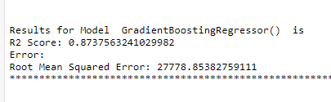
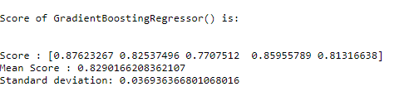
GradientBoosting Regressor
GradientBoosting Regressor
GB builds an additive model in a forward stage-wise fashion; it allows for the optimization of arbitrary differentiable loss functions. In each stage a regression tree is fit on the negative gradient of the given loss function.
Cross Validation

Slide 42
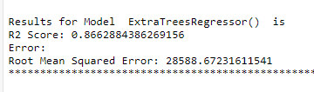
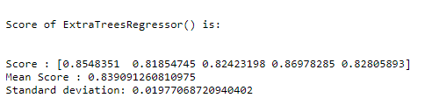
ExtraTrees Regressor
ExtraTrees Regressor
This class implements a meta estimator that fits a number of randomized decision trees (a.k.a. extra-trees) on various sub-samples of the dataset and uses averaging to improve the predictive accuracy and control over-fitting.
Cross Validation

Slide 43
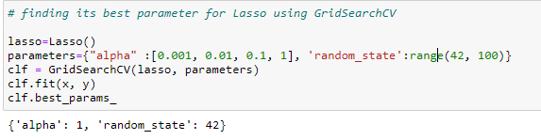
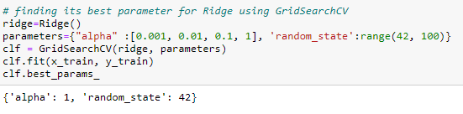
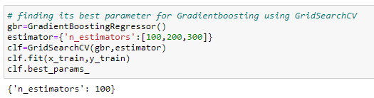
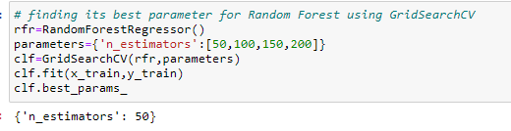
GridSearch CV
Grid search is an approach to hyper parameter tuning that will methodically build and evaluate a model for each combination of algorithm parameters specified in a grid.
We have used this for 4 high scoring models.

Slide 44
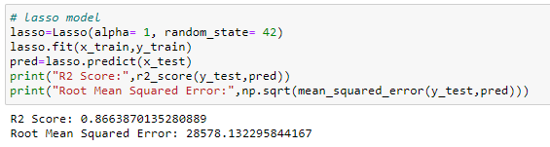
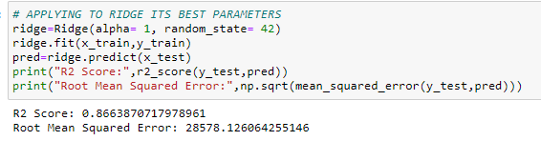
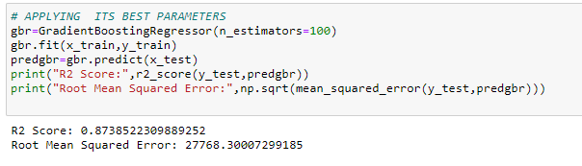

Applying Results of GridSearch CV

Slide 45


Choosing the Best Model
The GradientBoosting Regressor is working best and can be considered as finalised model to predict the Test dataset price.

Slide 46

Predicting for Test Data

Slide 47
Conclusion
The GradientBoosting Regressor model is working with highest R2 score of 87.385.
The cross_val_score of model is 0.83299359 which again show that cross val score is better compared to other models in the table.
All these points prove that GradientBoosting Regressor model is working best and can be considered as finalised model.

Slide 48
Learning Outcomes of the Study in respect of Data Science
Price Prediction modeling – This allows predicting the prices of houses & how they are varying in nature considering the different factors affecting the prices in the real time scenarios.
Prediction of Sale Price – This helps to predict the future revenues based on inputs from the past and different types of factors related to real estate & property related cases. This is best done using predictive data analytics to calculate the future values of houses. This helps in segregating houses, identifying the ones with high future value, and investing more resources on them.
Deployment of ML models – The Machine learning models can also predict the houses depending upon the needs of the buyers and recommend them, so customers can make final decisions as per the needs.

Slide 49

Limitations of this work and Scope for Future Work
The biggest limitation I observed was that not all categories of a particular feature were available in the training data. So if there were new category in the test data the model would not be able to identify that.
Example : All 8 categories in MSZoning are:
However in the Training dataset only 5 categories are present …what happen if other 3 categories will present in test data in future. It would be difficult for machine to identify and predict.

Slide 50
References
State of the Nation’s housing report – US housing supply falls short of what is needed – Chris Herbert
Affordable Housing in the United States - By Gordon Davis, Jaime Bordenave, Roger Williams, Richard A. Hanson, and Richard Shields - June 12, 2006
Real Estate Value Prediction Using Linear Regression - Nehal N Ghosalkar, Sudhir N Dhage
Housing Affordability Literature Review and Affordable Housing Program Audit - Elena Sliogeris, Louise Crabtree, Peter Phibbs and Kate Johnston
Social Housing Finance in Australia as a Missing or Incomplete Market - George Earl, Judy Kraatz, Benjamin Liu, Sherif Mohamed, Eduardo Roca.
Investment in Social Housing Finance in Australia - Nirodha Jayawardena & Griffith University, Australia

Slide 51
THANK YOU

