Slide 1

Malignant Comments Prediction
Submitted by,
Ekansh Gupta

Slide 2
PROBLEM STATEMENT
Different Social media online platforms allows users to express their views in the form of comments across the globe. In addition to this online platforms also suffers with involvement of unexpected comments which can be describe/categorized as abusive language, aggression, cyberbullying, hatefulness and many others making the platform uncomfortable for most of the users.
This problem is to prepare a model which can identify and tag unexpected comments on social media platforms by categorizing them as hateful , abusive , malignant ,loathe ,threat.

Slide 3
EDA Steps
Checking data types of each features using dataframe.info() function and shape of the dataset.
Pointing out irrelevant features in dataset.
Viewing the distribution of each labels using seaborn barplot , only for abnormal comments to get insights of abnormal comments data.
Viewing the distribution of multilabel count using barplot.
Displaying word cloud for each target label to view kind of words present I each target.
Addition of new features like length (before preprocessing ) and cleaned_length (after preprocessing) to get an idea on the total length of the text.
Finding and removing of irrelevant words from text using regex ,nltk.
Addition of features like all_label_count which contain addition of all labes of each comment. This helped to visualize number of label commets belonged to .

Slide 4
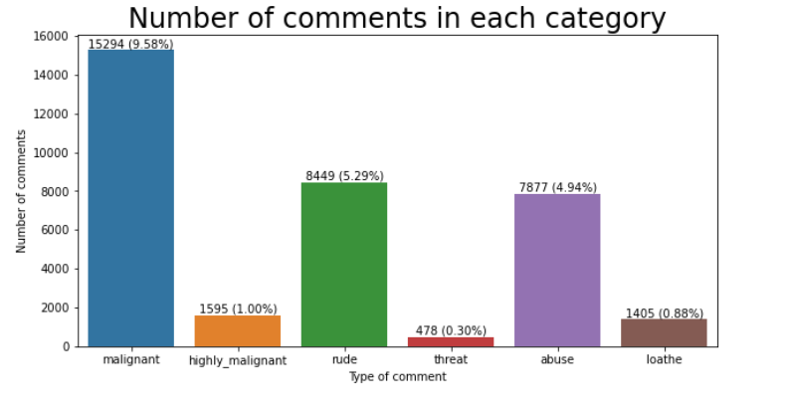
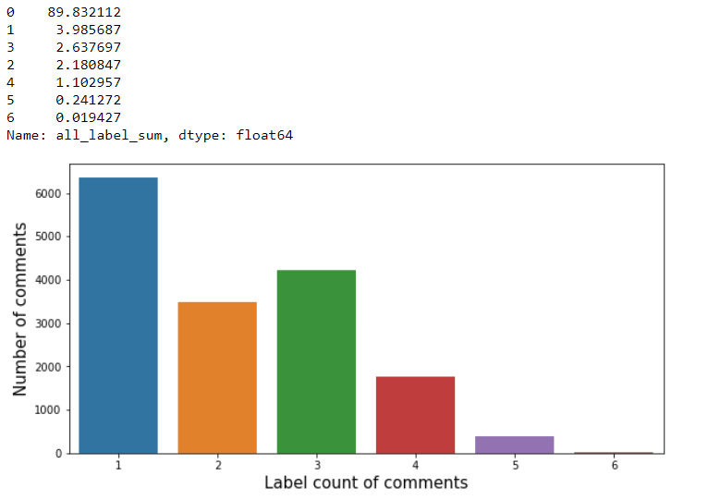
Visualizations done during EDA

Slide 5
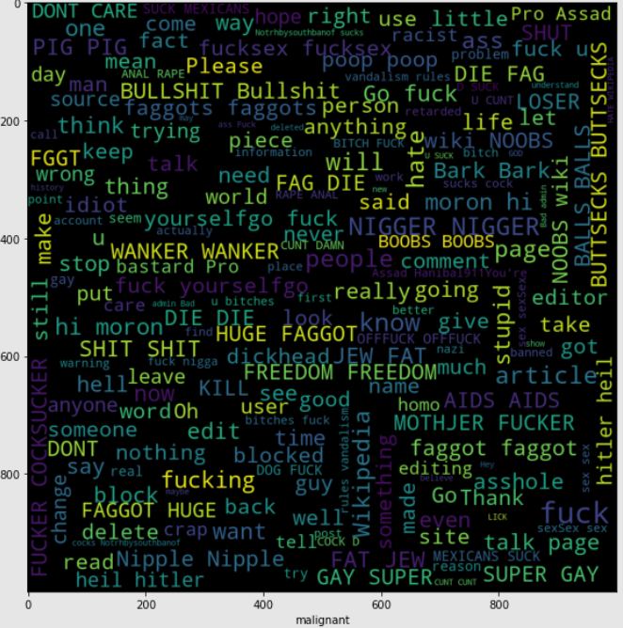
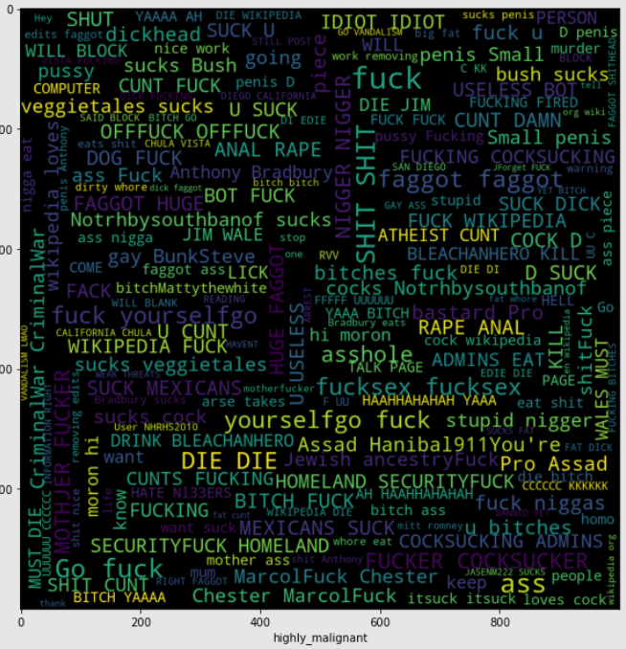
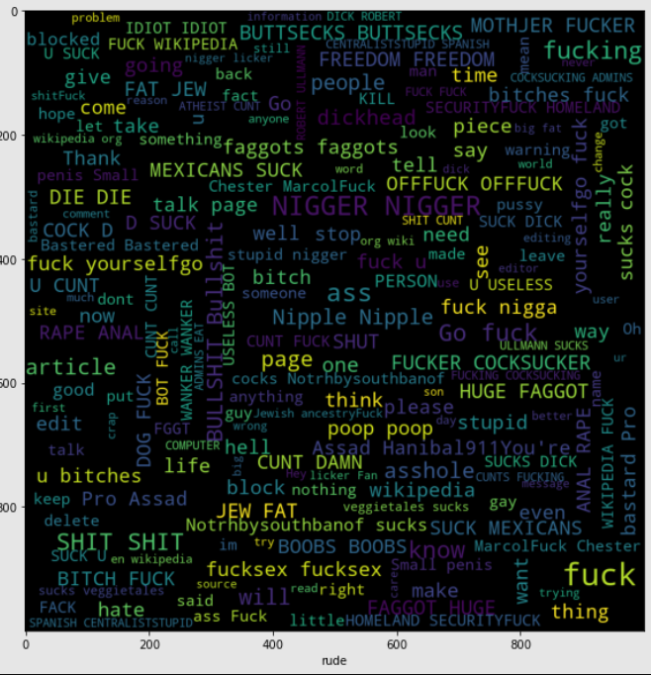
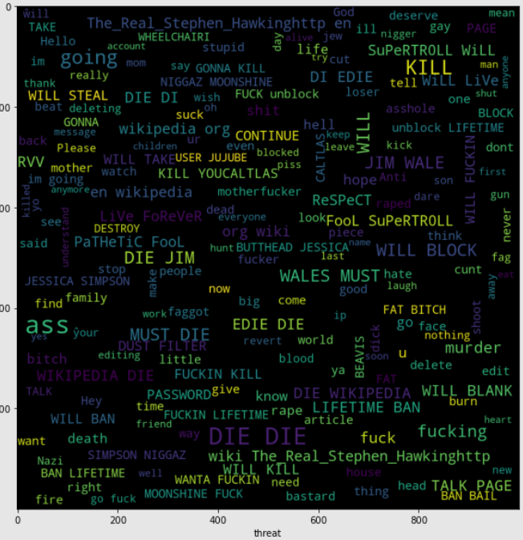
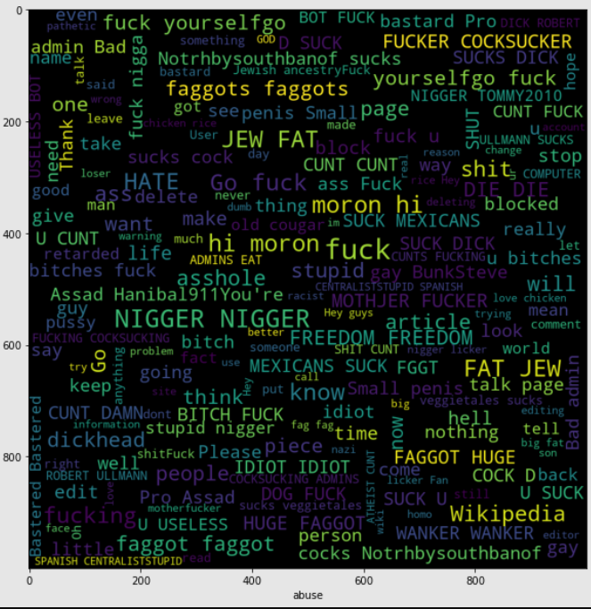
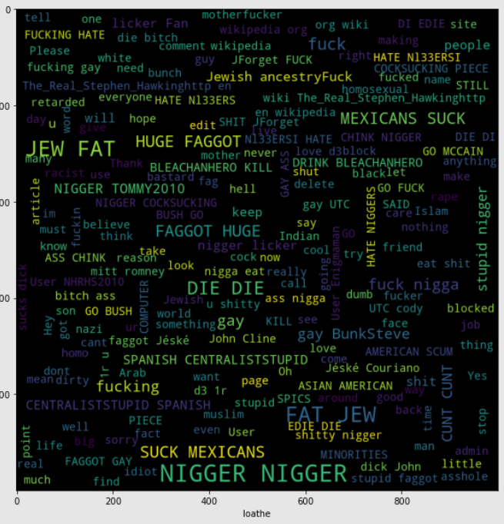
Visualizations done during EDA

Slide 6
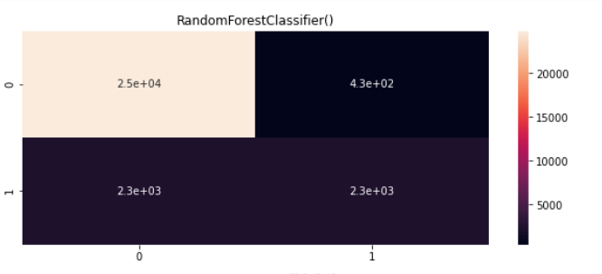
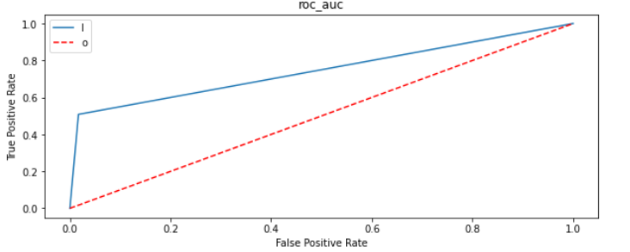
Visualizations done during EDA
Visualizations done in model performance

Slide 7
Steps and Assumptions Used to Complete the Project
Below are the steps and assumptions taken in the project:
In my analysis I have assumed that the target labels are independent of each other.
Since dataset had 90% comments which were normal , I decided to consider only 50 % of the normal comments considering that all words will be covered in those 50 % comments. This was done since dataset was huge and could have suffered time complexity when fed to a machine learning model.

Slide 8
Model Dashboard
Algorithm | Precision % | Recall % | ROC_AUC %
Logistic Regression | 85 | 75 | 75
K-Nearest Neighbors | 82 | 75 | 75
Decision Tree | 72 | 73 | 73
Gradient Boosting | 86 | 78 | 77
Random Forest | 88 | 75 | 74

Slide 9
Finalized model
Although the best precision and Recall is given by both Gradient Boosting and RandomForest but number of False negatives was less in Random Forest than GBM hence RandomForest was selected as final model
Parameters were tuned for RandomForest to improve the score and below is the final result.
After tuning parameters
Algorithm | Precision % | Recall % | ROC_AUC %
RandomForest | 88 | 75 | 74
Final Model

Slide 10
Conclusion
The saved model now can help any organization using social platform to give on estimate of probability about the type of toxicity of the comment.
It was overall a nice experience on working on a real time project of NLP domain to see how datascience and machine learning is useful in this field.

