Slide 1

Presentation on HOUSING PRICE PREDICTION
Submitted by:
Shama Tanweer

Slide 2
Introduction
A US based housing company named Surprise Housing has decided to invest in Australian Market. Their agenda is to buy houses in Australia at prices below their actual value in the market and sell them at high prices to gain profit
Company has collected the data of previously sold houses in Australia and with the help of this data they want to know to the value of prospective properties to decide whether it will suitable to invest in the properties or not.
To know the value of properties company has provided data to us to do data analysis and to extract the information of attributes which are important to predict the price of the houses. They want a machine learning model which can predict the price of houses and also the significance of each important attribute in house prediction i.e, how and to what intensity each variable impacts the price of the house.

Slide 3
Problem statement
The objective was to model the price of houses with the available independent variables. This model can then be used by the management to understand how exactly the prices vary with the variables. They can accordingly manipulate the strategy of the firm and concentrate on areas that will yield high returns. Further, the model will be a good way for the management to understand the pricing dynamics of a new market.
In this case,we have to predict Target Variable Sales Price based on 79 Features using Regression
The company also wants to know
• Which variables are important to predict the price of variable?
• How do these variables describe the price of the house?

Slide 4
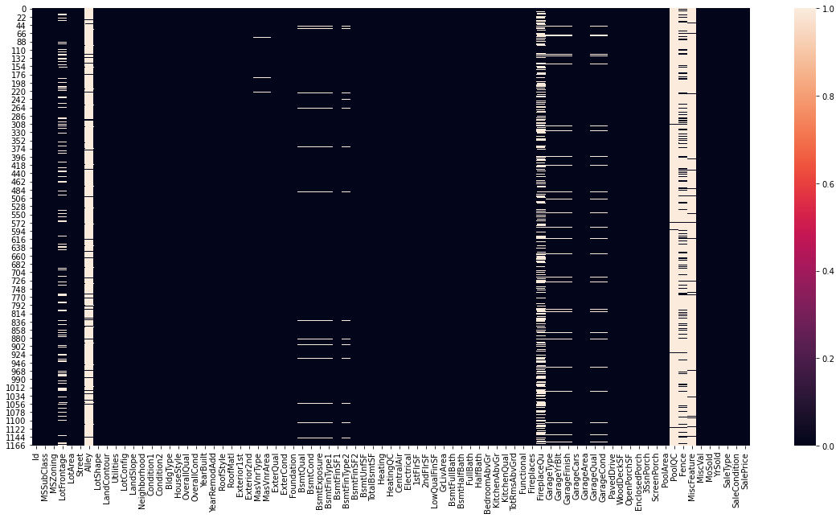
Exploratory Data Analysis
Checking data types of each features using dataframe.info() function.
checking for null values in each column
As per data description ,NA has different meaning for different features. So,NA has been replaced with actual words for categorical features,& for continuous feature nan values is filled with mean
The percentage of Null values in Categorical features:
Alley: 93.41% missing values
MasVnrType: 0.6% missing values
BsmtQual: 2.57% missing values
BsmtCond: 2.57% missing values
BsmtExposure: 2.65% missing values
BsmtFinType1: 2.57% missing values
BsmtFinType2: 2.65% missing values
FireplaceQu: 47.17% missing values
GarageType: 5.48% missing values
GarageFinish: 5.48% missing values
GarageQual: 5.48% missing values
GarageCond: 5.48% missing values
PoolQC: 99.4% missing values
Fence: 79.71% missing values
MiscFeature: 96.23% missing values
The percentage of Null values in continuous features:
LotFrontage: 18.32% missing values
MasVnrArea: 0.6% missing values
GarageYrBlt: 5.48% missing values

Slide 5
The data description revealed that :
Std is greater than mean for some features such as LowQualFinSF,PoolArea etc which means data is widely spread & indicate the presence of skewness.
There is large difference between maxm value and 75% ,which means that outliers are present
MasVnrArea,BsmtFinSF1,BsmtFinSF2,2ndFlrSF,LowQualFinSF,BsmtFullBath,HalfBath,Fireplaces,WoodDeckSF,OpenPorchSF,EnclosedPorch,3SsnPorch,ScreenPorch,PoolArea,MiscVal have outliers

Slide 6
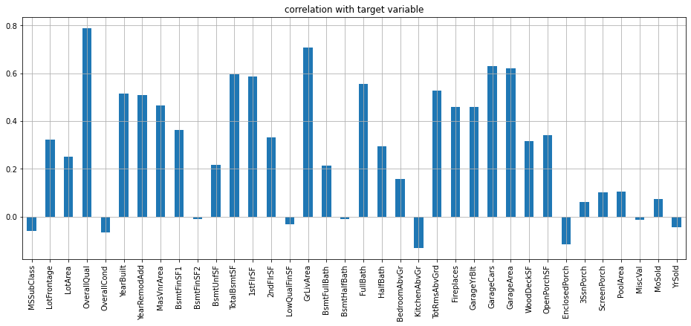
Correlation of all columns with target variable .ie SalePrice
'MSSubClass' ,'OverallCond' ,'OverallCond' ,'LowQualFinSF' ,'BsmtHalfBath' ,'KitchenAbvGr' ,'YrSold', 'EnclosedPorch', 'MiscVal' are negatively correlated with the target column,rest all are positively correlated
'OverallQual' & 'GrLivArea' are highly positively correlated with target column
'MSSubClass' ,'OverallCond' ,'OverallCond' ,'LowQualFinSF' ,'BsmtHalfBath' ,'YrSold', 'MiscVal', 'MoSold', '3SsnPorch' are least correlated with the target column

Slide 7
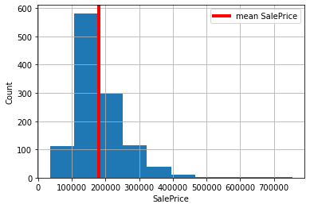
Data Visualisation
From above,we find that mean sale price is around 190000
For better visualization I split categorical and numerical features and stored them in separate list.

Slide 8
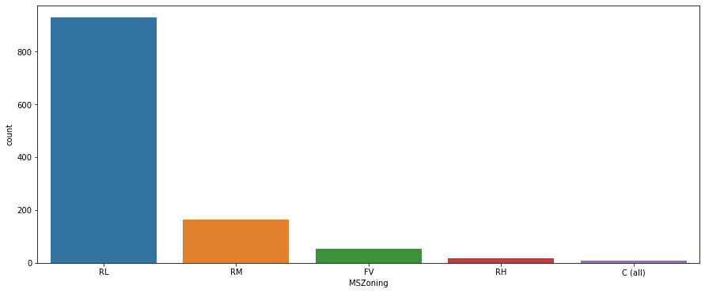
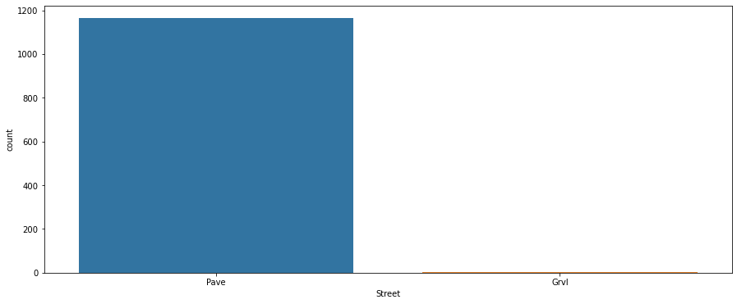
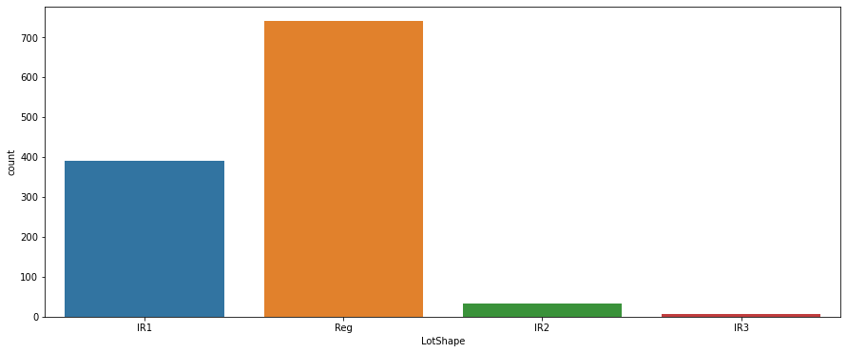
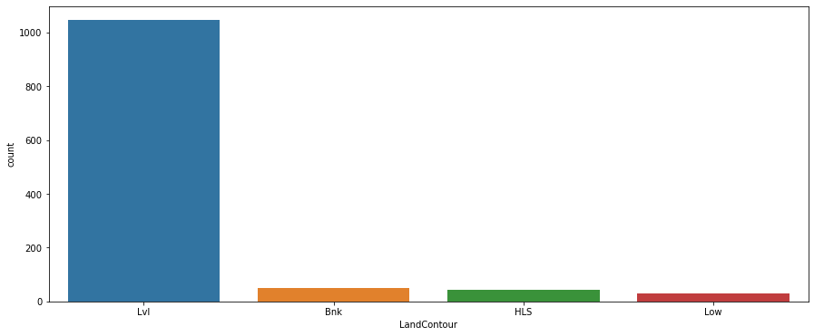
Univariatr Analysis • I then used seaborn’ countplot on all categorical features to check the count of each category present inside them

Slide 9
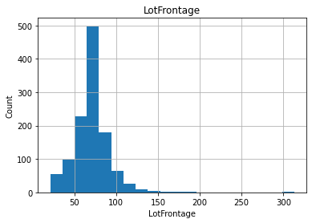
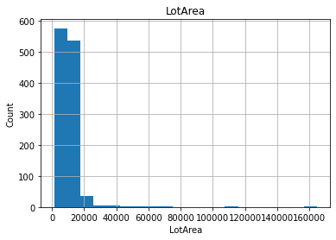
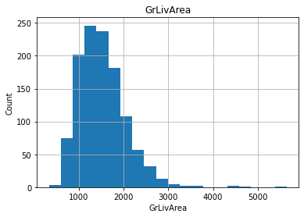
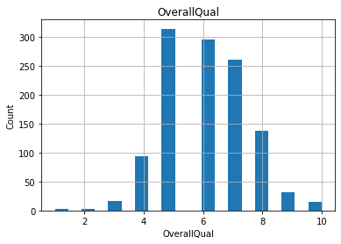
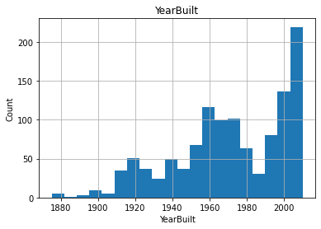
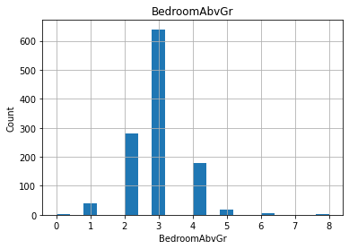
visualizing each continuous feature

Slide 10
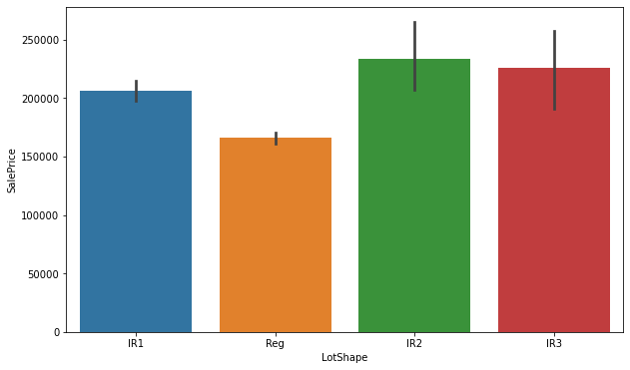
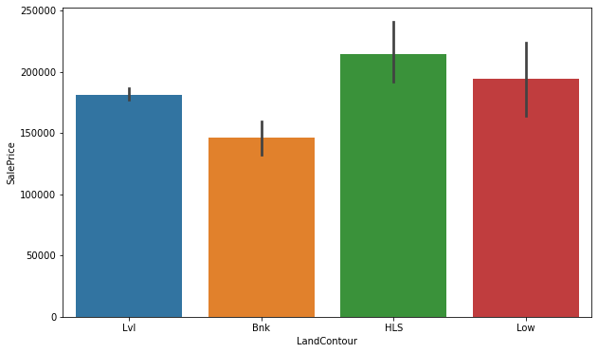
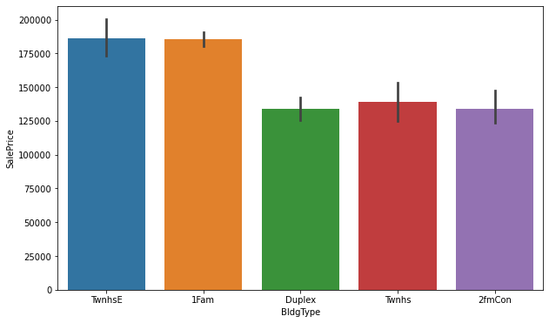
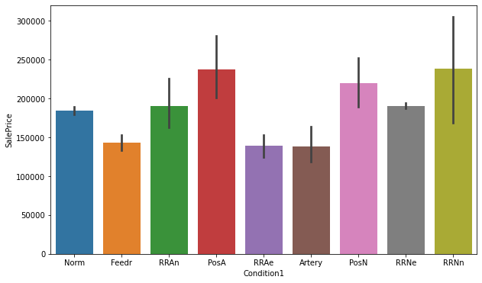
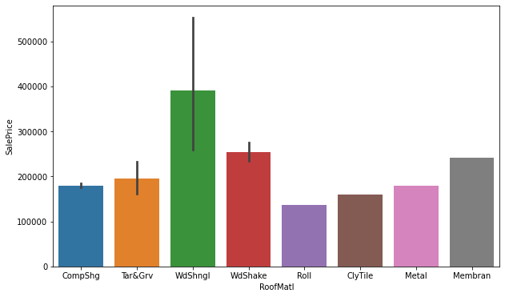
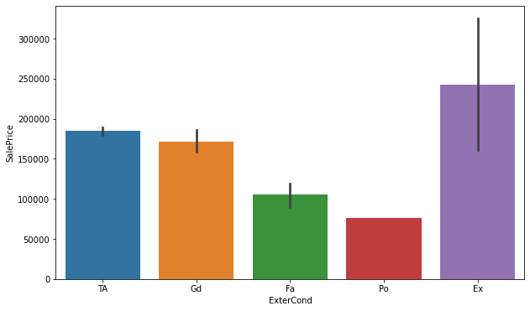
Bivariate analysis visualizing categorical column wrt sale price

Slide 11
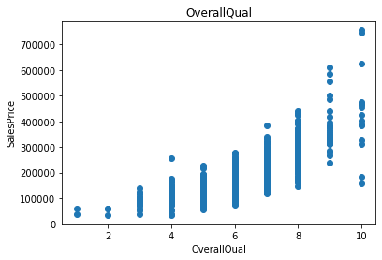
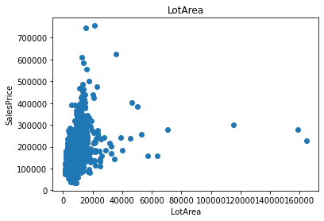
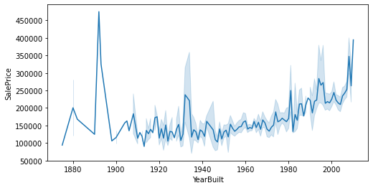
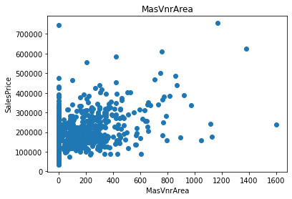
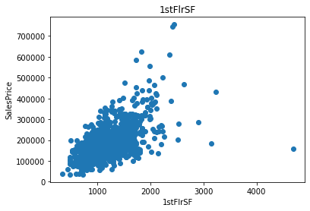
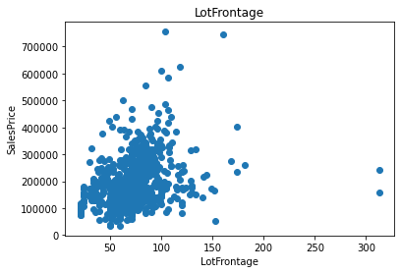
visualizing categorical column wrt sale price

Slide 12
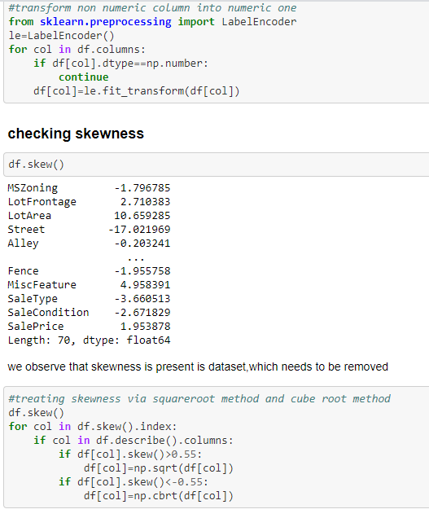
Transforming categorical features into numeric & Checking & removingskewness

Slide 13
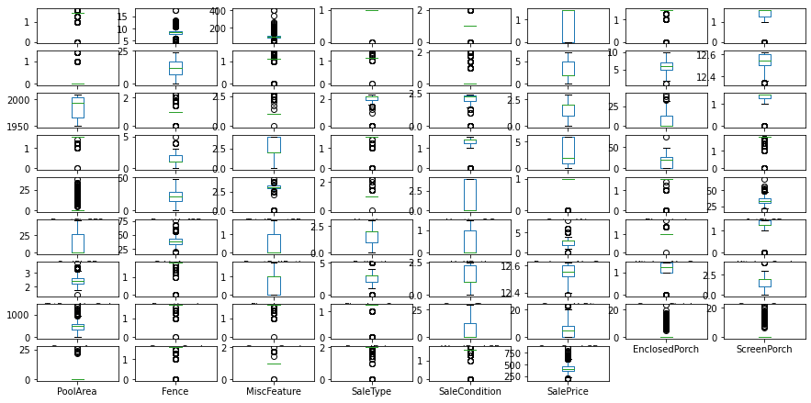
Checking outliers

Slide 14

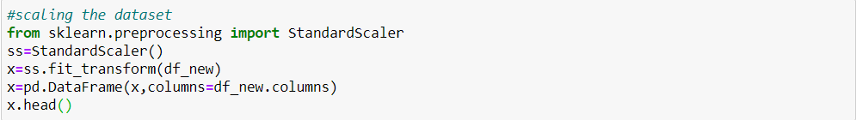
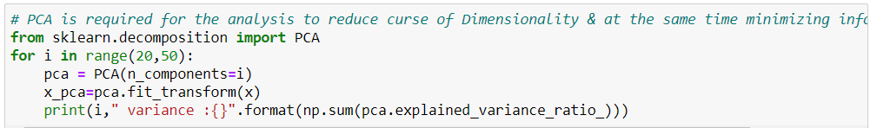
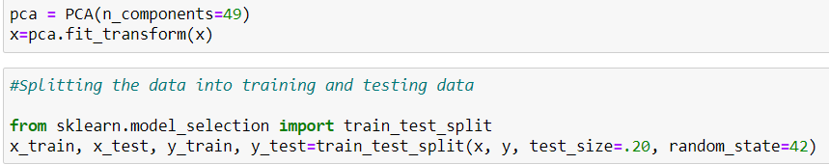
Feature Selection

Slide 15
Model Building & Performance
it’s a regression type problem and below models were used:
LinearRegression,Lasso,Ridge
SVR
DecisionTreeRegressor
KNeighborsRegressor
RandomForestRegressor
AdaBoostRegressor
GradientBoostingRegressor

Slide 16
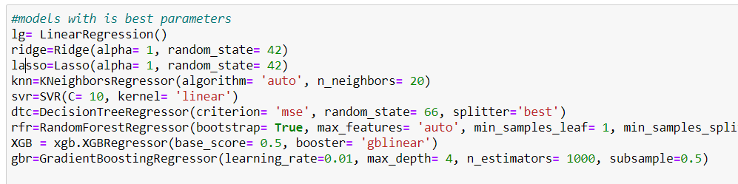
Selecting best parameter after doing Hyperparameter tuning using gridsearchcv

Slide 17
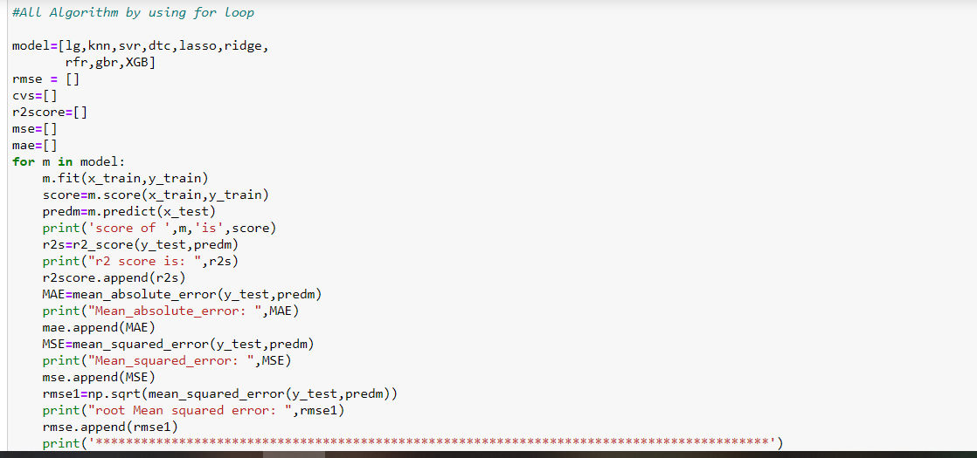
All algorithm by using for loop

Slide 18
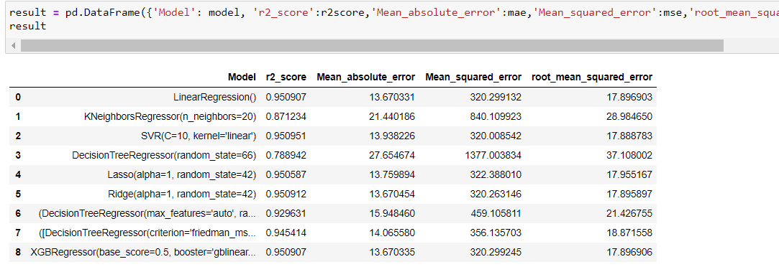
4 models have approximately same r2_score ,therefore I choose ridge as the final model

Slide 19
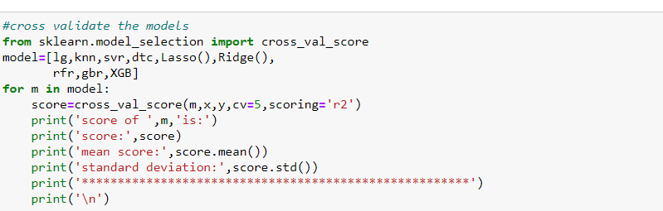
Cross validation

Slide 20
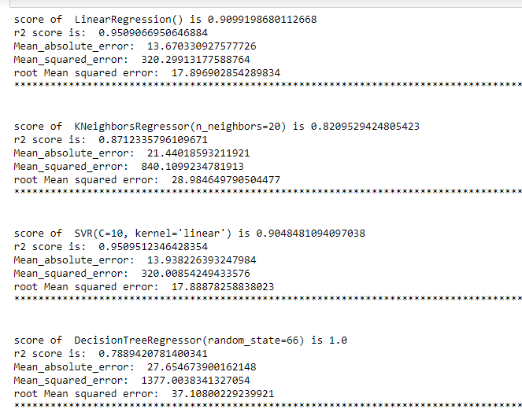
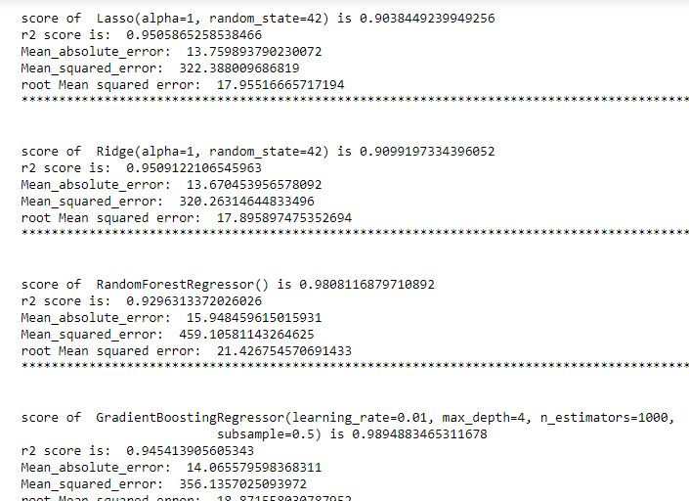

Slide 21
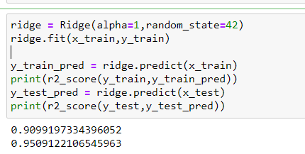
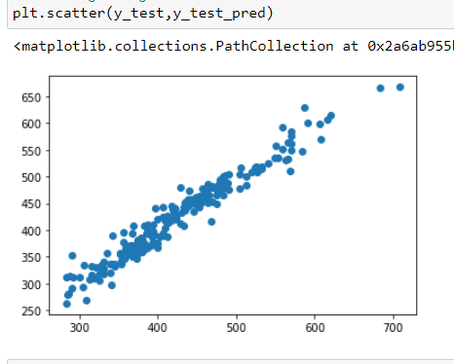
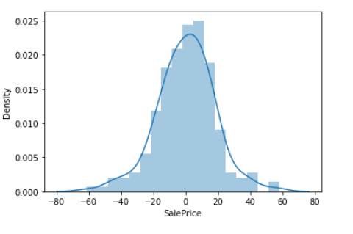
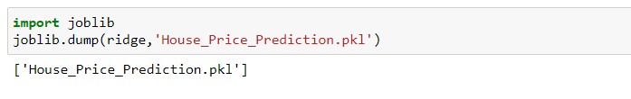
Final model

Slide 22
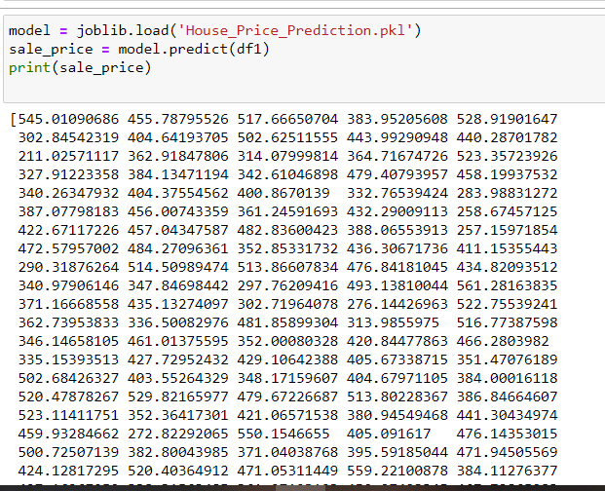
Predicting for Test Data All the preprocessing step performed fot train data .ie df has been performed for test data .ie df1 also

Slide 23
Steps and Assumptions Used to Complete the Project
Assumption while replacing NaN values for each continuous variable with mean value considering it will give accurate predictions.
Some attributes like ‘Id’ were dropped since they were irrelevant looking at the problem statement.
Attributes like 'MSSubClass' ,'OverallCond' ,'OverallCond' ,'LowQualFinSF' ,'BsmtHalfBath' ,'YrSold', 'MiscVal', 'MoSold', '3SsnPorch' were removed since they were least correlated with target variable.
Attributes which had more than 99% NaN values .ie , ‘PoolQC’,’ were dropped so that my predictions can be more .

Slide 24
Conclusion
we built regression models to predict the price of some house given some of the house features. We evaluated and compared each model to determine the one with highest performance.
The saved model now can help to give an estimate of House prices with respect to the the data fed to the model and hence will be helpful in making decisions.

